Slide 1
YouTube Global Statistics Analysis
Data-Driven Insights on Channel Growth and Earnings
Prepared by: Mercy Wairimu Mburu | October 2025

Slide 2
Introduction
Objective:
To analyze YouTube data to uncover insights on subscribers, uploads, and earnings.
Key Questions:
What factors drive creator success?
How do uploads, views, and earnings relate?
Which regions and channel types perform best?
Tools Used: Pandas, Matplotlib, Seaborn

Slide 3
Dataset Overview
Dataset: Global YouTube Statistics
Records: 1,000+ YouTube channels
Main Columns:
- Subscribers
- Video Views
- Uploads
- Continent
- Channel Type
- Highest Yearly Earnings
- Country

Slide 4
Data Preparation
Steps:
Data loaded using pandas
Missing values replaced with mode()
Code Snippet:
.df['channel_type_rank']=df['channel_type_rank'].fillna(df['channel_type_rank'].mode()[0])
df['video_views_for_the_last_30_days']=df['video_views_for_the_last_30_days'].fillna(df['video_views_for_the_last_30_days'].mode()[0])
df['country_rank']=df['country_rank'].fillna(df['country_rank'].mode()[0])

Slide 5
Continuation
Converted created date column data types to date_time
Code Snippet
df["created_date"]=pd.to_datetime(df["created_date"])
• Feature engineered the country column to get continents
Function to fill the continent column with the appropriate continent of the country
def result(Country):
if Country in Africa: return 'Africa’

Slide 6
elif Country in Europe:
return 'Europe’
elif Country in Asia:
return 'Asia’
elif North_America:
return 'North_America’
elif South_America:
return 'South_America’
else:
return 'Australia_and_Oceania’
# Applying the function into the df
df['continent'] = df.Country.apply(lambda x:result(x))

Slide 7
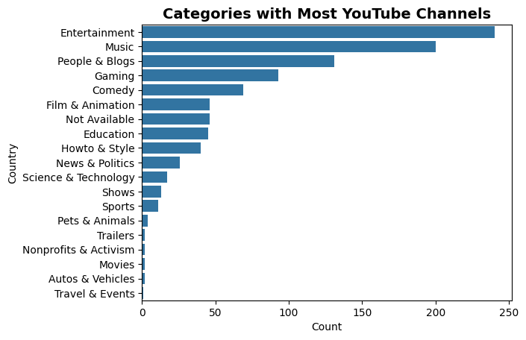
Univariate Analysis
What category have the most activity?
This chart identifies the most dominant content category on YouTube. Entertainment is the most saturated or popular field.

Slide 8
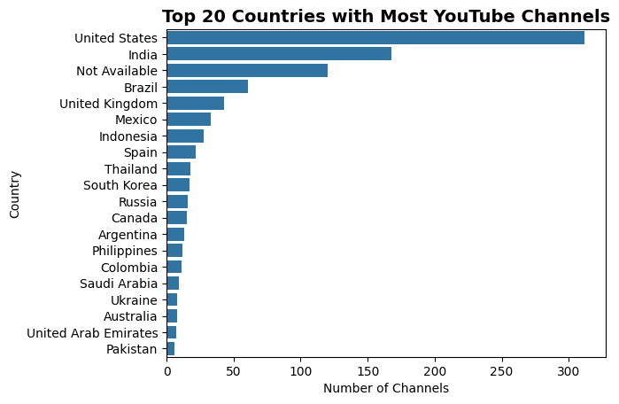
What Countries have the highest amount of YT activity?
The chart shows Distribution of YouTube channels across countries.
Highlights which countries host the largest number of YouTube creators. Countries like the USA, India, and Brazil often appear at the top, showing they contribute most to YouTube content creation globally.

Slide 9
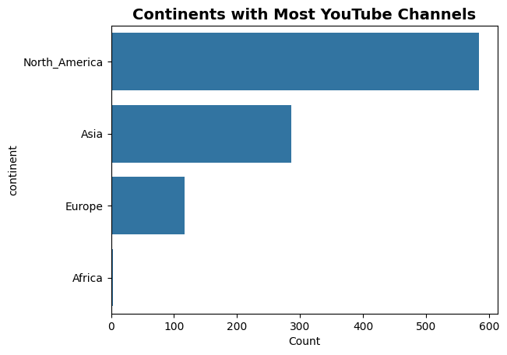
What continent have the highest amount of YT activity?
Interpretation:
Reveals global reach — e.g., North America and Asia tend to dominate, reflecting high internet penetration and content creation in these regions.

Slide 10
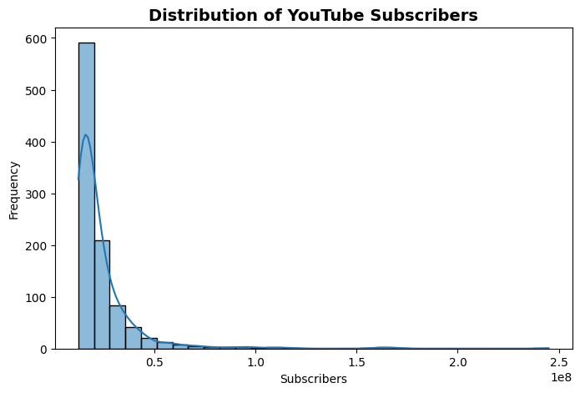
Distribution of subscribers
Frequency distribution of subscriber counts.
Interpretation:
This shows that most channels have fewer subscribers, while a few have very large subscriber counts — a right-skewed distribution. It reflects small number of channels dominate audience share..

Slide 11
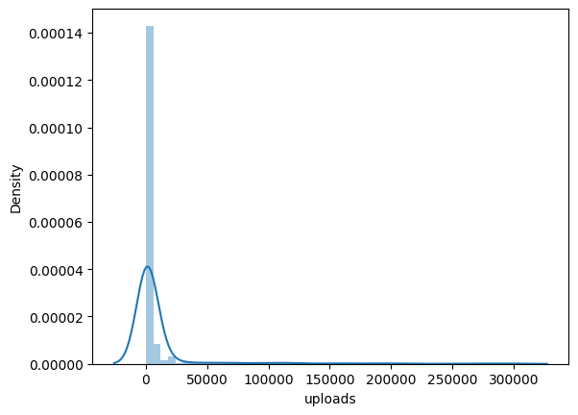
Distribution of uploads
Most values cluster at the low end, it means most channels upload fewer videos, while a few are highly active. It can help understand creator consistency and output levels.

Slide 12
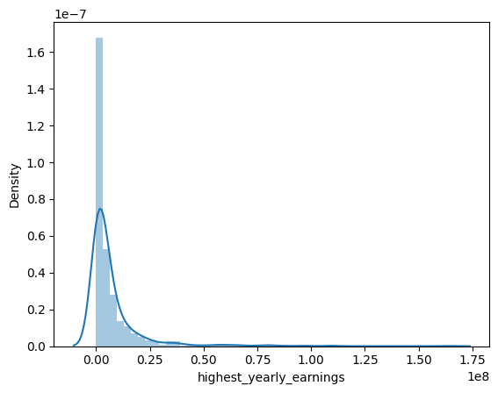
Distribution of Highest Yearly Earnings
Insights:
- Distribution is right-skewed, meaning few creators earn extremely high amounts.
- Majority of channels have low yearly earnings.
- Reflects income inequality in YouTube creator economy.

Slide 13
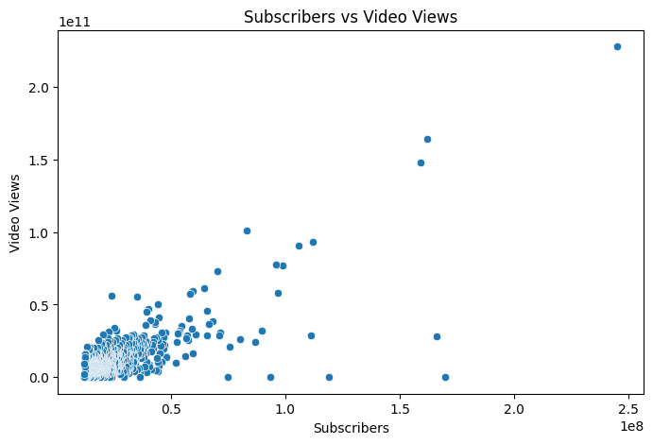
Bivariate Analysis:
Subscribers' vs Views
Interpretation:
A positive correlation — channels with more subscribers have more views. Outliers indicate viral channels with high views despite fewer subscribers

Slide 14
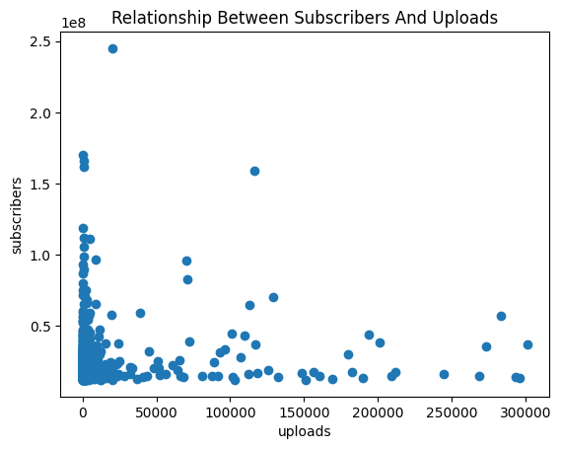
Relationship between Uploads and Subscribers
Frequent posting is not linked to higher subscriber counts. The weak correlation suggests that quality or niche may matter more than quantity.

Slide 15
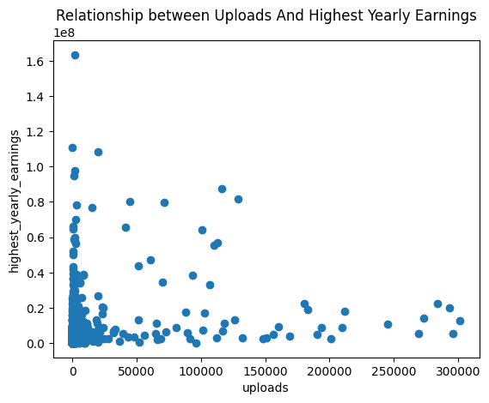
Relationship between Uploads and earnings
Impact of upload volume on annual earnings
Interpretation:
Earnings depend more on viewership quality than upload count
Upload count shows a weaker link — quality and niche matter more than volume.

Slide 16
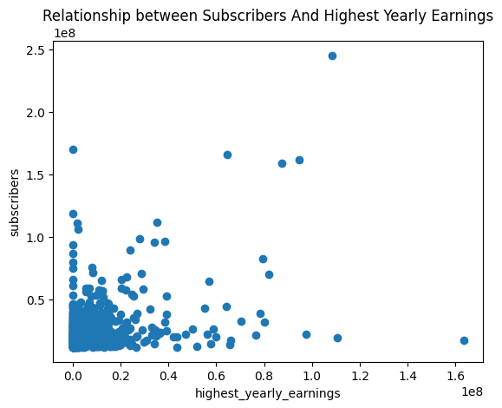
Relationship between Subscribers and Yearly earnings
Interpretation:
Typically positive — more subscribers → higher yearly earnings.
However, outliers show some small channels still earn highly, possibly due to niche sponsorships or monetization efficiency.

Slide 17
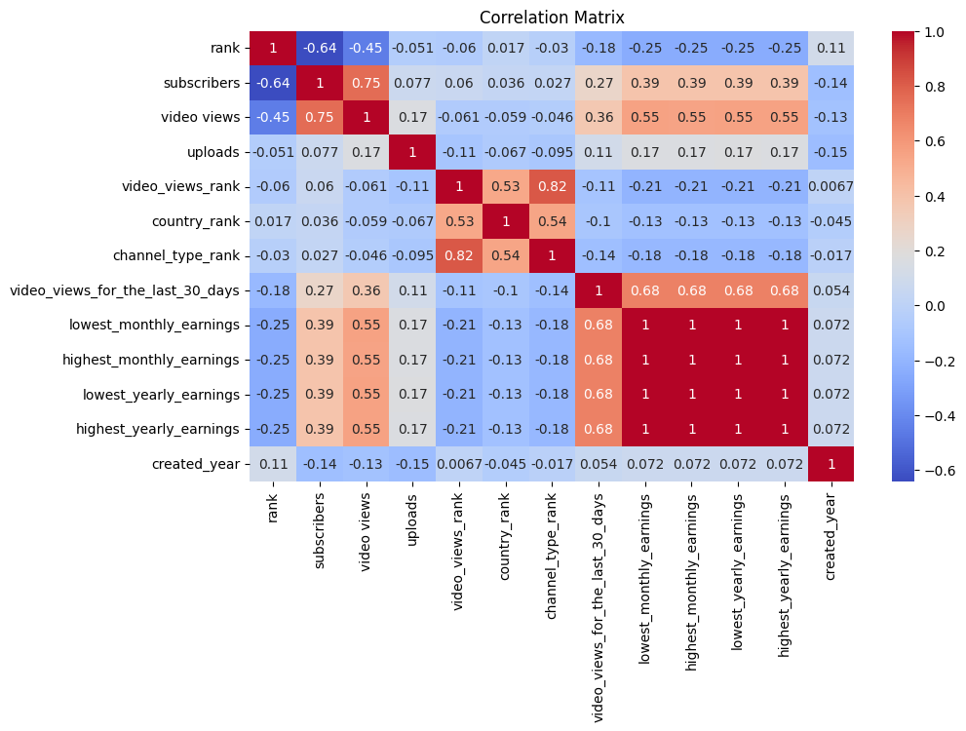
Checking for correlation with other variables using a heatmap
Pairwise correlations among numeric variables (subscribers, views, uploads, earnings).
Interpretation:
Highlights strong positive or negative relationships. For instance:
Subscribers and video views → strongly correlated
Uploads and earnings → moderate correlation
Subscribers ↔ Earnings: Moderate correlation
Uploads ↔ Subscribers: Weak correlation

Slide 18
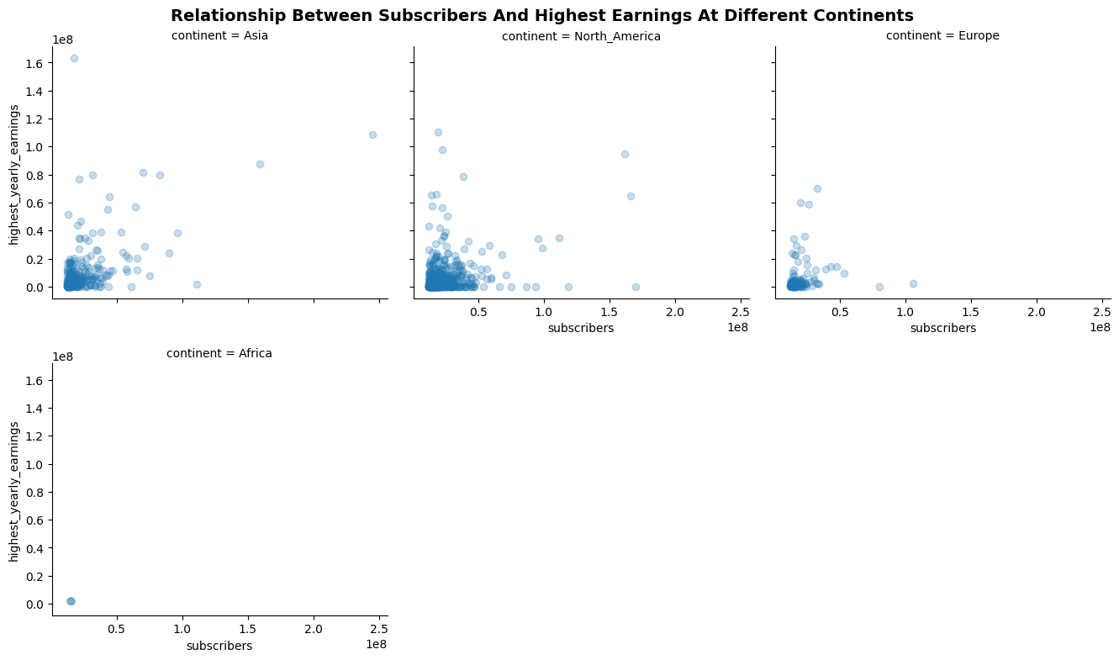
Multivariate Analysis:
Subscribers vs Earnings by Continent
FacetGrid showing Subscribers vs Highest Yearly Earnings per Continent.
Insights:
- Positive relationship between subscribers and earnings across all continents.
- North America and Europe channels monetize better and brand deals.
- Asian creators show wide variation due to mixed economies and monetization
Africa shows weaker or flatter relationships, suggesting that even with many subscribers, creators earn relatively less due to lower ad revenue rates or limited brand partnerships.

Slide 19
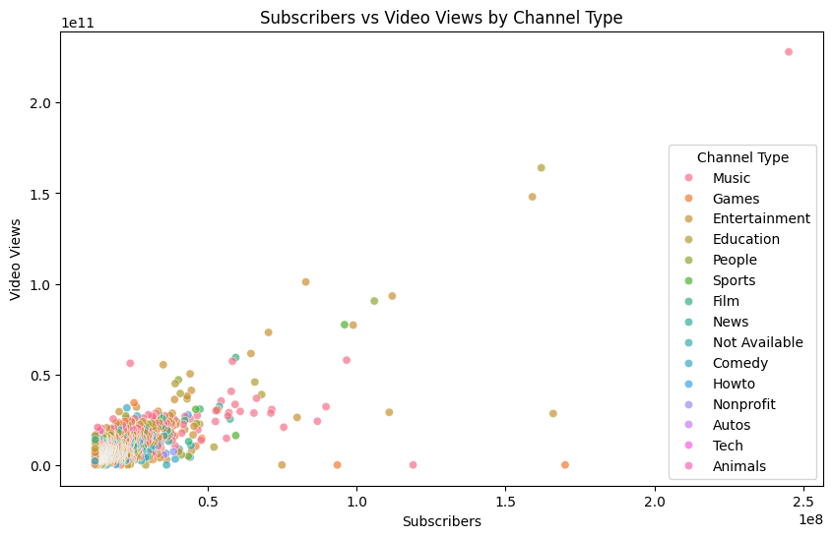
Subscribers vs Views by Channel Type
The visualization demonstrates that while subscriber count strongly predicts total video views, channel type plays a major moderating role.
Genres like Music and Entertainment dominate in both reach and engagement, whereas educational and niche channels attract smaller but more targeted audiences. This emphasizes that content type significantly influences growth potential on YouTube.

Slide 20
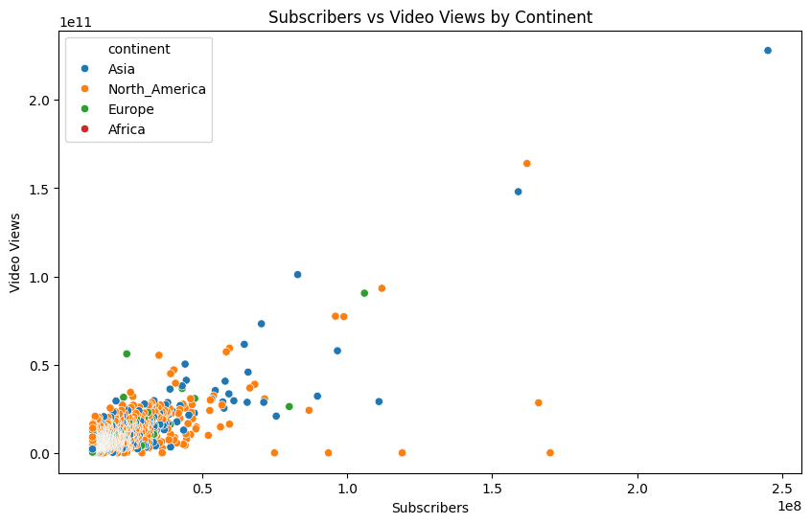
Subscribers vs video views by Continent
The plot confirms a universal positive relationship between subscribers and video views, while also revealing that regional differences affect scale and engagement. Channels from North America, Europe, and parts of Asia dominate the top performance tier, reflecting stronger infrastructure, audience size, and monetization opportunities compared to developing regions.

Slide 21
Key Takeaways
YouTube growth follows a power-law distribution.
Content quality and engagement matter more than quantity.
Geography affects monetization potential.
High-performing categories: Music, Entertainment, Gaming.

Slide 22
Recommendations
For Creators:
- Focus on consistent, high-quality uploads.
- Choose high-engagement categories.
For Marketers:
- Target regions and niches with high viewer loyalty.
For Platforms:
- Support creators in emerging regions.

Slide 23
Contact Information
Prepared by: Mercy Wairimu Mburu
Email: wmercy160@gmail.com
Phone: +254 717 476 880
Role: Data Analyst (Excel | Power BI | Python | SQL)
Organization: Momentum Credit

