Slide 1

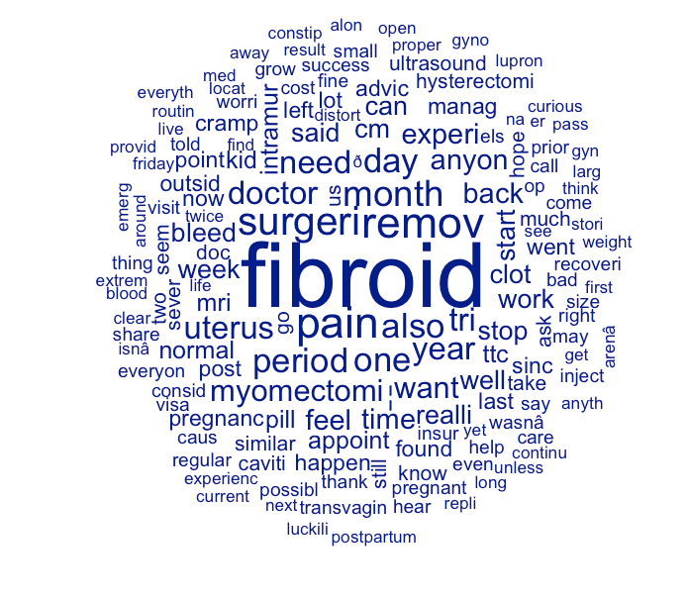
Patient Experiences and Outcomes After Myomectomy: A Text Analysis of Online Narratives
Mercy C. Ogbede
Data Analytics and Computational Social Science, University of Massachusetts, Amherst, United States
Data & Methods
Sentiment Analysis
Conclusion
Introduction
Data Source and analytical methods:
• Reddit (r/Fibroids subreddit)
• 25 patient-authored posts Methods:
• Text cleaning and preprocessing
• Word frequency analysis
• Custom sentiment dictionary
• Structural Topic Modeling (STM)
Sentiment distribution of how women described their experience:
• 48% Neutral
• 28% Negative
• 12% Positive
• 12% Mixed
Emotional recovery is variable, not uniformly positive.
The hypothesis that most women would describe improvement after myomectomy is rejected
Some posts expressed hope and recovery
However, negative and neutral tones were more common than positive
Pain-related language remained prominent
Online communities serve as spaces for validation and shared experience
Patient narratives reveal ongoing uncertainty rather than straightforward improvement
Uterine fibroids affect up to 70% of women of reproductive age
Myomectomy surgically removes fibroids while preserving the uterus
Online communities like Reddit provide authentic patient voices often missing from clinical research
This study analyzes how women describe their recovery experiences through Reddit posts
Results
STM Topics
Study limitation
Research Question
From the analysis (word frequency analysis), the top 5 most frequent terms are listed below and the overall data is presented in Figure 1:
fibroid 41
pain 17
remov 17
surgeri 15
Five themes were identified
1. Diagnostic Processes
ultrasound, gyn, routine
2. Pain & Work Management
pain, manage, work, doctor
3. Fertility Concerns
ttc, pregnancy, uterus
4. Symptom Control
pill, postpartum, endometriosis
5. Recovery Timelines
month, myomectomy, cramp
• Small sample size (25 posts)
• Self-selection bias
• No demographic data available
• Cross-sectional design
How do women describe their experiences of recovery, symptoms, and emotional well-being following myomectomy in on Reddit, and what themes dominate these patient-authored discussions.
Reference
Hypothesis
De Choudhury, M., Morris, M., & White, R. (2014). Seeking and sharing health information online. ACM TOCHI, 21(1), 1–32.
Stewart, E. A. (2015). Uterine fibroids. New England Journal of Medicine, 372, 1646–1655
Most (60%) women would describe improvement after myomectomy, such as reduced pain or bleeding
Figure 1: Visualization of the most frequent words

