Slide 1
DATA PROTECTION.
The amount of data being created has increased exponentially in the last few years. Because of that it has been very necessary to create and implement laws that provide data protection. In Kenya, the office of the Data Commissioner was set up in 2020 which is responsible for overseeing the Data Protection Act of 2019. The commissioner chairs a team whose responsibilities include but are not limited to: Registration of Data controllers and processors, Enforcing and Protecting Data Protection Laws and Facilitating cross-border data flows. Globally, rules and regulations that protect Data vary from country to country and region to region. For example in the US, different states have different rules because there is no specific federal law that has been set apart. For European Countries, the European Union came up with GDPR (General Data Protection Regulation) in 2018, which covers almost whole of Europe-44 out of 45 countries.

Slide 2
These laws have set the base for other data laws to be set. At the moment, most countries in the world are trying to have some sort of data protection laws. Statistics have it that 71% of countries in the world have legislation rules, 9% are drafting them, 15% have no laws and 5% have no data at all. These laws continue to evolve over time because data is not static and the more data is circulating the higher the threats hence need for laws to be reviewed.

Slide 3
Core principles and implications
The Data Protection Act/Laws are built on 3 primary rules: Lawfulness, Fairness and Transparency. Other grounds are Purpose limitation, Data minimization and Accuracy. The laws are guided by Notice, Choice, Consent, Access, Participation, Integrity, Security and Enforcement. DPA is necessary since it allows protection of both internal and external data, mitigates the risk of fraud and compromise and protect the individual. Organizations should have a Data Protection Officer to provide an oversight on data storage, journey and lineage. They should be able to explain to the company’s clients how their data is being used and assure them of safety. The consequences of not complying with data laws for individuals include being fined for 10 years, fine of 5 million shillings or both. For organizations, the fine is 10 million or a fine of not less 2% of the annual returns, whichever is lower, or both, depending on the circumstance. Other consequences include reputational damage and inadequate cybersecurity laws.

Slide 4
Challenges and solutions
Challenges being faced by businesses in Kenya when it comes to effective implementation of the DPA are as follows: Corporate culture. This is where people assume that they are not big enough to be targets of attacks. A solution to this is to encourage people to change their mentality and adopt data laws. No one is too safe or not at risk. Secondly, Security threats are a big issue. Security threats could be physical or cybersecurity. An example of a physical security threat is when data, is stored say in a room that anyone can easily access. Cyber security on the other hand is when phishing or ransomware happen. A valid solution is to be more careful. Whoever is in charge of physical data should be as vigilant as possible. However, for other reasons like fire accidents, it is advisable not to store data physically. The trends are changing, so should data storage. For cybercrimes, you should not click on suspicious links or visit sites that seem malicious.

Slide 5
In case of anything, report the suspected breach as soon as possible. Also workers need to be as professional as possible to curb inside threats. Companies and individuals are being advised to use tools that can help. With the onset of AI, there are many Data Protection software and Data Leak Detection software that help to detect frauds or and any abnormal thing in the pipeline before it happens.

Slide 6
Brief introduction
The European Union has set strict data laws to its citizens using the GDPR- General Data Protection Regulation-laws. Data from a certain GDPR dataset was recorded over a period of 4 years from when the measures were put in place in 2018. The data was then analyzed to explain more about Data Protection Laws in European countries by answering questions like: What are the fines for violations? Which companies that had the highest violations? Which country had the highest data crimes? Which article attracted the highest crime? Which articles were most violated? etc. The slides that follow attempt to answer these questions and explain more findings.

Slide 7
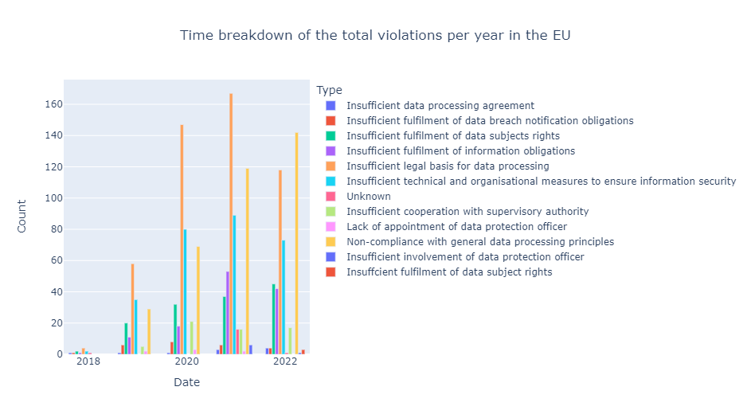
1. Time breakdown of the total violations in the EU.

Slide 8
The bar chart in the previous slide shows the time breakdown of the total violations per year in the EU, with bars representing the count of each violation type and different colors representing each violation type. The chart is grouped by years. It also shows the count of each of the violations and their trends over the years.
2. Most expensive violation by country, listing the specific violation type.
The bar chart in the next slide shows the most expensive violations by country. Each bar represents a country, and the length of the bar corresponds to the total cost of all the fines for all violations in that country. The color changes because the total fines per country are different i.e it corresponds with the value in the amount column.

Slide 9
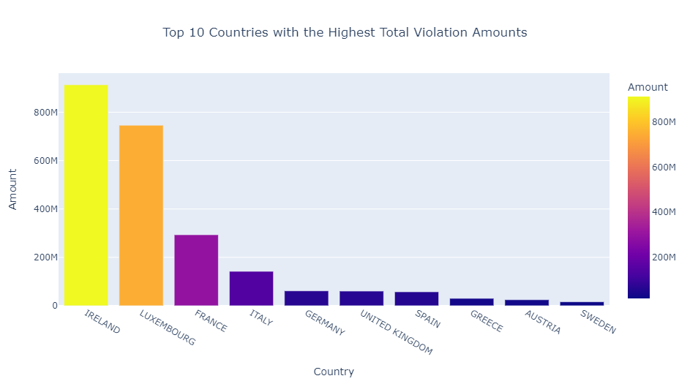

Slide 10
3. Vodafone's GDPR violations in volume.
It appears that the total number of violations committed by Vodafone in the dataset is 101. This means that out of all the violations recorded in the dataset, 101 of them were committed by Vodafone.
4. Companies with the highest violations
The purpose of the box plot in the next slide is to show the of the number of violations committed by each company, with the y-axis representing the number of violations and the boxes representing the quartiles of the distribution. We can also see the outliers, quartiles, the minimum and maximum values as well.

Slide 11
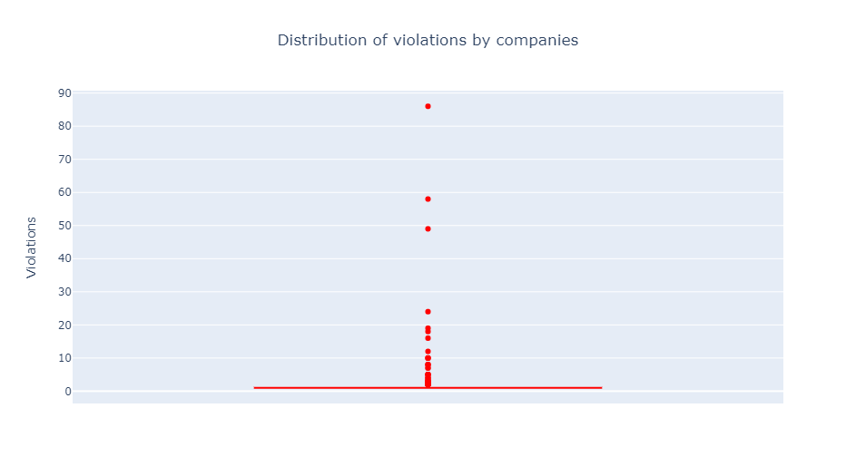

Slide 12
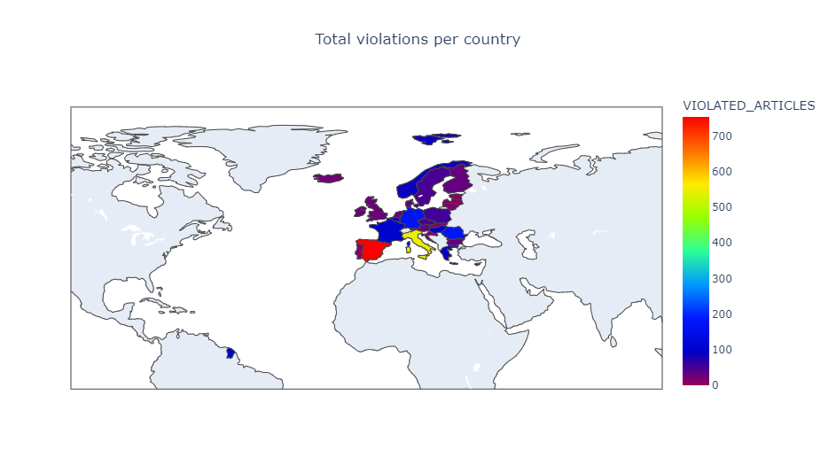
5. Map the data and make this interactive

Slide 13
The choropleth map is a good choice because the data is organized by country and we are interested in visualizing the total number of violations for each country. Darker colors represent higher numbers of violated articles, while lighter colors represent lower numbers.
6. Breakdown / Distribution and important metrics of fines levied per article.
The purpose of the box plot in the next slide is to show the distribution of fines levied per article. The x-axis represents the violated articles of the GDPR, while the y-axis represents the amount fined. The box plot shows the distribution of GDPR fines for each of the 10 articles that were violated. It is necessary to note that only a subset of the articles can lead to monetary penalties, and those are the ones included in the dataset used in this example.

Slide 14
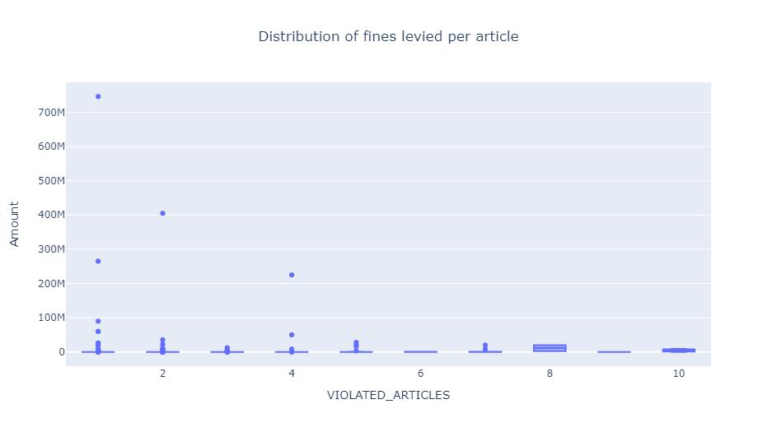

Slide 15
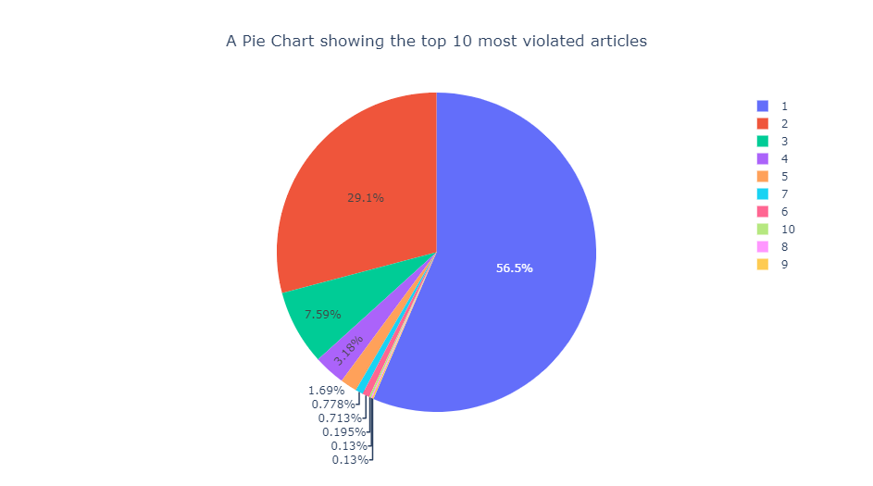
7. Top 10 most violated articles

Slide 16
The pie chart in the previous slide shows each article as a slice of the pie, with the size of the slice representing the proportion of violations for that article. The legend on the right side of the chart shows the number of violations for each article. The chart also shows the percentage of violations for each of the top 10 most violated articles.
8. Article with the highest associated fine
The scatter plot in the next slide displays the highest associated fine for the violated article. The x-axis represents the articles that were violated, and the y-axis represents the amount of the fine. The size and color of the scatter markers are determined by the "colors" variable, which assigns a unique color to each data point. The resulting plot shows the top 10 articles with the highest associated fines, with each data point representing a unique article and the size/color indicating the magnitude of the fine.

Slide 17
