Slide 1

Predictive Analysis Project on Ames, Iowa Real Estate
Tabitha Hagen

Slide 2
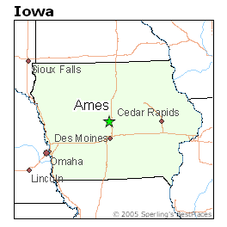
Residential Home Sales in Ames, Iowa
The data set contains many explanatory variables on the quality and quantity of physical attributes of residential homes in Iowa sold between 2006 and 2010. Most of the variables describe information a typical home buyer would like to know about a property (square footage, number of bedrooms and bathrooms, size of lot, etc.).

Slide 3
Description of the 81 Variables
Character variables |  | Q2 | Numeric Variables | Q4
MS_SubClass MS_Zoning Street Alley Lot_Shape | Roof_Style Roof_Matl Exterior_1st Exterior_2nd Mas_Vnr_Type | Electrical Kitchen_Qual Functional Fireplace_Qu Garage_Type | Lot_Frontage Lot_Area Year_Built Year_Remod_Add Mas_Vnr_Area | Bedroom_AbvGr Kitchen_AbvGr TotRms_AbvGrd Fireplaces Garage_Cars
Land_Contour Utiities Lot_config Land_Slope Neighborhood Condition_1 | Exter_Qual Exter_Cond Foundation Bsmt_Qual Bsmt_Cond Bsmt_Exposure | Garage_Finish Garage_Qual Garage_Cond Paved_Drive Pool_QC Fence | BsmtFinSF_1 BsmtFinSF_2 Bsmt_Unf_SF Total_Bsmt_SF First_Flr_SF Second_Flr_SF Low_Qual_Fin_SF | Garage_Area Wood_Deck_SF Open_Porch_SF Enclosed_Porch Three-season_porch Screen_Porch Pool_Area
Condition_2 Bldg_Type House_Style Overall_Qual Overall_Cond | BsmtFin_Type_1 BsmtFin_Type2 Heating Heating_QC Central_Air | Misc_Feature Sale_Type Sale_Condition Above_Median | Gr_Liv_Area Bsmt_Full_Bath Bsmt_Half_Bath Full_Bath Half_Bath | Misc_Val Mo_Sold Year_sold Longitude Latitude

Slide 4
Cleaning & Ordering Data
Steps taken to clean Data:
Look for missing values
Look for Duplicates
Modify and Graph variables to compare to see if they can help predict Above_Median
The data started with 2053 observations or rows and 81 variables. It appeared to have already had missing values removed from the student version.
Upon examination, the data included 12 variables where ratings are varying length are used. In future data collection, it would be better to streamline this to 1 scale which could be applicable to all 12 areas, making them easier to compare.

Slide 5
Variables modified:
Bldg_Type
Basement_Exposure
The levels “TwnhsE” and “Twnhs” mean the same type of building, so they were combined. The new levels of this variable are:
0 - One Family House
1 – Townhouse
2 – Duplex House
3 – Two Family Condo
The levels “No” and “No_Basement” mean the same thing so they were combined. The new levels of this variable are:
0 – No Basement
1 – Minimal
2 – Average
3 – Good

Slide 6
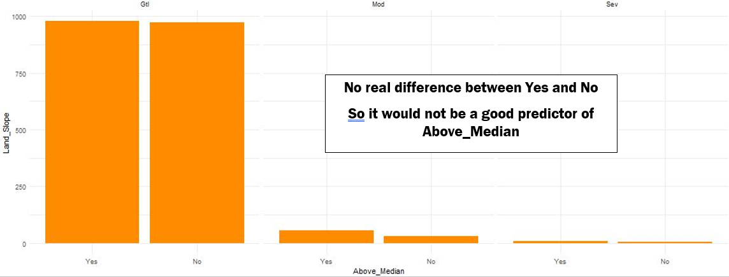
Comparing Variables with Levels
The Esquisse App allows quick and easy comparison of Above_Median to the other variables. The histogram above is one example of a visualization comparing a single variable with 3 levels: “Gtl”, “Mod”, and “Sev”
The complete comparison can be found here: https://drive.google.com/file/d/1rhv-ButSuqcScUmLIQRzTw5Bm9ZuT07v/view?usp=sharing

Slide 7
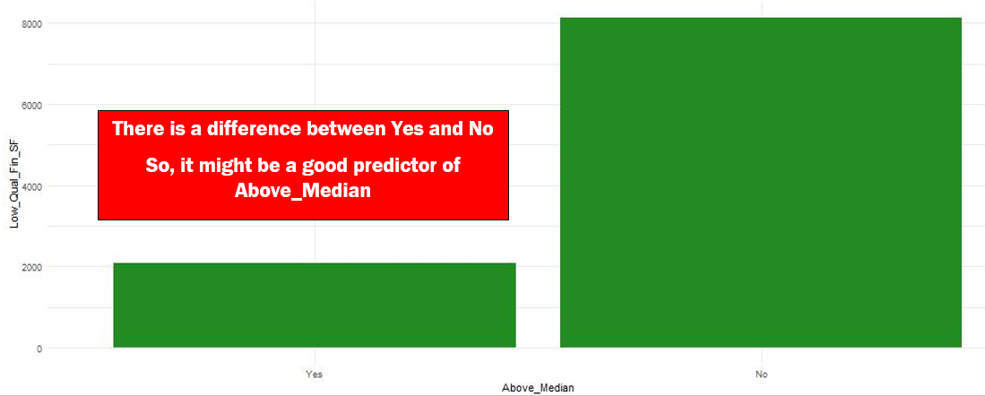
Comparing Simple Variables
The histogram above is one example comparing two variables that showed a marked difference. This was done for each set of variables to determine the best predictors.
The complete comparison can be found here: https://drive.google.com/file/d/1rhv-ButSuqcScUmLIQRzTw5Bm9ZuT07v/view?usp=sharing

Slide 8
21 Chosen variables which may be strong predictors of
Neighborhood
Second_Flr_SF
Overall_Qual
Low_Qual_Fin_SF
Mas_Vnr_Type
Mas_Vnr_Area
Exter_Qual
Foundation
Bsmt_Qual
Heating_QC
Half_Bath
Kitchen_Qual
Fireplaces
Fireplace_Qu
Garage_Type
Garage_Finish
Wood_Deck_SF
Open_Porch_SF
Enclosed_Porch
Screen_Porch
Lot_Shape
Above_Median
Next Steps:
test the variables using models

