Slide 1

Predictive Analysis Project on Ames, Iowa Real Estate
Phase II
Tabitha Hagen

Slide 2
21 Chosen variables which may be strong predictors of
From Phase 1
Neighborhood
Second_Flr_SF
Overall_Qual
Low_Qual_Fin_SF
Mas_Vnr_Type
Mas_Vnr_Area
Exter_Qual
Foundation
Bsmt_Qual
Heating_QC
Half_Bath
Kitchen_Qual
Fireplaces
Fireplace_Qu
Garage_Type
Garage_Finish
Wood_Deck_SF
Open_Porch_SF
Enclosed_Porch
Screen_Porch
Lot_Shape
Above_Median
Next Steps:
test the variables using models

Slide 3
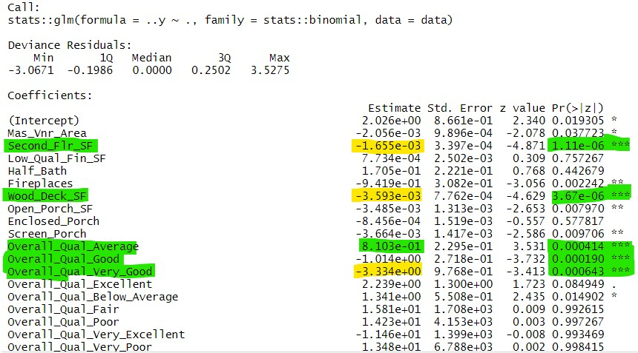
The Generalized Linear Regression Model
All 21 possible predictor variables were put into a model which made Overall_Qual and its sublevels stand out. Then, the 21 variables were split into 3 smaller groups and tested again. Overal_Qual stood out again. However, there were many negative coefficients which logically should have been positive. Also, Lot_Shape stood out as a secondary predictor followed by Mas_Vnr_Area.

Slide 4
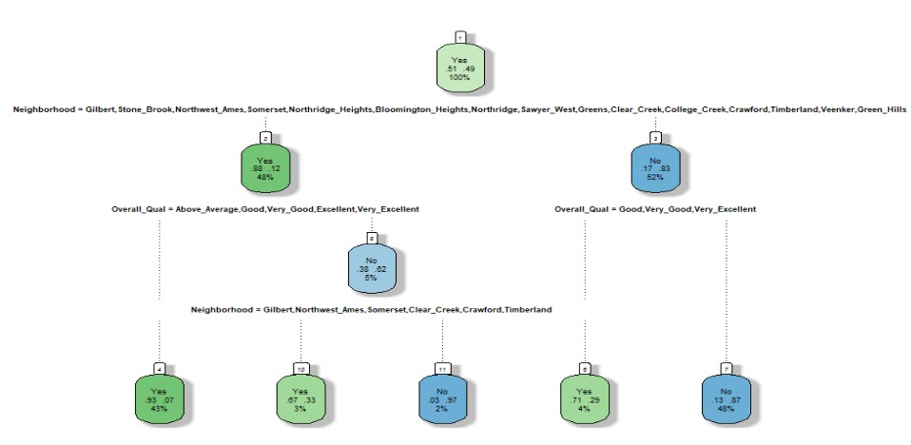
Classification TRee
All 21 possible predictor variables were put into a Classification Tree model which made Neighborhood and some of its sublevels the strongest predictors. Then it had Overall_Qual and more (but not all) of Neighborhood’s sublevels as secondary predictors.

Slide 5
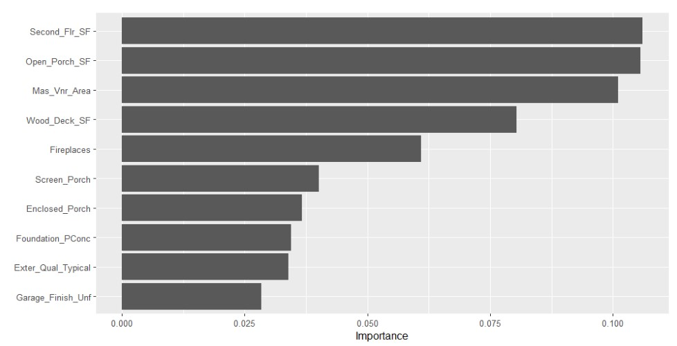
XGBoost Regression Model
All 21 possible predictor variables were put into this model which creates multiple random decision trees to find the strongest predictors. Second_Flr_SF and Open_Porch_SF equally stood out as the best predictors with Mas_Vnr_Area as a secondary predictor. Overall_Qual was not among the top ten predictors, surprisingly.

Slide 6
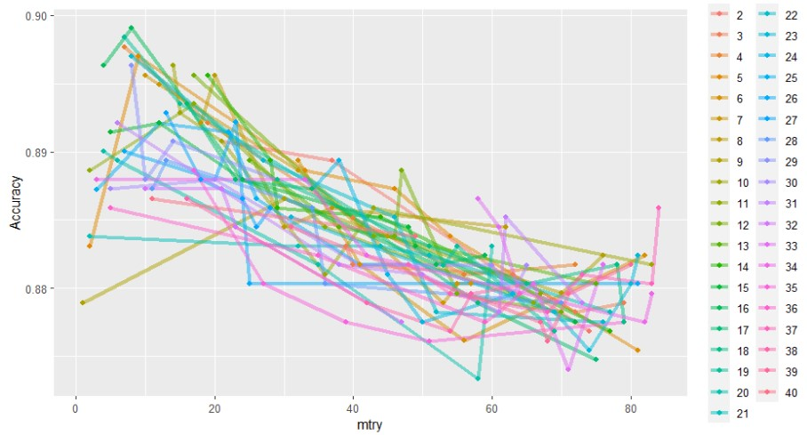
Random Forest Model
All 21 possible predictor variables were put into this model which creates multiple random decision trees to find the strongest predictors. This model showed the wide variety brought on by so many variables. Ultimately, it did not help in my conclusions.

Slide 7
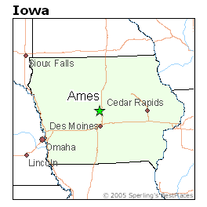
CONCLUSION
The four models did not have agreement which variables were strong predictors of a house being “Above_Median” price. We saw “Overall_Qual” start strong only to be replaced by “Neighborhood” in our second model. The third model tossed both of these variables aside and said that “Second_Flr_SF” and “Open_Porch_SF” mattered more. Overall, All of these predictor variables together would probably be good indicators of a home above the Median Home Value in Ames, Iowa.

