Slide 1
Transactions

Slide 2
What is a transaction
A logical operation that may require multiple physical database operations
Logical operations: actions of an organization, typically with a name
Bank account transfer
University class registration
Physical operations: SQL operations that realize the logical operations: e.g. SELECT, INSERT, UPDATE, DELETE

Slide 3

Banking: Account Transfer
Logical operation: Move $100 from checking to savings
Possible Physical Operations:
UPDATE checking account -$100
UPDATE savings account +$100
Possible Physical Operations:
INSERT journal entry -$100 to checking
INSERT journal entry +$100 to savings
Notes:
The data in our database needs to remain accurate and that means we need to be careful about how we update or modify information it contains. If we are simply adding or removing a customer in our customer table, for example, it's a pretty straightforward operation. One record is added or one record is removed, but in a more complex interaction, such as transferring money between bank accounts where more than one operation makes up the task, we need to be more strict about how the change to the data takes place. In this case, the complex operation of transferring money between accounts takes a few steps.

Slide 4
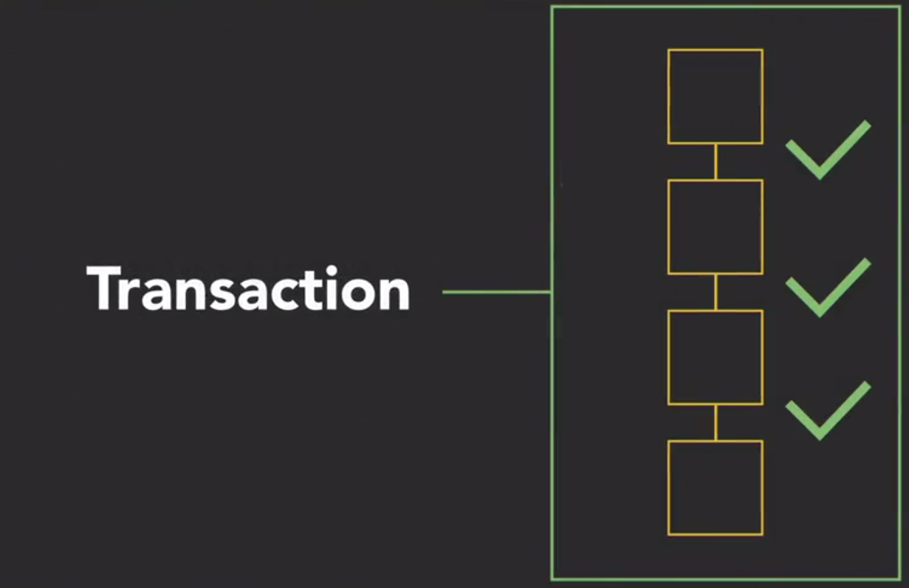
Transaction
A transaction is a set of operations that must all be completed, and if for some reason any of the individual operations aren't completed, no changes are made to the database.

Slide 5
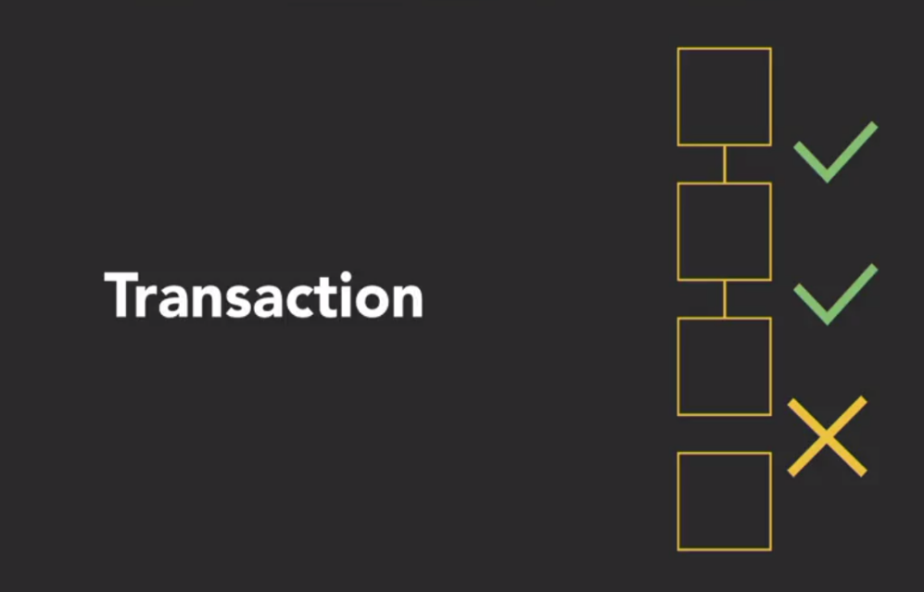
Transaction
Anything that's partially done will be undone.
Ex: The debit-credit transaction transfers funds from one bank account to another.
The first operation removes funds, say $100, from one account,
The second operation deposits $100 in another account.
If the first operation succeeds but the second fails, $100 is mysteriously lost. The transaction must complete and save either both operations or neither operation.

Slide 6
ACID Transaction Requirements
Transactions follow a set of principles outlined by the acronym ACID. Perfect transactions satisfy the following principals:
A-atomic
C-consistent
I-isolated
D-durable
Note: Perfection is not always feasible or desirable
Takes effort
More money
Slower systems

Slide 7
Atomic
All or Nothing, indivisible
A transaction should complete all its operations, or none of them. A transaction should not end partially complete. Just like an atom, a transaction is meant to be indivisible.
One of two things should happen with a transaction
All physical operations complete
None of the physical operations complete

Slide 8
Consistent
Transactions should maintain consistency in the database. Completed transactions that violate any rules are rolled back.
If the data in the database is in a good state at the beginning of the transaction, the data in the database should be in a good state at the end of the transaction.
Universal rules apply to all relational data. Ex: Primary keys must be unique and not NULL.
Business rules are particular to a specific database or application. Ex: Funds must not be lost in a debit-credit transaction.
Other rules: appropriate data types/ranges, satisfying check constraints, entity integrity, referential integrity, balancing operations (add/subtract), etc.
Notes:
Consistency means that whatever the transaction does, it needs to leave the database in a valid or consistent state.

Slide 9
Isolated
Transactions should not impact each other - Logically, the database should appear to be completely dedicated to each individual transaction.
isolation means that while the activities in the transaction are being completed, nothing else can make changes to the data involved.
the transaction should deal with concurrency – concurrency is simultaneous access to the same resource by multiple transactions
Isolated transactions behave as if each transaction were executed one at a time, or serially, when in fact the transactions are processed concurrently.
Example: If we were in the middle of moving money from one account to another, and the user submitted another transfer request, that request would have to wait until the first one finishes completely.
Notes:
isolation means that while the activities in the transaction are being completed, nothing else can make changes to the data involved. If we were in the middle of moving money from one account to another, and the user submitted another transfer request, that request would have to wait until the first one finishes completely.

Slide 10
Durable
Transactions should not be affected by database failures that occur during the transaction. A durable transaction is permanently saved in the database once committed, regardless of system failures.
Example:
System loses power before a transaction completes
On power up, the DBMS notices the incomplete transaction, and resume it
Durability is addressed by write‐ahead transaction logs:
transaction operations are written to the log, on disk, before the operations (transfer from memory to disk)
Transaction log is reviewed on every startup
Also, could be achieved by: Clustering, mirroring, etc.
How much do you want to spend? How much delay can you tolerate to ensure durability?
Notes:
Durability means that the information we change in the transaction actually gets written to the database. When the transaction is reported as complete, the data is there. The change has been made.

Slide 11
Transactions
Saving complete transaction results in the database is called a commit.
Rejecting an incomplete transaction is called a rollback. A rollback reverses the transaction and resets data to initial values.

Slide 12
Examples
A variety of circumstances cause a rollback:
The operating system detects a device failure. Ex: Magnetic disk fails during execution of a transaction, and transaction results cannot be written to the database.
The database detects a conflict between concurrent transactions. Ex: Two airline customers attempt to reserve the same seat on a flight.
The application program detects an unsuccessful database operation. Ex: In the debit-credit transaction, funds are removed from the debit account, but the credit account is deleted prior to deposit.
When a failure occurs, the database is notified and rolls back the transaction. If the failure is temporary, the database attempts to restart the transaction. If the failure is persistent, the database 'kills' the transaction permanently.

Slide 13
Syntax
Transaction statements are standardized in SQL and implemented in most relational databases. However, most databases offer nonstandard extensions.
SET TRANSACTION – sets the isolation level for subsequent transactions
A transaction boundary is the first or last statement of a transaction. A transaction boundary is one of three statements:
BEGIN TRAN – subsequent operations are part of a transactions
COMMIT TRAN – make the operations permanent since the BEGIN TRAN
ROLLBACK TRAN – undo any operations since the BEGIN TRAN

Slide 14
Syntax
SET TRANSACTION
ISOLATION LEVEL appropriateIsolationLevel --more isolation needs more money
DECLARE @err
BEGIN TRY
BEGIN TRAN
INSERT ...
UPDATE..
..other operations ..UPDATE
..
COMMIT TRAN
END TRY
BEGIN CATCH
SELECT @ err = Error_number()
ROLLBACK TRAN
END CATCH

