Slide 1
Views

Slide 2
VIEWS
A SELECT statement with a name
A SELECT statement always returns a table
VIEWS can be treated like tables
Saved in the database
VIEWS are usually not updatable

Slide 3
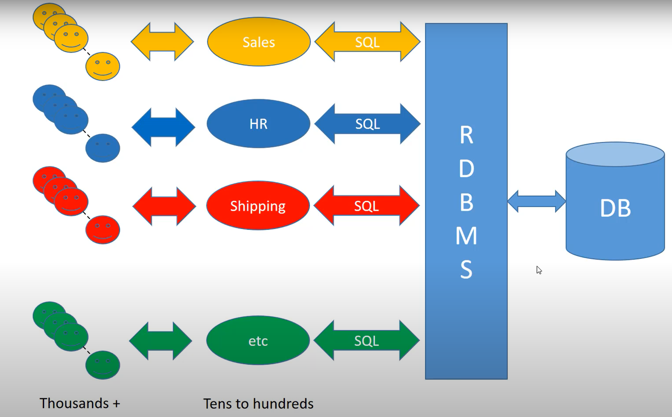
Revised OLTP Architecture
VIEWS
SELECT

Slide 4
VIEWS - Benefits
To present a less complex logical module to consumer of data
Join up 6 related tables and give them to a user as a view
Now all they need to do is filter them, for example in a spreadsheet, or Tableau
They don’t need to know the underlying data model
They don’t need to know how to do a join

Slide 5
VIEWS - Benefits
For Access Control
Create a VIEW with only Marketing employees from Employee table
Give the manager of Marketing Department access to the VIEW
Don’t give the manager access to the whole Employee table
You can limit records and columns (no SSN)

Slide 6
VIEWS - Benefits
Code re-usability and modularity
A re-usable piece – why write it over and over
Similar to a function or subroutine in other programming languages
Help ‘divide and conquer’
A fix to a VIEW will fix all systems that use that VIEW

Slide 7
Syntax
CREATE VIEW [Syrups and Sauces] (ProductID,ProductName, UnitPrice)
AS
SELECT ProductID,
ProductName,
UnitPrice
FROM Products
WHERE CategoryID = 2 --------------------------------------
SELECT ProductID,
ProductName
FROM [Syrups and Sauces]
ORDER BY UnitPrice DESC

