Slide 1
Module 1
Overview of the R Environment and Programming Basics
Professor Cummings
MIS503
Programming for Analytics

Slide 2
Module1 Objectives:
Navigate through the environment and be able to set up directories for saving/loading programs (CO1, CO4)
Create scripts within the RStudio environment for code reuse (CO2)
Install and load packages to run existing functions within R (CO2)
Demonstrate fundamentals of programming in R through an interactive activity (CO3)
Store data in atomic vectors and access that data while using different types of objects including doubles, integers, and characters. (CO3)
Build data frames and be able to access data from those data frames as well as assigning a value within the data frame (CO3)

Slide 3
Readings this week
Hands-On Programming (online only):
The Very Basics
Packages and Help
R Objects
R Notation
R for Data Science:
Workflow: Basics
Workflow: Scripts
Workflow: Projects

Slide 4

Why choose R?
R is a programming language with a variety of publically available packages
Flexible and powerful
Large community of developers
Availability (Open Source)
Visualization tools

Slide 5
What is R?
R is an integrated suite of software facilities for data manipulation, calculation and graphical display. It includes:
an effective data handling and storage facility,
a suite of operators for calculations on arrays, in particular matrices,
a large, coherent, integrated collection of intermediate tools for data analysis,
graphical facilities for data analysis and display either on-screen or on hardcopy, and
a well-developed, simple and effective programming language which includes conditionals, loops, user-defined recursive functions and input and output facilities.
From: https://www.r-project.org/about.html

Slide 6
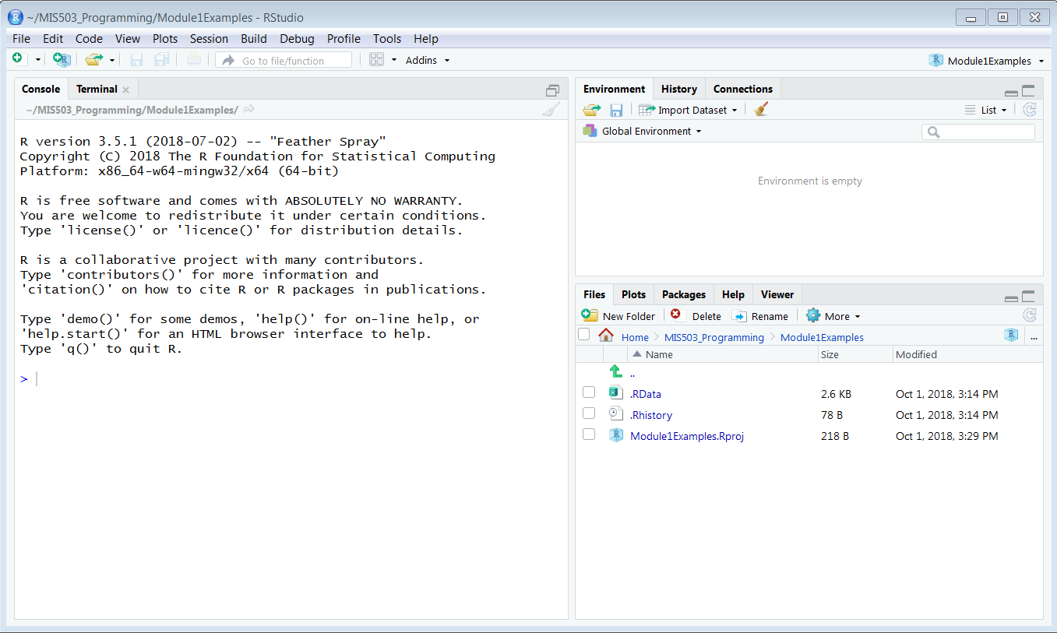
RStudio

Slide 7
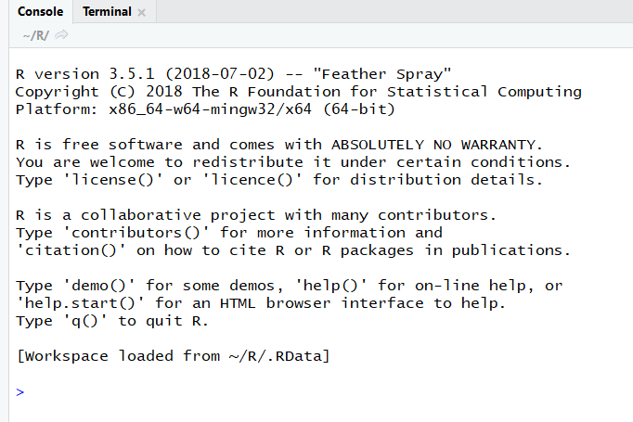
Basics of R
Console (Command Prompt)

Slide 8
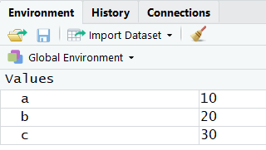

Basics of R
Objects

Slide 9
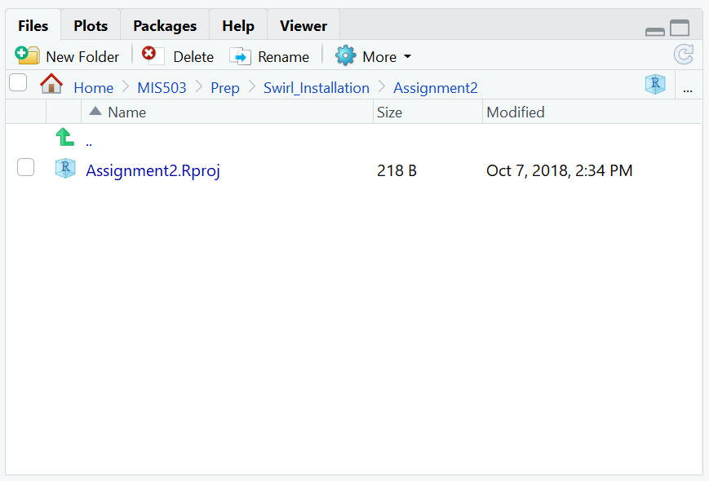
Basics of R
Files, Plots, Packages, etc.

Slide 10
Scripts
Plain text file that you save R code in.
Done through Rstudio by selecting:
File -> New File -> R Script
Execute code by line or the entire script

Slide 11
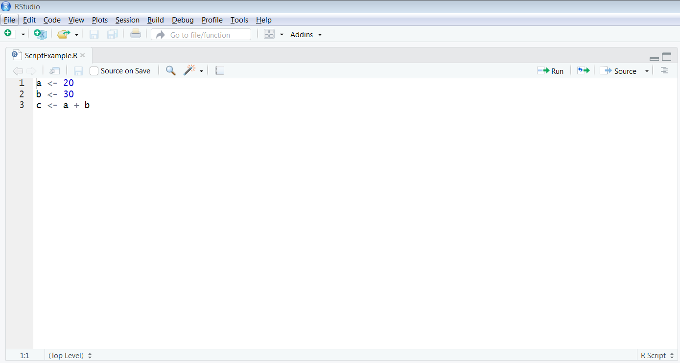
Scripts
Run script line by line
Run entire script
Code for the script
The default location of the script panel is the upper left pane just below the menu

Slide 12
Packages
Many of the most useful tools in R come from existing R packages.
R packages are functions that have been created by the R community (other developers and statisticians)
To utilize packages you must:
First, install the package within Rstudio (is done only once to get the package on your machine)
Second, load the package (this must be done everytime you intend to use the pacakge)

Slide 13
Packages
Installing Packages (only done once)
Open Rstudio
Must be connected to the Internet (RStudio will connect to the R website to download the files for you)
Run the install command at the console:
install.packages(“ggplot2”)

Slide 14
Packages
Loading Packages
Must be done each time you want to use the package
Run the “library” command at the console:
library (“ggplot2”)
Just remember you only need to install a package once but you will load the library each time you wish to use it in a new R session

Slide 15
Atomic Vectors
Simple vector of data
One dimensional
Can only store one type of data
Types of Data in R:
Doubles*
Integers
Characters*
Logicals*
Complex
Raw
* Most commonly used in analytical analysis

Slide 16
Doubles
Stores regular numbers
Can be positive or negative
Decimals
Default type R uses when saving numbers
rank <- c(1,2,3,4,5,6,7,8,9,10)

Slide 17
Integers
Numbers that can be written without decimals.
Specified with a capital L next to the number
**In general, you will not use this often.**
rank <- c(-2L,4L,-8L)

Slide 18
Characters
Store small amounts of text
Specified with double quotes around the string or character
rank <- c(“First”, “Second”, “Third”)

Slide 19
Logicals
Vectors that store either TRUEs or FALSEs (Boolean data)
Specified by using capital letters of either TRUE or FALSE
rank_logical <- c(TRUE,FALSE,TRUE)

Slide 20
Vector Attributes
Name – assign names to the values
names(rank) <- c(“first”,”second”,”third”,”fourth”,…)
Dim – creates a multi dimensional array
In the example below, creates a 2 row, 3 column matrix
dim(rank) <-(2,3)
Dates/Times – current time/date on the machine
now <- Sys.time()

Slide 21
Factors
Storing categorical information (e.g., gender, ethnicity, etc.)
Useful for treatment levels in a study and categorical variables.
gender <- factor(c(“male”,”male”,”female”))

Slide 22
Data Frames
Most commonly used approach for storing data that needs to be analyzed
Think of this as R’s version of Excel
Each column can contain different information but within the column, it must be the same data.
1 | “A” | TRUE
2 | “B” | FALSE
3 | “C” | TRUE
doubles | character | logical

Slide 23
R Notation
You can also select specific information from data frames using the coding below:
rank[ , ]
Indexing can be accomplished in the following ways, each doing something slightly different:
Positive Integers
Negative Integers
Zero
Blank Spaces
Logical Values
Names

