Slide 1
MIS503 Programming for Analytics
Module 2
Data and
R Markdown
Professor Cummings

Slide 2
Module 2 Objectives:
Modify existing data within vectors as well as subset to work with chunks of data (CO4, CO5)
Upload a variety of data sets including CSV files, Excel files, other statistical package files (e.g., SPSS) and connecting to a database (CO 4)
Create output using RMarkdown (CO 8)

Slide 3
Readings this week
Hands-On Programming:
Chapter 5 - Modifying Values (MO1)
Appendix D - Loading and Saving Data in R (MO2)
R for Data Science:
Data Import with readr
Chapter21 - R Markdown (MO3)
Chapter23 – R Markdown Formats (MO3)

Slide 4
Working with Data
Up to this point, we have primarily been inputting data into R manually (i.e., creating vectors or data frames)
However, much of the data we use as data analysts comes from an external source (e.g., sales reports)
Notes:
There are also a number of packages available for this

Slide 5
Existing Data within Base R
There are a number of datasets that are included as part of Base R which we will be accessing throughout the course in our examples.
You can explore these data sets by typing:
help(package = “datasets”)
Notes:
There are also a number of packages available for this

Slide 6
Importing Data into R
To import your own data, you use a read function. Below are some of the pre-packaged shortcuts to importing certain types of data:
Function | Use
read.table | General purpose read function
read.csv | Comma-separated-variable (CSV) file (from Excel)
read.delim | Tab-delimited file
Notes:
There are also a number of packages available for this

Slide 7
Importing Excel Data into R
Packages have been created to work with Excel including XLConnect.
Based on prior lectures, you can easily load this package by using the code below:
install.packages(“XLConnect”)
library(“XLConnect”)
Notes:
There are also a number of packages available for this

Slide 8
Accessing data from a database
Dependent on the type of database. Here are some of the packages available:
Type of Connection | Package Name
ODBC | RODBC
Individual Drivers* | DBI
MySQL | RMySQL
SQLite | RSQLite
Oracle | ROracle
PostgreSQL | RPostgreSQL
* Must be installed and then download the database-specific package
Notes:
There are also a number of packages available for this

Slide 9
Importing Data into R with readr
Using tidyverse, a better option for importing is to use the readr function.
Save the file you want to import in the folder where your project is and then left click and select:
Import -> Dataset..
Notes:
There are also a number of packages available for this

Slide 10
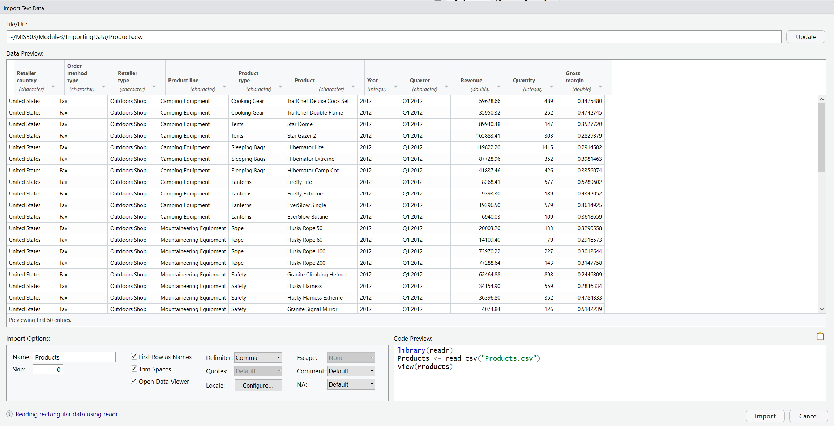
Importing Data into R with readr
Notes:
There are also a number of packages available for this

Slide 11
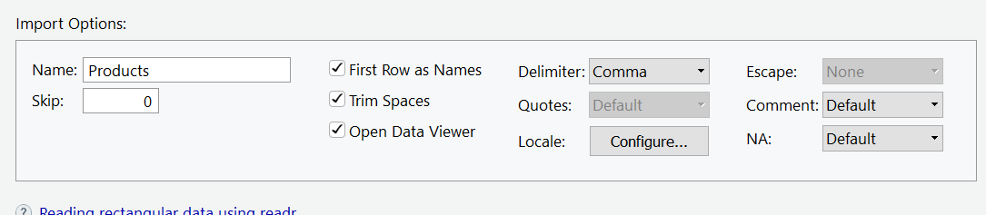
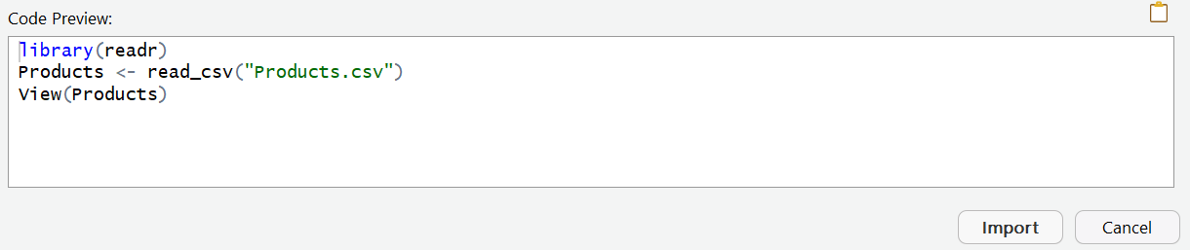
Importing Data into R with readr
Notes:
There are also a number of packages available for this

Slide 12

R Markdown
Provides a unifying framework for data science which you can keep code, results and provide commentary on your analysis
Designed to be used in three ways:
Communicating to decision makers
Collaborating with other data analysts
As an environment to do data science
Notes:
There are also a number of packages available for this

Slide 13
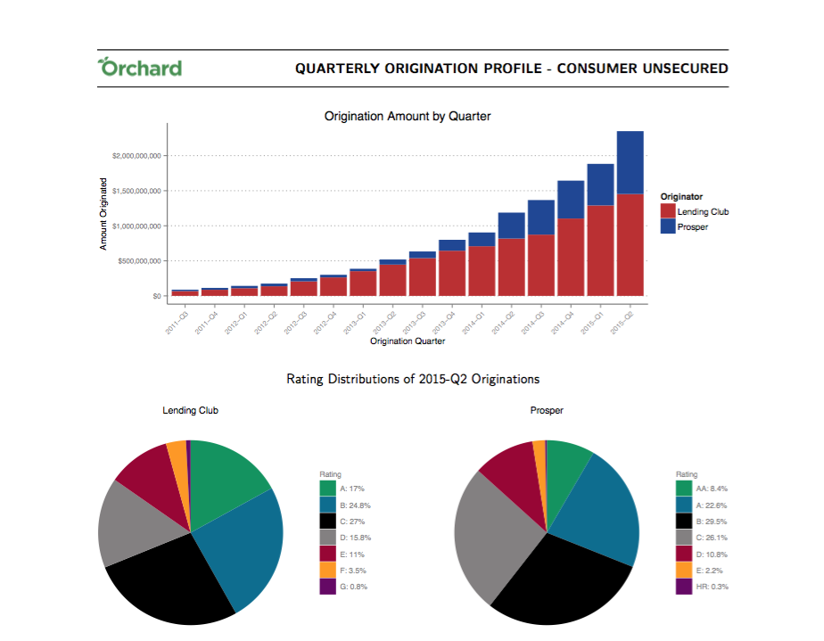
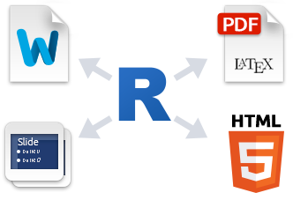
R Markdown
Notes:
There are also a number of packages available for this

