Slide 1
Basic Statistical Analysis
and
Intro to the tidyverse
Professor Cummings
MIS503 Programming for Analytics

Slide 2
Module 3 Objectives:
Demonstrate the ability to perform basic statistical analysis (e.g., descriptive, frequencies, t-tests, etc.) in R (CO9)
Perform data visualization from a set of data through the use of ggplot (CO10)
Perform exploratory data analysis including generating questions about data and then searching for answers through visualizing, transforming and modelling data (CO10)

Slide 3
Basic Statistical Analysis
R has many different, built-in statistical analysis techniques that can be easily used for any data set. Some of the approaches we will cover in this module include:
Descriptive Statistics (mean, SD, min,etc.)
Correlation/Covariance
t-tests
ANOVA/MANOVA
Regression Analysis
Notes:
There are also a number of packages available for this

Slide 4
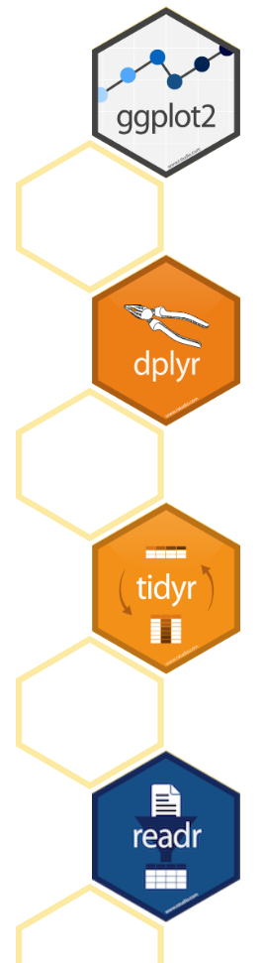
Introduction to tidyverse
A coherent system of packages for data manipulation, exploration and visualization (all share a common philosophy)
Primarily developed by Hadley Wickham
Packages are intended to make statisticians and data scientists more productive by guiding them through workflows that facilitate communication, and result in reproducible work products.
Fundamentally, the connections between the tools that make the workflow possible

Slide 5
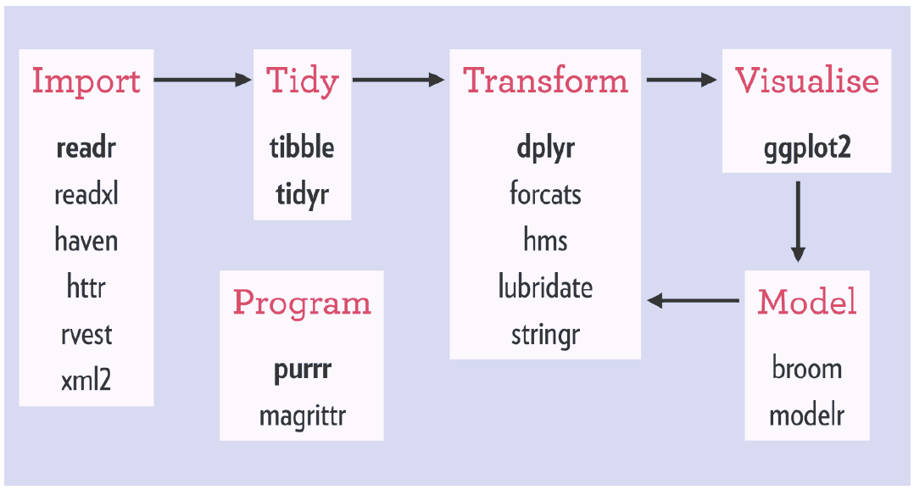
Tidyverse Workflow
Notes:
There are also a number of packages available for this

Slide 6
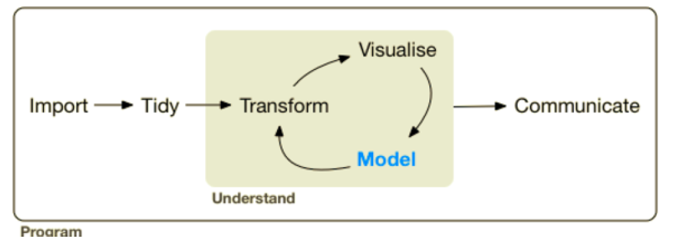
Packages covered in this course
Over the next few modules we will be covering the following packages from tidyverse:
Import: readr
Tidy: tibble and tidyr
Transform: dplyr
Visualize: ggplot2

Slide 7
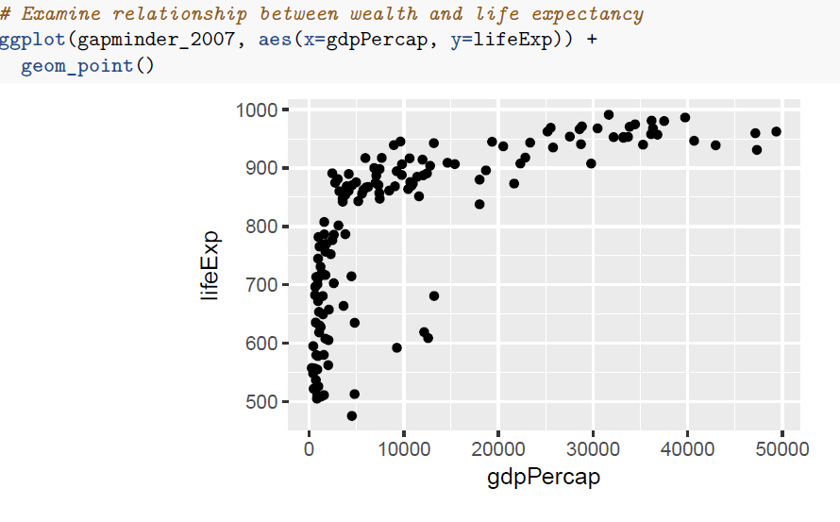
Visualization with ggplot2
Implements the “grammar of graphics” which is used to visualize data.
Provides a variety of outputs including:
Scatter Plots
Line Plots
Bar Plots
Histograms
Box Plots

Slide 8
Exploratory Data Analysis
Exploring data systematically through the use of visualization and transformation
Topics include:
Variation
Missing Values
Covariation
Patterns and Models

