Slide 1
Module Introduction
Wrangle Data with lubridate,
Statistical Analysis &
Intro to Jupyter Notebooks
Professor Cummings
MIS503 Programming for Analytics

Slide 2
Module Objectives:
Learn how to work with date and times in R by using the lubridate package (CO13)
Perform additional statistical analysis including regression, correlation, t-test and ANOVA (CO14)
Install and explore the basics of Python including the use of Jupyter Notebooks (CO16)

Slide 3
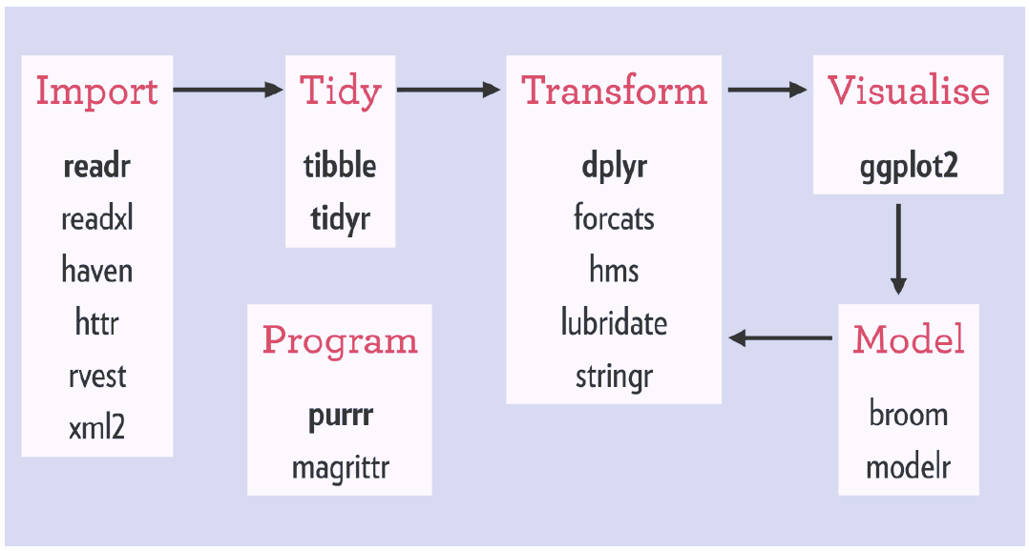
Tidyverse Workflow
Notes:
There are also a number of packages available for this

Slide 4

lubridate
Date-time data can be frustrating to work with in R. R commands for date-times are generally unintuitive and change depending on the type of date-time object being used. Moreover, the methods we use with date-times must be robust to time zones, leap days, daylight savings times, and other time related quirks, and R lacks these capabilities in some situations.
Lubridate makes it easier to do the things R does with date-times and possible to do the things R does not.

Slide 5
lubridate
Although lubridate is part of the tidyverse, you will need to include library(lubridate) to load this package (does not load with tidyverse)
The lecture will include various ways of working dates and times.

Slide 6
Statistical Analysis
t-test: compare the values of the means from two samples
Correlation analysis: a method of statistical evaluation used to study the strength of a relationship between two, numerically measured, continuous variables

Slide 7
Statistical Analysis
Regression: examine the relationship between two or more variables of interest
ANOVA: analyze the differences among group means in a sample

Slide 8
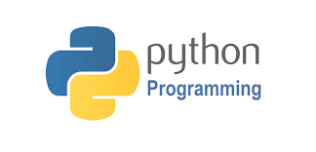


Python and Jupyter Notebooks
Anaconda is the standard platform for Python data science
The Jupyter Notebook is an open-source web application that allows you to create and share documents that contain live code, equations, visualizations and narrative text.

