Slide 1

An Introduction
to R Shiny
Professor Cummings
MIS503 Programming for Analytics

Slide 2
What is Shiny?
A web application framework for R
R Shiny makes it easy to build interactive web applications with R
This presentation is taken from the R Studio tutorial for Shiny available at:
http://shiny.rstudio.com/tutorial/

Slide 3
Two Basic Shiny App Components
User-interface Definition (UI) file (ui.R)
Used to set-up what the user will actually see in the web app, i.e. the layout of the web page (Title, sliders, widgets, plots, location of items on the page, etc.)
Also used to accept input from the user–e.g. It recognizes what the user has entered in the slider
Server script file (server.R)
Does the computational R work “under the hood” with familiar functions such as hist(), plot(), etc.
Contains the instructions that your computer needs to build your app
These two source files work together to create your R Shiny web application
Notes:
There are also a number of packages available for this

Slide 4
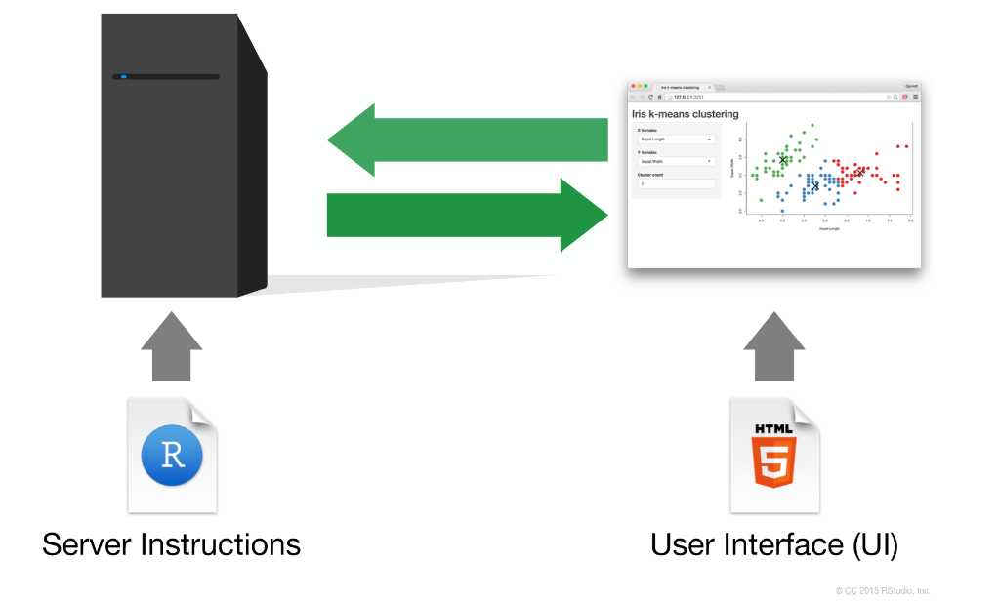
Two Basic Shiny App Components
These two source files work together to create your R Shiny web application
Notes:
There are also a number of packages available for this

Slide 5
Basics for Shiny
You will first need to install the package
install.packages(“Shiny”)
For this presentation, we will be looking at pre-built application included in Shiny. Run the following code:
library(shiny)
runExample("01_hello")
Notes:
There are also a number of packages available for this

Slide 6
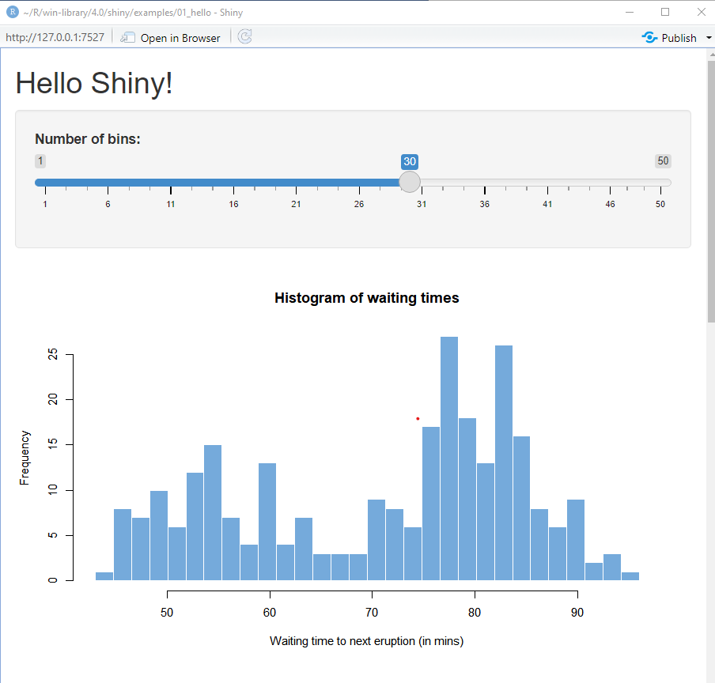
01_hello Application
Notes:
There are also a number of packages available for this

Slide 7
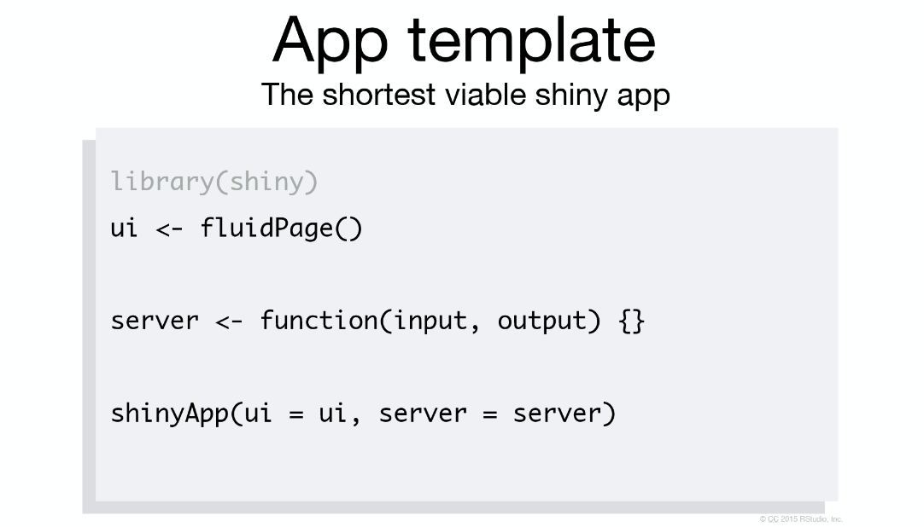
Building your own app

Slide 8
UI Code
# Define UI for application that draws a histogram
ui <- fluidPage(
# Application title
titlePanel("Old Faithful Geyser Data"),
# Sidebar with a slider input for number of bins
sidebarLayout(
sidebarPanel(
sliderInput("bins",
"Number of bins:",
min = 1,
max = 50,
value = 30)
),
# Show a plot of the generated distribution
mainPanel(
plotOutput("distPlot")
)
)
)

Slide 9
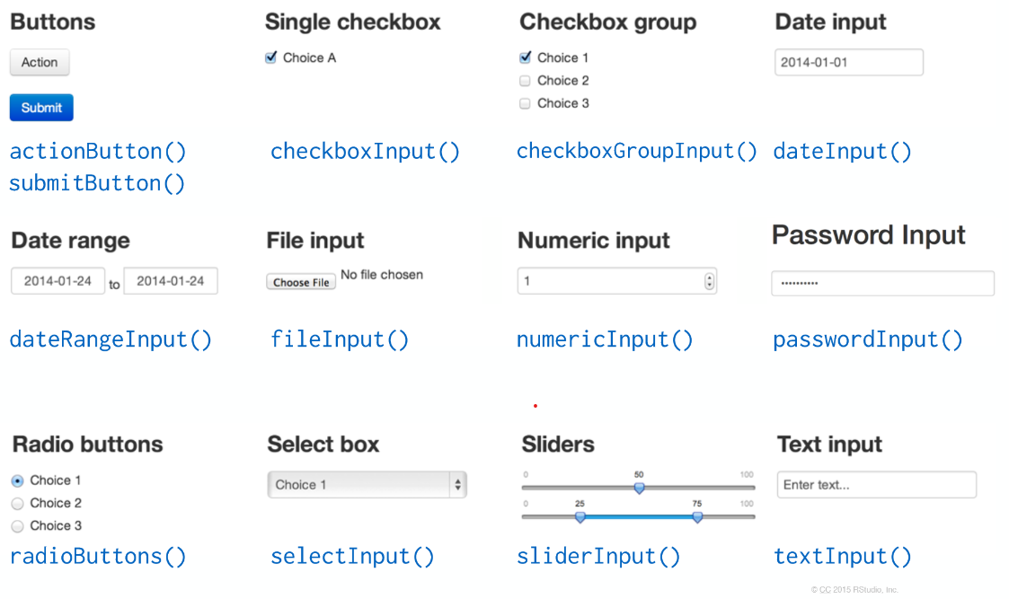
UI - Input

Slide 10
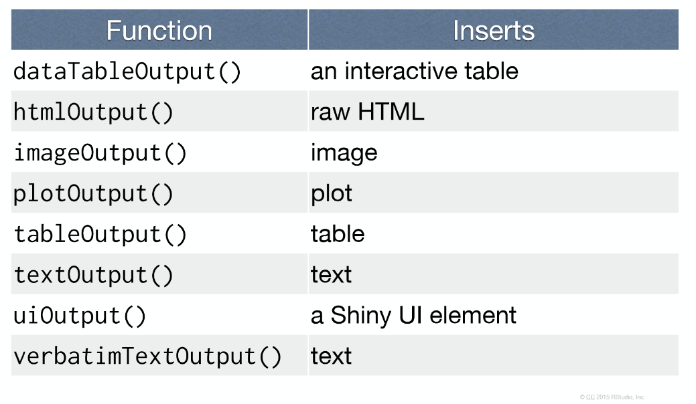
UI – Output Functions

Slide 11
Server Code
# Define server logic required to draw a histogram
server <- function(input, output) {
output$distPlot <- renderPlot({
# generate bins based on input$bins from ui.R
x <- faithful[, 2]
bins <- seq(min(x), max(x), length.out = input$bins + 1)
# draw the histogram with the specified number of bins
hist(x, breaks = bins, col = 'darkgray', border = 'white')
})
}

Slide 12
Application Run Code
# Run the application
shinyApp(ui = ui, server = server)

