Slide 1
Module Introduction
Wrangle Data
Professor Cummings
MIS503 Programming for Analytics

Slide 2
Module Objectives:
Create tibble data within tidyverse and name the differences between tibbles and data frames.(CO13)
Use readr function to load flat files within R. (CO13)
Create tidy data using the tidyr package within tidyverse. (CO13)

Slide 3
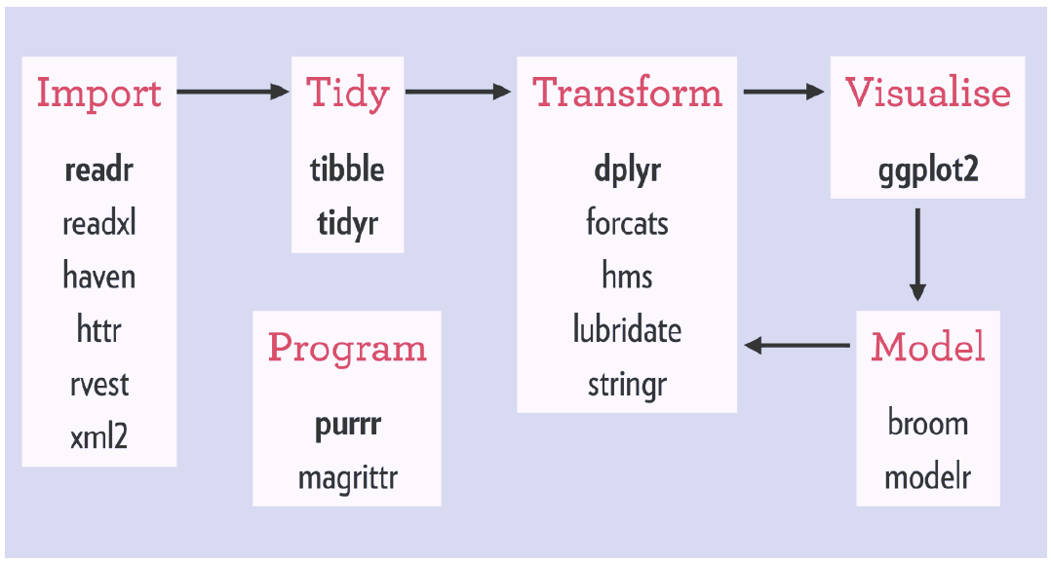
Tidyverse Workflow
Notes:
There are also a number of packages available for this

Slide 4

Tibbles
With the tidyverse package, imported data come in as tibbles and not the traditional data frame
However, tibbles are data frames
While most of the time you will import data sets as tibbles, you can create tibbles using a similar code to data frames:
Data <- tibble(x=1:5, y=6:10)

Slide 5


readr Package
readr allows you to import various forms of data including the functions:
read_csv() => comma-delimited files
read_csv2() => semicolon-separated files
read_tsv() => tab-delimited files
read_delim() => reads files with any delimiter
read_fwf() => reads fixed width files
read_log() => Apache style logs
Readxl will also be introduced to work with data coming from an Excel file

Slide 6

tidyr
Helps data analysts create tidy data within the R environment
Tidy data describes a standard way of storing data to be used throughout the tidyverse
Goal of having tidy data:
Each variable is in a column
Each observation is in a row
Each value is in a cell

Slide 7
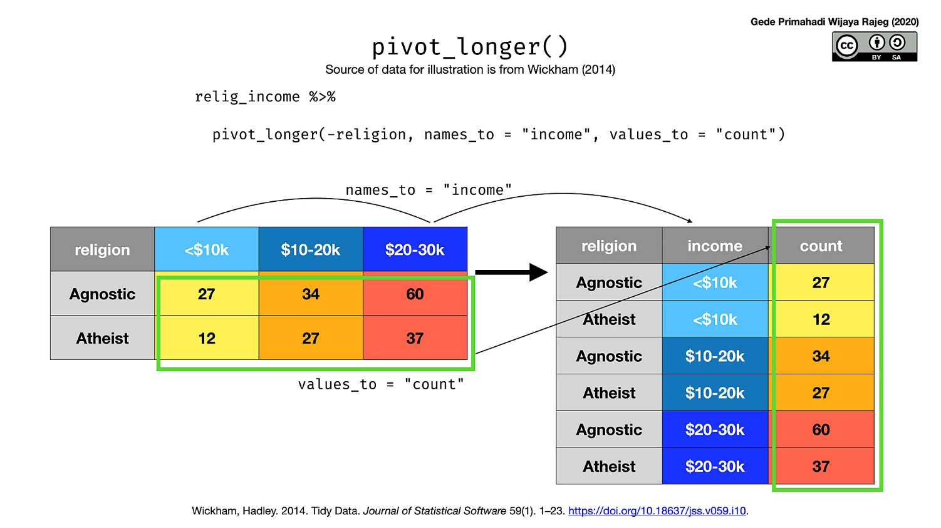
pivot_longer( )*
Decreasing the number of columns and increasing the number of rows
* Replaces gather( )

Slide 8
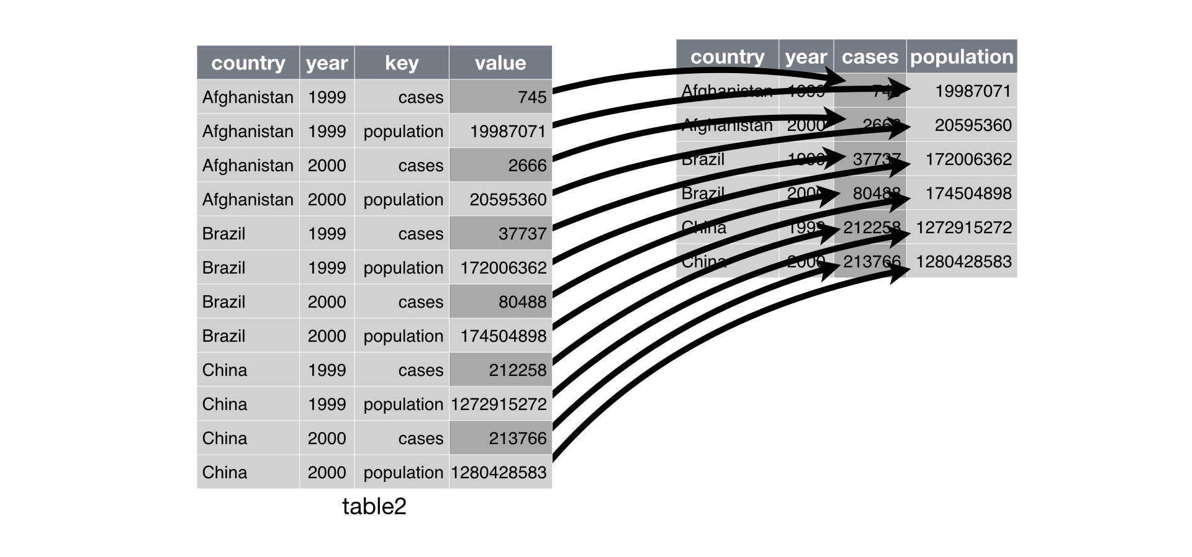
pivot_wider( )*
Increasing the number of columns and decreasing the number of rows.
* Replaces spread( )

Slide 9
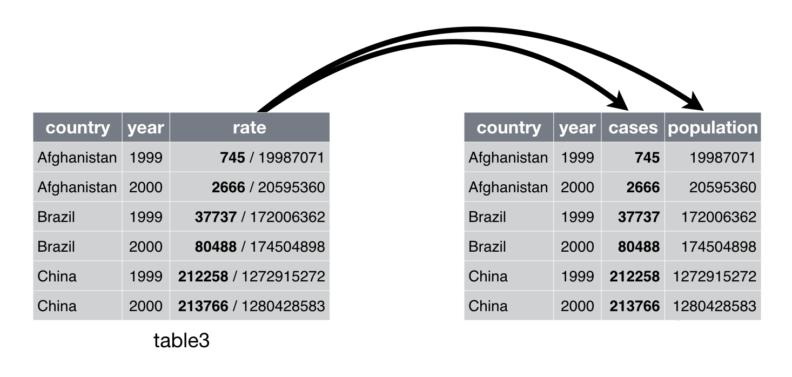
separate( )
pulls apart one column into multiple columns, by splitting wherever a separator character appears.

Slide 10
Tidyverse Workflow
Notes:
There are also a number of packages available for this

