Slide 1
Module Introduction
Data Transformation with dplyr
Professor Cummings
MIS503 Programming for Analytics

Slide 2
Module Objectives:
Transform data to provide data in a form that will better help with other analysis such as visualization (CO11)
Using dplyr, perform the following functions on a specific dataset (CO11):
filter() - Observations by Value
arrange() – Reorder rows
select() – Variable selection by name
mutate() – Create new variables with functions of existing variables
summarize() – Collapse values down to single summary
Work with relational data to join separate tables of data (relational data) (CO12)

Slide 3
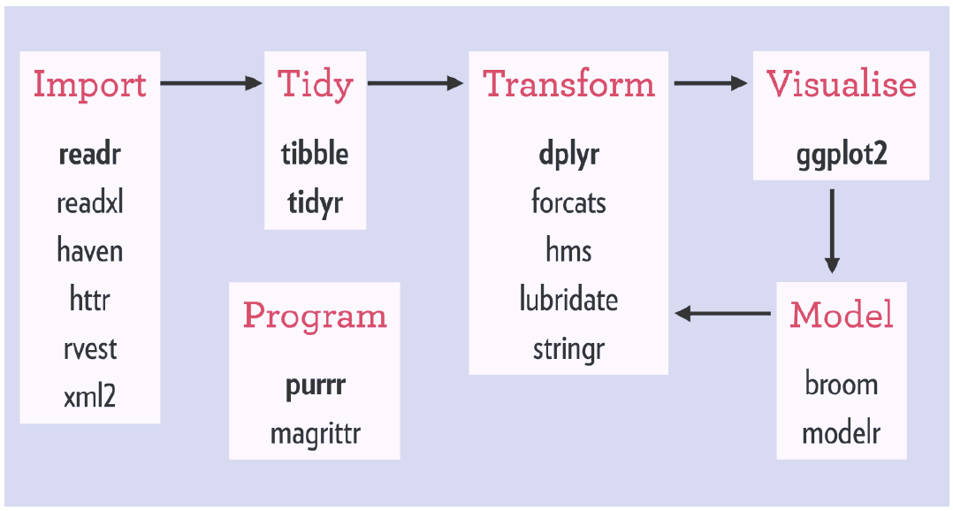
Tidyverse Workflow
Notes:
There are also a number of packages available for this

Slide 4

dplyr Package
It is rare to get data in the exact form needed to run your visualizations
dplyr helps you transform data by adding new variables, including summaries, and reordering/renaming variables
Since dplyr is part of the tidyverse, to load this function:
library(tidyverse)

Slide 5
Key dplyr Functions
filter() - Observations by Value
arrange() – Reorder rows
select() – Variable selection by name
mutate() – Create new variables with functions of existing variables
summarize() – Collapse values down to single summary

Slide 6
filter()
Allows you to subset observations based on values.
New Data frame <- filter(data frame, expression filter)
JanFlight <- filter(flights, month == 1)
This will create a new data frame (JanFlight) from the data frame (flights) that will contain all the rows of flight that have a month entry of 1

Slide 7
arrange()
Orders your data frame based on the arguments given (i.e., variable)
arrange(data frame, expression filter)
arrange(flights, year)
This will reorder the flights data by year in ascending order.

Slide 8
select()
Allows you to subset observations based on values.
select(data frame, variables (i.e., columns) to be in new dataset)
Sm_flight <- select(flights, year, month, day)
This will create a new data frame (Sm_flight) from the data frame (flights) that will contain only the columns (year, month, day) in the original dataframe (flights)

Slide 9
mutate()
Creates new columns using data from existing columns
mutate(data frame, new variable = existing variables)
mutate(flights, hours = arr_time / 60)
This will create a new variable (hours) from dividing an existing variable (arr_time) by 60. This new variable will be the last column of flights.

Slide 10
summarize()
Collapses a dataframe into a single row. Usually done in combination with group_by ()
More information will be provided in the video covering dplyr basics

Slide 11
Relational Data with dplyr
Many times data analysis requires multiple tables that need to somehow be joined.
This includes mutating joins, inner joins and outer joins. This will be covered in a separate video for this module.

