Slide 1

Towards More Satisfied Airline Customers
Customer Survey Analysis And Recommendations

Slide 2
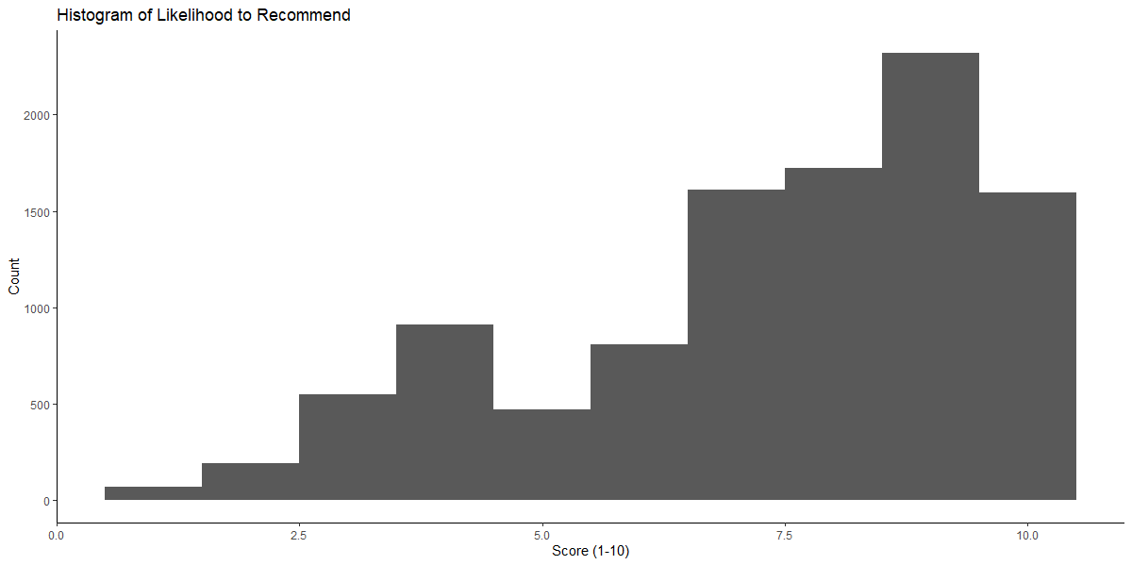
Customer Satisfaction Is Widely Distributed

Slide 3
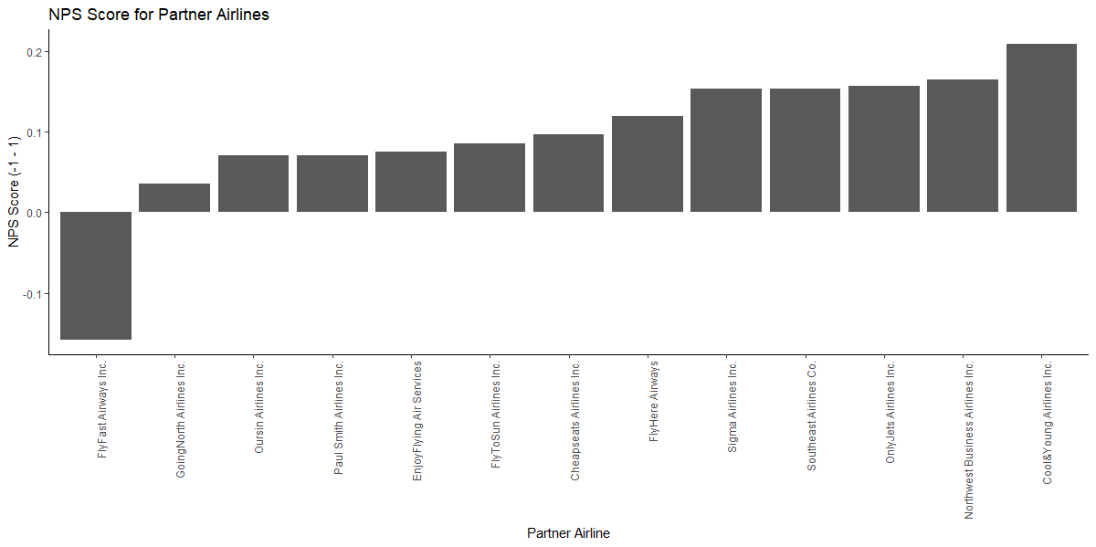
AIRLINES Differ Significantly In Customer SatisFaction

Slide 4
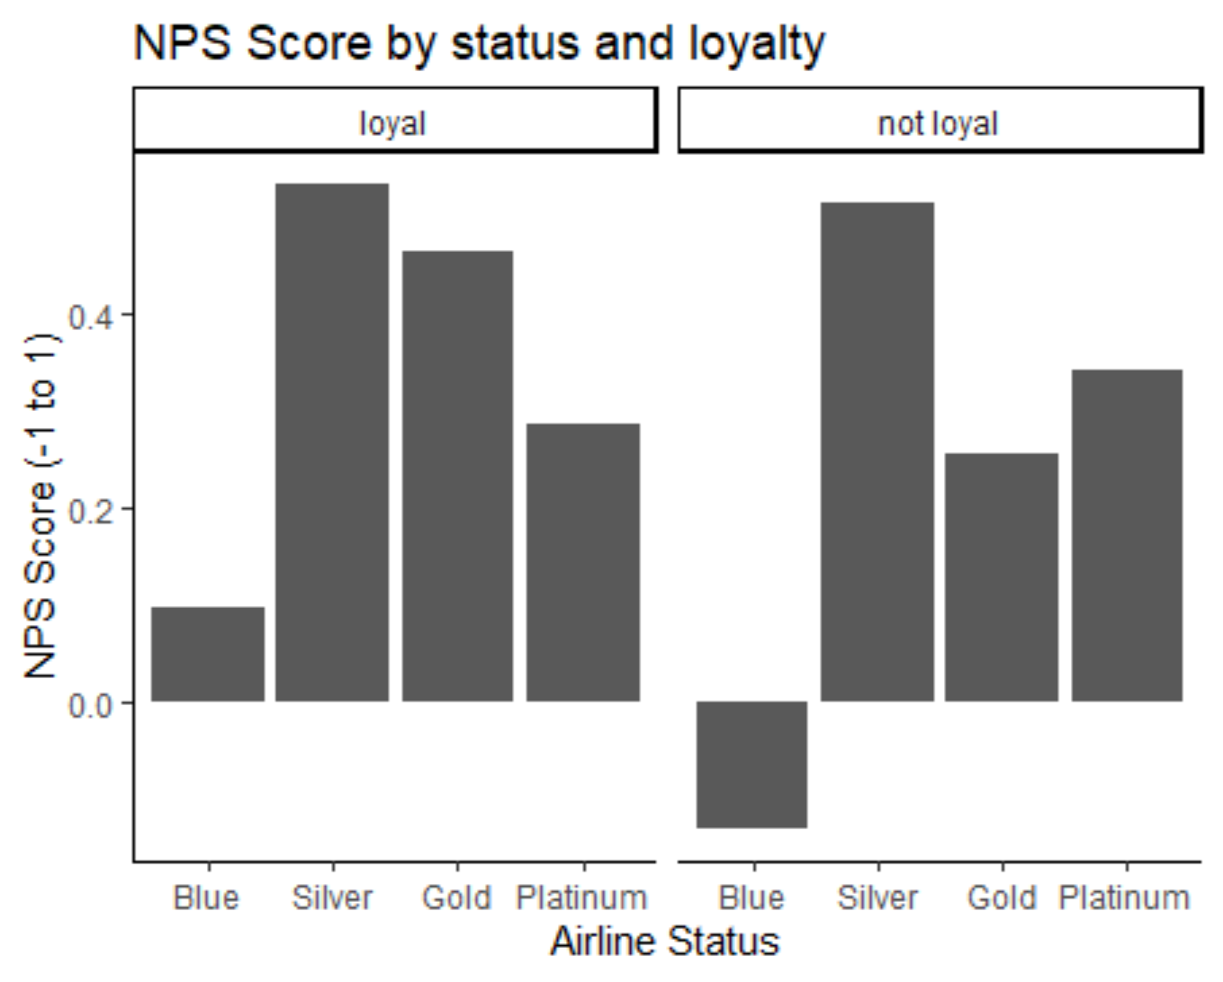
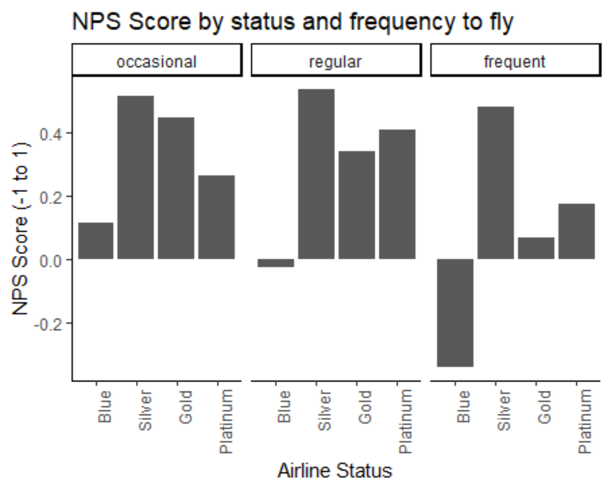
Silver Status iS ASSociated with a significant bump in Satisfaction

Slide 5
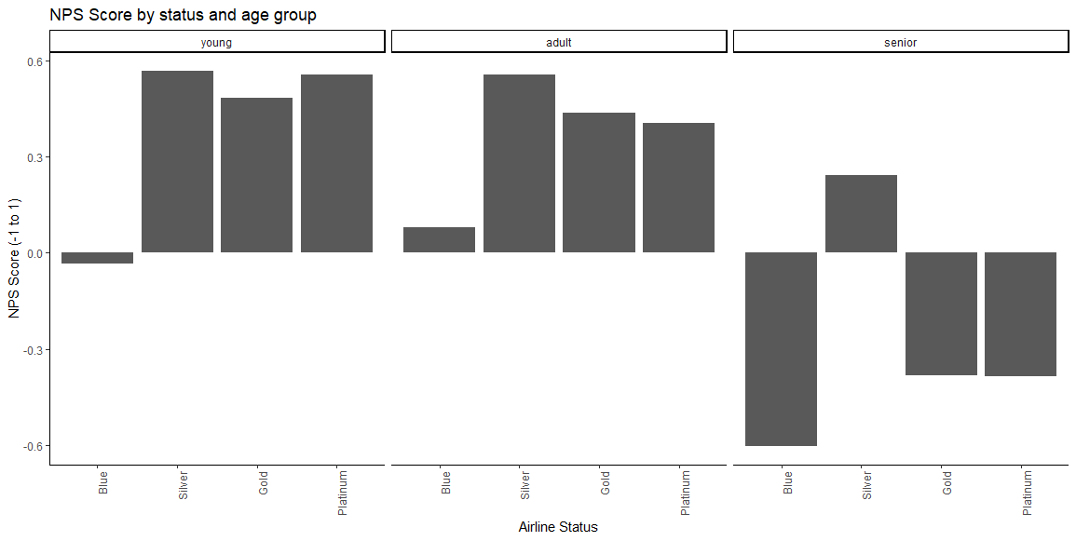
Seniors Are Significantly Less Satisfied
Silver status produces a significant increase in statisfaction

Slide 6
Other Factors Associated With Senior Satisfaction and DissatiSfaction (Based on Association Rules Analysis)
Senior are most likely to be detractors when
Seniors are most likely to be promoters when
{Airline.Status=Blue,Partner.Name=FlyFast Airways Inc.}
{Type.of.Travel=Personal Travel,Partner.Name=FlyFast Airways Inc.}
{Airline.Status=Blue,Type.of.Travel=Personal Travel,Partner.Name=FlyFast Airways Inc.}
{Airline.Status=Blue,Partner.Name=FlyFast Airways Inc.,loyalCustomer=not loyal}
{Type.of.Travel=Personal Travel,Class=Eco,Partner.Name=FlyFast Airways Inc.}
→ Risk factors: Personal travel, FlyFast Airways
{Airline.Status=Silver}
{Type.of.Travel=Business travel}
{Airline.Status=Silver, loyalCustomer=not loyal}
{Airline.Status=Silver, Total.Freq.Flyer.Accts}
{Airline.Status=Silver, Flight.cancelled=No}
→ Opportunities: Silver Status, Business travel

Slide 7
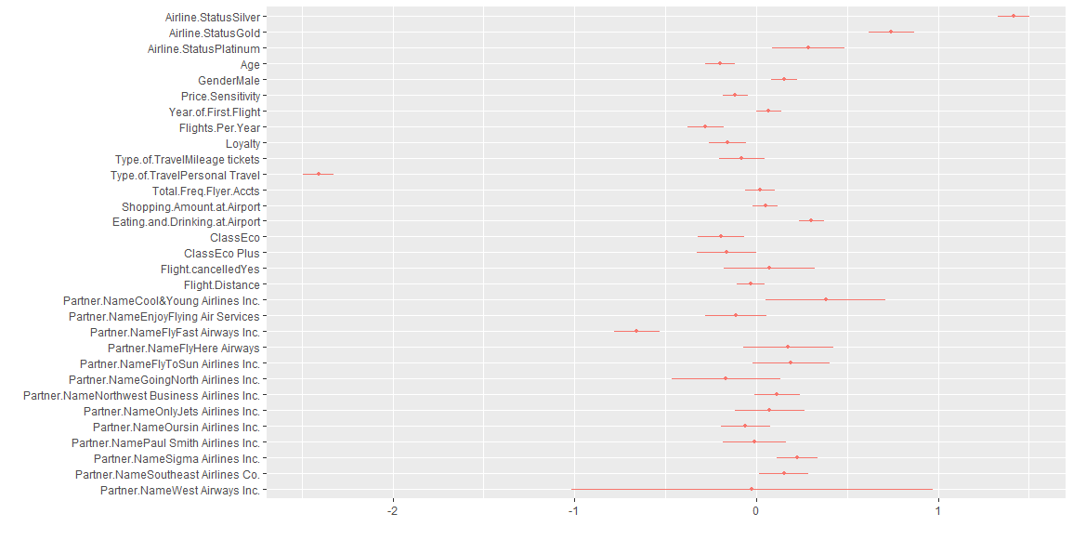
Linear Modelling Confirms & Extends Descriptive Statistics

Slide 8
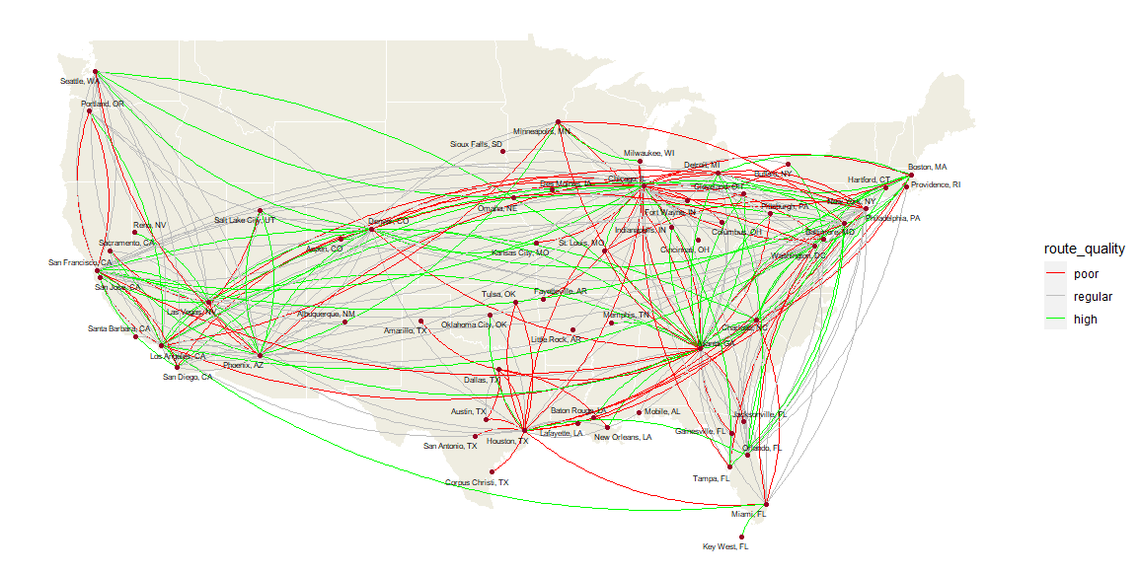
Route Satisfaction Shows Geographic Patterns
280 Most commonly flown routes (10+ customer surveys)
Routes in and out of Houston show particular weakness
West Coast routes look particulary promising

Slide 9
Recommendation 1: Re-evaluate relationship with Fly Fast Airlines
Only airline with a net-negative NPS score (i.e. more dissatisfied than satisfied customers)
Associated with discontent among senior flyers
Effect holds in model controlling for other factors

Slide 10
Recommendation 2: Make Silver Status Easier to Reach
Silver status is one of the strongest positive factors, affecting satisfaction among all groups
Silver status holders are the only net-satisfied group among seniors
Silver status has a stronger effect than gold or platinum status

Slide 11
Recommendation 3: Evaluate Houston Based Routes
The Houston hub shows significantly worse performance than other hubs
In particular, comparisons to West Coast hubs may be useful

