Slide 1
Analysis of Alcohol Content and Bitterness in Beer
Meredith Ludlow

Slide 2
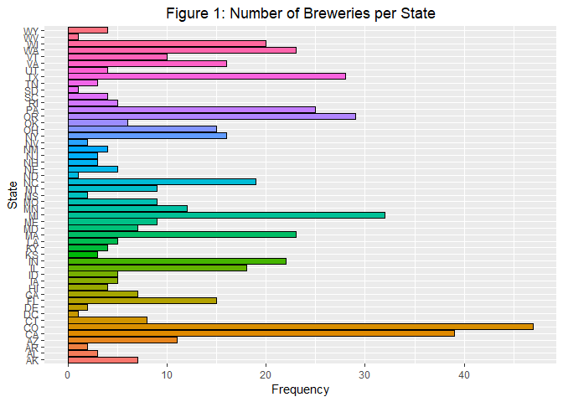
Breweries per State
Download brewery data.
Counted number of breweries in each state.
Results in Figure 1.
Colorado and California have the most breweries per state.

Slide 3
Merge Data Sets and Count Missing Data
Table 3: The Number of Missing Data for each Variable
Brew_ID | 0
BeerName | 0
Beer_ID | 0
ABV | 62
IBU | 1005
Style | 0
Ounces | 0
BrewerieName | 0
City | 0
State | 0
Download beer data set.
Change variable name in beer data set to match brewery data set.
Merge data.
Count number of missing data.
IBU has significantly more missing data points than other variables.

Slide 4
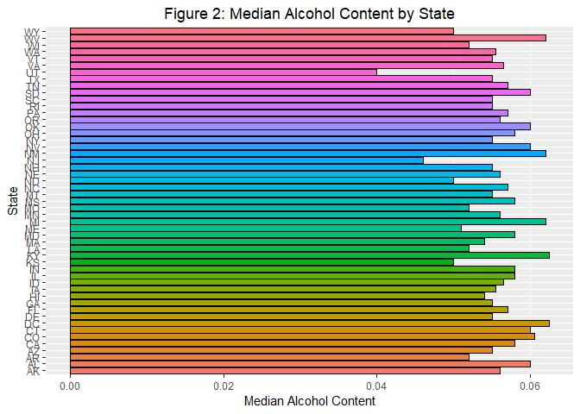
Finding the Median ABV and IBU per State
Separate the data into groups by state.
Find the median ABV and IBU for each state.
Results in Figures 2 and 3.

Slide 5
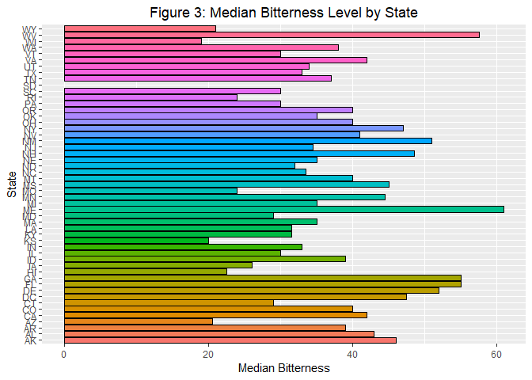

Slide 6
Beers with the Maximum ABV and IBU
Summary Statistics of ABV
 | ABV | IBU
State | Colorado | Oregon
Value | 0.128 | 138
Statistic | Value
Minimum | 0.001
First Quartile | 0.05
Median | 0.056
Mean | 0.05977
Third Quantile | 0.067
Maximum | 0.128
Missing Data | 62

Slide 7
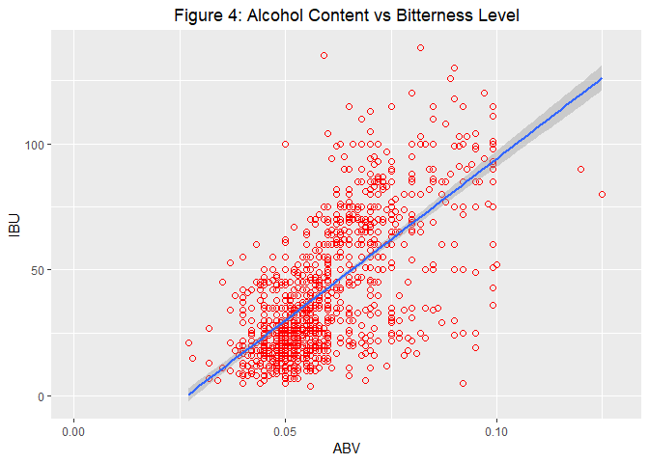
Scatterplot of IBU v. ABV
Create a scatterplot of IBU versus ABV: Figure 4
Has a positive correlation.
Further avenues of investigation.

Slide 8
Link to YouTube Recording of The Presentation
https://youtu.be/m68MuFXb5_g

