Slide 1
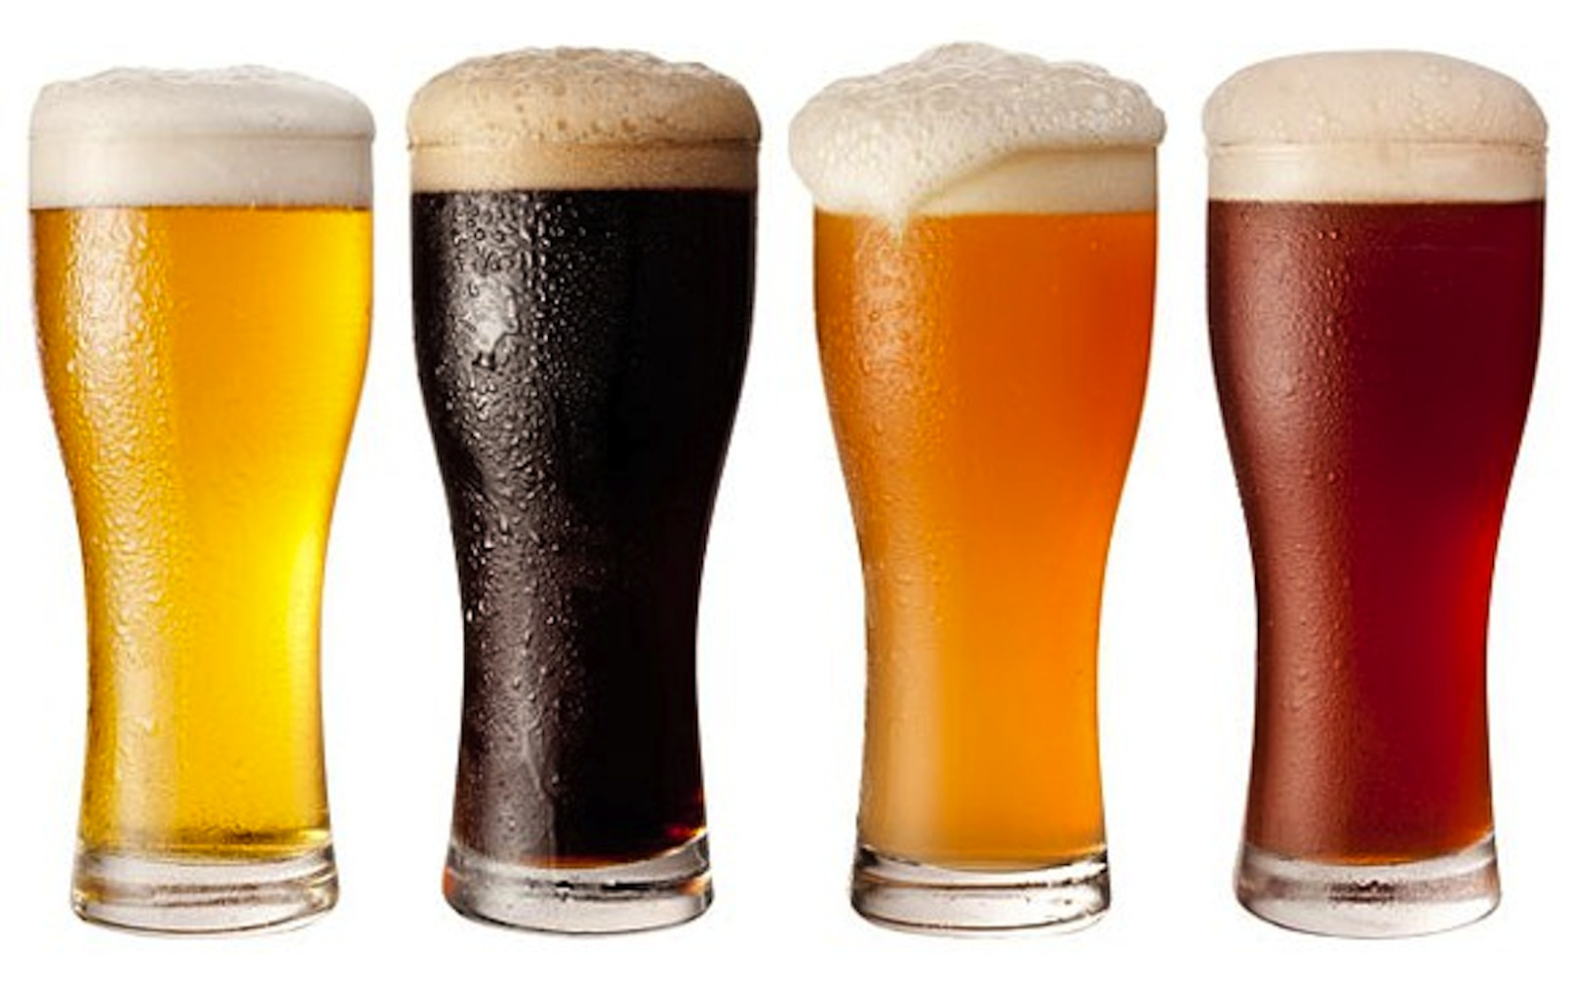
Doing Data Science Case Study
Alcohol Content and Bitterness – US Craft Beers
Kito Patterson

Slide 2
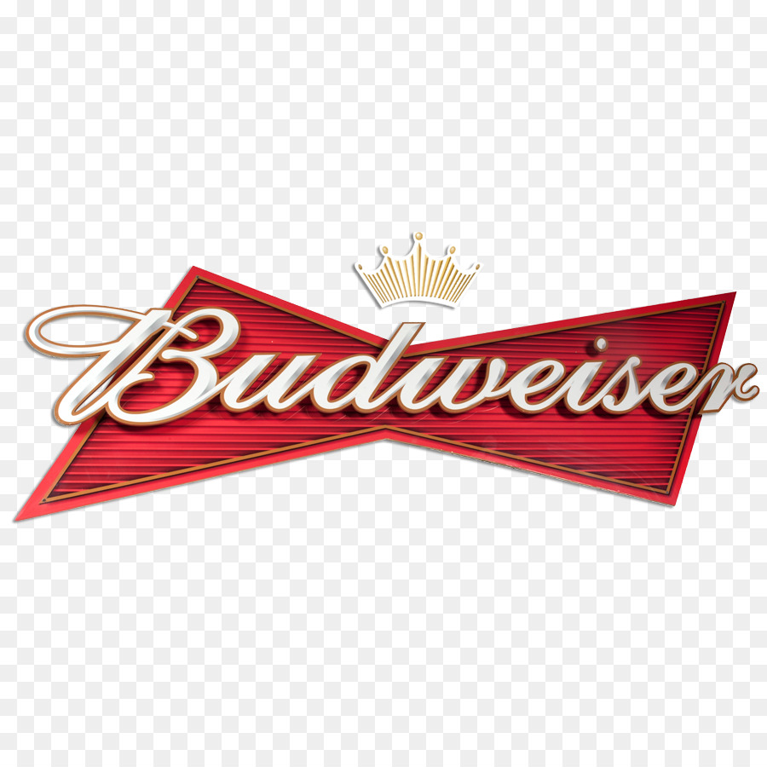
Introduction
We analyzed two data sets, one containing information about breweries across the US and one containing information about different beer brands/types to get a better sense of the current craft beer market. We also focused on the international bitterness unit (IBU) and alcohol level (ABV) to see which states have the highest bitterness level and alcohol content and if there is a correlation between the two variables.
The data provides information pertaining to breweries across the country with information about the products they produce including beer name, alcohol content, bitterness level and location specifics.
The analysis of this data is expected to:
Identify trends which can provide areas of focus for deeper insights
Uncover potential market opportunities

Slide 3


Questions Of Interest
Are there opportunities to open additional breweries?
How many breweries are present in each state?
What do the summary statistics tell us?
Can beer contents uncover any insights?
What is the distribution of beer types?

Slide 4
Data Preparation
Breweries
Brew_ID
Name
Beers
Name
Brews & Beers (Merged)
Brew_ID*
CIty
State
ABV (Alcohol Content)
IBU (Bitterness Level)
Style
Ounces
Identify/Filter NA values
ABV = 62
IBU = 1005
Mutate
Create StyleCategory column

Slide 5
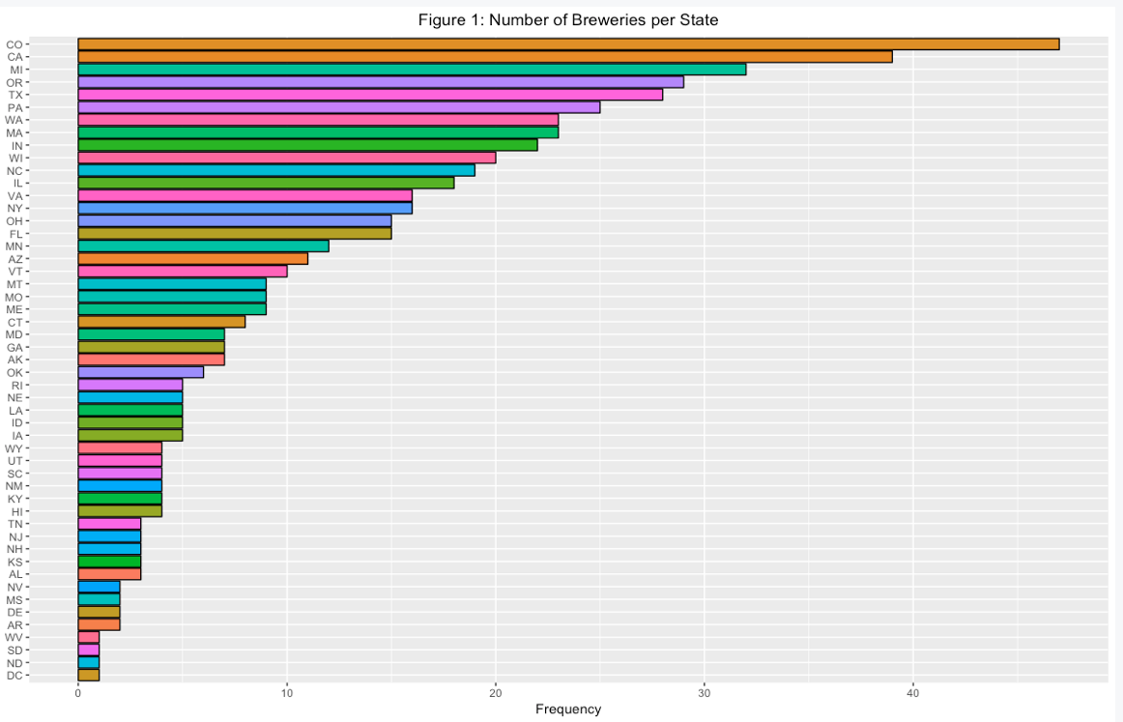
Brewery Count by State
The bar graph shows the number of breweries in each state
The western states have large concentration of breweries with 4 of the top 6 highest amount of breweries (CO, CA,OR and WA)
Almost 1/3 of all breweries are located in western territories
Notes:
There may be opportunities to partner with breweries in underserved markets across the country.

Slide 6
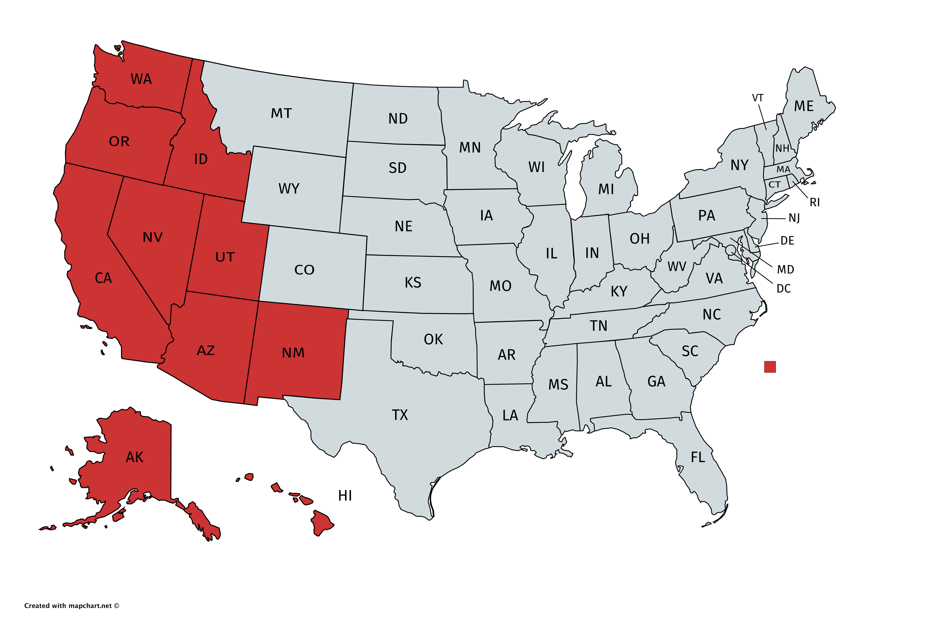
Percentage of Total Breweries Western Territories
4%
5%
1%
Over 1/3rd of breweries are located in the West
1%
1%
7%
2%
1%
1%
1%
Notes:
There may be opportunities to partner with breweries in underserved markets across the country.

Slide 7
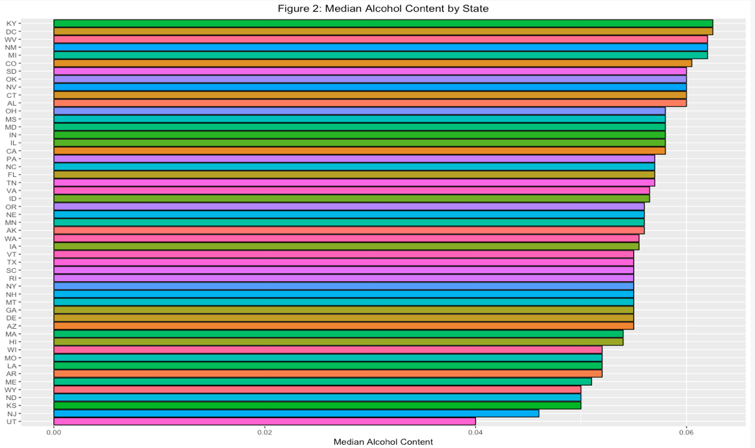
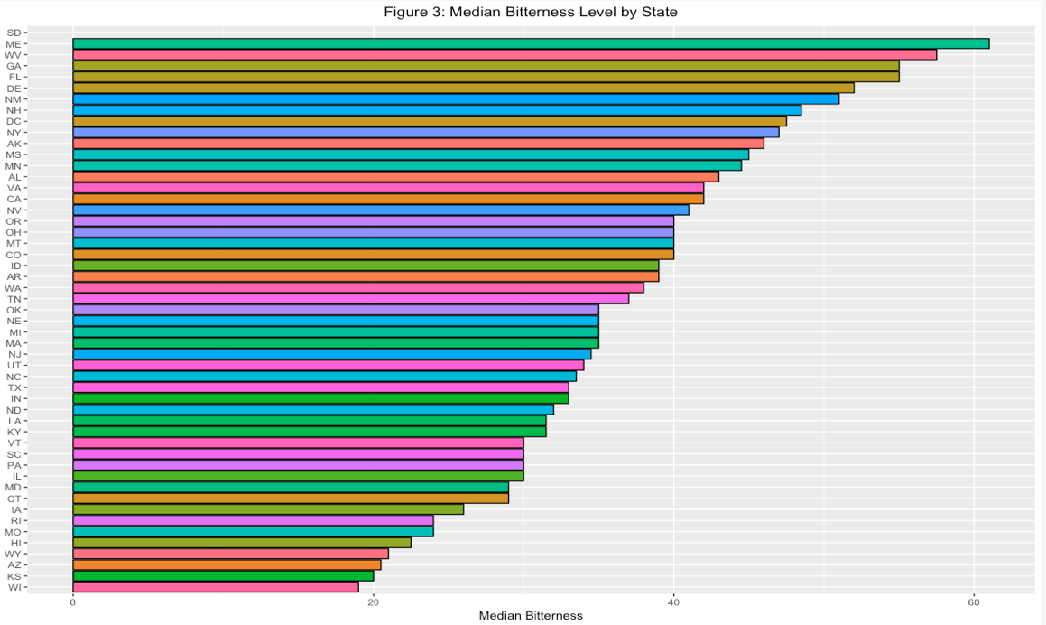
Median Alcohol and Bitterness by State
Notes:
There seems to be far more variability in bitterness levels than in alcohol content. This may suggest that bitterness/taste plays a far greater role in popularity than alcohol content.

Slide 8
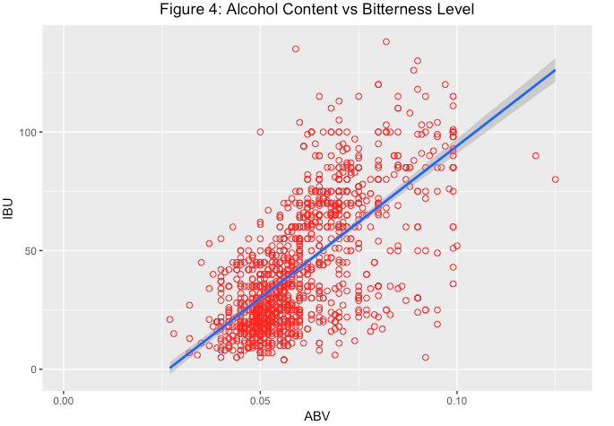
Alcohol Content vs Bitterness Level
Notes:
This graph suggest there may be a relationship in the compositional makeup of beer. As the alcohol content increases so does the bitterness level.

Slide 9
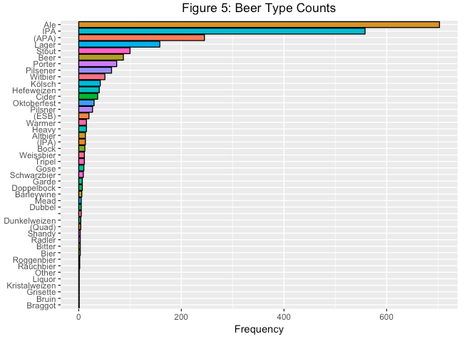
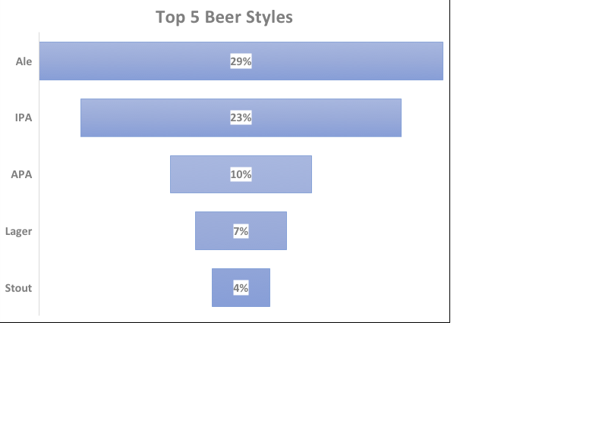
Beer Style Distribution
Over 73% of all beer styles are dominated by the top 5

Slide 10
Further Analysis Questions
What does the distribution of beer types by region tell us?
What does alcohol content and bitterness look like when overlaid over the brewery count by state graph look like? Is there a story to tell?
Is there truly a linear relationship between alcohol content and bitterness.
Hypothesis Testing possibly?

Slide 11
Youtube Video Presentation
DDS-CaseStudy1-Youtube

