Slide 1
SOFTWARE REQUIREMENTS SPECIFICATION FOR EXAM CELL AUTOMATION
GROUP No: 9
Haneen Mohammed A
Mereena Joseph
Nandana KrishnaV
Aziyaa Subair

Slide 2
CONTENTS
Problem statements
Why this website?
Stakeholders Identifications
Requirement Gathering Methodologies
Project Plan
Literature Review
Functional Requirements
Non Functional Requirements
UML Diagram
Tools used
Interfaces
Test Case
Conclusion
References

Slide 3
Problem Statement
Most of the institutions are becoming unwilling to centralize examination system day by day.
With the increasing number of students, courses and departments, it becomes almost unmanageable to allocate proper exam seats.
It is quite difficult to properly allocate the seats among a large number of students whenever the students are from different subjects.
We have to follow some pre conditions for proper allocation of exam seats.

Slide 4
Why this website?
The purpose of this website is to streamline and automate various administrative tasks and processes involved in managing the examination
The methods usually entail utilizing Excel or paper-based approaches to organize student assignments into classes.
Computerize the traditional way of conducting exams.
The automation project can help in reducing the workload of exam cell staff.
It provides swift and efficient generation of hall allotment data, requiring only a few clicks to allocate students to various classes while ensuring that students with the same exam are not seated together.
Invigilators can upload attendance data via the system's website, eliminating the need for additional faculty members to perform this task. Helps in reporting malpractice during examinations.

Slide 5
SCOPE
The software being specified is a hall allotment system designed to automate and streamline the process of allocating rooms in university halls.
The system will also provide a user-friendly interface to manage the allocation process and assign rooms based on predefined rules and regulations such that no two students having same subjects will be placed together.
The software also enables attendance updation.
Reduce the workload of the exam cell .
Provides a much more effective and efficient exam attendance management.

Slide 6
Stakeholder Identification
Students
Students are the primary stakeholders as they are the ones taking the exams. Exam automation can provide benefits such as easier registration, faster result processing, and online access to exam material.
Exam cell unit
The exam cell management team would be responsible for implementing the automation software, training staff and students, and ensuring smooth operation of the system.
Faculty
Faculty and staff are responsible for managing the exams, grading papers, and maintaining student records.

Slide 7
Requirement Gathering Methodologies
INTERVIEW
Requirements are gathered by directly interacting with exam controller of college.
The description of the process of allocation was obtained from the exam controller.
By asking the faculties of TKMCE for necessary inputs like roll list, class list and capacity of each class.
link : https://docs.google.com/document/d/1zjz0B-YiyK9Q5KMjMxl4wY8GumFfuLvIovx_9a2nZhQ/edit

Slide 8
Project Plan
DETAIL GATHERING
IDEA CREATION
GUI FRAMEWORK
HARDWARE REQUIREMENTS
SOFTWARE REQUIREMENTS
PRODUCT TESTING
DEPLOYMENT

Slide 9
DETAIL GATHERING 14-3-2023 Requirements are gathered by directly interacting with exam controller of college. Got idea regarding how exam seat allocation are conducting and the problems faced during seat allocation. GUI FRAMEWORK 23-3-2023 Logo created. UI/UX developed using tool called Figma. HARDWARE REQUIREMENTS Hardware requirements are identified. DEPLOYEMENT | IDEA CREATION 28-3-2023 Brain storming and conceptualizing different approaches to seat allocation. Conducted discussion regarding various algorithms and methods to implement the seating arrangement. SOFTWARE REQUIREMENTS Software requirements where identified. •Operating system: Microsoft windows 11 •Database management system: MongodB •Programming languages used : HTML, CSS, JavaScript, Python. PRODUCT TESTING

Slide 10
Literature Review
Sr.No | Author | Name of the paper | Description
1. | R.Chandrashekar | Automation of Hall Seating Arrangement System | This paper show off venture which offers a solution to examination seating arrangement problems by means of executing the proposed chromatic polynomial set of rules
2. | Dinesh Chandewar, Mainka Saha | Automatic Seating Arrangement of University | The paper is to lessen the significant mission of manually allocating seats at some point of an exam. The device will provide an effective measure to dynamically allocate students in a lecture room
Link : https://docs.google.com/document/d/1LVaXdv9A-MjOI1AHAo4xmciXaTcNqrPOzN2EmhLFZzM/edit

Slide 11
Functional Requirements
1. USER AUTHENTICATION
This is to allow Exam Cell and the faculty to login into the Exam Cell Automation System.
User enters username and password.
If they are valid and is admin, admin is taken to admin landing page.
Else, the user is taken to faculty landing page.

Slide 12
Landing page of admin
This page lists out the functionalities that the admin can access including add faculty, set and cancel exam, allotment , view attendance and malpractice reports.
Admin logs in the website.
Click on one among the 6 buttons available in the page.
Based on the functionality selected they will be directed to different pages.
3. Landing page of faculty
This page lists out the functionalities that the faculty can access including view allotment, update attendance and report malpractice.
Faculty logs in the website.
Click on one among the 3 buttons available in the page.
Based on the functionality selected they will be directed to different pages.

Slide 13
4. Add faculty
This page is for controlling the access to the software, which is a functionality provided to ensure security of the system.
Admin on clicking the add faculty button is directed to this page.
Admin adds the details of the faculty who can access the system.
Click the submit button.
5. Set / Cancel Exam
This page is used for setting the timetable or the exam dates based on the given branch, exam type, exam timing and semester.
Admin on clicking the set exam button is directed to this page.
Admin can add the details of the exam to be conducted
Click the submit button.
There is also a cancel exam button for canceling the exam.
Admin on clicking the cancel button in the landing page is directed to this page.

Slide 14
6. Allotment
This page is for allotting the classes for conducting examinations.
Admin on clicking the allotment button is directed to this page.
Admin can choose branch, year and choose the classes where the exam has to be conducted.
Click the submit button.
7. Attendance
This page is for viewing the attendance of students .
Admin on clicking the attendance button in the landing page is directed to this page.
Admin can choose a class and then press the submit button.

Slide 15
8. Malpractice report
This page is for checking the malpractice report from the exam halls .
Admin on clicking the Malpractice report button in the landing page is directed to this page.

Slide 16
9. View Allotment
This page is for the faculty to view the exam hall allotment.
Faculty on clicking the view allotment button in the landing page is directed to this page.
Select the class.
Press the Submit button.
10. Update Attendance
This page is for the invigilator in each class to update the attendance of students attending the exam.
Faculty on selecting the Update Attendance button in the landing page is directed to this page.
Select the class.
Update the attendance of the students present in the class.

Slide 17
11. Report malpractice
This page is for the invigilators to report any incidences of malpractice in the exam hall.
Faculty on selecting the Report Malpractice button in the landing page is directed to this page.
Select the class.
Enter the details of the student (class, branch, roll number) and any other required comments.
Press the Submit button.

Slide 18
Non Functional Requirements
Performance Requirements
The website would be functional for 24 hours a day to enable user interaction at any point of time.
Security Requirements
Authentication:
The Exam Cell is responsible for managing user access to the Exam Cell Automation system. Once admitted by the Exam Cell, faculty members are authorized to use the system.
The Exam Cell possesses the capability to retrieve and inspect the login information of faculty members, which allows them to monitor and manage access to the Exam Cell Automation system.
The Exam Cell Automation system implements a secure login process for the admin by requiring them to enter a One-Time Password (OTP) that is sent to their email address.

Slide 19
Authorization:
The Exam Cell has exclusive authority to schedule exams, assign classrooms, and view reports on attendance and instances of malpractice within the Exam Cell Automation system.
On the other hand, faculty members are not granted access to these functionalities, as they are only authorized to report malpractice incidents, update attendance records, and view classroom assignments.
Data Backup and recovery
System implements a regular backup schedule. The backup data is stored in cloud storage service , Amazon S3.

Slide 20
Maintainability
The Exam Cell Automation System employs a commercial database for persistent storage of its data, and the web application is hosted by an application server.
In the event of a system failure, the program is reinitialized to its original state, thereby allowing the system to recover from any errors that may have occurred.
The system has been designed with a modular architecture to ensure that changes to the system can be made with ease and without adversely affecting the overall performance.

Slide 21
Software Quality Attributes
Adaptability: New changes can be easily accommodated.
Availability: This website would be functional for 24*7 .
Flexibility: Provides highly flexible service to the user. The admin can select any class with the given layout and any number of batches for conducting the exams.
Portability: Not dependent on a particular OS.

Slide 22
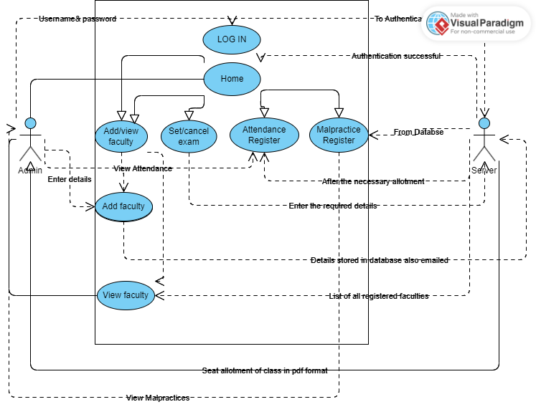
UML DIAGRAM

Slide 23
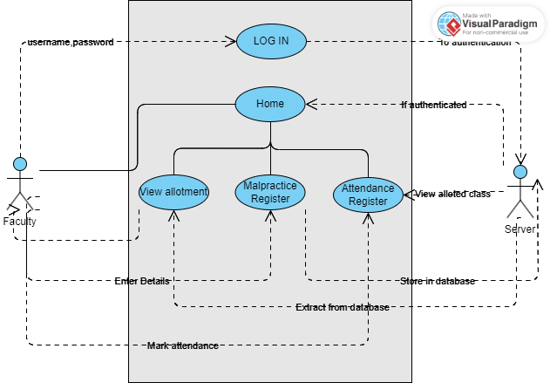

Slide 24
TOOLS USED
Windows O.S
Design : Figma
IDE: Visual Studio code, Spyder
Front End: Vue.JS
Back End: Django
Database used: MongoDB , MySql

Slide 25
INTERFACE
Login page(where password and username both are hardcoded)
Landing Page:-The user can choose between attendance and class allotment. If the user selects class allotment it takes to the allotment screen
Allotment Input Screen :- Shows a window to upload the raw csv to upload and capture roll number of each batch of that specified year.
Allotment Display :- The layout of the specific class will be displayed according to the algorithm followed.
Attendance :- Activates only after the layout process is completed.

Slide 26
TEST CASE
INPUT
Do you want to enter more batches1
Enter the batch for examCS
Do you want to enter more batches1
Enter the batch for examEC A
Do you want to enter more batches1
Enter the batch for examCH
Do you want to enter more batches1
Enter the batch for examEC B
Do you want to enter more batches0
['CS', 'EC A', 'CH', 'EC B']
Total number of students :300
Total number of classes : 7

Slide 27
OUTPUT
B19CSA01 B19ECA01 B19CSA06 B19ECA06 B19CSA11 B19ECA11 B19CSA16 B19ECA16 B19CSA21
B19CSA02 B19ECA02 B19CSA07 B19ECA07 B19CSA12 B19ECA12 B19CSA17 B19ECA17 B19CSA22
B19CSA03 B19ECA03 B19CSA08 B19ECA08 B19CSA13 B19ECA13 B19CSA18 B19ECA18 B19CSA23
B19CSA04 B19ECA04 B19CSA09 B19ECA09 B19CSA14 B19ECA14 B19CSA19 B19ECA19 B19CSA24
B19CSA05 B19ECA05 B19CSA10 B19ECA10 B19CSA15 B19ECA15 B19CSA20 B19ECA20 B19CSA25

Slide 28
B19ECA21 B19CSA26 B19ECA26 B19CSA31 B19ECA31 B19CSA36 B19ECA36 B19CSA41 B19ECA41
B19ECA22 B19CSA27 B19ECA27 B19CSA32 B19ECA32 B19CSA37 B19ECA37 B19CSA42 B19ECA42
B19ECA23 B19CSA28 B19ECA28 B19CSA33 B19ECA33 B19CSA38 B19ECA38 B19CSA43 B19ECA43
B19ECA24 B19CSA29 B19ECA29 B19CSA34 B19ECA34 B19CSA39 B19ECA39 B19CSA44 B19ECA44
B19ECA25 B19CSA30 B19ECA30 B19CSA35 B19ECA35 B19CSA40 B19ECA40 B19CSA45 B19ECA45

Slide 29
Conclusion
As compared to existing system our system take very less time to execute all the data and allocate seats to students.
This system is able to reduce a lot of burden to the people in examination department.
All types of exam can be conducted under this system so that there is no specific limit of students.

Slide 30
References
Prof. S. S. Aravinth 1, G. Pavithra 2, M. Myvizhimalar3, D. Divya4, M. Rathinakrithika, "Test Hall and every single Seating Arrangement System Using PHP", International Journal of Computer Applications (0975 – 8887) Volume 149 – No.9, September 2016
Muhammad Ramees C. K 1 , Sherin Eliyas2," Efficient Seat Each and every singleocation Process in College Exam System" ,International Journal for Research in Applied Science and Engineering Technology (IJRASET) ISSN: 2321-9653; IC Value: 45.98; SJ Impact Factor: 6.887 Volume 6 Issue V, May 2018.
"Seating course of action Tools for assessments", Author-Ashti Fatima Alam

Slide 31


