Slide 1
Scrum
By Merel Volgers – January 2021

Slide 2
Introduction to scrum
What is Scrum?
Scrum <> Waterfall
Scrum works following “sprints” which last 1 to 3 weeks. Each sprint follows the same working process:
PLAN > BUILD > TEST > REVIEW (SPRINT)

Slide 3
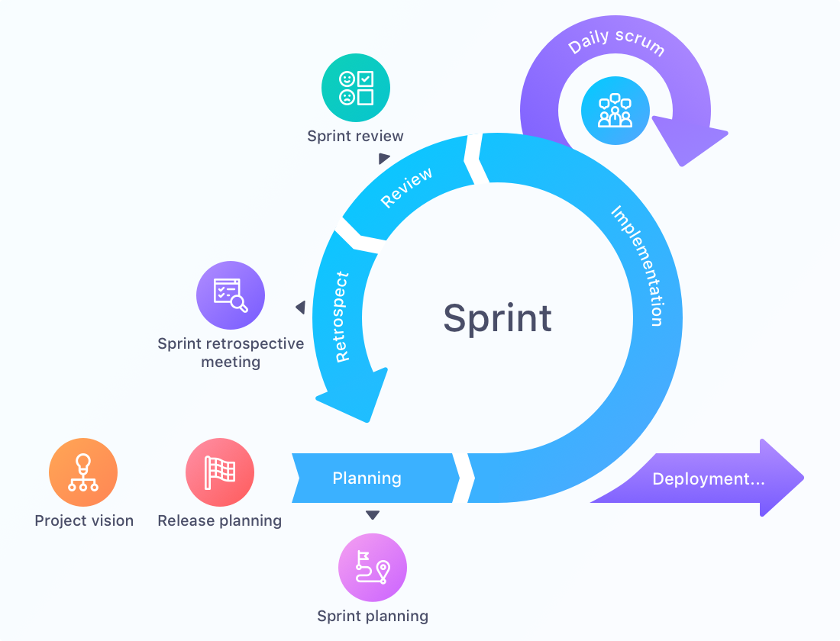

Slide 4
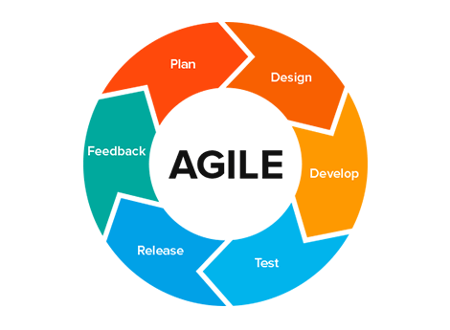
INTRODUCTION TO SCRUM
Scrum en Agile werken
Working with the team “as a whole” : self-organizing, cross-functional team
Scrum en development
> Software development usually manages projects using the Scrum framework

Slide 5
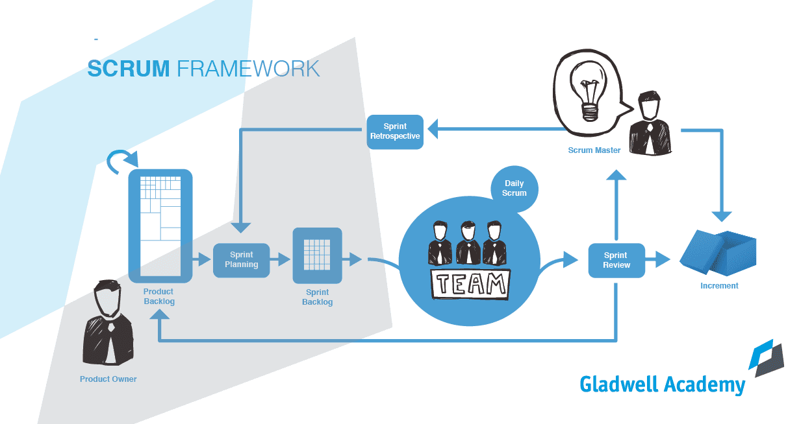

Slide 6
Scrum roles
Role | Tasks
Product Owner (Manager/ customers/ users) | Guide the team towards the right product. Defines features, comes with ideas
Scrum Master | Coach for the team who arranges meetings and keeps track of the process
Team (developers, testers, writers) | Create the product

Slide 7
Scrum events
What is a retrospective?
What is a refinement?
What is a standup?

Slide 8
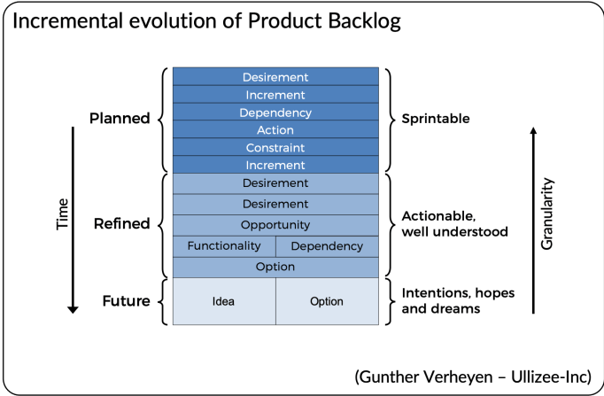
Scrum artifacts
What is a product backlog?

Slide 9
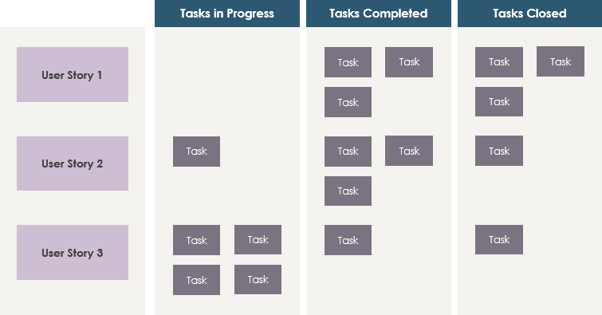
Scrum artifacts
What is a sprint backlog?

Slide 10
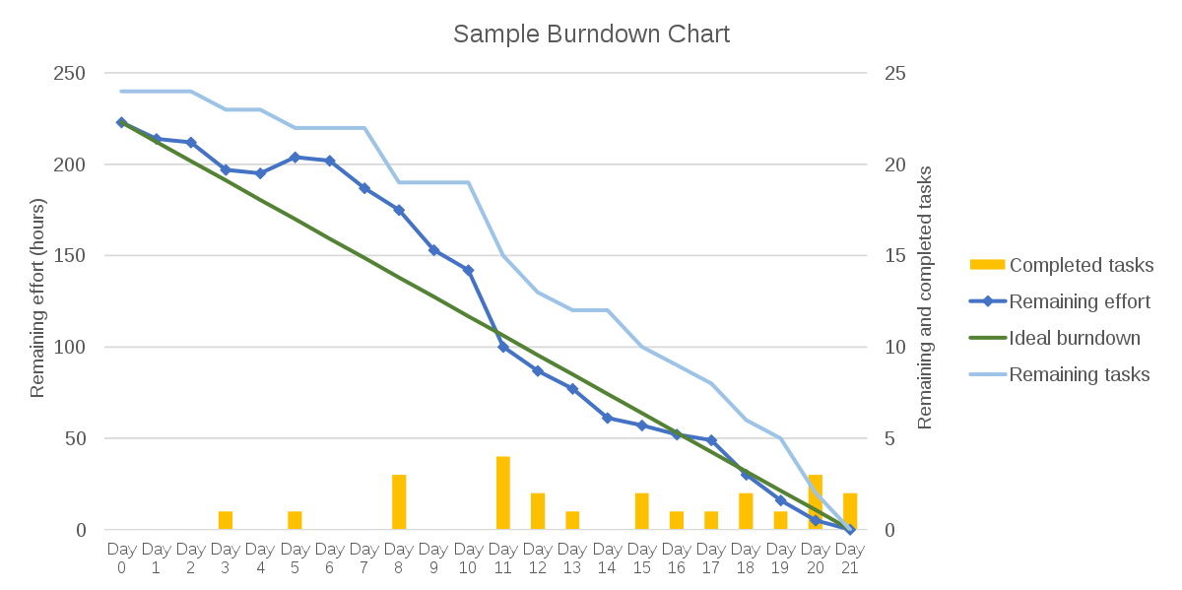
Scrum artifacts
What is a burndown chart?

