Slide 1
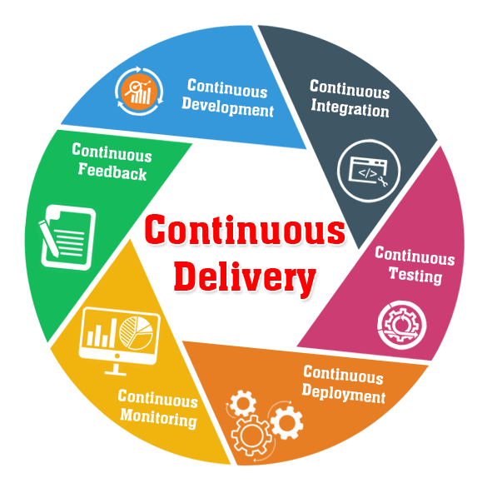
CI/CD Fundamentals and Benefits Ghasem Elyasi

Slide 2

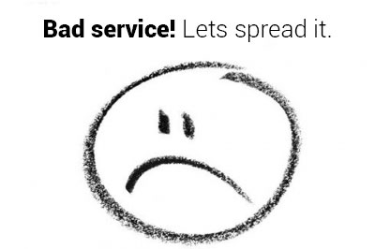
Traditional Approach
Deploy software in annual, quarterly, or monthly
Long time to market
Long Preparation time before release
Low quality, more bugs, etc: Customer is not satisfied despite all efforts!
Unhappy customers talk, they talk some more!

Slide 3

Traditional Approach (continue)
Long downtimes: this is a huge cost for company since service is down, customer is not happy and there is also a big chance to rollback!
Humans as the main part of every actions, human errors are inevitable
More employees, more efforts, more cost, less outcome!

Slide 4


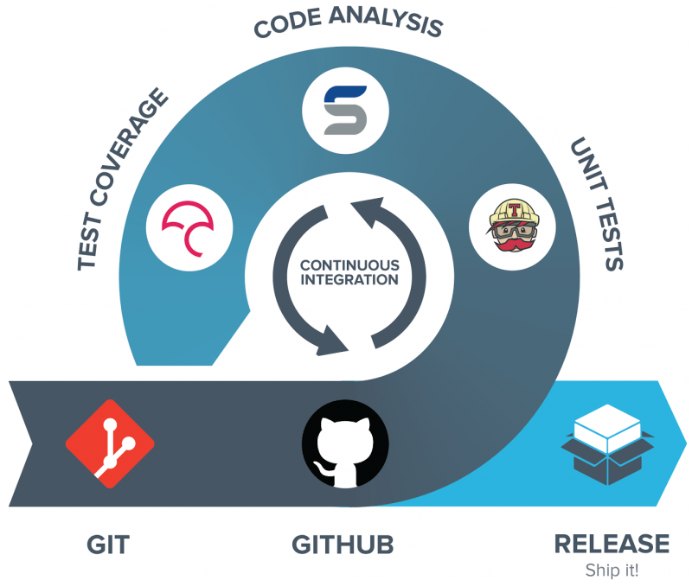
CI/CD Fundamentals
Possibility to deploy a new version on every single ticket
Automate as much as possible
Involve human as less as possible

Slide 5

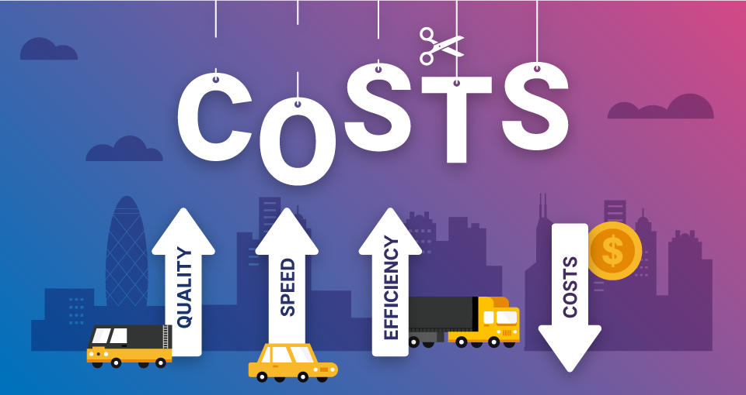
CI/CD Benefits
Several deployment during a day!
Much faster time to market
Almost no need for preparation to deploy
Much Less people are needed in the process after code implementation
High quality code, less bugs!
Automated processes without human errors
Reliable Releases
Stress reduction for everyone in company!
Happy Customers with much less cost!
(who don’t want that…)

