Slide 1


Object Oriented Programming and Design WEEK 6 – Abstraction,Interface,Exception Handling

Slide 2
Revision Topic
Class and Object
Constructor
Encapsulation
Inheritance
Polymorphism

Slide 3
LET’S GET STARTED WITH Tutorial 6

Slide 4
Will Be Dealing With
•Abstraction
•Abstract
•Abstract Class
•Abstract Method
•Interface
•Multiple Inheritance

Slide 5
Inheritance Revision
What is inheritance?

Slide 6
Inheritance
Process where one class acquires the properties (methods and fields) of another.
Why to do? Reuse of code.

Slide 7
Abstraction,Interface,Exception Handling

Slide 8
Abstraction

Slide 9
Key Terminologies
1. Abstraction
1.1 Abstraction
1.2 Abstract Class
1.3 Abstract Method
2. Interface
2.1 Multiple Inheritance
3.Exception Handling
3.1Types of Exception
3.1.1 Checked Exception
3.1.2 Unchecked
Exception
3.2 Exception Hierarchy
3.3 Catching exception
3.4 Finally
3.5 Throw
3.6 Throws
•Abstraction
•Abstract Class
•Abstract Method
•Multiple Inheritance
•Interface

Slide 10
Abstraction
1. Abstraction
1.1 Abstraction
1.2 Abstract Class
1.3 Abstract Method
2. Interface
2.1 Multiple Inheritance
3.Exception Handling
3.1Types of Exception
3.1.1 Checked Exception
3.1.2 Unchecked
Exception
3.2 Exception Hierarchy
3.3 Catching exception
3.4 Finally
3.5 Throw
3.6 Throws
Abstraction is a process of hiding the implementation details and showing only functionality to the user.
It keeps all the unnecessary information hidden from the users.

Slide 11
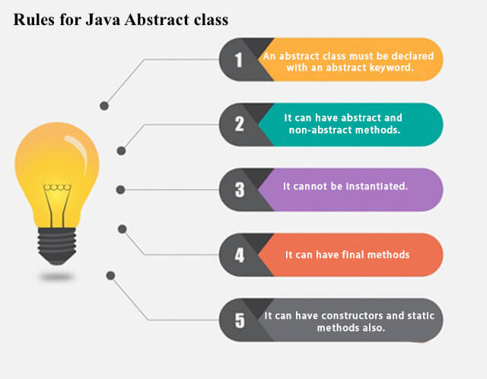
Abstract Class and Method
1. Abstraction
1.1 Abstraction
1.2 Abstract Class
1.3 Abstract Method
2. Interface
2.1 Multiple Inheritance
3.Exception Handling
3.1Types of Exception
3.1.1 Checked Exception
3.1.2 Unchecked
Exception
3.2 Exception Hierarchy
3.3 Catching exception
3.4 Finally
3.5 Throw
3.6 Throws

Slide 12
Example
1. Abstraction
1.1 Abstraction
1.2 Abstract Class
1.3 Abstract Method
2. Interface
2.1 Multiple Inheritance
3.Exception Handling
3.1Types of Exception
3.1.1 Checked Exception
3.1.2 Unchecked
Exception
3.2 Exception Hierarchy
3.3 Catching exception
3.4 Finally
3.5 Throw
3.6 Throws
package week6;
//Example of an abstract class that has abstract and non-abstract methods
abstract class Bike {
Bike() {System.out.println("Bike constructor is created");}//constructor
abstract void run();//abstract method
void changeGear() {//non abstract method
System.out.println("gear changed");
}
}
//Creating a Child class which inherits Abstract class
class Honda extends Bike {
void run() {
System.out.println("running safely..");
}}

Slide 13
Example
1. Abstraction
1.1 Abstraction
1.2 Abstract Class
1.3 Abstract Method
2. Interface
2.1 Multiple Inheritance
3.Exception Handling
3.1Types of Exception
3.1.1 Checked Exception
3.1.2 Unchecked
Exception
3.2 Exception Hierarchy
3.3 Catching exception
3.4 Finally
3.5 Throw
3.6 Throws
//Creating a Test class which calls abstract and non-abstract methods
class TestAbstraction{
public static void main(String args[]) {
Bike obj = new Honda();
obj.run();
obj.changeGear();
}
}
Output:
Bike constructor is created
running safely..
gear changed

Slide 14
Questions
1.Create an abstract class 'Bank' with a method 'deposit'. It has two subclasses each having a method with the same name 'deposit' that prints "This is first subclass" and "This is second subclass" respectively. Call the methods 'message' by creating an object for each subclass.
2.Create an abstract class 'Bank' with an abstract method 'getBalance'. $100, $150 and $200 are deposited in banks A, B and C respectively. 'BankA', 'BankB' and 'BankC' are subclasses of class 'Bank', each having a method named 'getBalance'. Call this method by creating an object of each of the three classes.

Slide 15
2. Interface

Slide 16
Interface
1. Abstraction
1.1 Abstraction
1.2 Abstract Class
1.3 Abstract Method
2. Interface
2.1 Multiple Inheritance
3.Exception Handling
3.1Types of Exception
3.1.1 Checked Exception
3.1.2 Unchecked
Exception
3.2 Exception Hierarchy
3.3 Catching exception
3.4 Finally
3.5 Throw
3.6 Throws
•Is used to specify what a class does but not how to do it.
•Interface is a special class which is fully abstracted.
•Interface can be used to achieve the multiple inheritance in java.
•One interface can extends one or more interfaces.

Slide 17
Interface
1. Abstraction
1.1 Abstraction
1.2 Abstract Class
1.3 Abstract Method
2. Interface
2.1 Multiple Inheritance
3.Exception Handling
3.1Types of Exception
3.1.1 Checked Exception
3.1.2 Unchecked
Exception
3.2 Exception Hierarchy
3.3 Catching exception
3.4 Finally
3.5 Throw
3.6 Throws
•One class can implements one or more interfaces.
•Interface don’t have the constructor.

Slide 18
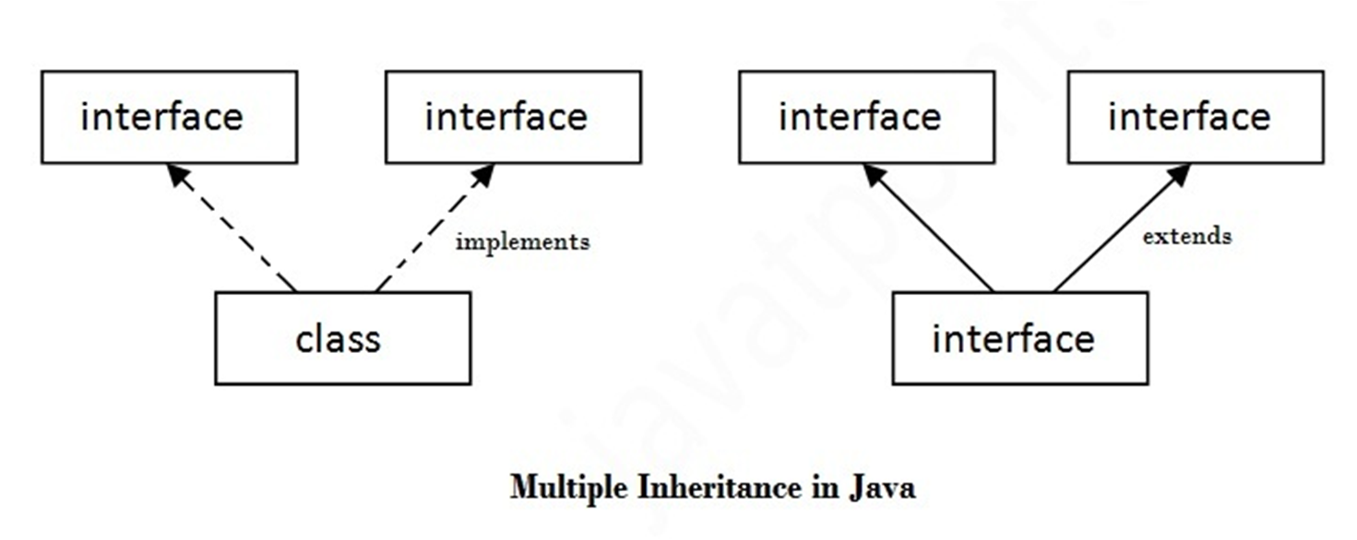
Multiple Inheritance in java by interface
1. Abstraction
1.1 Abstraction
1.2 Abstract Class
1.3 Abstract Method
2. Interface
2.1 Multiple Inheritance
3.Exception Handling
3.1Types of Exception
3.1.1 Checked Exception
3.1.2 Unchecked
Exception
3.2 Exception Hierarchy
3.3 Catching exception
3.4 Finally
3.5 Throw
3.6 Throws

Slide 19
Inheritance can contain following members
1. Abstraction
1.1 Abstraction
1.2 Abstract Class
1.3 Abstract Method
2. Interface
2.1 Multiple Inheritance
3.Exception Handling
3.1Types of Exception
3.1.1 Checked Exception
3.1.2 Unchecked
Exception
3.2 Exception Hierarchy
3.3 Catching exception
3.4 Finally
3.5 Throw
3.6 Throws
Methods declared in interface are by-default, public and abstract, so it is unnecessary to use these modifiers for variables.

Slide 20
Multiple Inheritance in java by interface
1. Abstraction
1.1 Abstraction
1.2 Abstract Class
1.3 Abstract Method
2. Interface
2.1 Multiple Inheritance
3.Exception Handling
3.1Types of Exception
3.1.1 Checked Exception
3.1.2 Unchecked
Exception
3.2 Exception Hierarchy
3.3 Catching exception
3.4 Finally
3.5 Throw
3.6 Throws
package week6;
interface Scooter {
void mileage();
}
interface Brand{
void model();
}
class RayZr implements Scooter,Brand{
@Override
public void mileage(){
System.out.println("Max mileage of 55km/hr");
}
@Override
public void model() {
System.out.println("Modeled by yamaha");
}
}

Slide 21
Multiple Inheritance in java by interface
1. Abstraction
1.1 Abstraction
1.2 Abstract Class
1.3 Abstract Method
2. Interface
2.1 Multiple Inheritance
3.Exception Handling
3.1Types of Exception
3.1.1 Checked Exception
3.1.2 Unchecked
Exception
3.2 Exception Hierarchy
3.3 Catching exception
3.4 Finally
3.5 Throw
3.6 Throws
public class MultipleInheritance {
public static void main(String[] args) {
RayZr zr = new RayZr();
zr.mileage();
zr.model();
}
}
Output:
Max mileage of 55km/hr
Modeled by yamaha

Slide 22
Questions
1.Create an interface 'Bank' with a method 'deposit' and ‘withdraw’. It has subclass ‘Nepal Bank’ that implements the interface ‘Bank’.
2.Create an interface 'Bank' with a method 'deposit' and ‘withdraw’. Create another interface ‘Nepal Bank’ that extends the interface ‘Bank’.

Slide 23
3. Exception Handling

Slide 24
Overview
1. Abstraction
1.1 Abstraction
1.2 Abstract Class
1.3 Abstract Method
2. Interface
2.1 Multiple Inheritance
3.Exception Handling
3.1Types of Exception
3.1.1 Checked Exception
3.1.2 Unchecked
Exception
3.2 Exception Hierarchy
3.3 Catching exception
3.4 Finally
3.5 Throw
3.6 Throws
Introduction of Exception
try and catch blocks
finally block
types of Exception
throw and throws keyword

Slide 25
1. Abstraction
1.1 Abstraction
1.2 Abstract Class
1.3 Abstract Method
2. Interface
2.1 Multiple Inheritance
3.Exception Handling
3.1Types of Exception
3.1.1 Checked Exception
3.1.2 Unchecked
Exception
3.2 Exception Hierarchy
3.3 Catching exception
3.4 Finally
3.5 Throw
3.6 Throws
Exception
What do you mean by word exception. Any ideas? And What does it refers in Java?

Slide 26
Introduction
1. Abstraction
1.1 Abstraction
1.2 Abstract Class
1.3 Abstract Method
2. Interface
2.1 Multiple Inheritance
3.Exception Handling
3.1Types of Exception
3.1.1 Checked Exception
3.1.2 Unchecked
Exception
3.2 Exception Hierarchy
3.3 Catching exception
3.4 Finally
3.5 Throw
3.6 Throws
•An exception (or exceptional event) is a problem that arises during the execution of a program.
•When an exception occurs the normal flow of the program is disrupted and the program/Application terminates abnormally.Hence these exception must be handled.

Slide 27
Introduction
1. Abstraction
1.1 Abstraction
1.2 Abstract Class
1.3 Abstract Method
2. Interface
2.1 Multiple Inheritance
3.Exception Handling
3.1Types of Exception
3.1.1 Checked Exception
3.1.2 Unchecked
Exception
3.2 Exception Hierarchy
3.3 Catching exception
3.4 Finally
3.5 Throw
3.6 Throws
package exception;
public class NewExcep {
public static void main(String[] args) {
int x=10;
int y=0;
System.out.println(x/y);
System.out.println("Hello Java");
}
}
Output:
Exception in thread "main" java.lang.ArithmeticException: / by zero
at oodp/exception.NewExcep.main(NewExcep.java:7)

Slide 28
Error vs Exception
1. Abstraction
1.1 Abstraction
1.2 Abstract Class
1.3 Abstract Method
2. Interface
2.1 Multiple Inheritance
3.Exception Handling
3.1Types of Exception
3.1.1 Checked Exception
3.1.2 Unchecked
Exception
3.2 Exception Hierarchy
3.3 Catching exception
3.4 Finally
3.5 Throw
3.6 Throws
Error: An Error indicates serious problem that a reasonable application should not try to catch.
Exception: Exception indicates conditions that a reasonable application might try to catch.

Slide 29
Types of Exception
1. Abstraction
1.1 Abstraction
1.2 Abstract Class
1.3 Abstract Method
2. Interface
2.1 Multiple Inheritance
3.Exception Handling
3.1Types of Exception
3.1.1 Checked Exception
3.1.2 Unchecked
Exception
3.2 Exception Hierarchy
3.3 Catching exception
3.4 Finally
3.5 Throw
3.6 Throws
Depending on whether the compiler is verifying the exception at compile time or not, Exceptions are divided into two types.
1. Checked exceptions
2. Unchecked exceptions

Slide 30
Exception
1. Abstraction
1.1 Abstraction
1.2 Abstract Class
1.3 Abstract Method
2. Interface
2.1 Multiple Inheritance
3.Exception Handling
3.1Types of Exception
3.1.1 Checked Exception
3.1.2 Unchecked
Exception
3.2 Exception Hierarchy
3.3 Catching exception
3.4 Finally
3.5 Throw
3.6 Throws
package week6;
public class CheckedExcep {
public static void main(String[] args) {
int x=20;
int y=0;
int z=x/y;
System.out.println(z);
}
}
Output:
Exception in thread "main" java.lang.ArithmeticException: / by zero
at oodp/week6.CheckedExcep.main(CheckedExcep.java:7)

Slide 31
Exception
1. Abstraction
1.1 Abstraction
1.2 Abstract Class
1.3 Abstract Method
2. Interface
2.1 Multiple Inheritance
3.Exception Handling
3.1Types of Exception
3.1.1 Checked Exception
3.1.2 Unchecked
Exception
3.2 Exception Hierarchy
3.3 Catching exception
3.4 Finally
3.5 Throw
3.6 Throws
package week6;
public class NullExcep {
public static void main(String[] args) {
String s=null;
System.out.println(s.length());//NullPointerException
}
}
Output:
Exception in thread "main" java.lang.NullPointerException: / Cannot invoke String.
at oodp/week6.NullExcep.main(NullExcep.java:6)

Slide 32
Exception
1. Abstraction
1.1 Abstraction
1.2 Abstract Class
1.3 Abstract Method
2. Interface
2.1 Multiple Inheritance
3.Exception Handling
3.1Types of Exception
3.1.1 Checked Exception
3.1.2 Unchecked
Exception
3.2 Exception Hierarchy
3.3 Catching exception
3.4 Finally
3.5 Throw
3.6 Throws
package week6;
public class ArrayOut {
public static void main(String[] args) {
int a[]=new int[5];
a[10]=50; //ArrayIndexOutOfBoundsException
}
}
Output:
Exception in thread "main" java.lang.ArrayIndexOutOfBoundsException: Index 10 out of bounds for length 5
at oodp/week6.ArrayOut.main(ArrayOut.java:6)

Slide 33
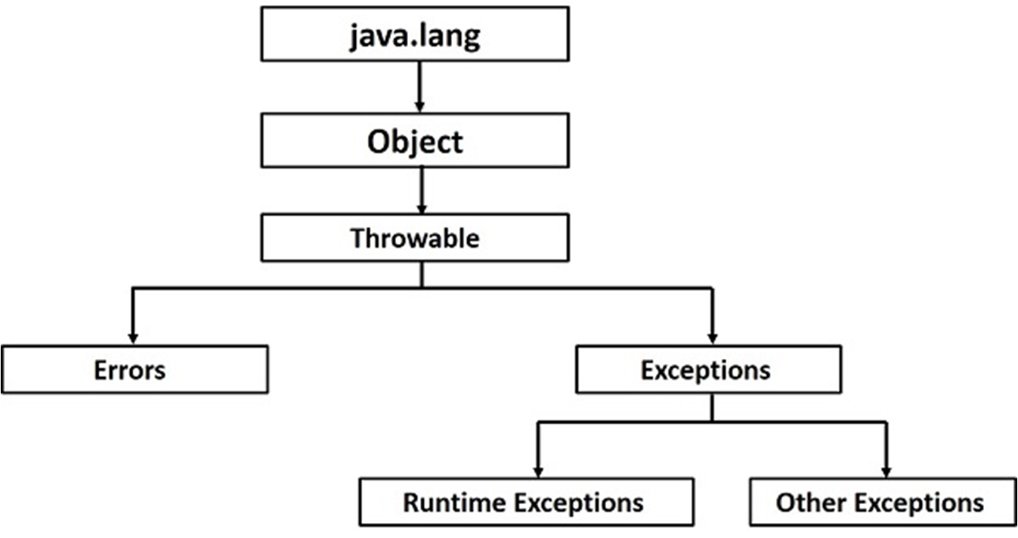
1. Abstraction
1.1 Abstraction
1.2 Abstract Class
1.3 Abstract Method
2. Interface
2.1 Multiple Inheritance
3.Exception Handling
3.1Types of Exception
3.1.1 Checked Exception
3.1.2 Unchecked
Exception
3.2 Exception Hierarchy
3.3 Catching exception
3.4 Finally
3.5 Throw
3.6 Throws
Exception Hierarchy

Slide 34
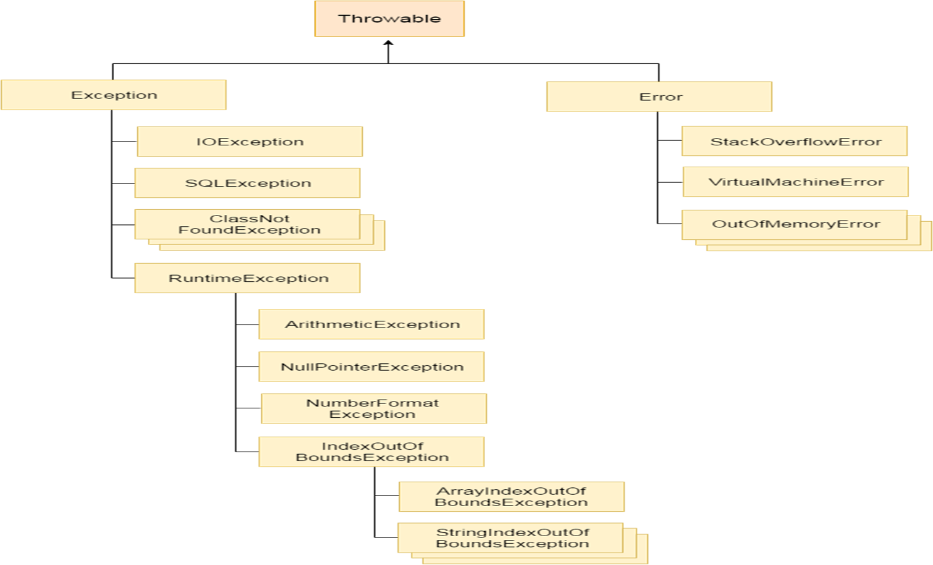
1. Abstraction
1.1 Abstraction
1.2 Abstract Class
1.3 Abstract Method
2. Interface
2.1 Multiple Inheritance
3.Exception Handling
3.1Types of Exception
3.1.1 Checked Exception
3.1.2 Unchecked
Exception
3.2 Exception Hierarchy
3.3 Catching exception
3.4 Finally
3.5 Throw
3.6 Throws
Exception Hierarchy

Slide 35
1. Abstraction
1.1 Abstraction
1.2 Abstract Class
1.3 Abstract Method
2. Interface
2.1 Multiple Inheritance
3.Exception Handling
3.1Types of Exception
3.1.1 Checked Exception
3.1.2 Unchecked
Exception
3.2 Exception Hierarchy
3.3 Catching exception
3.4 Finally
3.5 Throw
3.6 Throws
Catching Exception
A method catches an exception using a combination of the try and catch keywords.
Syntax:
try {
// Protected code
} catch (ExceptionType1 e1) {
// Catch block
}

Slide 36
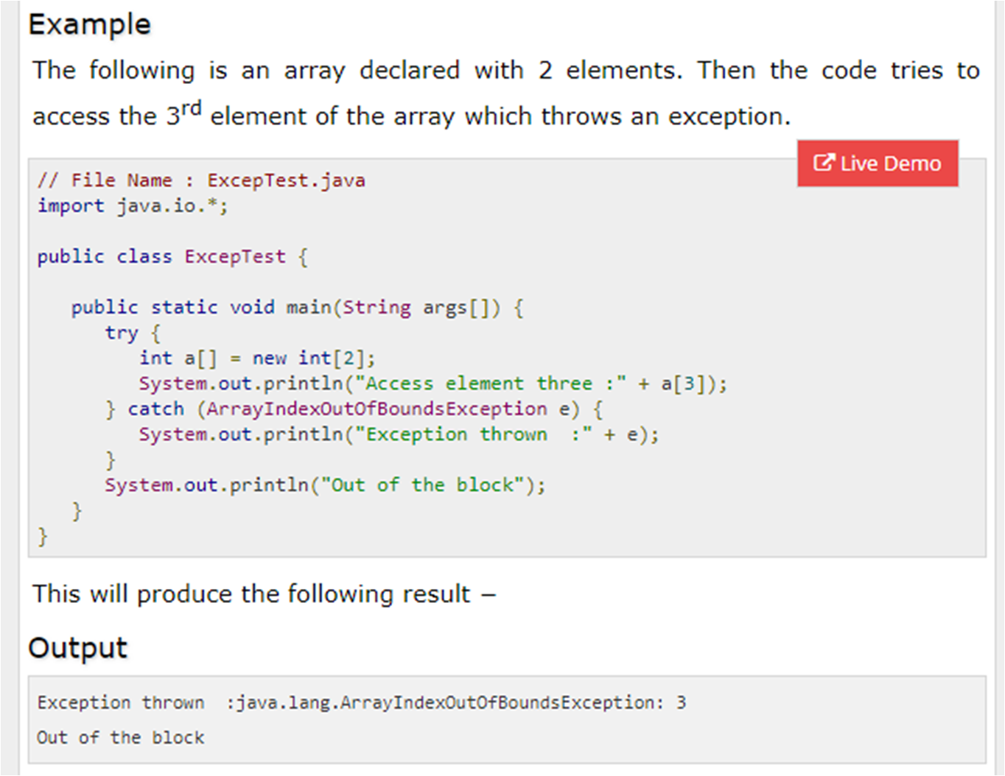
1. Abstraction
1.1 Abstraction
1.2 Abstract Class
1.3 Abstract Method
2. Interface
2.1 Multiple Inheritance
3.Exception Handling
3.1Types of Exception
3.1.1 Checked Exception
3.1.2 Unchecked
Exception
3.2 Exception Hierarchy
3.3 Catching Exception
3.4 Finally
3.5 Throw
3.6 Throws

Slide 37
1. Abstraction
1.1 Abstraction
1.2 Abstract Class
1.3 Abstract Method
2. Interface
2.1 Multiple Inheritance
3.Exception Handling
3.1Types of Exception
3.1.1 Checked Exception
3.1.2 Unchecked
Exception
3.2 Exception Hierarchy
3.3 Catching Exception
3.4 Finally
3.5 Throw
3.6 Throws
Multi Catch Blocks
A try block can be followed by multiple catch blocks. The syntax for multiple catch blocks looks like the following
Syntax:
try {
// Protected code
} catch (ExceptionType1 e1) {
// Catch block
} catch (ExceptionType2 e2) {
// Catch block
} catch (ExceptionType3 e3) {
// Catch block
}

Slide 38
1. Abstraction
1.1 Abstraction
1.2 Abstract Class
1.3 Abstract Method
2. Interface
2.1 Multiple Inheritance
3.Exception Handling
3.1Types of Exception
3.1.1 Checked Exception
3.1.2 Unchecked
Exception
3.2 Exception Hierarchy
3.3 Catching Exception
3.4 Finally
3.5 Throw
3.6 Throws
Multi Catch Blocks
Rule 1: At a time only one Exception is occured and at a time only one catch block is executed.
Rule 2: All catch blocks must be ordered from most specific to most general i.e. catch for ArithmeticException must come before catch for Exception

Slide 39
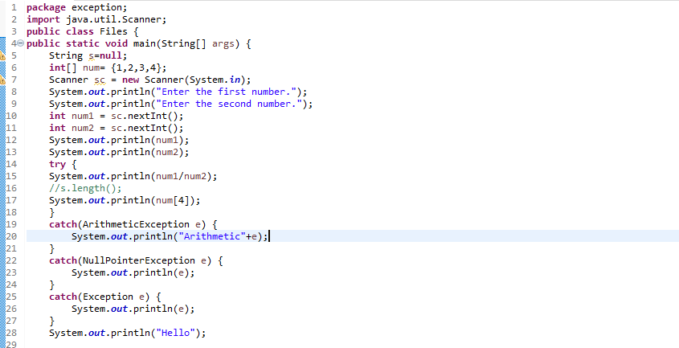
1. Abstraction
1.1 Abstraction
1.2 Abstract Class
1.3 Abstract Method
2. Interface
2.1 Multiple Inheritance
3.Exception Handling
3.1Types of Exception
3.1.1 Checked Exception
3.1.2 Unchecked
Exception
3.2 Exception Hierarchy
3.3 Catching Exception
3.4 Finally
3.5 Throw
3.6 Throws
Multi Catch Blocks

Slide 40
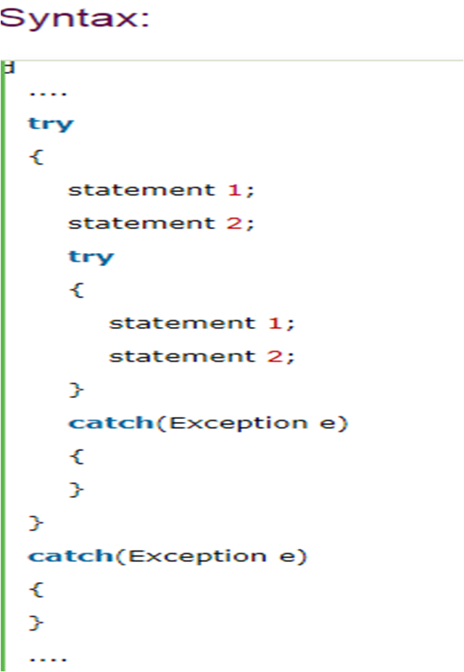
1. Abstraction
1.1 Abstraction
1.2 Abstract Class
1.3 Abstract Method
2. Interface
2.1 Multiple Inheritance
3.Exception Handling
3.1Types of Exception
3.1.1 Checked Exception
3.1.2 Unchecked
Exception
3.2 Exception Hierarchy
3.3 Catching Exception
3.4 Finally
3.5 Throw
3.6 Throws
Nested Try Block

Slide 41
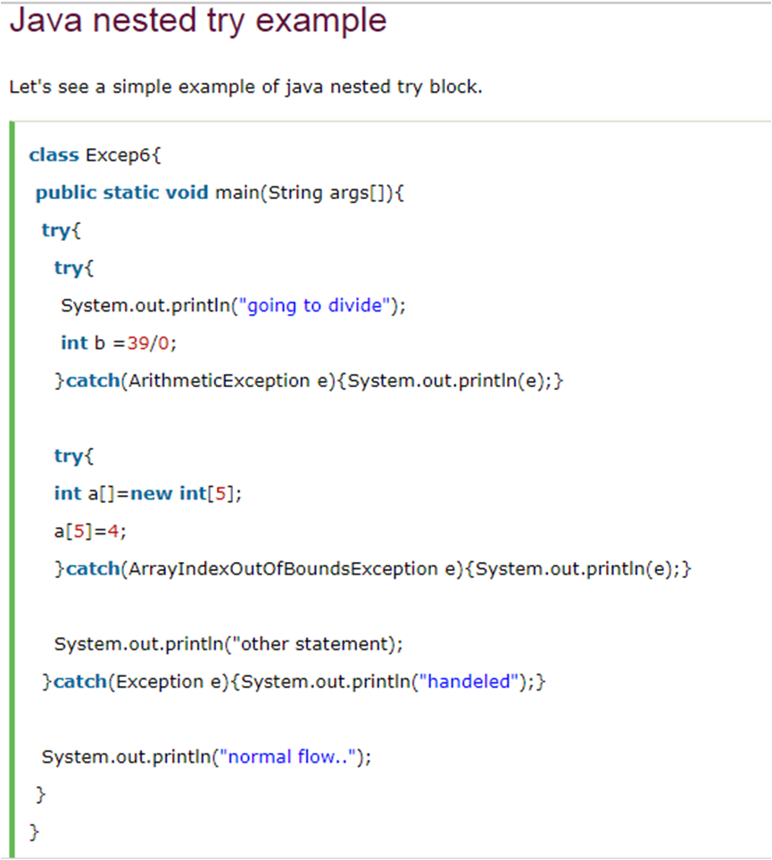
1. Abstraction
1.1 Abstraction
1.2 Abstract Class
1.3 Abstract Method
2. Interface
2.1 Multiple Inheritance
3.Exception Handling
3.1Types of Exception
3.1.1 Checked Exception
3.1.2 Unchecked
Exception
3.2 Exception Hierarchy
3.3 Catching Exception
3.4 Finally
3.5 Throw
3.6 Throws

Slide 42
1. Abstraction
1.1 Abstraction
1.2 Abstract Class
1.3 Abstract Method
2. Interface
2.1 Multiple Inheritance
3.Exception Handling
3.1Types of Exception
3.1.1 Checked Exception
3.1.2 Unchecked
Exception
3.2 Exception Hierarchy
3.3 Catching Exception
3.4 Finally
3.5 Throw
3.6 Throws
Finally Block
Java finally block is a block that is used to execute important code such as closing connection, stream etc.
Java finally block is always executed whether exception is handled or not.
Java finally block follows try or catch block.

Slide 43
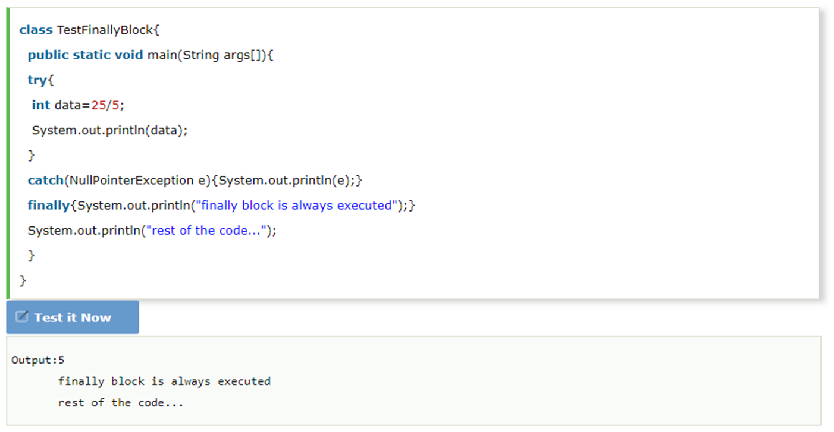
1. Abstraction
1.1 Abstraction
1.2 Abstract Class
1.3 Abstract Method
2. Interface
2.1 Multiple Inheritance
3.Exception Handling
3.1Types of Exception
3.1.1 Checked Exception
3.1.2 Unchecked
Exception
3.2 Exception Hierarchy
3.3 Catching Exception
3.4 Finally
3.5 Throw
3.6 Throws
Finally Block

Slide 44
1. Abstraction
1.1 Abstraction
1.2 Abstract Class
1.3 Abstract Method
2. Interface
2.1 Multiple Inheritance
3.Exception Handling
3.1Types of Exception
3.1.1 Checked Exception
3.1.2 Unchecked
Exception
3.2 Exception Hierarchy
3.3 Catching Exception
3.4 Finally
3.5 Throw
3.6 Throws
Throw Keyword
•The Java throw keyword is used to explicitly throw an exception.
•We can throw either checked or unchecked exception in java by throw keyword. (Only one exception)
•The throw keyword is mainly used to throw custom exception. We will see custom exceptions later.

Slide 45
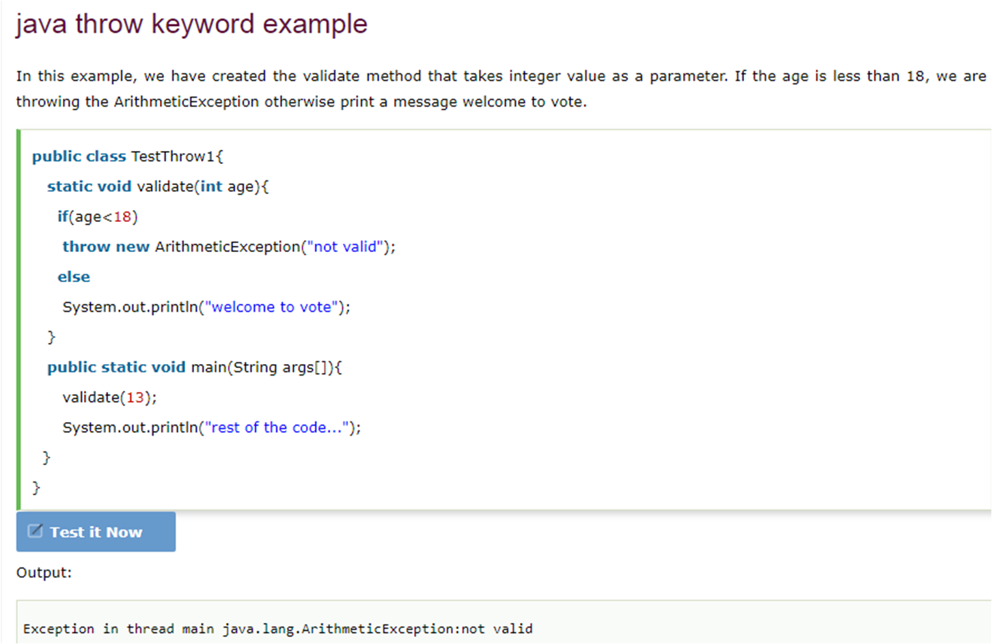
1. Abstraction
1.1 Abstraction
1.2 Abstract Class
1.3 Abstract Method
2. Interface
2.1 Multiple Inheritance
3.Exception Handling
3.1Types of Exception
3.1.1 Checked Exception
3.1.2 Unchecked
Exception
3.2 Exception Hierarchy
3.3 Catching Exception
3.4 Finally
3.5 Throw
3.6 Throws

Slide 46
1. Abstraction
1.1 Abstraction
1.2 Abstract Class
1.3 Abstract Method
2. Interface
2.1 Multiple Inheritance
3.Exception Handling
3.1Types of Exception
3.1.1 Checked Exception
3.1.2 Unchecked
Exception
3.2 Exception Hierarchy
3.3 Catching Exception
3.4 Finally
3.5 Throw
3.6 Throws
Throws Keyword
•The Java throws keyword is used to declare an exception.
•It gives an information to the programmer that there may occur an exception so it is better for the programmer to provide the exception handling code so that normal flow can be maintained.

Slide 47
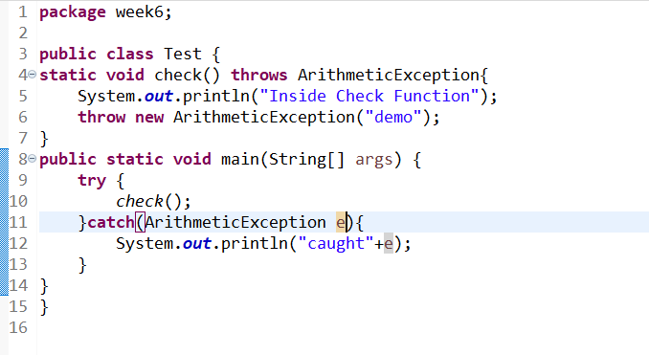
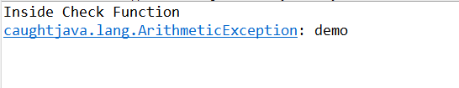
1. Abstraction
1.1 Abstraction
1.2 Abstract Class
1.3 Abstract Method
2. Interface
2.1 Multiple Inheritance
3.Exception Handling
3.1Types of Exception
3.1.1 Checked Exception
3.1.2 Unchecked
Exception
3.2 Exception Hierarchy
3.3 Catching Exception
3.4 Finally
3.5 Throw
3.6 Throws
Throws Keyword
Output

Slide 48
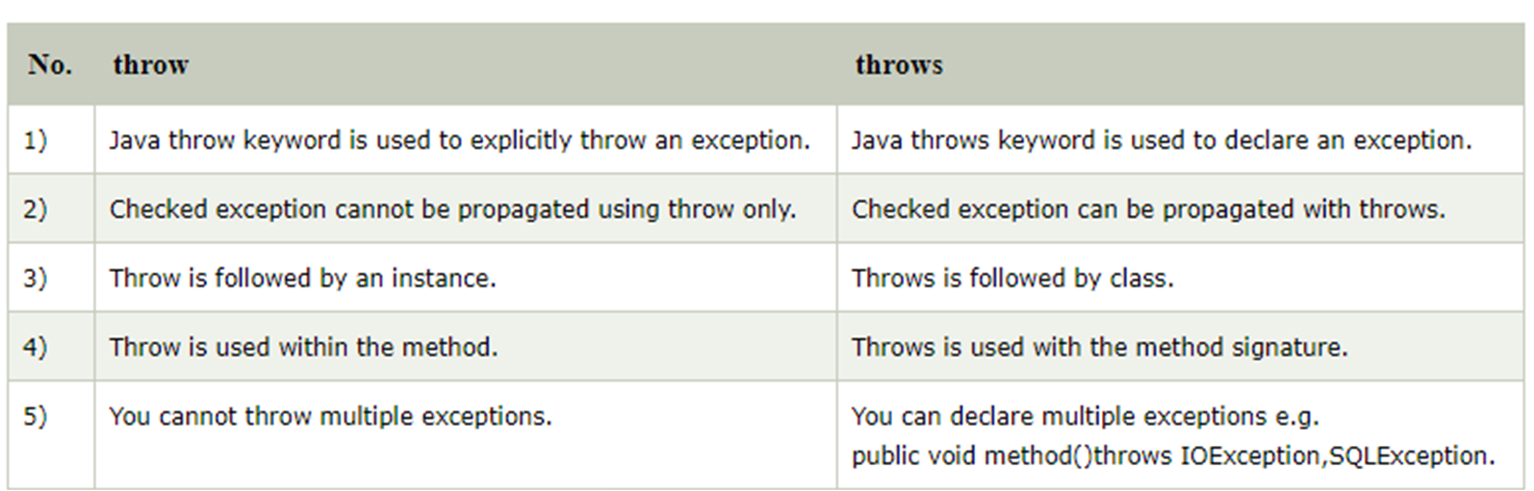
1. Abstraction
1.1 Abstraction
1.2 Abstract Class
1.3 Abstract Method
2. Interface
2.1 Multiple Inheritance
3.Exception Handling
3.1Types of Exception
3.1.1 Checked Exception
3.1.2 Unchecked
Exception
3.2 Exception Hierarchy
3.3 Catching Exception
3.4 Finally
3.5 Throw
3.6 Throws
Difference between throw and throws

Slide 49


