Slide 1
AI vs. Human Grading:
What Students at Kepler College Really Think
BUS82406 · Statistics & Probability for Business · Trimester II · 2025–2026
Instructor: Vedaste Nyandwi
Notes:
1

Slide 2



RESEARCH PROBLEM
Kepler Is Considering AI Grading — But Do Students Trust it?
Context
Hypotheses
Fairness in grading shapes student confidence, motivation, and trust in the institution. This study asked 116 Year 2 students cohort 2025 at Kepler college to rate the fairness of human grading and AI grading on a 1–10 scale.
Paired t-test
H₀: Mean fairness scores are equal (human = AI)
H₁: There is a significant difference in fairness scores
Chi-square test
H₀: Preferred grading system is independent of academic program
H₁: Preferred grading system is associated with academic program
Research Objective
To determine whether at Kepler College rate human grading as significantly fairer than AI grading, and whether preferred grading system is associated with academic program.
Significance level: α = 0.05
Notes:
2

Slide 3
METHODOLOGY
How We Designed the Study
Data Collection
Sample
Primary research via Google Forms survey. Distributed to students at Kepler College. Approval was requested from research@keplercollege.ac.rw.
116 valid responses after data cleaning. 74 Business Analytics students, 41 Project Management students. All respondents are Kepler students.
Key Variables
Statistical Tests
Human_Fairness (1–10 scale)
AI_Fairness (1–10 scale)
AI_Bias_Concern (1–10 scale)
System_Preference (categorical)
Academic_Program (categorical)
Paired t-test: compares fairness scores from same students
Chi-square test: checks association between program and preference
Descriptive statistics: mean, standard deviation
Demographics placed at end of survey to reduce response bias (stereotype threat mitigation).
Notes:
3

Slide 4


DATA CLEANING
From Raw Data to Analysis-Ready Dataset
Issues Found in Raw Data
Final Clean Dataset
Timestamp column — not needed for analysis → removed
Metric
Value
Total valid responses
116
Inconsistent program labels — e.g., "business analytics" vs "Business Analytics" → standardised
Business Analytics students
74
Project Management students
41
1 missing value in AI_Objectivity_Belief column → retained; excluded only from that specific test
Missing values (numeric)
0
Numeric scale columns — all verified as integer 1–10
Duplicates removed
0
Both raw and clean data kept in separate tabs for full transparency and reproducibility.
Notes:
4

Slide 5
DESCRIPTIVE STATISTICS
Students Rate Human Grading Higher Than AI Grading
6.90
6.06
Human Fairness
AI Fairness
Mean score out of 10
SD = 2.74
Mean score out of 10
SD = 2.32
6.20
0.82
Bias Concern
Score Gap
Mean score out of 10
SD = 2.27
Human rated higher than AI on average
On average, students rated human grading 0.89 points higher than AI grading. This gap, while moderate in absolute terms, is statistically meaningful — as confirmed by hypothesis testing. AI Bias Concern scored 6.20, indicating that concerns about algorithmic unfairness are moderate but real.
Variable
N
Mean
SD
Min
Max
Human Fairness
116
6.90
2.37
1
10
AI Fairness
116
6.06
2.30
1
10
AI Bias Concern
116
6.20
2.19
1
10
Notes:
5

Slide 6
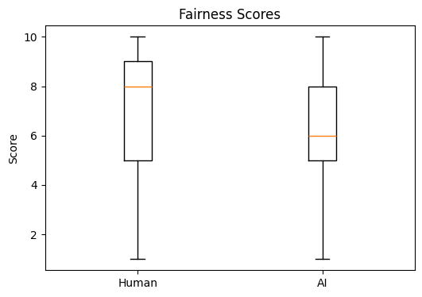
FAIRNESS COMPARISON
Human Grading Scores Consistently Higher — The Data Confirms It
Key Observations
6.90
Human median score is visibly higher than AI across all response groups.
Both distributions span the full 1–10 range, showing real disagreement among students.
The overlap between scores confirms the difference is real but not extreme — making the paired t-test the right tool to confirm significance.
Mean fairness scores from 116 student responses. Scale: 1–10.
Notes:
6

Slide 7

HYPOTHESIS TEST 1
Students Perceive Human Grading as Significantly Fairer
Paired t-Test Results
What This Means
Test
Result
The p-value (0.0105) is below the 0.05 threshold. This means the difference in fairness ratings is not due to chance — it is statistically significant.
Test type
Paired t-test (same students rated both)
Students gave human grading an average score of 6.90 vs. 6.06 for AI grading. We are 95% confident the true difference is between 0.21 and 1.57 points — consistently in favour of human grading.
t-statistic
2.615
p-value
0.0105
Why Paired t-Test?
95% Confidence Interval
[0.21, 1.57]
The same 116 students rated both systems. A paired test removes individual variation and isolates the real effect of grading type — making it the most appropriate statistical tool for this design.
Significance level
α = 0.05
Decision
Reject H₀
Result: The difference in fairness ratings is statistically significant. p = 0.0105 < 0.05.
Notes:
7

Slide 8
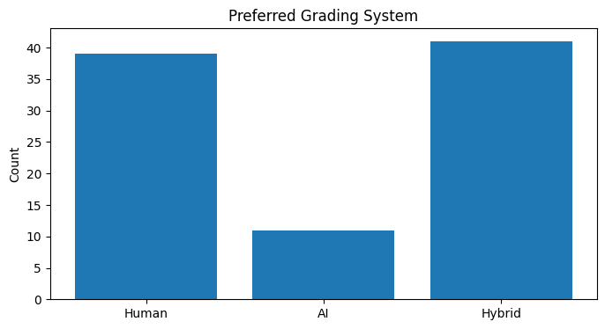
GRADING PREFERENCE
Most Students Want Humans in the Loop — Very Few Want Full AI
Breakdown
39
41
45% — Hybrid
43% — Human Only
41 students prefer AI scoring with human review. The #1 choice.
39 students prefer human grading exclusively.
11
12% — AI Only
Only 11 students want full AI grading with no human involvement.
Preferred grading system across 116 Year 2 students cohort 2025. N = 116.
88% of students want a human involved in some form. This is not about rejecting AI — it is about wanting accountability and oversight.
Notes:
8

Slide 9
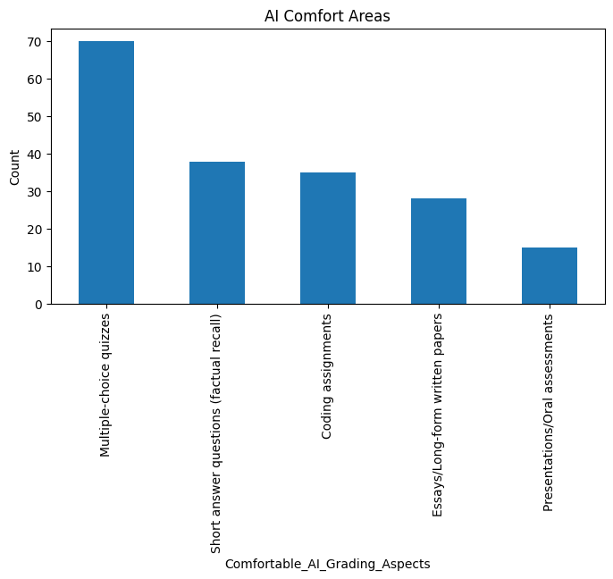
AI COMFORT AREAS + CHI-SQUARE TEST
Students Are Comfortable with AI for Objective Tasks — Not Subjective Ones
Chi-Square Test of Independence
Test
Result
Test type
Chi-square test of independence
Chi² statistic
0.453
p-value
0.7115
Degrees of freedom
2
Significance level
α = 0.05
Decision
Fail to Reject H₀
What this means: Preferred grading system is not associated with academic program. Business Analytics and Project Management students responded similarly. Program type does not predict grading preference.
Students trust AI most for clear, rule-based tasks (quizzes: 70/116). Trust drops sharply for essays and oral assessments — areas requiring nuance, creativity, and human judgement.
Notes:
9

Slide 10
CONCLUSION & RECOMMENDATIONS
The Data Is Clear: Students Trust Humans More — But Want a Smarter System
Key Findings
Recommendations for Kepler
1
Human grading rated significantly fairer
Adopt a Hybrid Model — Use AI for structured tasks (MCQs, coding); require human review for all high-stakes or subjective assessments.
Mean 6.90 vs 6.06; p = 0.0105 → H₀ rejected
2
Program does not drive preference
Be Transparent — Communicate clearly to students how AI grading works, what it grades, and what checks are in place.
No statistical association between major and preferred system; H₀ not rejected (p = 0.7115)
Address Bias Concerns — Proactively explain how algorithmic bias is managed; involve students in testing and feedback.
3
Hybrid is the top choice
45% prefer AI scoring with human review
Continue Research — This study covers Year 2 cohort 2025 only. Extend to Year 1 and Year 3 to capture a full picture before wider deployment.
4
AI trusted for objective tasks only
Quizzes and coding: yes. Essays and presentations: no.
5
Algorithmic bias is a real concern
Average concern score: 6.20/10
This study was conducted with ethical approval from Kepler Research Office. Data is anonymous and used solely for academic purposes.
Notes:
10

