Slide 1


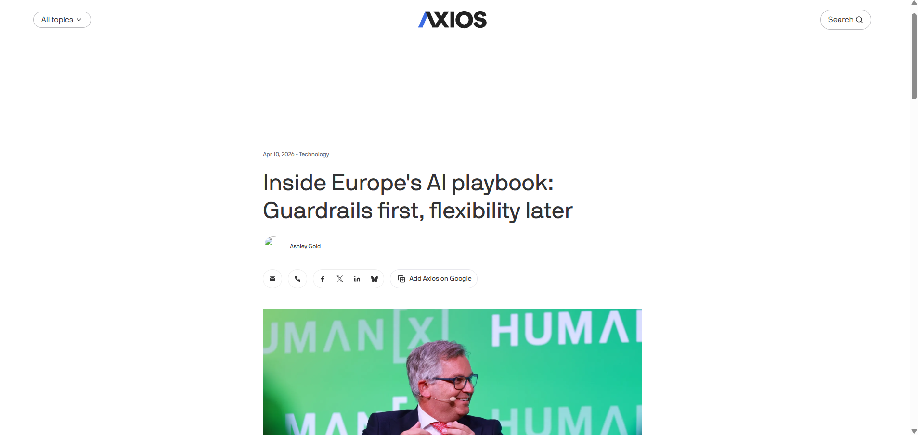

Inside Europe’s AI Playbook: Guardrails First, Flexibility Later
Article published on April 10, 2026
Link: https://www.axios.com

Slide 2
Main Findings and Arguments
- The EU emphasizes "guardrails," which are clear, well-defined rules designed to protect citizens and foster trust in AI technologies.
- The EU AI Act aims to establish a unified regulatory framework, focusing on transparency, accountability, fairness, and ethics.
- The EU's approach contrasts with the more decentralized and fragmented policies seen in the U.S.
- The goal is to prevent the rise of a "wild west" situation, ensuring consistent and uniform AI regulations across member states.

Slide 3
Broader Implications for Society
- Increased public trust in AI technologies due to stronger protections for privacy, fairness, and transparency.
- The EU's regulatory framework is expected to inspire global AI practices, raising the bar for ethical and responsible AI development.
- The EU aims to create a safer, more responsible AI environment that aligns with core societal values such as privacy and equality.

Slide 4
Relevance or Potential Influence on the Construction Industry
- The EU AI Act could impact the use of AI-driven technologies like autonomous machinery, predictive analytics, and robotics in construction.
- AI regulations could result in more robust safety measures, ensuring efficiency without compromising worker safety.
- Construction companies will need to adopt transparency in their AI systems, addressing issues like resource allocation and job displacement due to automation.
- Smaller companies might face challenges complying with these regulations, which could increase costs but also drive innovation.

