Slide 1

California Cements Its Role as the National Testing Ground for AI Rules
Ashley Gold, Axios (Publiation Date:April 3, 2026)
Link: https://www.axios.com/2026/04/03/california-national-testing-ground-ai-rules

Slide 2



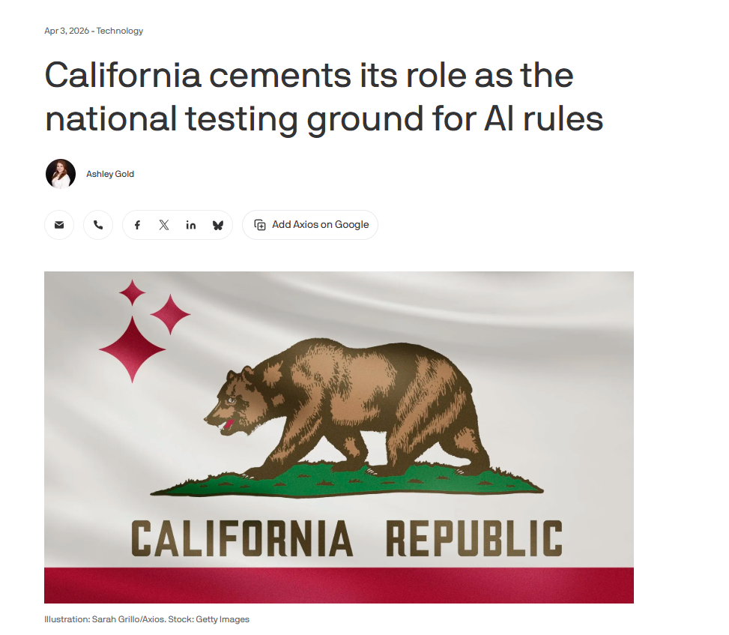


Screenshot of Article Headline

Slide 3

Main Findings and Arguments
- California is taking proactive steps to regulate AI across various sectors, including AI procurement and its impact on minors.
- The state's regulations are likely to set a de facto national standard due to California's influence over U.S. tech policy.
- Growing public concerns about the risks of AI, such as biases and misuse, are driving these regulatory efforts.
- California aims to balance AI innovation with societal protection, ensuring ethical deployment of AI technologies.

Slide 4

Broader Implications for Society
- AI Safety: Ensuring AI systems do not introduce new societal risks, such as bias or misuse.
- Ethical Concerns: Balancing technological innovation with individual rights, particularly around data privacy.
- AI's Impact on Children: Protecting minors from AI-driven manipulation and privacy risks in digital spaces.
- California is positioning itself as a leader in ensuring that AI technologies are ethically deployed.

Slide 5

Relevance to the Construction Industry
- AI in Construction: Predictive analytics, AI-powered safety monitoring, and Building Information Modeling (BIM) are transforming construction processes.
- Impact of California's Regulations: Construction firms in the AEC sector must adapt to meet evolving AI safety standards and ensure ethical AI use.
- California's AI rules could set a national standard for how AI is used in construction management, ensuring safety, privacy, and quality.

