Slide 1


Alphabet Investors Push for Safeguards on Use of Its Cloud, AI Tech
By | April 29, 2026

Slide 2
Article Details
Article Publication Date: April 29, 2026
Link: https://www.reuters.com/sustainability/boards-policy-regulation/alphabet-investors-push-safeguards-use-its-cloud-ai-tech-2026-04-29/?utm_source=chatgpt.com

Slide 3
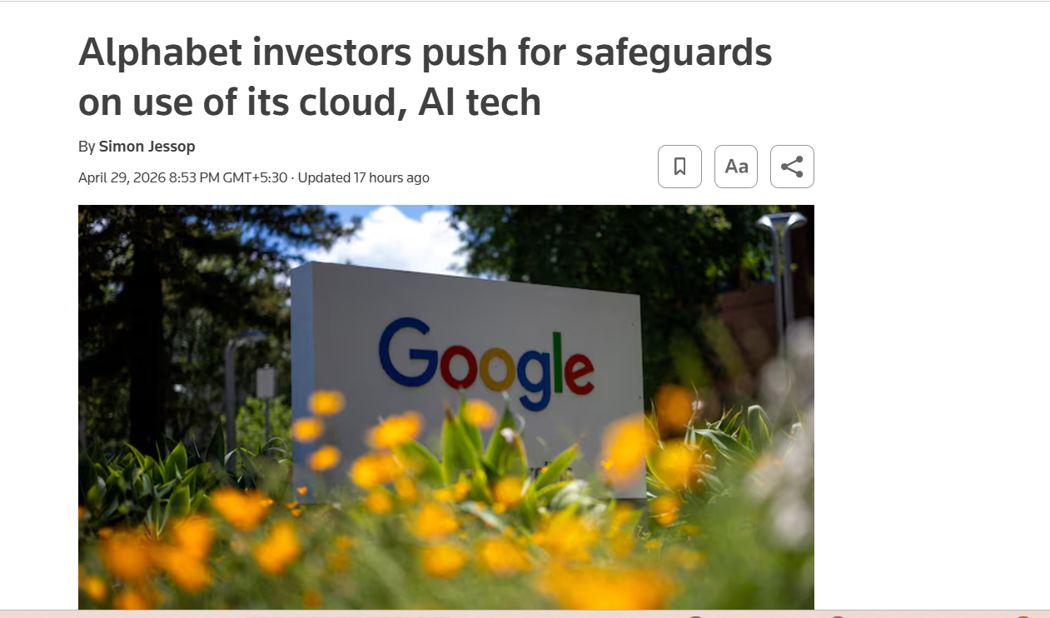
Headline Screenshot

Slide 4
Main Findings and Arguments
• Investors press Alphabet to explain how it controls the use of its AI technology and cloud services.
• Concerns about surveillance risks in high-risk contexts like U.S. immigration authorities and Israeli government contracts.
• Alphabet claims existing data privacy measures are sufficient.
• Investors call for more transparency and safeguards.

Slide 5
Broader Implications for Society
• Growing concerns about the misuse of technology for surveillance, especially by governments.
• Increasing demand for transparency and accountability from tech companies in AI and cloud usage.
• Ethical concerns around the militarization and civil liberties impacts of AI.

Slide 6
Relevance to the Construction Industry
• Construction companies utilizing cloud and AI technologies must ensure responsible use to avoid surveillance misuse.
• Companies should focus on ethical implications and transparency in their AI-driven operations.
• Regulatory frameworks for AI usage will impact industries like construction that rely on these technologies for efficiency.

