Slide 1
AI in Construction Engineering & Management
Based on: Pan & Zhang (2021) — Automation in Construction (Article 103517)
Source link (DOI): https://doi.org/10.1016/j.autcon.2020.103517

Slide 2
Title: Roles of artificial intelligence in construction engineering and management: A critical review and future trends
Authors: Yue Pan; Limao Zhang
Journal: Automation in Construction (Elsevier)
Volume/Issue: Volume 122 (February 2021)
Article number: 103517
Available online / Version of record: 17 December 2020
DOI link: https://doi.org/10.1016/j.autcon.2020.103517
Publication details

Slide 3

Main findings and arguments (from the AI summary)
CEM is in rapid digital transformation; AI is a key enabler for modeling, monitoring, predicting, and optimizing projects across the lifecycle.
The review combines scientometric + qualitative analysis over 4,473 journal articles (1997–2020) and finds strong growth in AI-in-CEM research, especially in the last decade.
Research focus has shifted from “expert systems” toward BIM, digital twins, and other data-driven approaches.
Core AI benefits in CEM: modeling/pattern detection, prediction, and optimization.
Six highlighted technical topics: knowledge representation & reasoning; information fusion; computer vision; natural language processing; intelligent optimization; process mining.

Slide 4
Construction is economically and socially critical, yet faces chronic challenges (low productivity, high safety risk).
AI-enabled forecasting, monitoring, and optimization can reduce waste, improve resource use, and support safer working conditions.
By targeting “laborious, complex, or even dangerous tasks,” AI adoption can improve reliability of infrastructure delivery that communities depend on.
Broader implications for society

Slide 5
Provides an evidence-based map of AI adoption in CEM to help stakeholders prioritize investment and capability-building.
Identifies six forward-looking R&D directions: smart robotics; cloud VR/AR; AIoT; digital twins; 4D printing; blockchains.
Positions these technologies as practical pathways to expand automation and intelligence across design, construction, and O&M.
Overall message: AI is already creating value by enabling more reliable, automated, time-saving, and cost-effective CEM processes.
Potential influence on the construction industry

Slide 6
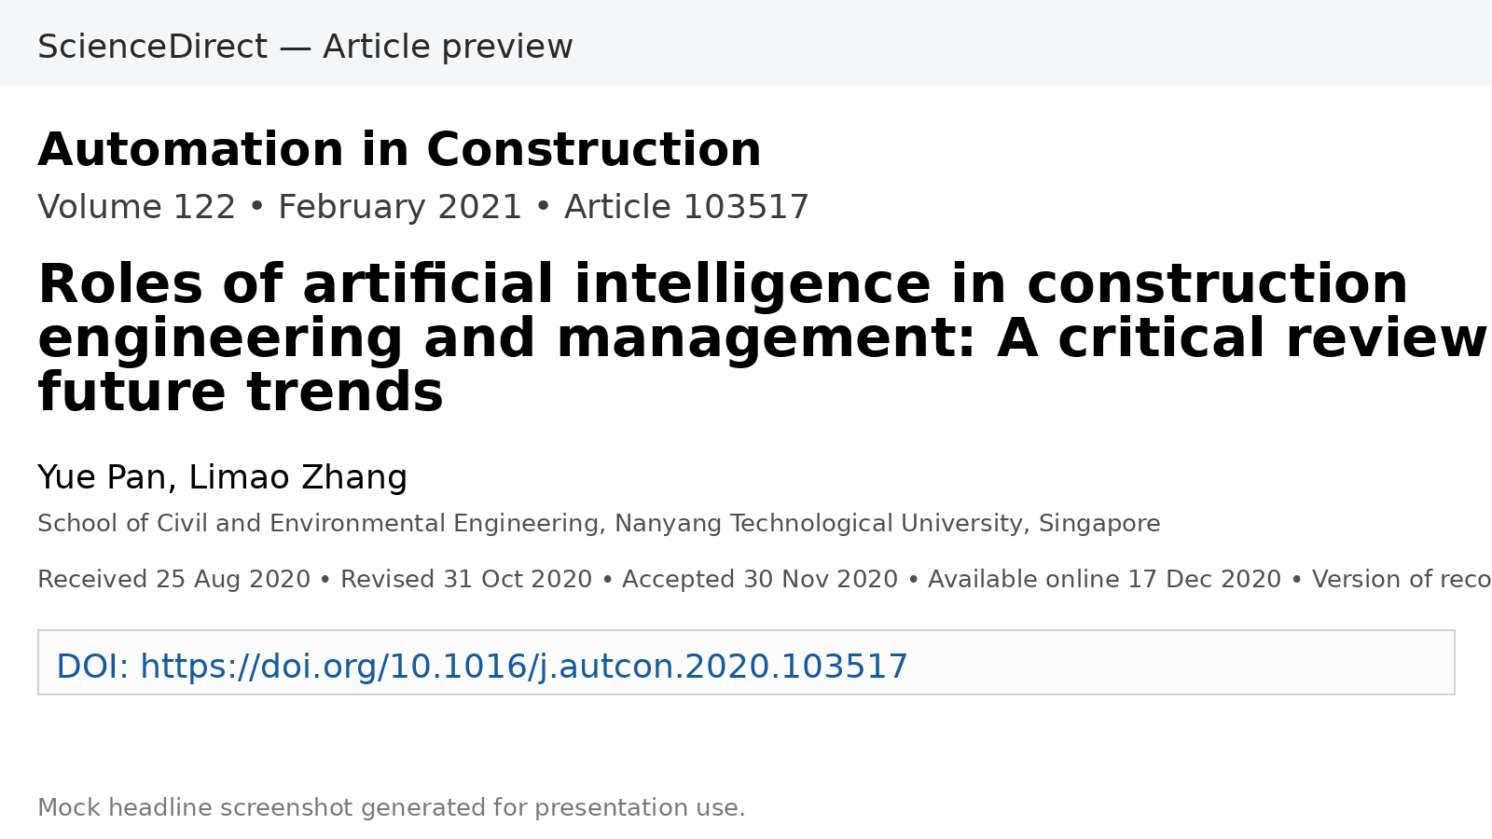
Screenshot of the headline
Source link (DOI): https://doi.org/10.1016/j.autcon.2020.103517

