Slide 1
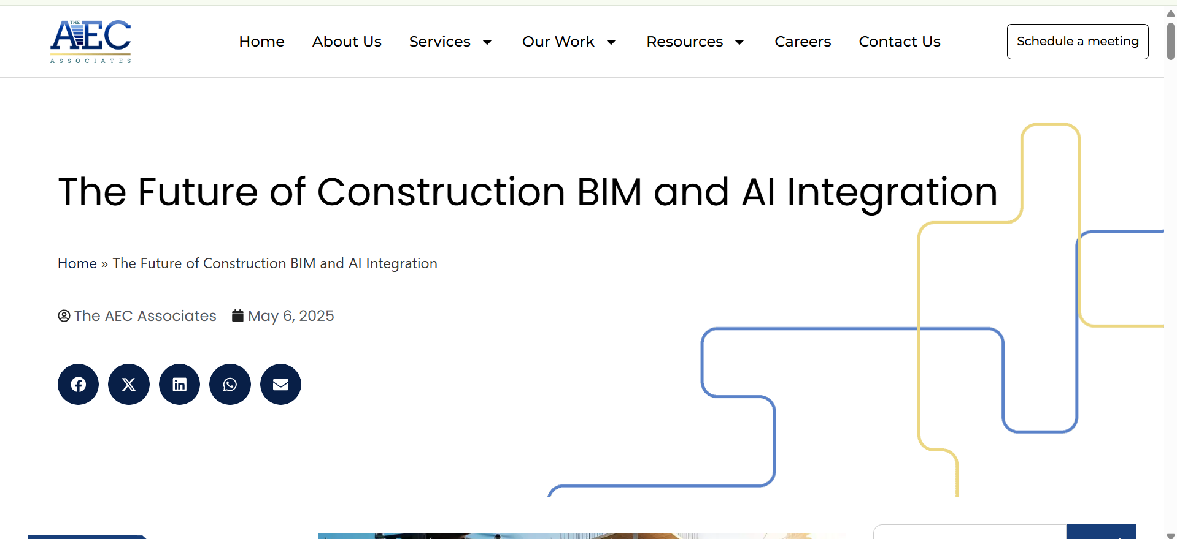
The Future of Construction BIM and AI Integration
Article Publication Date: May 6, 2025
Article Link: https://theaecassociates.com/blog/bim-and-ai-integration/?utm_source
Screenshot of the Headline

Slide 2

Introduction to BIM and AI Integration
• Integration of BIM and AI reshaping the AEC industry.
• Enhances productivity, precision, and project outcomes.
• AI automates repetitive tasks, interprets data, and provides insights.

Slide 3
AI Enhancing Automation and Clash Detection
• AI detects design clashes faster than manual methods.
• Reduces rework during construction and improves coordination.
• Real-time clash resolution enhances design quality and safety.

Slide 4
Optimizing Model Accuracy and Predictive Planning
• AI analyzes historical data for accurate project forecasts.
• Predicts scheduling risks and cost overruns.
• Real-time updates improve project timelines and cost control.

Slide 5
Improved Collaboration and Informed Decision-Making
• AI synthesizes data for informed decision-making.
• Enhances collaboration between architects, engineers, and contractors.
• Reduces review cycles and conflict resolution time.

Slide 6
Data-Driven Planning and Execution
• AI monitors real-time progress and compares it to BIM models.
• Early detection of discrepancies allows faster corrective actions.
• Improves scheduling accuracy and ensures workforce efficiency.

Slide 7
BIM AI in Smart Construction
• Digital twins provide real-time monitoring of building performance.
• AI enhances sustainability through energy usage and carbon footprint analysis.
• Robotics integrated with BIM for autonomous construction tasks.

Slide 8
Broader Societal Implications
• AI and BIM help reduce construction’s environmental impact.
• Optimizes energy efficiency and promotes eco-friendly buildings.
• AI improves safety by predicting high-risk zones and unsafe practices.

Slide 9
Relevance to the Construction Industry
• AI and BIM integration leads to smarter, more efficient construction practices.
• Reduces costs, accelerates timelines, and increases accuracy.
• Addresses skilled labor shortages by automating tasks.

Slide 10
Conclusion
• BIM and AI integration is shaping the future of construction.
• Offers smarter, safer, and more sustainable building practices.
• Continued innovation will drive digital transformation in the industry.

