Slide 1

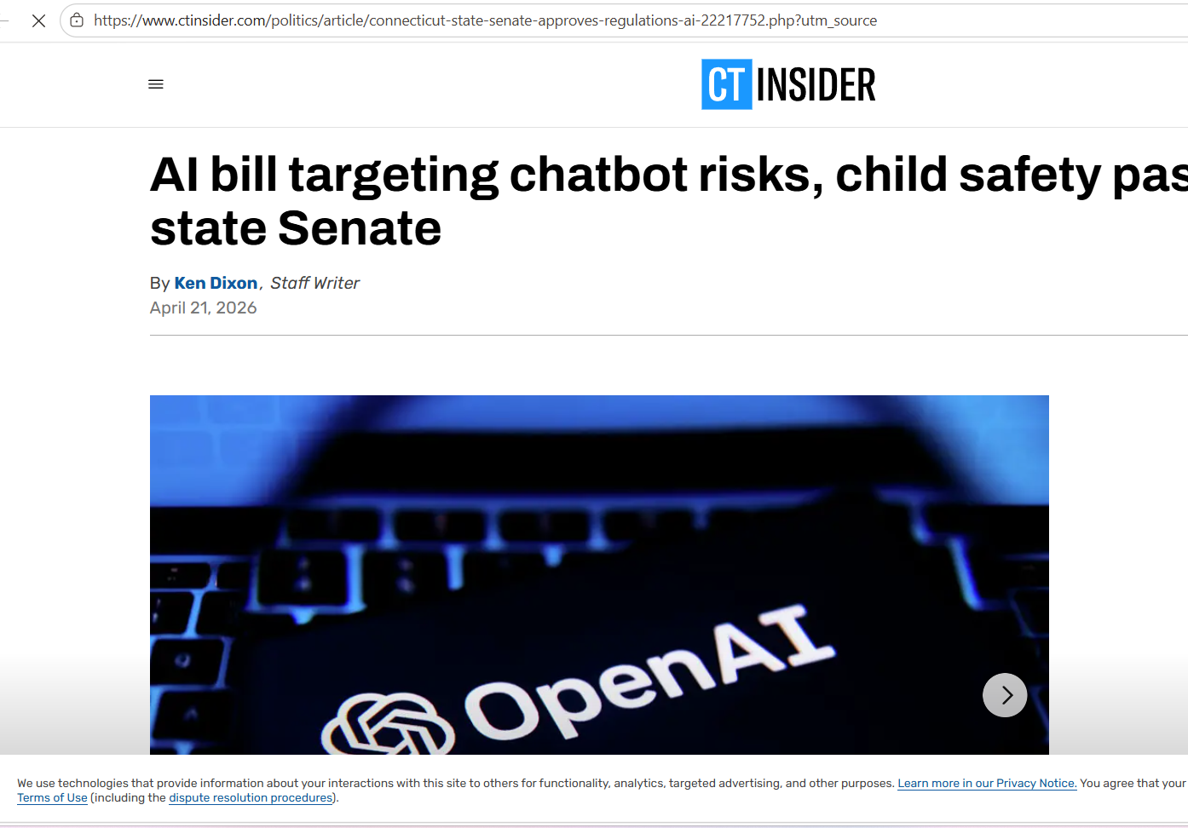

AI Bill Targeting Chatbot Risks, Child Safety Passes CT State Senate
Publication Date: April 21, 2026
Source: CT Insider
Link to Source: https://www.ctinsider.com/politics/article/connecticut-state-senate-approves-regulations-ai-22217752.php

Slide 2
Summary of the Article
Main Findings & Arguments:
- The Connecticut State Senate passed a bipartisan bill to regulate AI technologies, focusing on chatbot risks and child safety.
- The bill also aims to encourage workforce development and mandate transparency in the AI industry.
- Governor Ned Lamont supports the bill, citing its potential to empower residents to use AI responsibly.
- Key aspects of the bill include AI literacy, economic growth, and child protection.

Slide 3

Broader Implications for Society
Potential Societal Impact:
- The bill sets a precedent for state-level regulation of AI to protect vulnerable populations (e.g., children) and ensure responsible use.
- Promotes AI literacy and prepares the workforce for future AI-driven industries, potentially driving economic growth.
- Encourages trust in AI technologies and could influence national policy regarding AI regulation.

Slide 4
Relevance to the Construction Industry
Implications for Construction:
- AI-driven tools, like chatbots for customer service or AI project management systems, can be regulated for transparency and safety.
- The emphasis on AI literacy could benefit the construction workforce by integrating AI technologies for tasks like safety monitoring, resource management, and project planning.
- Regulation ensures safe and ethical AI usage, potentially improving public trust in AI systems within the construction sector.

Slide 5
Conclusion
Key Takeaways:
- The Connecticut bill on AI represents a significant move towards ensuring the safe, transparent use of AI technologies.
- Its broader societal implications can influence industries, including construction, to adopt AI responsibly while fostering economic development and workforce empowerment.

