Slide 1
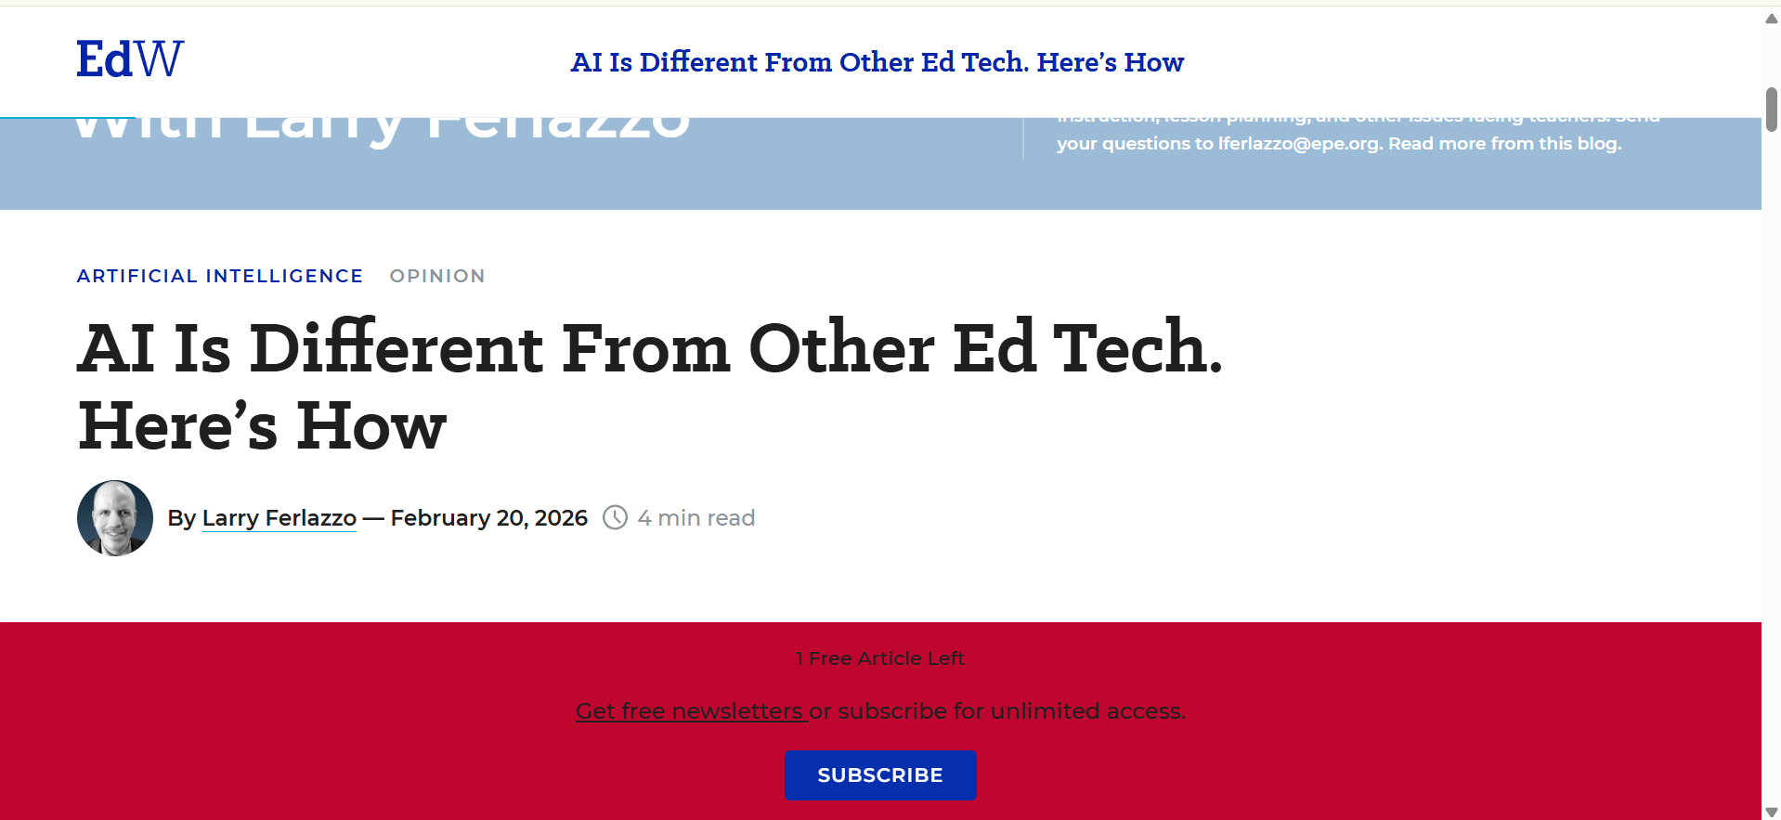
AI Is Different From Other Ed Tech. Here’s How
By Larry Ferlazzo - February 20, 2026

Slide 2
Main Findings and Arguments
The article discusses the polarized debate around AI in education. Some view AI as a revolutionary tool, while others see it as overhyped. The author emphasizes the need for nuanced discussions around AI's role in the classroom, highlighting its potential for improving learning outcomes and raising philosophical questions about knowledge, creativity, and the human role in education.

Slide 3
Broader Implications for Society
AI is shaping broader societal discussions about the nature of knowledge and creativity. The integration of AI in education raises fundamental questions about what it means to be human, as AI becomes a tool not just for learning but for philosophical reflection on knowledge and its production.

Slide 4
Relevance to Construction Industry
While the article focuses on education, its themes about AI's ethical implications, trust in AI-driven decisions, and the balance between human expertise and AI are also relevant to the construction industry. AI’s role in automation, predictive analytics, and safety monitoring in construction brings up similar ethical concerns.

Slide 5
Article Link
For full article, visit the link below:
AI Is Different From Other Ed Tech. Here’s How
https://www.edweek.org/technology/opinion-ai-is-different-from-other-ed-tech-heres-how/2026/02?utm_source=chatgpt.com

