Slide 1

Final Project
Software Engineering

Slide 2
MEMBER OF GROUP 8
Tô Trọng Phúc
519H0341
01
Hoàng Minh Tân
519H0129
02
03

Slide 3
TABLE OF CONTENT
Introduction.
Architecture.
01
04
Project Management Plan.
Design.
02
05
Requirement Specifications.
Demo.
03
06

Slide 4
01
INTRODUCTION

Slide 5
Purpose and Scope
-The warehouse management will be better and help the goods to be more stable, reducing the amount of inventory significantly. If the company is using the traditional method of warehouse management, it will take a lot of time and effort in taking notes. Sometimes it also leads to errors, confusion and not being proactive in terms of time. Management software will help limit many risks for the company.
02
3

Slide 6
Product Overview
- Software was created with the belief that it would replace manual methods. With features such as import and export, buy, sell, statistics. We believe that this software will make the sales management of companies and agents more convenient and time-saving. Information will be saved in the data so it will avoid information loss.
02
3

Slide 7
02
PROJECT MANAGEMENT PLAN

Slide 8
-Risk management is essential to prevent damage from occurring during product completion. Risk assessment methods can sometimes be used to identify and reduce a risk. Processes include:
Plan and implement risk management.
Manage project risk profile.
Perform risk analysis.
Perform risk treatment.
Perform risk monitoring
Evaluate risk management process.
02
3

Slide 9
Lifecycle Model Used
-Because this is a small project, we use the waterfall model to get the job done as efficiently and as quickly as possible.
-This is a model with a 6-stage sequential and sequential design process.
Requirement Analysis: The team does a search for requirements, functions, and constraints related to the project.
Design: Define design goals, system logic, and implementation.
Development: Products are built to support design or built-in units for testing and subsequent integration.
Test: The entire system is tested to find defects and ensure design goals.
Deployment: Deploying the system, making the system accessible to users.
+Maintenance: Solve customer problems encountered during use. Repair and upgrade patches and errors to perfect the system.
02
3

Slide 10
Deliverables and Schedule
Task | Person Responsible | Deliverable | Due Date
Meeting online | All team member | Review project, schedule, plan | 1st December
Write the report | All team member | Part 1 | 2nd December
Write the report | All team member | Part 2 | 3rd - 4th December
Write the report | All team member | Part 3 | 5th – 10th December
Write the report | All team member | Part 4 | 10th- 12th December
Write the report | All team member | Part 5 | 12th – 17th December
Do the project | All team member | Start research and implement the project | 17th December – 1st January
Write the report | All team member | Part 6 | 2nd – 3rd January
Write the report | All team member | Part 7 | 4th January
Prepare for the presentation | All team member | Overview | 5th January
02
3

Slide 11
03
REQUIREMENT SPECIFICATIONS

Slide 12
Stakeholders for the system
Business partner The company's main customers will be distribution agents. Customers will be businesses that distribute products abroad, supermarkets, and small grocery stores.
Accountant The accounting function records the history, receives, processes and provides information about the financial performance of the company.
Other stakeholders There will be 3 payment methods:
Paying with cash will have to go to the store
Payment by bank transfer with the company's bank information is available
Pay by scanning QR code momo
02
3

Slide 13
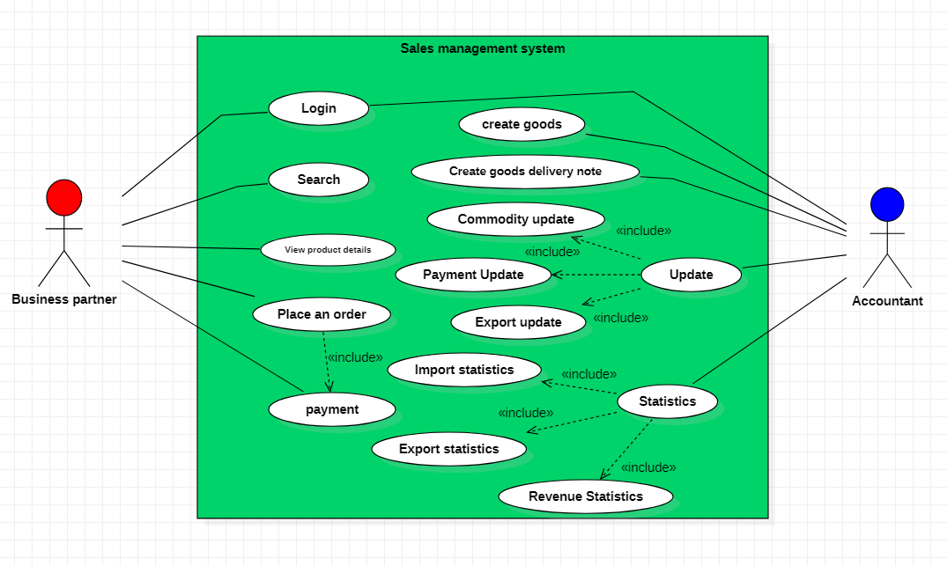
Use case model
02
3

Slide 14
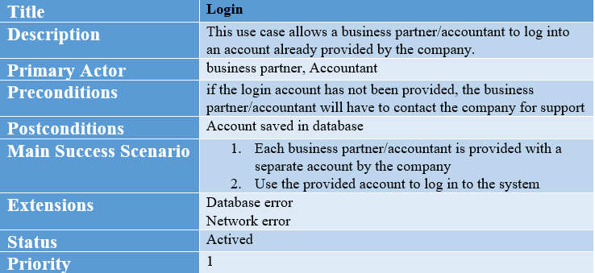
Textual Description For Each Use Case
02
3

Slide 15
Textual Description For Each Use Case
02
3

Slide 16
Textual Description For Each Use Case
02
3

Slide 17
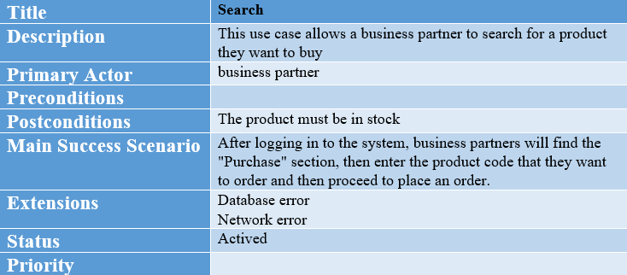
Textual Description For Each Use Case
02
3

Slide 18
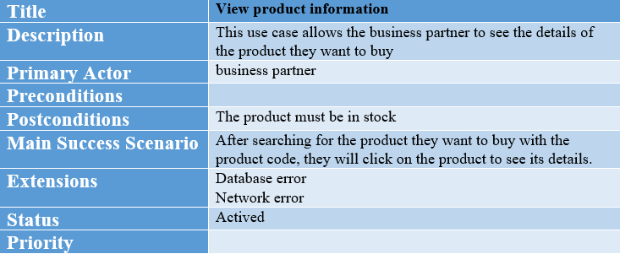
Textual Description For Each Use Case
02
3

Slide 19
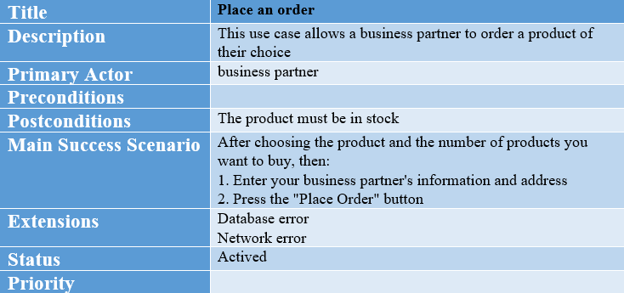
Textual Description For Each Use Case
02
3

Slide 20
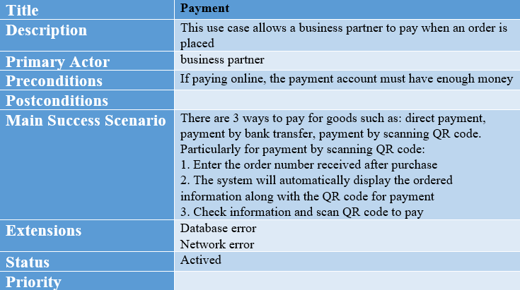
Textual Description For Each Use Case
02
3

Slide 21
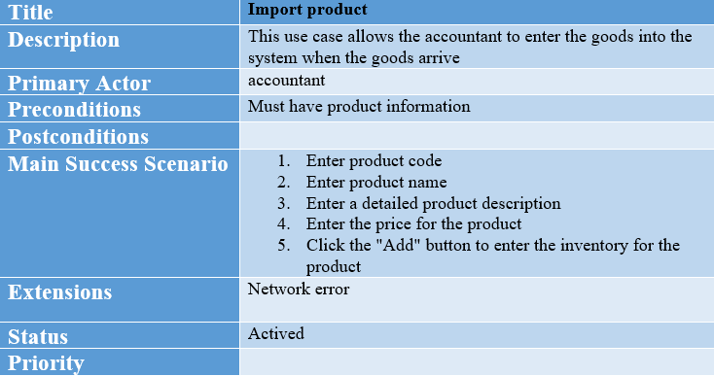
Textual Description For Each Use Case
02
3

Slide 22
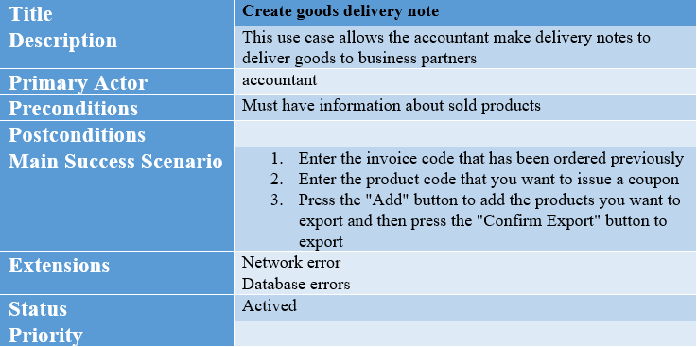
Textual Description For Each Use Case
02
3

Slide 23
Functional requirements
+ Business partners can log in and buy goods, After the purchase is complete, they can pay in many ways.
+ Purchase information will be clearly displayed and will be accompanied by a delivery note
+ The accountant can review the imported goods, the accountant can make the delivery note
02
3

Slide 24
Non-functional requirements
Business partners can only post to the system when they already have an account of the supplier company
The system requires the user to have a network connection
The delivery note can only be made if the business partner has already paid
Items are only visible on the web while in stock.
02
3

Slide 25
04
ARCHITECTURE

Slide 26
Architectural style(s) used
-We use MVC Architecture. Model view controller (MVC) is a software design pattern commonly used for developing user interfaces that divide the related program logic into three interconnected elements. This is done to separate internal representations of information from the ways information is presented to and accepted from the user
02
3

Slide 27
Rationale for your architectural style and model
MVC is an architectural pattern which means it rules the whole architecture of the applications. Even though often it is known as design pattern but we may be wrong if we refer it only as a design pattern because design patterns are used to solve a specific technical problem, whereas architecture pattern is used for solving architectural problems, so it affects the entire architecture of our application.
It is known as the lowest level which means it is responsible for maintaining data. Handle data logically so it basically deals with data. The model is actually connected to the database so anything you do with data. Adding or retrieving data is done in the model component. It responds to the controller requests because the controller never talks to the database by itself. The model talks to the database back and forth and then it gives the needed data to the controller. Note: the model never communicated with the view directly.
02
3

Slide 28
05
DESIGN

Slide 29
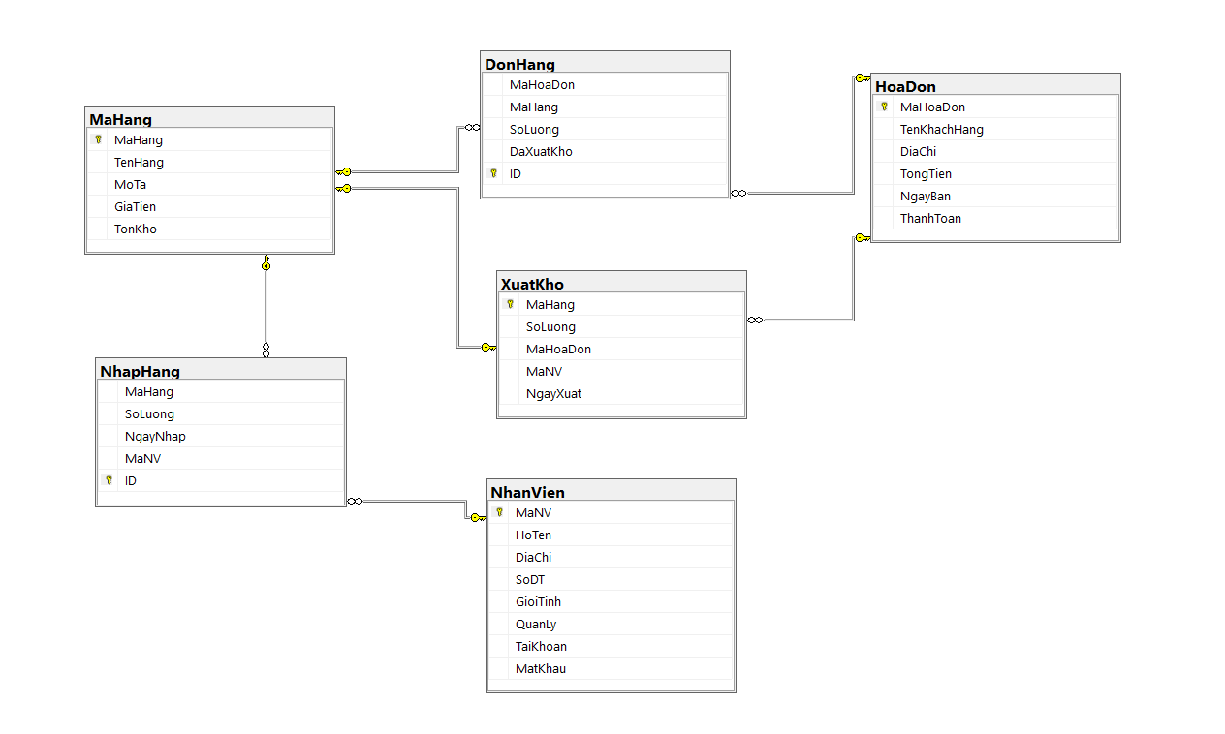
Database Design
02
3

Slide 30
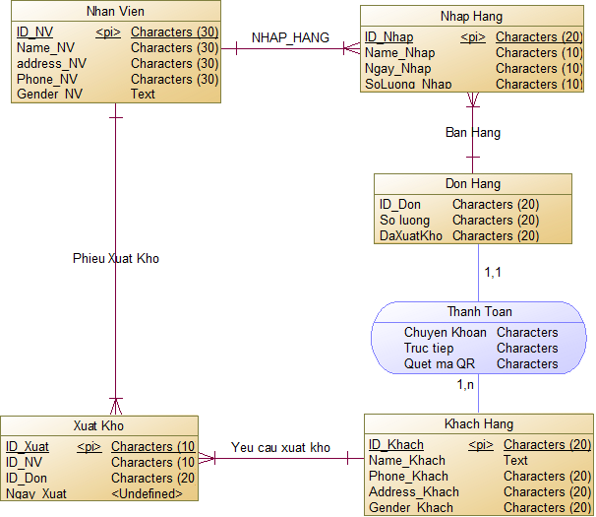
Static Model – Class Diagrams
02
3

Slide 31
Dynamic model – sequence diagrams
02
3

Slide 32
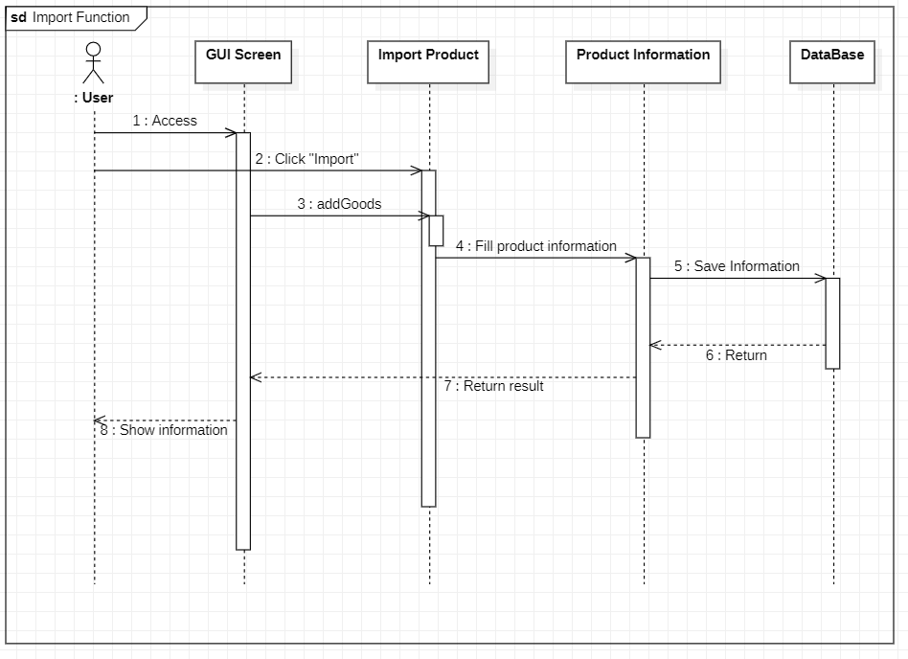
Import Function
02
3

Slide 33
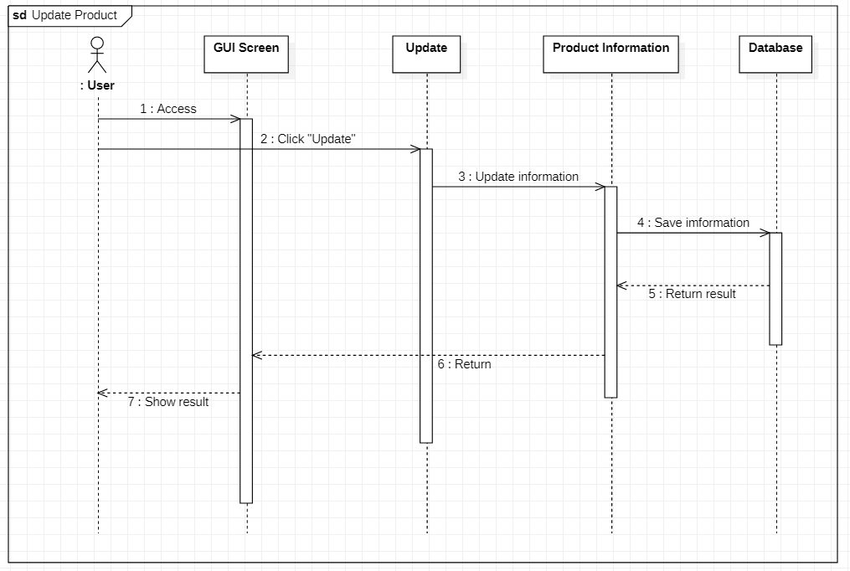
Update Product
02
3

Slide 34
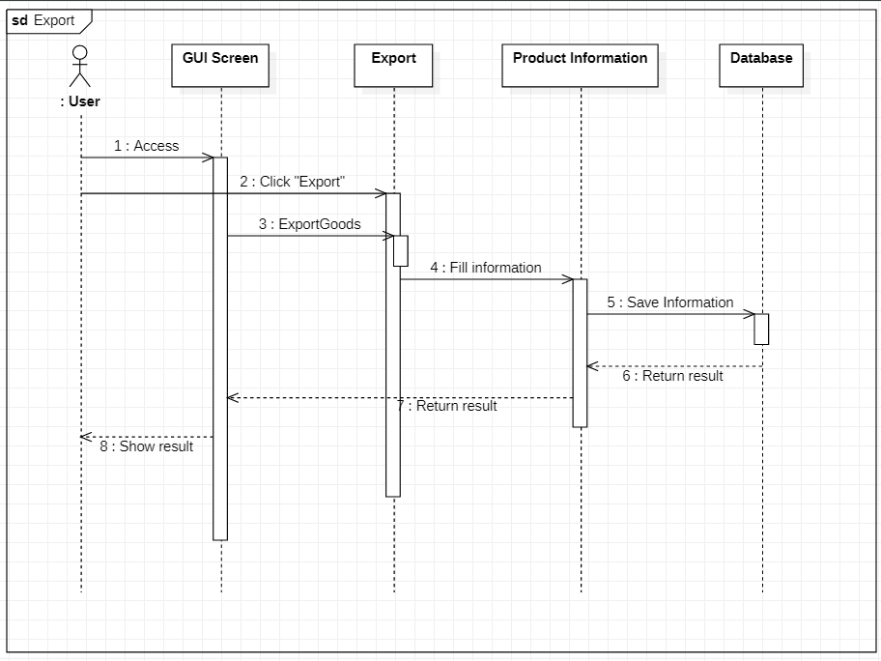
Export
02
3

Slide 35
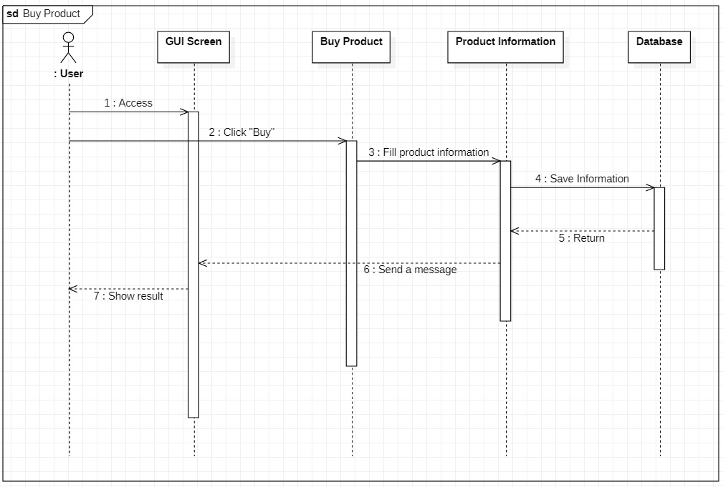
Buy Product
02
3

Slide 36
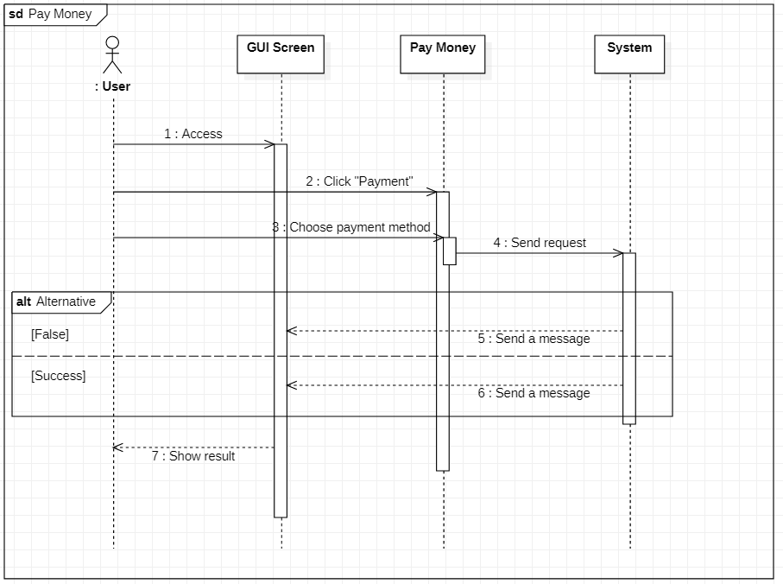
Pay Money
02
3

Slide 37
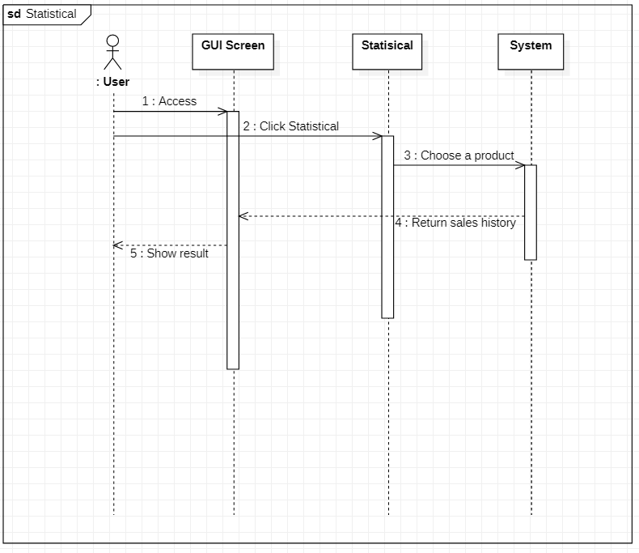
Statistical
02
3

Slide 38
06
DEMO

Slide 39
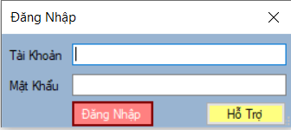
Login
02
3

Slide 40
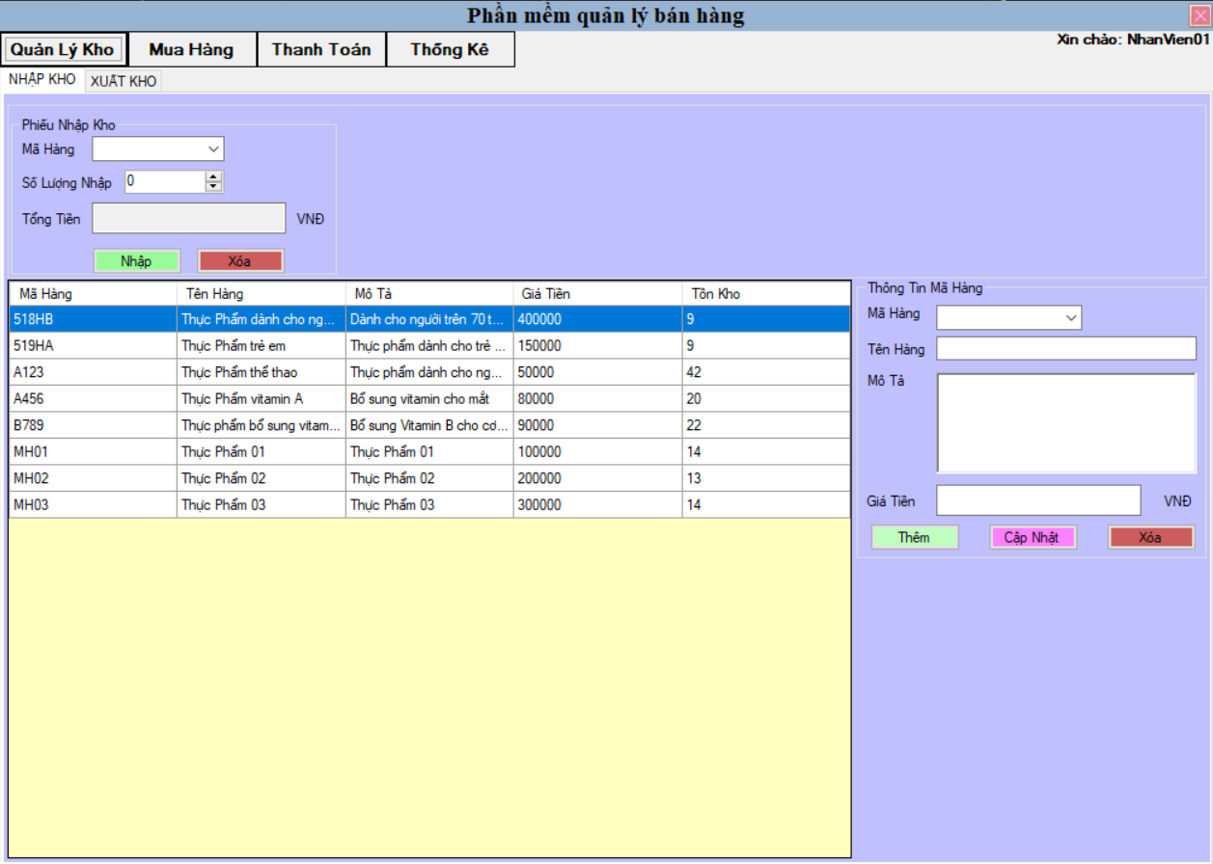
Import Function
02
3

Slide 41
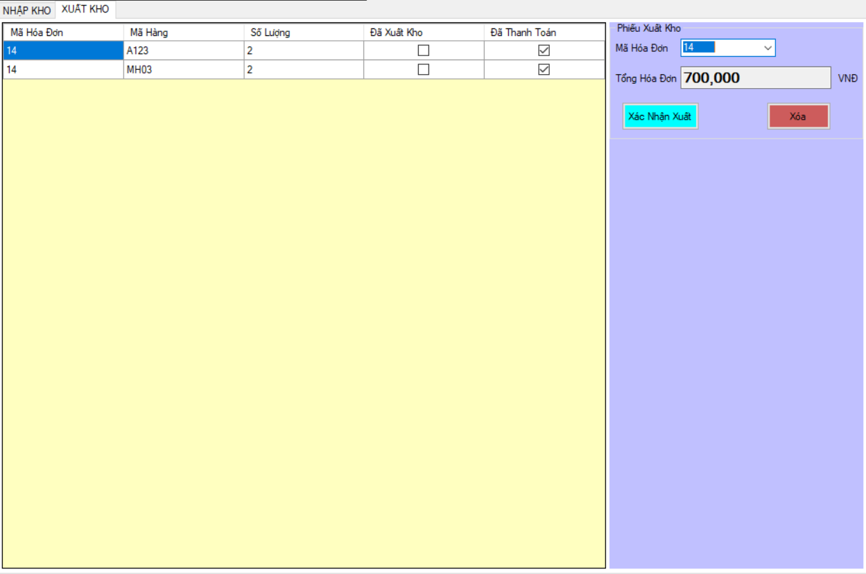
Export
02
3

Slide 42
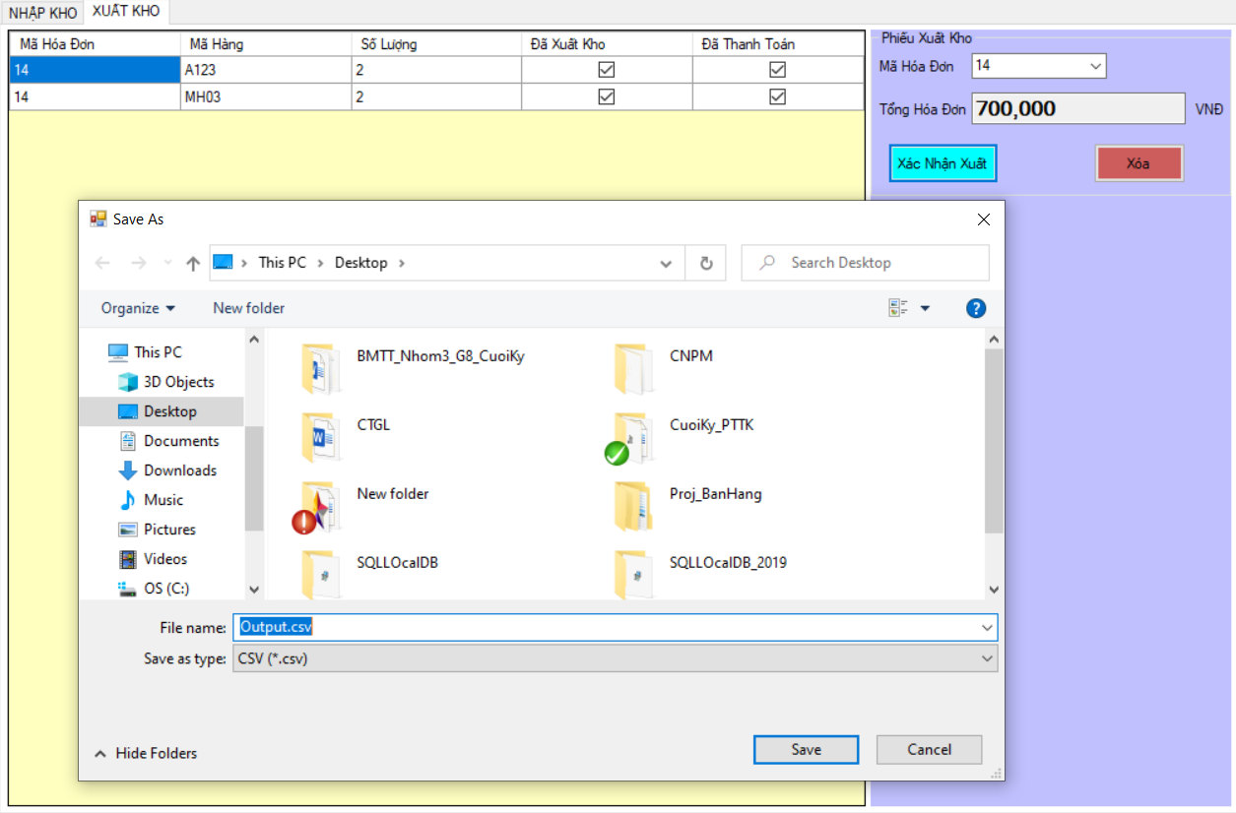
Export Excel File
02
3

Slide 43
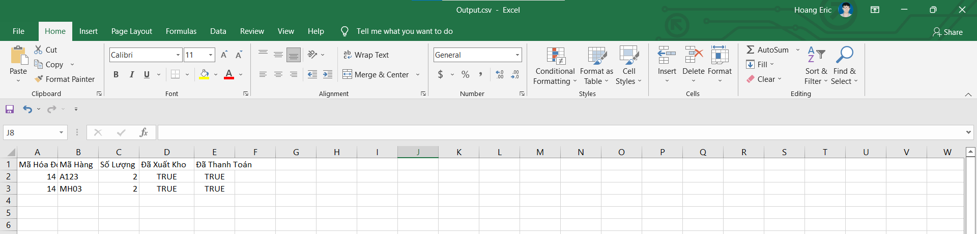
Export Excel File
02
3

Slide 44
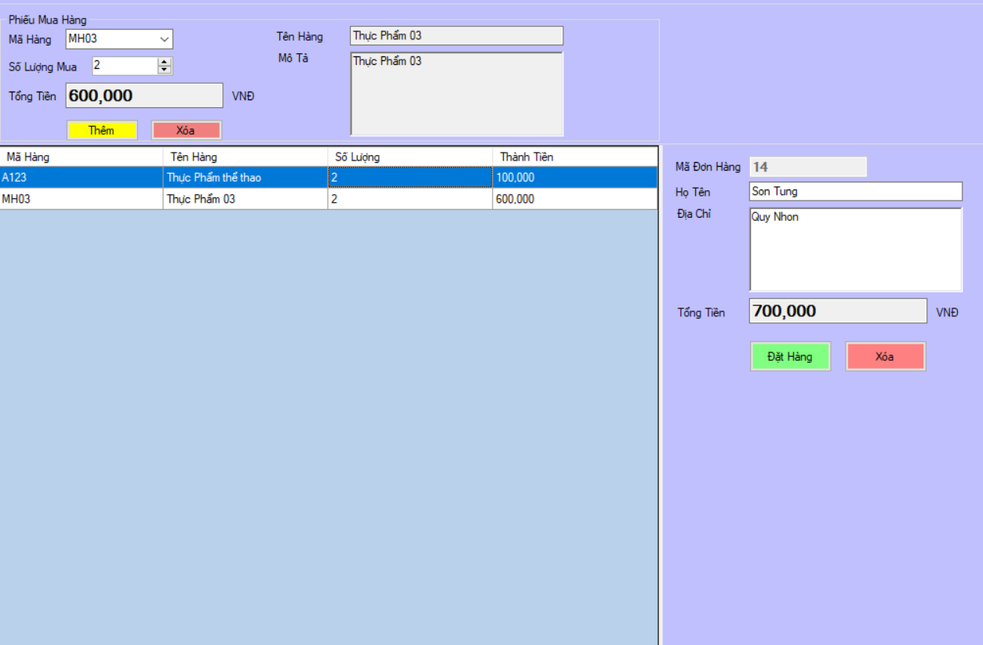
Buy Product
02
3

Slide 45
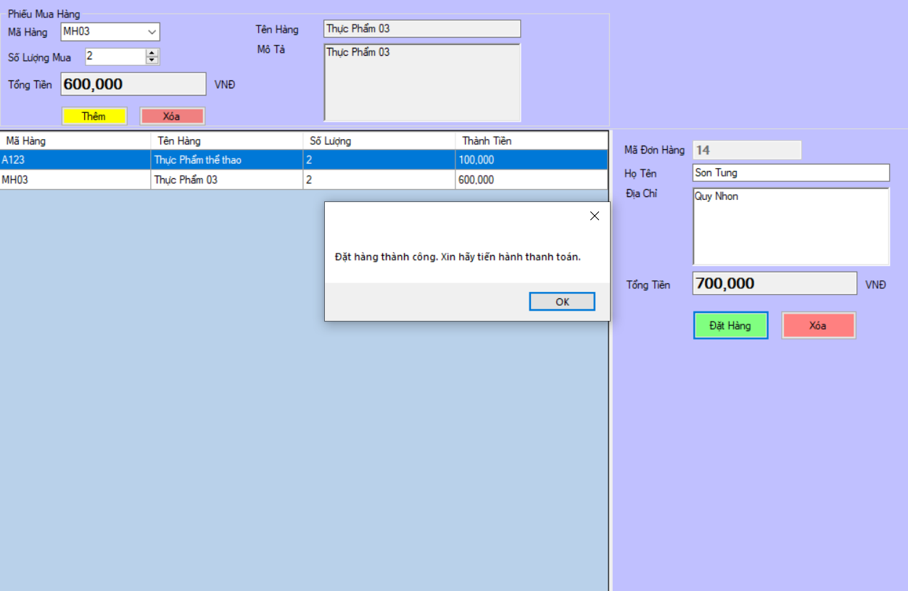
Buy Product
02
3

Slide 46
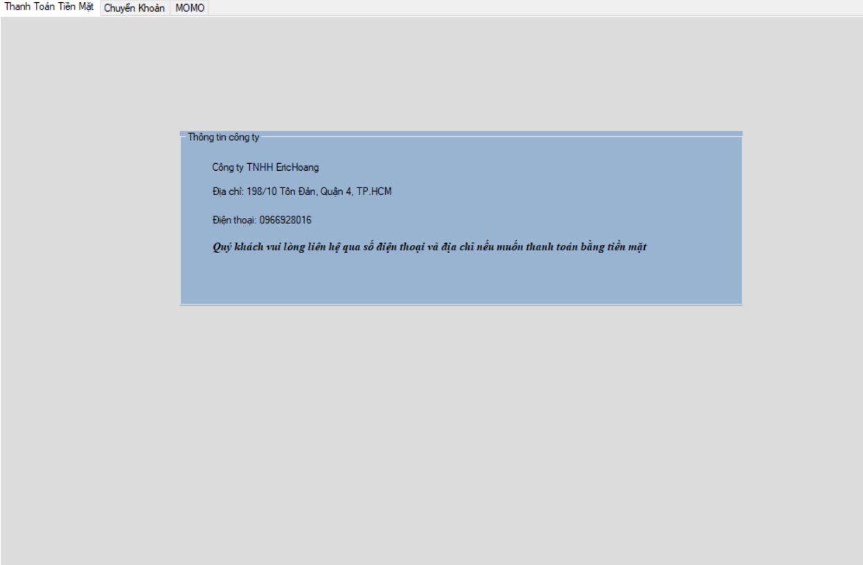
Pay Money
02
3

Slide 47
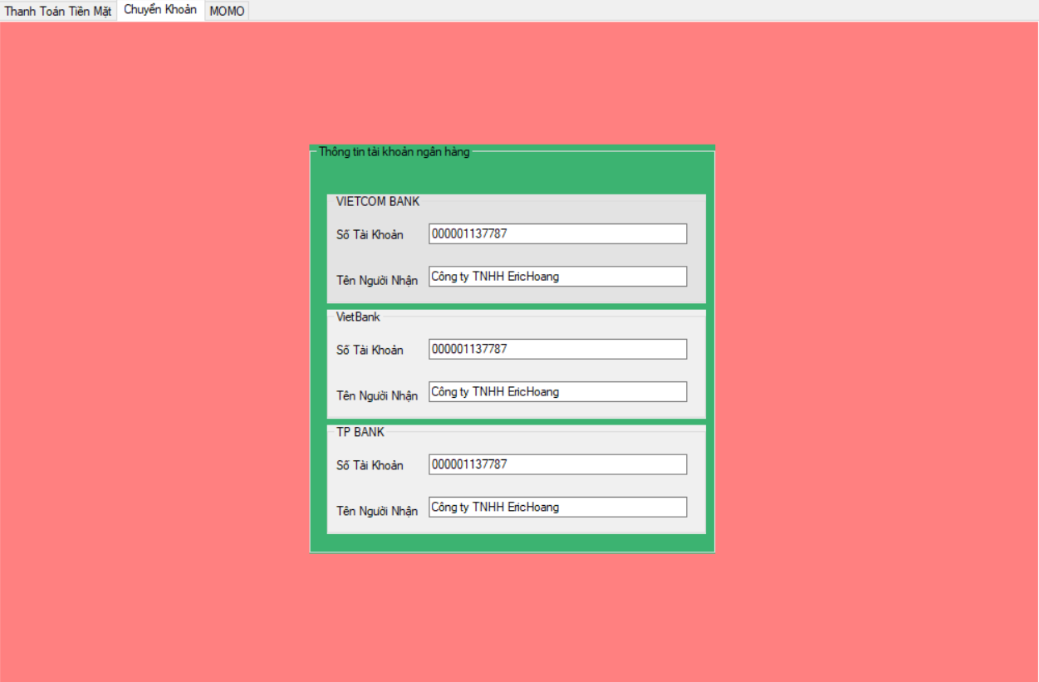
Pay Money
02
3

Slide 48
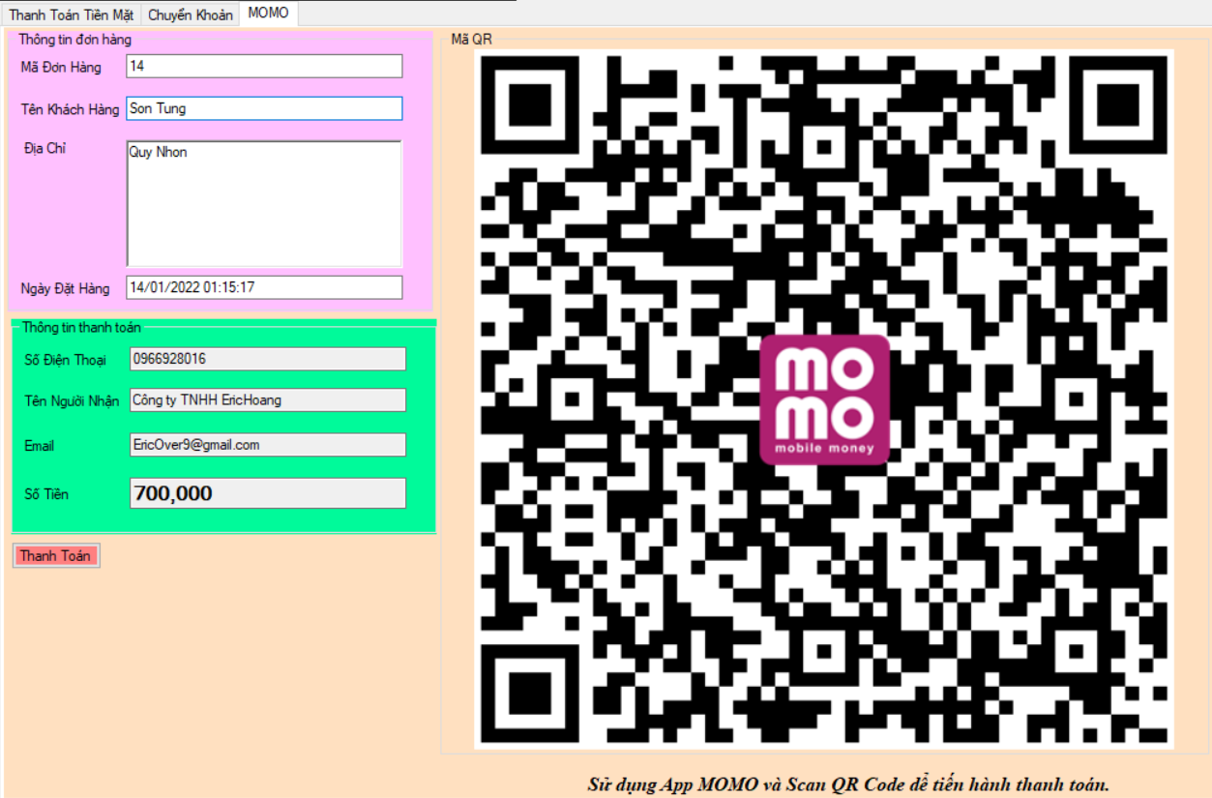
Pay Money
02
3

Slide 49
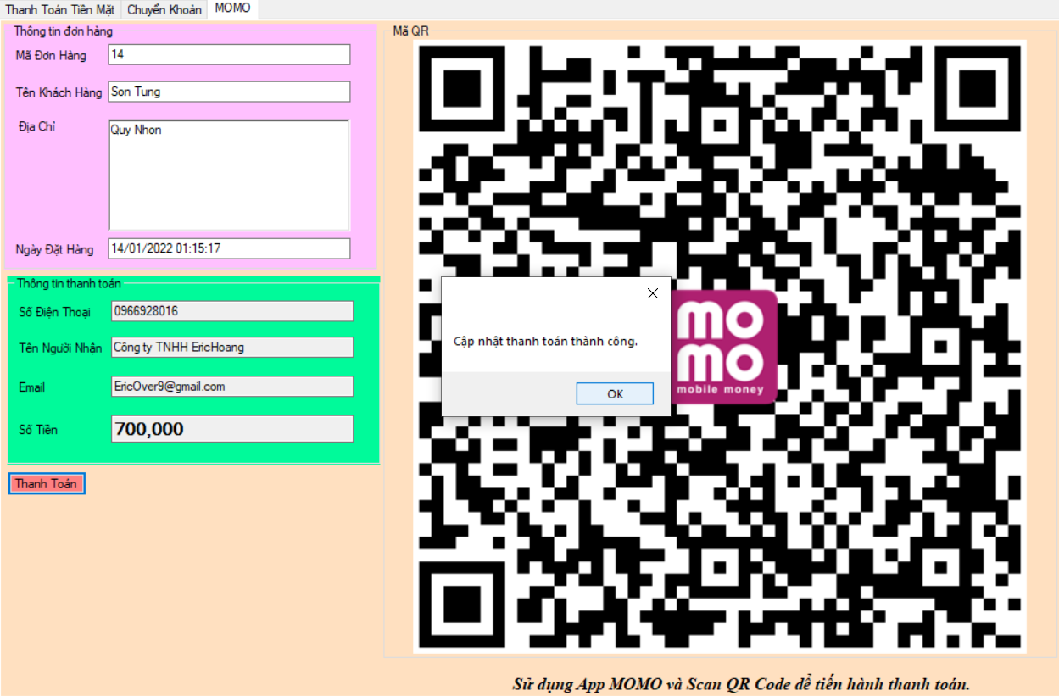
Pay Money
02
3

Slide 50
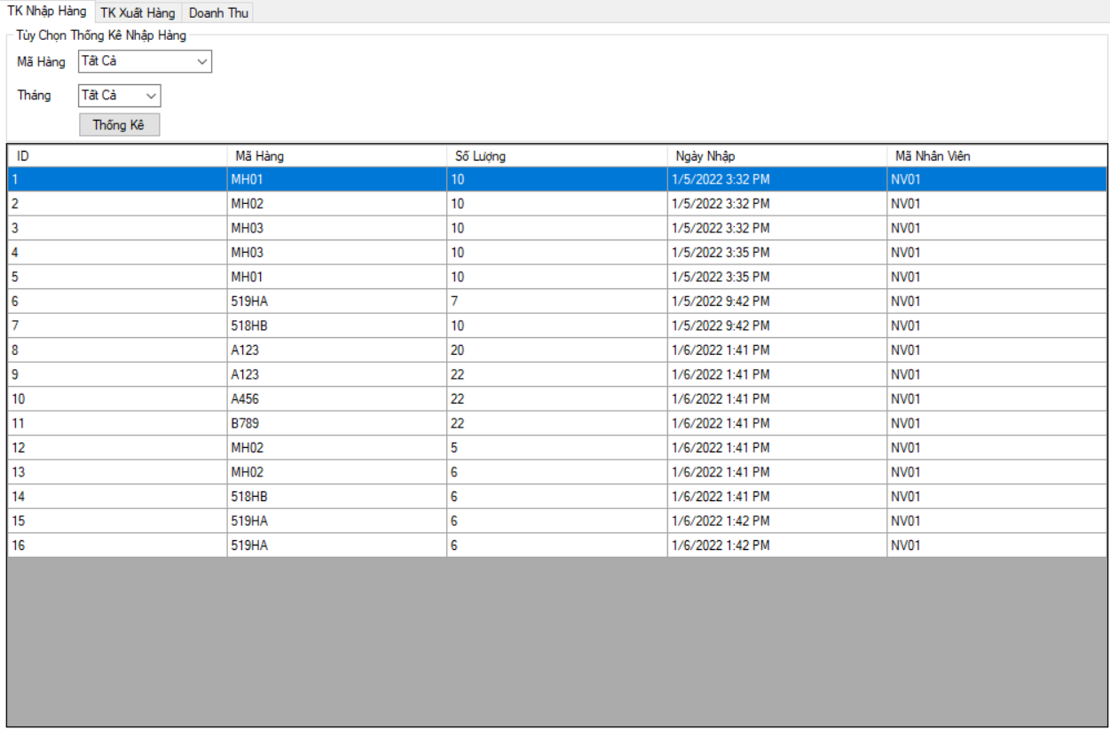
Statistical
02
3

Slide 51
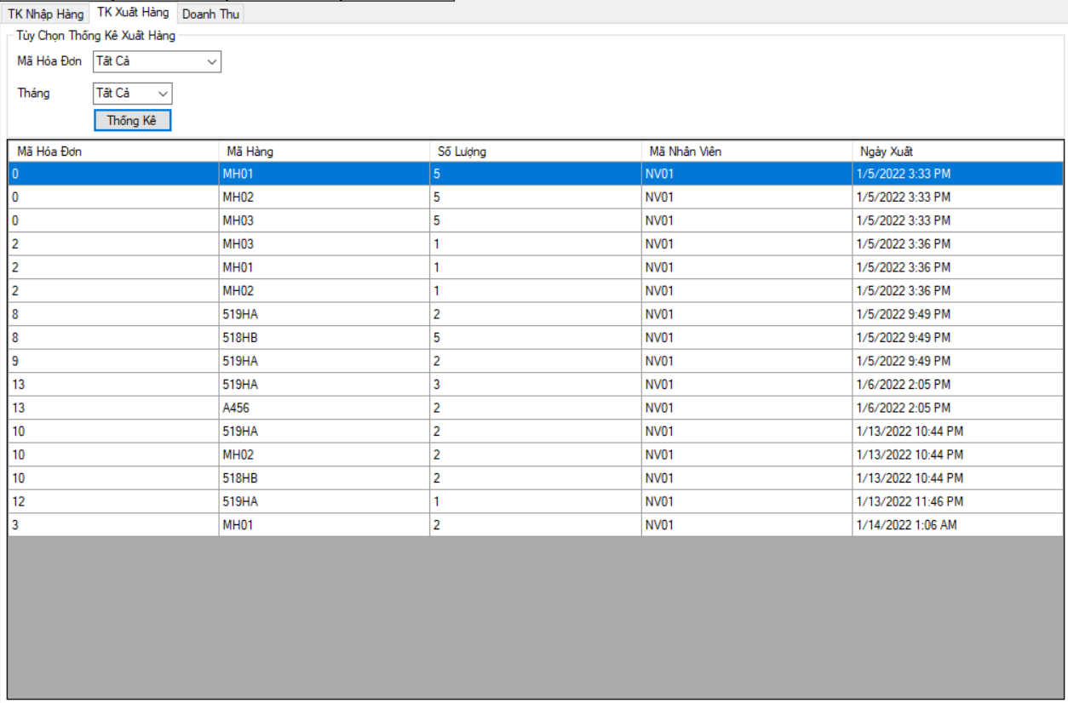
Statistical
02
3

Slide 52
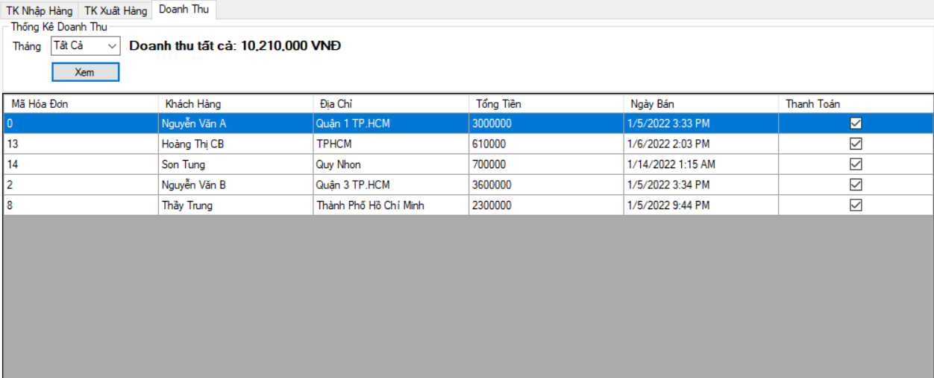
Statistical
02
3

Slide 53
THE END

