Slide 1
TWO-STAGE RECOMMENDER SYSTEM
Степанов Даниил
Бредихин Александр
Конюшенко Юлия
Яскевич Александр
Ачарйа Кирилл
Фролов Евгений - Дирижёр

Slide 2
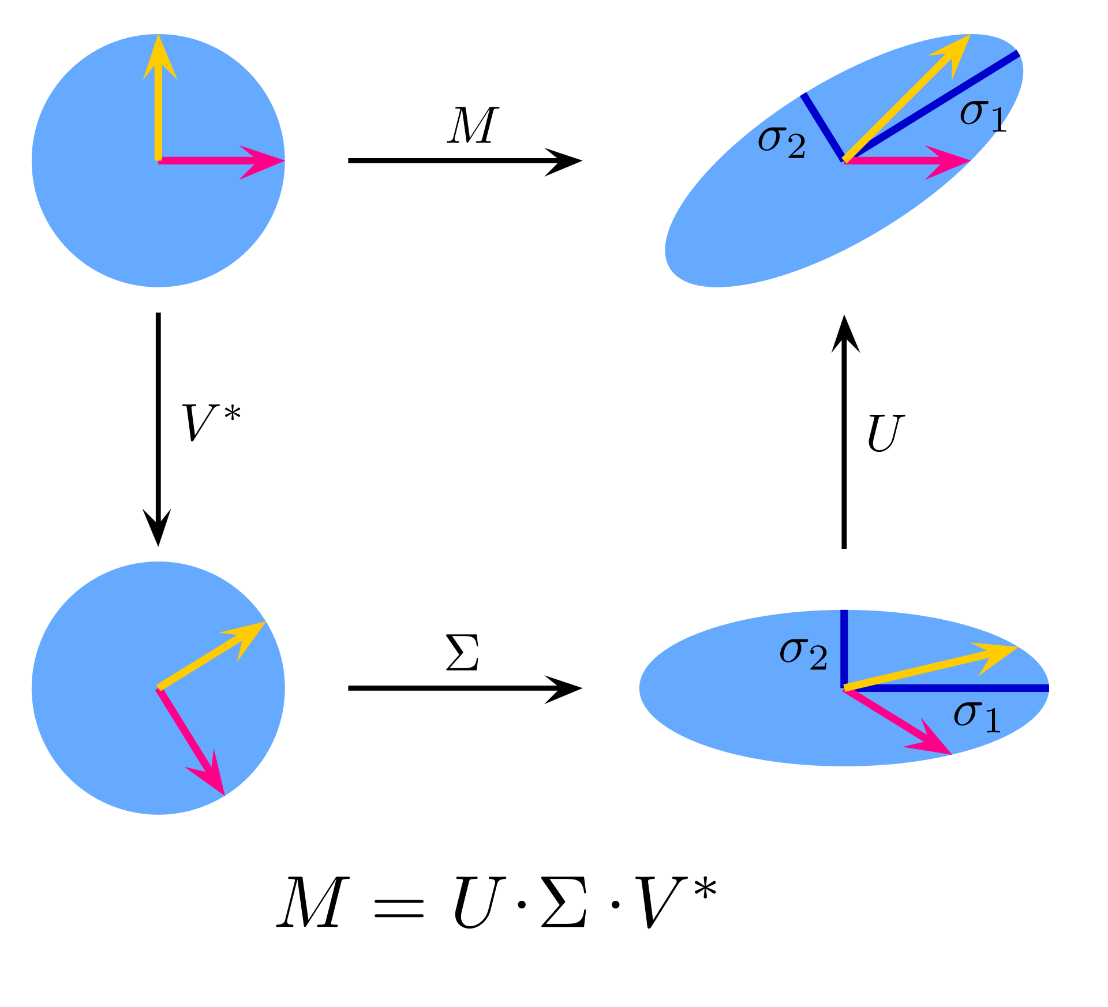
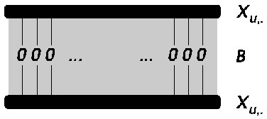
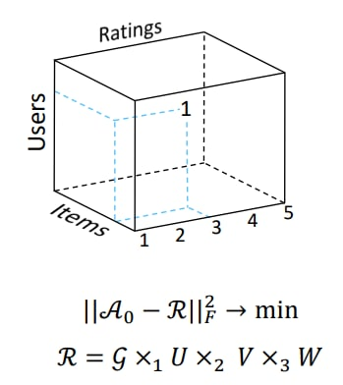
First-stage models
SVD
EASEr
Tensor Model
Directly generate top-10 candidates for scoring
Options
Generate candidates for second-stage

Slide 3
Why Two-stage
Recommender system?
Many real-world recommender systems need to be highly scalable: matching millions of items with billions of users, with milliseconds latency. The scalability requirement has led to widely used two-stage recommender systems, consisting of efficient candidate generation model(s) in the first stage and a more powerful ranking model in the second stage.

Slide 4
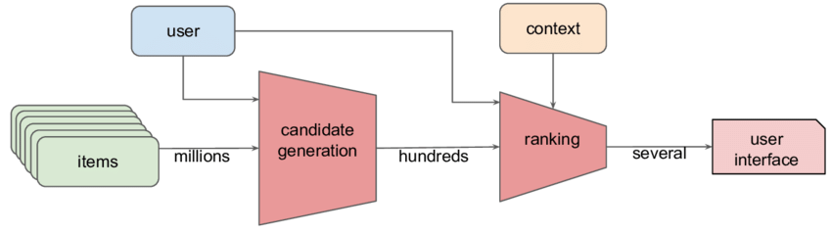

What is this?
This is Problems, Always
Big data
No open-source
evfro - exception
Low metrics
Validation leakage

Slide 5

Our plan
Honestly split the data
Train and test 1st stage models
Make some feature generation
Train and test 2nd stage models
Tune hyperparameters for combined model

Slide 6
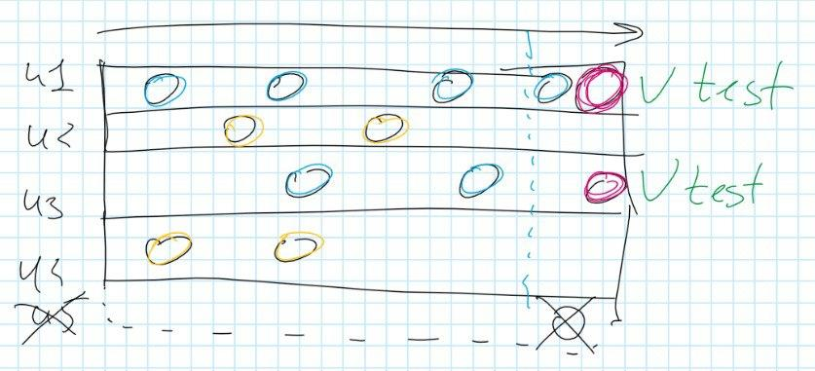
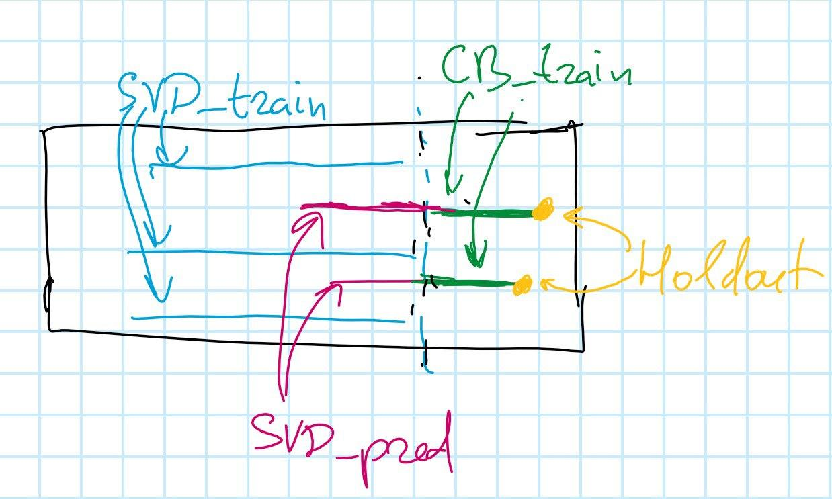
Data preprocessing
First split: train - 95% and test - 5%
Remove test users from train
Split train on stage1_train, stage2_predict, stage2_train, stage2_holdout
Add generated features to stage2_train
Finally, split test on test_predict and test_holdout
Data by time: stage1_train, stage2_predict, stage2_train, stage2_holdout, final_test, final_train
train
from this
to this

Slide 7

Feature Engineering
Main concept - Sequential features
Your browser history?
Interactions with objects
Metadata of items
SVD-embeddings
BERT-embeddings

Slide 8

Second-stage model
How to fit?
Get candidates from the first-level model
Merge with stage2_train to generate labels
Add generated features
Train model
How to predict?
Repeat 1, 2, 3 steps from fit for final_test, but without labels
Score candidates and choose top-10
Calculate metrics on final_holdout

Slide 9
Results
Качественные результаты
Разработана схема валидации двухуровневой модели
Проверены следующие гипотезы:
1. Двухуровневая модель лучше одноуровневой
2. Динамические признаки лучше статических
3. Тензорная модель уточняет предсказания
Baseline models results
model | hit rate | mrr | cov
SVD | 0.0841 | 0.0325 | 0.2670
EASEr | 0.0912 | 0.0365 | 0.1861
Two-stage model results
model | hit rate | mrr | cov
SVD + CB | 0.0859 | 0.0332 | 0.2459

Slide 10
Sources
Блоги про двухуровневый подход:
https://habr.com/ru/company/okko/blog/454224/
https://habr.com/ru/company/tinkoff/blog/454818/
https://habr.com/ru/company/avito/blog/439206/
Литература по моделям:
https://dl.acm.org/doi/10.1145/1864708.1864721
https://arxiv.org/abs/1607.04228
Генерация фичей:
https://habr.com/ru/post/447376/
https://github.com/aprotopopov/retailhero_recommender
https://github.com/mike-chesnokov/x5_retailhero_2020_recs
https://arxiv.org/abs/1610.04850
Примеры:
https://github.com/evfro/recsys19_hybridsvd/tree/master/data
https://github.com/skoltech-ai/Recommender-Systems-Intro-Sber-2022/blob/main/Evaluation.ipynb
https://github.com/sharthZ23/your-second-recsys/blob/master/lecture_5/tutorial_hybrid_model.ipynb/

