Slide 1
Non-Parametric
17
Statistical tests
Probability
and
Statistics
COMS10011
Dr. Anne Roudaut
csxar@bristol.ac.uk
(Thanks S. Massa, Oxford)

Slide 2
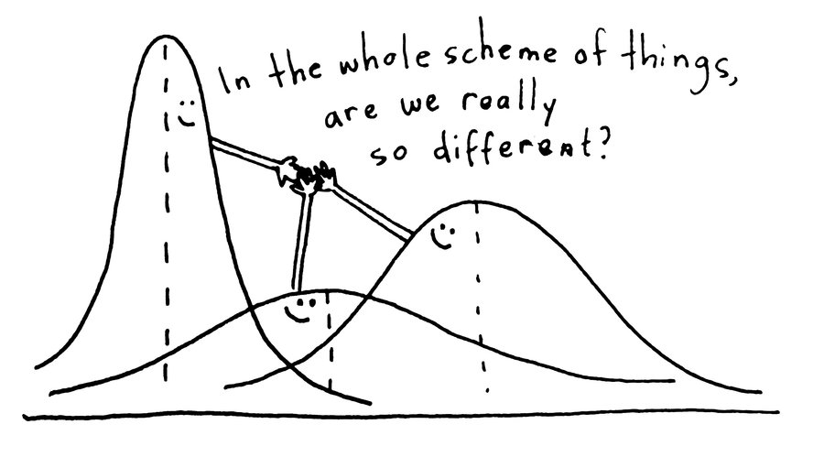
but if we have
distributions like this …
(assumption normality non verified)
… or that
(assumption homogeneity non verified)

Slide 3

we cannot use Ttest and Anova

Slide 4
continuous independent variable
What type of data?
discrete independent variable
we can choose non-parametric tests
continuous dependent variable
discrete dependent variable
Continuous dependent variable
Discrete/categorical dependent variable
regressions
logistic
regressions
normally distributed
skewed
2 grp
>2 grp
2 grp
>2 grp
2 grp
>2 grp
Non paired
paired
Non paired
paired
Non paired
paired
Non paired
paired
Counts >= 5 in >= 75% cells
Counts >= 5 in < 75% cells
T-test
ANOVA
Mann-Whitney Utest
Wilcoxon signed rank test
Kruskall-Wallis test
Chi-square test
Fisher’s exact test
Chi-square test
Paired-t-test
Friiedman test
McNemar’s test

Slide 5
today::
we will look at four non-parametric tests

Slide 6
four non-parametric tests are very robust (i.e. skewed and non-homogeneous data ok) but nothing is perfect: what you gain in robustness you lose in power.
parametric equivalent
(unpaired t-test)
2 grp
>2 grp
Non paired
paired
Non paired
paired
(paired t-test)
(anova)
Mann-Whitney Utest
Wilcoxon signed rank test
Kruskall-Wallis test
Friiedman test
(anova)

Slide 7
so parametric tests used mean and variance, what do we do now?
signal
?
noise

Slide 8
most tests use ranking … let’s look at one example

Slide 9
rank sum test (Mann Whitney)
Mann Whitney by hand
pdf in GitHub repository
http://www.real-statistics.com/non-parametric-tests/mann-whitney-test/
unpaired t-test equivalent

Slide 10
received drug A 9 9.50 9.75 10 13 9.50
(different sets of participants for each)
received drug B 11.50 12 9 11.50 13.25 13
1. rank the observations according to their size relative to the whole sample.
9 9 9.50 9.50 9.75 10 11.50 11.50 12 13 13 13.25
rank 1 2 3 4 5 6 7 8 9 10 11 12
modified rank 1.5 1.5 3.5 3.5 5 6 7.5 7.5 9 10.5 10.5 12
(when ties – average the rank)
Notes:
y1<- c(9,9.50, 9.75, 10,13, 9.50)
y2<- c(11.50 ,12,9,11.50,13.25, 13)
wilcox.test(y1,y2,paired=FALSE)

Slide 11

2. add up the ranks for the observations which came from smaller group.
our statistic R =
here we have the same sample size for each group so we can take any, e.g. R (drug B) = 9 and R (drug A) = 17
9 9 9.50 9.50 9.75 10 11.50 11.50 12 13 13 13.25
modified rank 1.5 1.5 3.5 3.5 5 6 7.5 7.5 9 10.5 10.5 12
R1 = 30 (n1 = 6)
R2 = 48 (n2=6)
we keep the min

Slide 12
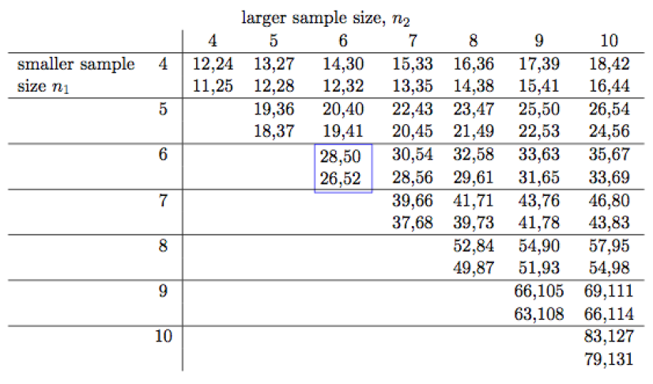
3. we then look in the critical table
rows and columns correspond to the sizes of the smaller and larger samples, respectively.
… why two values?

Slide 13

the top gives the 10% critical values = one-tail test
the bottom the 5% ones = two-tail test
R = 9 < 26.52 (let’s say we do a two tails)
so we reject the null hypothesis and conclude that the two groups are significantly different

Slide 14
R
#wilcox.test do both paired (Mann whitney test) and unpaired, so paired = TRUE would run the Wilcoxon sign rank test, otherwise the Mann Whitney (sometime called Wilcoxon sum rank test)
y1<- c(9,9.50, 9.75, 10,13, 9.50)
y2<- c(11.50,12,9,11.50,13.25, 13)
wilcox.test(y1,y2,paired=FALSE)
data: y1 and y2
W = 9, p-value = 0.1705
alternative hypothesis: true location shift is not equal to 0
Notes:
kruskal.test(weight ~ group, data = my_data)

Slide 15
signed rank test (Wilcoxon)
Wilcoxon by hand
pdf in GitHub repository
http://www.real-statistics.com/non-parametric-tests/wilcoxon-signed-ranks-test/
paired t-test equivalent

Slide 16
very quite similar but this time our data are paired (each participants made the two conditions so we have two data points per participants)
example: we measured the effect of two car seats on level of discomfort, here are the differences for 19 participants
-0.525, 0.172, -0.577, 0.200, 0.040, -0.143, 0.043, 0.010, 0.000, -0.522, 0.007, -0.122, -0.040, 0.000, -0.100, 0.050, -0.575, 0.031, -0.060

Slide 17
1. rank the observations by absolute values and removing the zeros
0.007 0.010 0.031 0.040 -0.040 0.043 0.050 -0.060 -0.100
1 2 3 4.5 4.5 6 7 8 9
-0.122 -0.143 0.172 0.200 -0.522 -0.525 -0.575 -0.577
10 11 12 13 14 15 16 17
2. we then compute R+ (sum of ranks for only positive differences) and R- (sum of ranks for negative differences)
3. We take the min of the two (call this T)
R+ = 48.5
R- = 104.5
T = 48.5

Slide 18
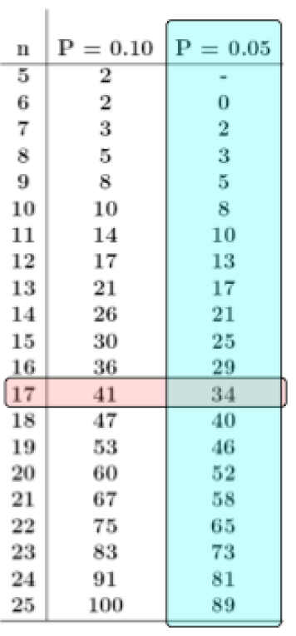
4. we then compare with appropriate table
we computed T = 48:5
since we dropped two values (zeros) our sample size is 19-2=17.
we found the critical value of 34 at the 5% level.
since 48.5 > Tcric of 34, we can’t reject the null hypothesis, therefore effect of these seats are not significantly different

Slide 19
rather simple no?
Kruskal Wallis and Friedman, which are the non-parametric ANOVA equivalent, work on a very similar principles but for more groups depending if they are paired or not (within or between)

Slide 20
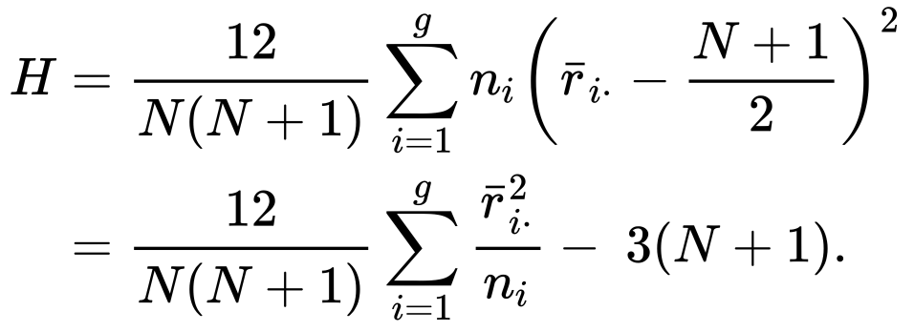
Kruskal Wallis
Kruskal Wallis by hand
pdf in GitHub repository
http://www.real-statistics.com/one-way-analysis-of-variance-anova/kruskal-wallis-test/
ANOVA between subject equivalent

Slide 21
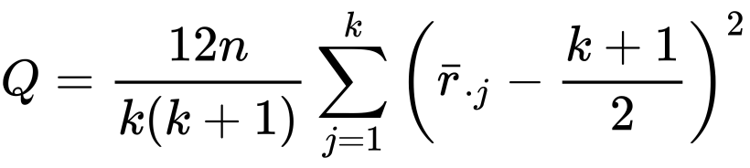
Friedman
Friedman by hand
pdf in GitHub repository
http://www.real-statistics.com/anova-repeated-measures/friedman-test/
ANOVA within subject (also called repeated measure ANOVA) equivalent

Slide 22
practically

Slide 23
one dataset we know well: our experiment on reward vs. punishment
remember we assumed the data was normal but it was not
so now we will finally be able to conclude!

Slide 24
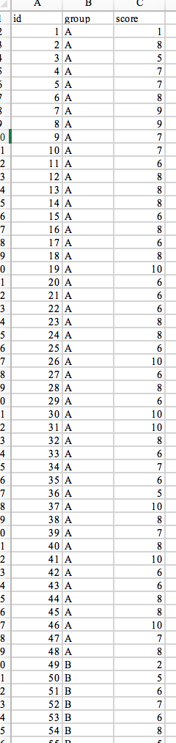
here is our data (chocolate vs. baseline)
2 grp
>2 grp
Non paired
paired
Non paired
paired
Mann-Whitney Utest
Wilcoxon signed rank test
Kruskall-Wallis test
Friiedman test

Slide 25
R
#wilcox.test do both paired (Mann whitney test) and unpaired
dat = read.csv("HCI2018results.csv", header = TRUE)
wilcox.test(dat$score[dat$group == "A"], dat$score[dat$group =="B"],paired=FALSE)
Wilcoxon rank sum test with continuity correction
W = 1290, p-value = 0.6408
Notes:
kruskal.test(weight ~ group, data = my_data)

Slide 26
now let’s add the hypothetical group (punishment)
2 grp
>2 grp
Non paired
paired
Non paired
paired
Mann-Whitney Utest
Wilcoxon signed rank test
Kruskall-Wallis test
Friiedman test

Slide 27
R
dat = read.csv("HCI2018results.csv", header = TRUE)
kruskal.test(score ~ group, data = dat)
data: score by group
Kruskal-Wallis chi-squared = 44.77,
df = 2, p-value = 1.898e-10
pairwise.wilcox.test(dat$score, dat$group, p.adjust.method = "bonferroni")
A B
B 1 -
C 1.6e-09 2.6e-09

Slide 28
here turns out we get the same tendencies than with parametric tests, i.e. there is no evidences of significant effect of chocolate reward on memorization
but there is an effect of punishment

Slide 29
just so you know how to do it
2 grp
>2 grp
Non paired
paired
Non paired
paired
Mann-Whitney Utest
Wilcoxon signed rank test
Kruskall-Wallis test
Friiedman test

Slide 30
R
#for friedman test (source in GitHub)
dat = read.csv("friedmanExample.csv", header = TRUE)
friedman.test(dat$count, dat$year, dat$month)
data: dat$count, dat$year and dat$month
Friedman chi-squared = 7.6, df = 2, p-value = 0.02237
# note there is a real drop in statistical power when using a Friedman test. There are methods that enable post-hoc tests but the power is such that obtaining significance is well nigh impossible. The best you can do is to present a boxplot of the data (dependent ~ group).

Slide 31
example from scratch

Slide 32
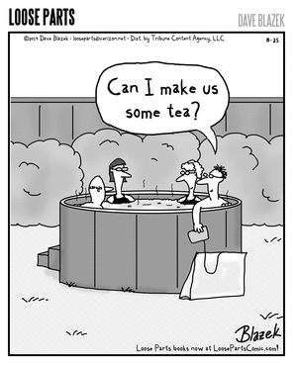
biggest cause disputes in UK
do you put milk in your cup of tea before or after the boiling water?

Slide 33
1
5
research question / hypothesis?
look at raw data
2
6
in(dependant) variables?
look at distributions
3a
within or between subjects?
7a
check for normality
3b
counterbalancing?
7b
run some stats
4
8
how many repetitions/trials?
conclude

Slide 34

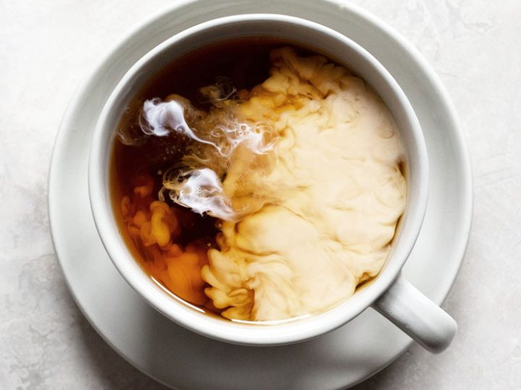

try this with a friend during reading weeks
https://tinyurl.com/statsBristol
tea
milk
water
don’t tell them how you made the cup
tea
water
milk

Slide 35
H = participants will prefer the taste of tea when the milk is put after the boiling water
IV = One cup is made with milk before
One cup is made with milk after
DV = tastiness
On a scale of 1 to 5 rate the tastiness of this cup?
1 very not tasty 2 not tasty 3 undecided 4 tasty 5 very tasty
Between subjects with one trial only

Slide 36
1 very not tasty 2 not tasty 3 undecided 4 tasty 5 very tasty
Likert are most often skewed

Slide 37
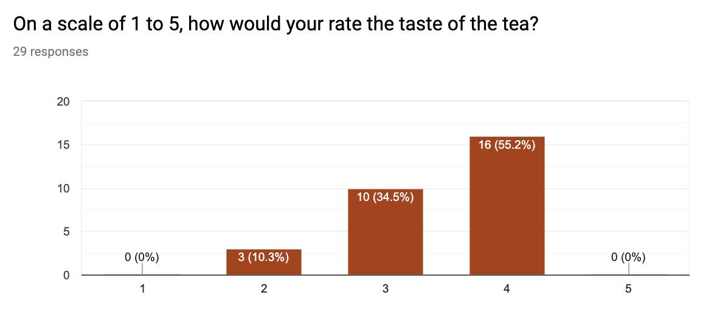

Slide 38
R
# Find the mean of each group
library(plyr)
dat = read.csv("milkexperiment.csv", header = TRUE)
cdat <- ddply(dat, "group", summarise, score.mean=mean(score))
cdat
group score.mean
1 A 3.647059
2 B 3.210526
# Overlaid histograms with means
library(ggplot2)
ggplot(dat, aes(x=score, fill=group)) + geom_histogram(binwidth=1, alpha=.3, position="identity") + geom_vline(data=cdat, aes(xintercept=score.mean, colour=group), linetype="dashed", size=1) + expand_limits(x = 0, y = 0)
Notes:
head(cars) # cars is a table that already comes with R and contain 50 observations of speed and distance in two rows
scatter.smooth(x=cars$speed, y=cars$dist, main="Dist ~ Speed") # scatterplot
linearMod <- lm(dist ~ speed, data=cars) # build linear regression model on full data
summary(linearMod) # summary(linearMod)$r.squared
abline(linearMod, col="blue")

Slide 39
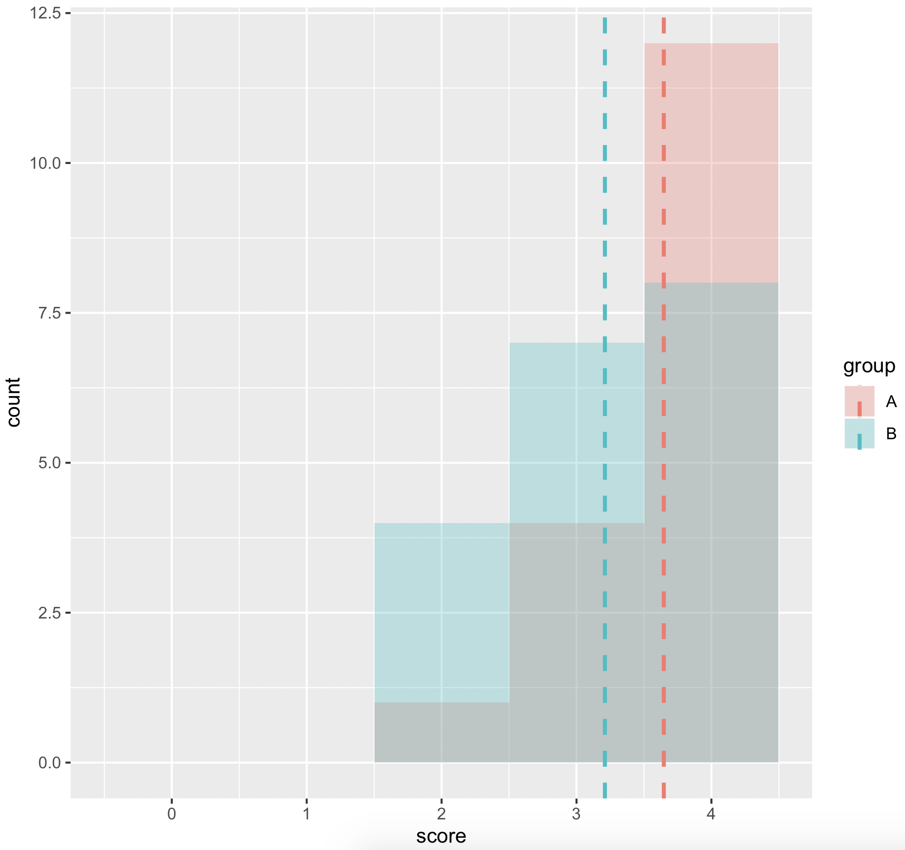

Slide 40
lest try to transform this … with square root

Slide 41
R
# Find the mean of each group
library(plyr)
dat = read.csv("milkexperiment.csv", header = TRUE)
cdat <- ddply(dat, "group", summarise, score.mean=mean(score))
cdat
group score.mean
1 A 1.902495
2 B 1.777958
# Overlaid histograms with means
library(ggplot2)
ggplot(dat, aes(x=score, fill=group)) + geom_histogram(binwidth=1, alpha=.3, position="identity") + geom_vline(data=cdat, aes(xintercept=score.mean, colour=group), linetype="dashed", size=1) + expand_limits(x = 0, y = 0)
Notes:
head(cars) # cars is a table that already comes with R and contain 50 observations of speed and distance in two rows
scatter.smooth(x=cars$speed, y=cars$dist, main="Dist ~ Speed") # scatterplot
linearMod <- lm(dist ~ speed, data=cars) # build linear regression model on full data
summary(linearMod) # summary(linearMod)$r.squared
abline(linearMod, col="blue")

Slide 42
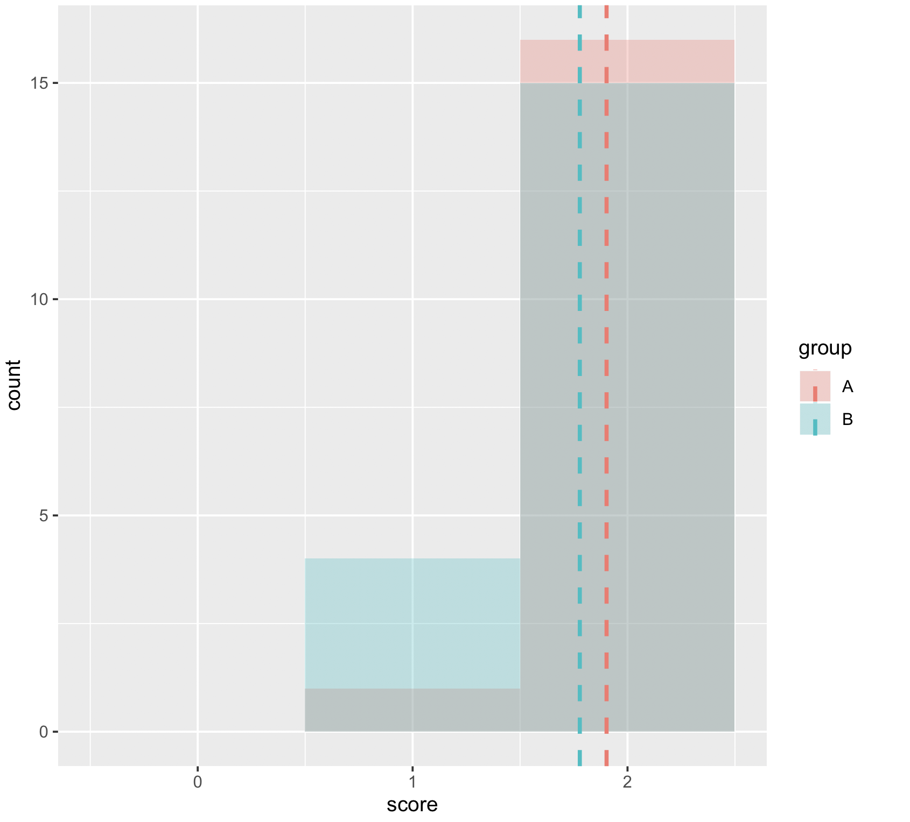

Slide 43
R
shapiro.test(dat$score)
Shapiro-Wilk normality test
data: dat$score
W = 0.72514, p-value = 7.196e-07
= definitely not normal!
Notes:
kruskal.test(weight ~ group, data = my_data)

Slide 44
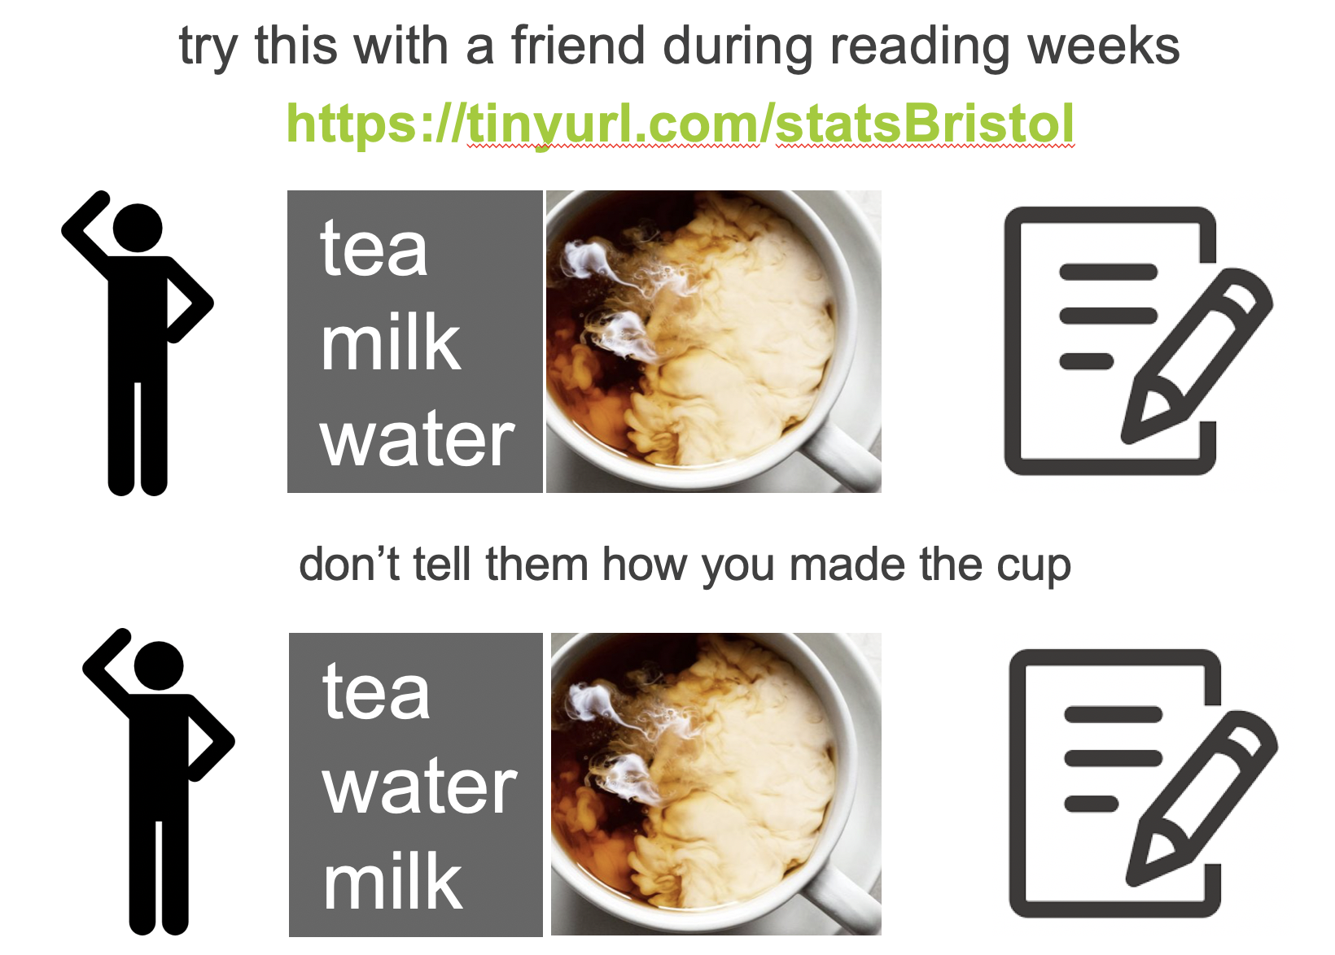
2 grp
>2 grp
Non paired
paired
Non paired
paired
Mann-Whitney Utest
Wilcoxon signed rank test
Kruskall-Wallis test
Friiedman test

Slide 45
R
#wilcox.test do both paired (Mann whitney test) and unpaired
dat = read.csv("milkexperiment.csv", header = TRUE)
wilcox.test(dat$scoreraw[dat$group == "A"], dat$scoreraw[dat$group =="B"],paired=FALSE)
Wilcoxon rank sum test with continuity correction
W = 212, p-value = 0.07612
Notes:
kruskal.test(weight ~ group, data = my_data)

Slide 46
unfortunately our experience was inconclusive
(because pvalue > 0.05)

Slide 47
what can be the reasons that there is no different?
-> low sample size
-> too much “noise” = did we control enough?
-> too weak signal = may be there is actually no difference in taste after all

Slide 48
summary

Slide 49
take away
Give the name of the four non-parametric tests seen today and when to use them
Explain the basis of Mann Whitney and Wilcoxon test, aka that they use ranks rather than mean
I will not ask you to do it by hand in the exam

Slide 50
next
continuous independent variable
What type of data?
discrete independent variable
continuous dependent variable
discrete dependent variable
Continuous dependent variable
Discrete/categorical dependent variable
regressions
logistic
regressions
normally distributed
skewed
2 grp
>2 grp
2 grp
>2 grp
2 grp
>2 grp
Non paired
paired
Non paired
paired
Non paired
paired
Non paired
paired
Counts >= 5 in >= 75% cells
Counts >= 5 in < 75% cells
T-test
ANOVA
Mann-Whitney Utest
Wilcoxon signed rank test
Kruskall-Wallis test
Chi-square test
Fisher’s exact test
Chi-square test
Paired-t-test
Friiedman test
McNemar’s test

Slide 51
end

