Slide 1

Citi Bike in New Jersey
Analysis for September 2017

Slide 2
Quick September-Facts
12.000 Bikes in Manhattan, Brooklyn Queens & Jersey City
Avg. 62.605 rides per day ➔ each bike 6.25 times used
Avg ride 14.50 minutes
Avg 2.3 miles

Slide 3
Explore Citi Bike
Use of Stations
Diversitiy of Users

Slide 4
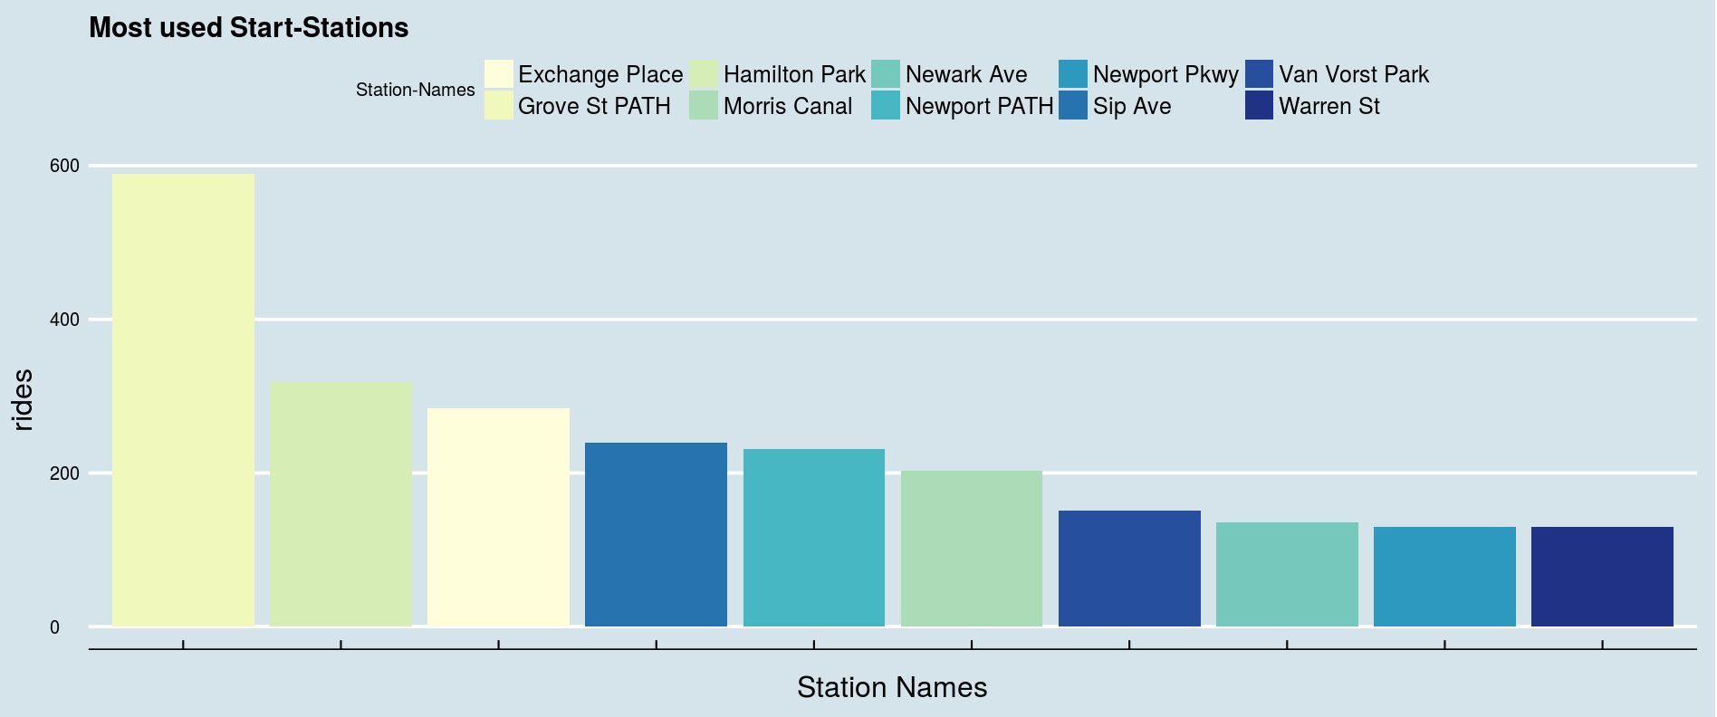
Frequency
More bikes needed
Additional stations
More frequent check up

Slide 5
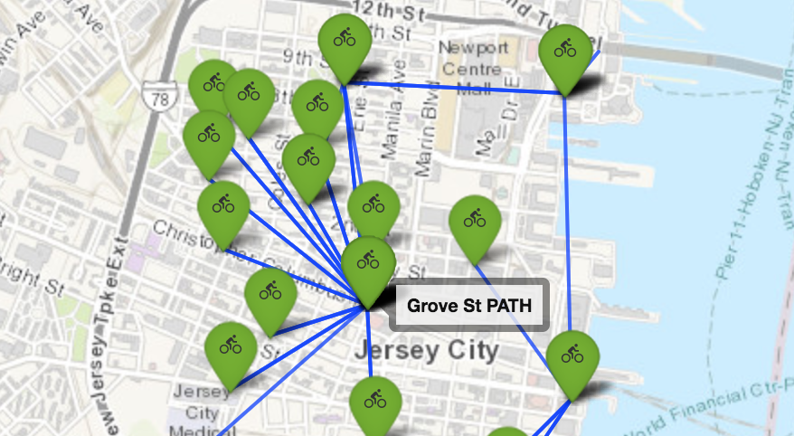
The routes
Identifying the most used routes:
Better bike path
Traffic light for bikes
Left turns for bikes

Slide 6
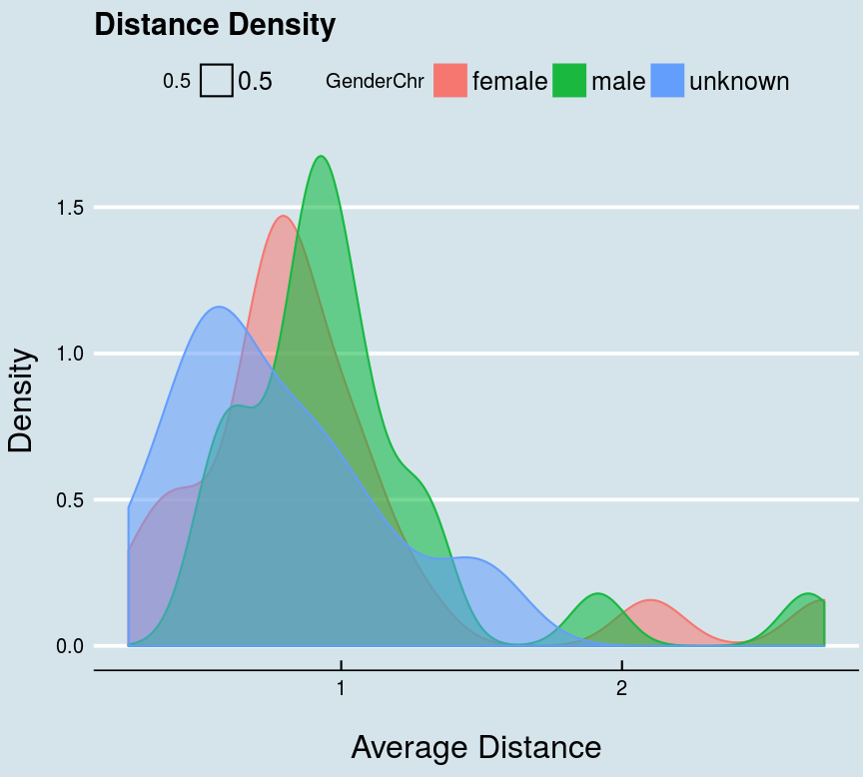
Distance
For what distances do riders
use the bikes?
(30 minutes maximum use)

Slide 7
Thank you very much for listening!

