Slide 1
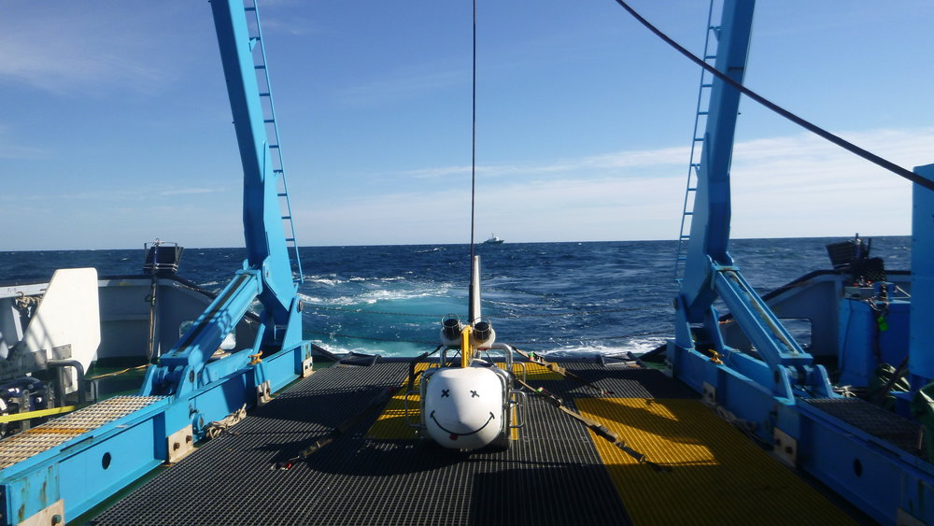
CSEM study on the Gekko well :

Slide 2
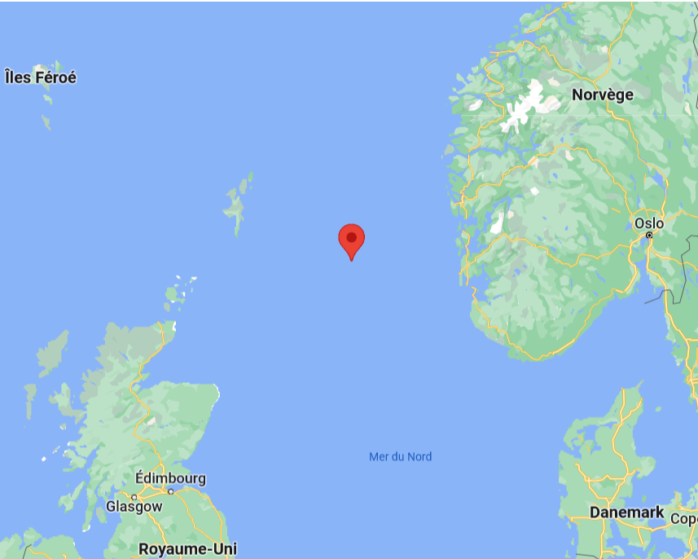
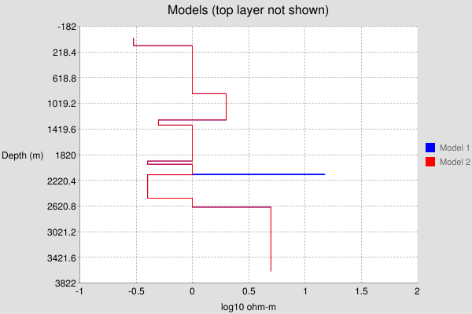

Slide 3
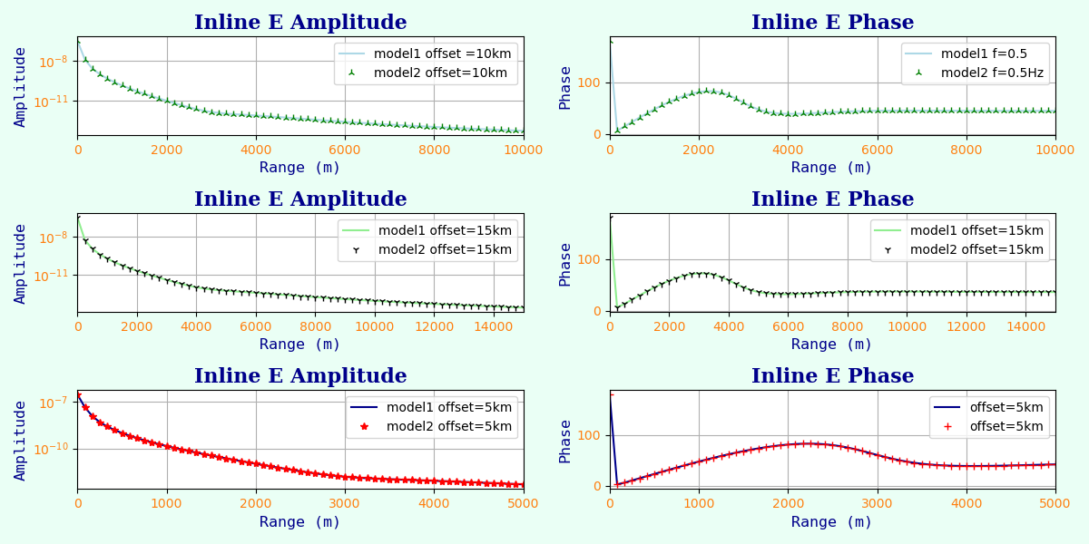
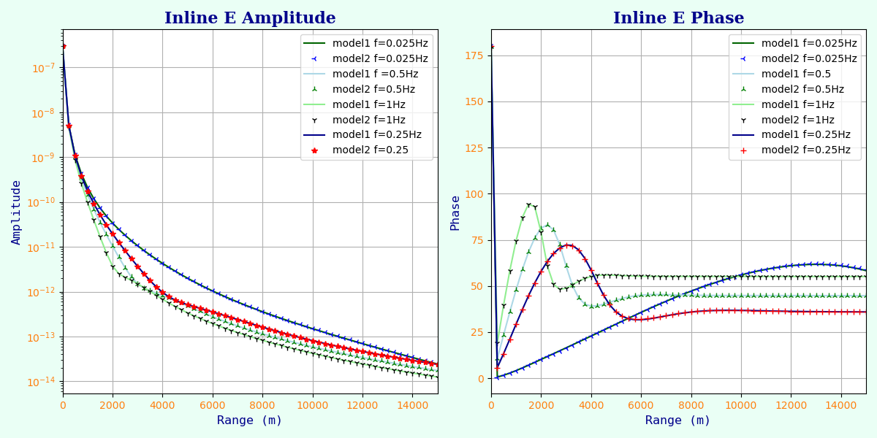

Slide 4
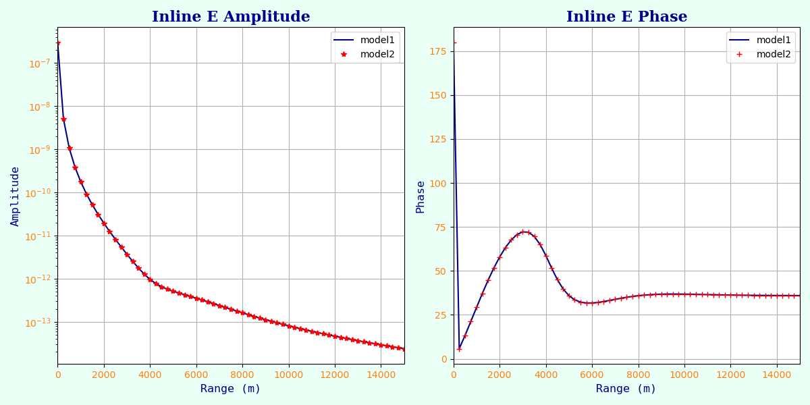
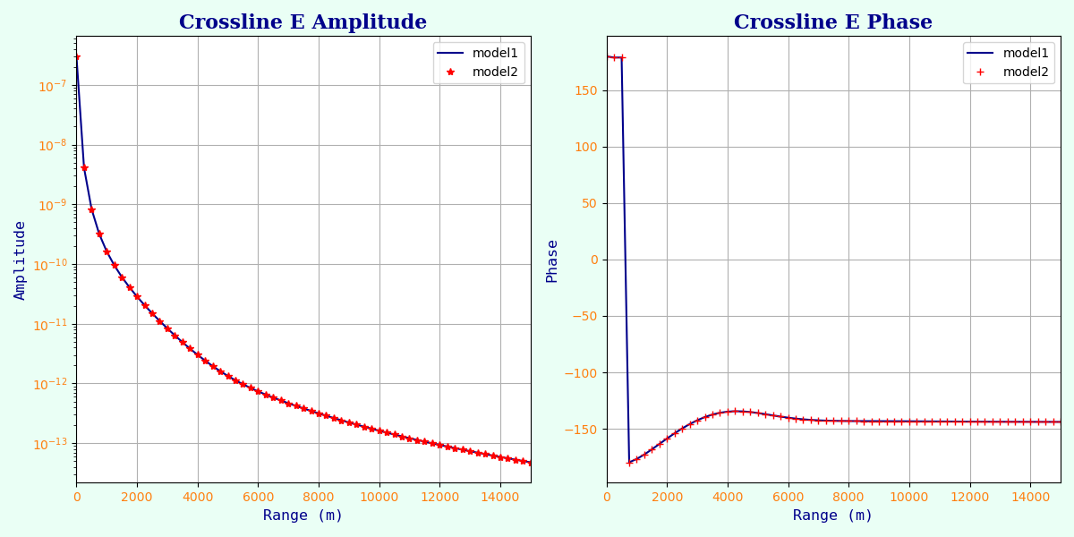

Slide 5
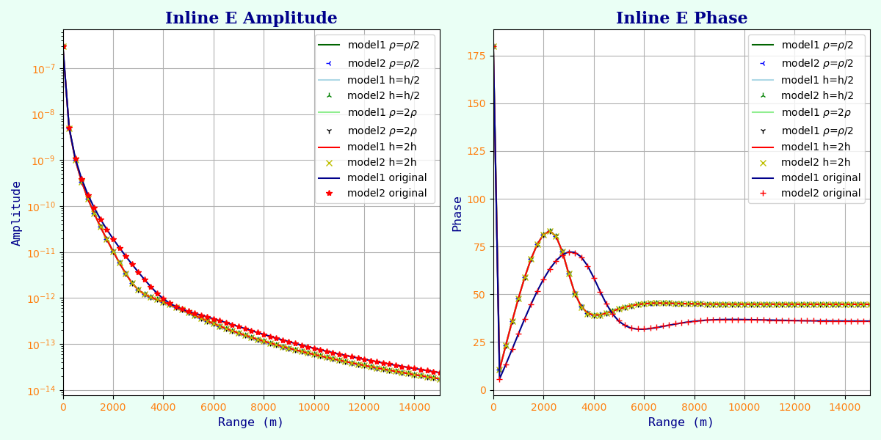

Slide 6
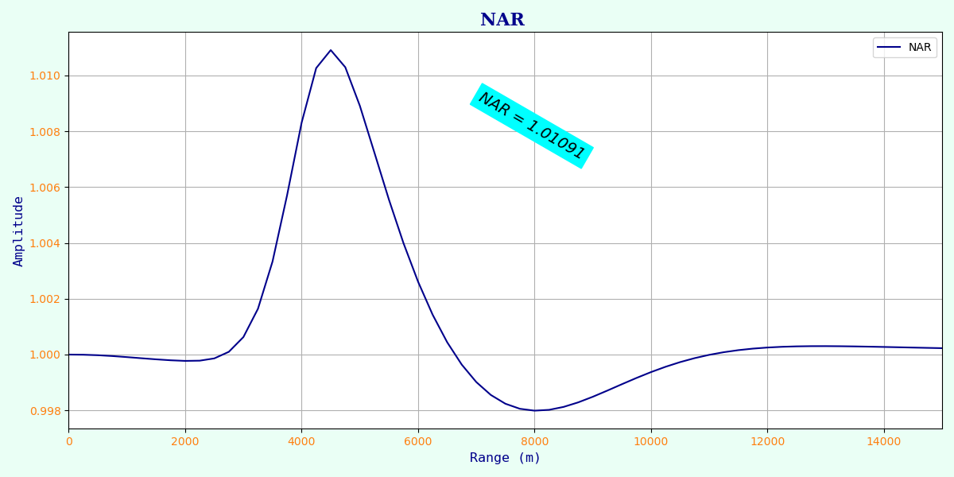

Slide 7
Conclusion :
- No relevant differences between Inline WITH and NO
- Also no differences between the Inline and Crossline curves
- Hesthammer criterion of 1% way under the 15% needed
We advise not to continue the exploitation of the Gekko well

