Slide 1


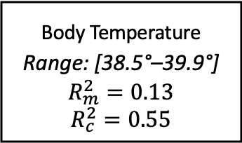
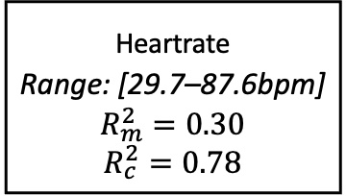
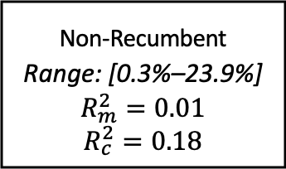
Body Temperature
Range: [38.5°–39.9°]
$$R_{m}^{2}=0.13$$
$$R_{c}^{2}=0.55$$
β = -0.019
β = -0.011
Temperature- Humidity-Index
Range: [38.4–82.1]
Non-Recumbent
Range: [0.3%–23.9%]
$$R_{m}^{2}=0.01$$
$$R_{c}^{2}=0.18$$
β = -0.140**
r = 0.126***
β = 0.116***
Heartrate
Range: [29.7–87.6bpm]
$$R_{m}^{2}=0.30$$
$$R_{c}^{2}=0.78$$
β = 0.069***
Notes:
Model with daynr and daynr^2

Slide 2
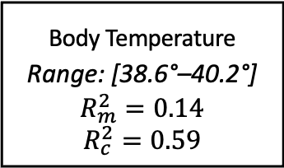
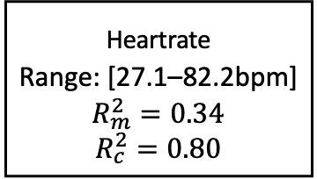
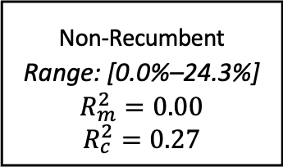
Body Temperature
Range: [38.6°–40.2°]
$$R_{m}^{2}=0.14$$
$$R_{c}^{2}=0.59$$
β = 0.043
+
β = –0.084**
β = -0.075**
Temperature- Humidity-Index
Range: [34.8–74.3]
Non-Recumbent
Range: [0.0%–24.3%]
$$R_{m}^{2}=0.00$$
$$R_{c}^{2}=0.27$$
β =-0.004
r = 0.143***
β = 0.129***
Heartrate
Range: [27.1–82.2bpm]
$$R_{m}^{2}=0.34$$
$$R_{c}^{2}=0.80$$
β = 0.027
Notes:
Model with daynr and daynr^2

Slide 3

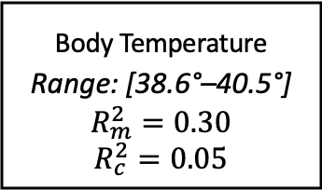
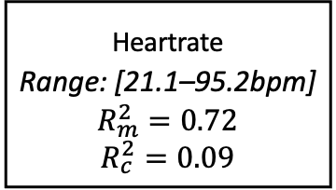
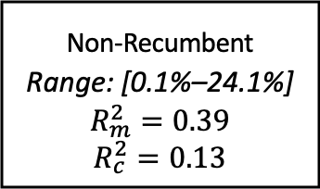
Body Temperature
Range: [38.6°–40.5°]
$$R_{m}^{2}=0.30$$
$$R_{c}^{2}=0.05$$
β = 0.003
+
β = 0.096**
β = 0.013
Temperature- Humidity-Index
Range: [55.8–90.6]
Non-Recumbent
Range: [0.1%–24.1%]
$$R_{m}^{2}=0.39$$
$$R_{c}^{2}=0.13$$
β = 0.075
r = 0.033
β = 0.200*
Heartrate
Range: [21.1–95.2bpm]
$$R_{m}^{2}=0.72$$
$$R_{c}^{2}=0.09$$
β = 0.062*
Notes:
Model with daynr and daynr^2

Slide 4
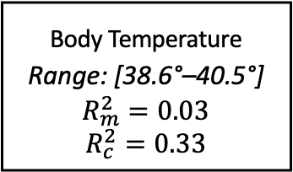
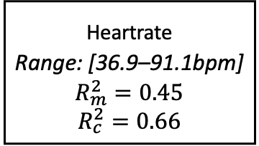
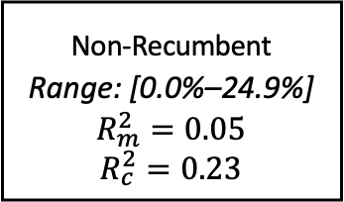
Body Temperature
Range: [38.6°–40.5°]
$$R_{m}^{2}=0.03$$
$$R_{c}^{2}=0.33$$
β = 0.099*
β = -0.045
Temperature- Humidity-Index
Range: [49.6–80.1]
Non-Recumbent
Range: [0.0%–24.9%]
$$R_{m}^{2}=0.05$$
$$R_{c}^{2}=0.23$$
β = -0.073
r = 0.002
β = 0.168***
Heartrate
Range: [36.9–91.1bpm]
$$R_{m}^{2}=0.45$$
$$R_{c}^{2}=0.66$$
β = 0.009
Notes:
Model with daynr and daynr^2

Slide 5

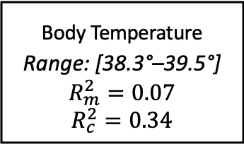
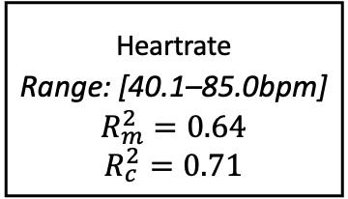
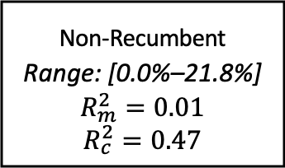
Body Temperature
Range: [38.3°–39.5°]
$$R_{m}^{2}=0.07$$
$$R_{c}^{2}=0.34$$
β = -0.074
β = -0.031
Temperature- Humidity-Index
Range: [38.4–85.5]
Non-Recumbent
Range: [0.0%–21.8%]
$$R_{m}^{2}=0.01$$
$$R_{c}^{2}=0.47$$
β = 0.125
r = 0.081
β₁ = 0.333***
β₂ = -0.228**
Heartrate
Range: [40.1–85.0bpm]
$$R_{m}^{2}=0.64$$
$$R_{c}^{2}=0.71$$
β = 0.059
Notes:
Model with daynr and daynr^2

Slide 6
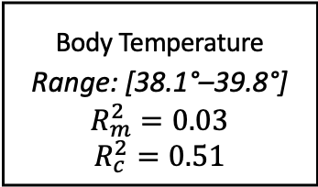
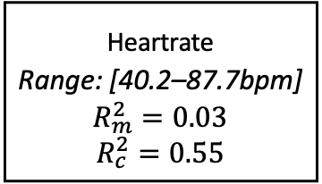
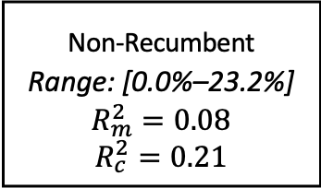
Body Temperature
Range: [38.1°–39.8°]
$$R_{m}^{2}=0.03$$
$$R_{c}^{2}=0.51$$
β = 0.232***
+
β = –0.135*
β = 0.007
Temperature- Humidity-Index
Range: [31.7–76.6]
Non-Recumbent
Range: [0.0%–23.2%]
$$R_{m}^{2}=0.08$$
$$R_{c}^{2}=0.21$$
β =-0.301***
r = 0.093*
+
β = 0.207**
β₁ = 0.291***
β₂ = -0.214**
Heartrate
Range: [40.2–87.7bpm]
$$R_{m}^{2}=0.03$$
$$R_{c}^{2}=0.55$$
β = 0.075*
Notes:
Model with daynr and daynr^2

Slide 7
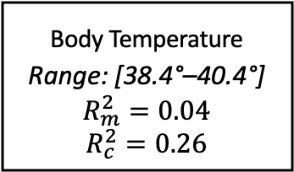
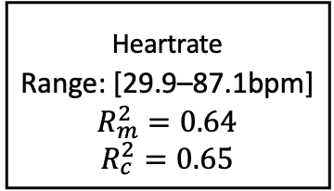
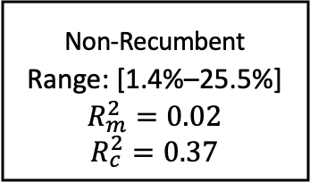
Body Temperature
Range: [38.4°–40.4°]
$$R_{m}^{2}=0.04$$
$$R_{c}^{2}=0.26$$
β = -0.015
β = -0.009
Temperature- Humidity-Index
Range: [33.8–84.6]
Non-Recumbent
Range: [1.4%–25.5%]
$$R_{m}^{2}=0.02$$
$$R_{c}^{2}=0.37$$
β = -0.146**
r = 0.183***
β = 0.094***
Heartrate
Range: [29.9–87.1bpm]
$$R_{m}^{2}=0.64$$
$$R_{c}^{2}=0.65$$
β = 0.026
Notes:
Model with daynr and daynr^2

Slide 8
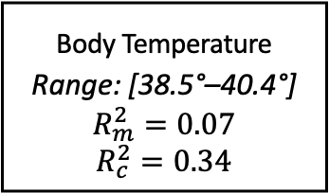
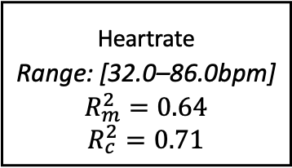
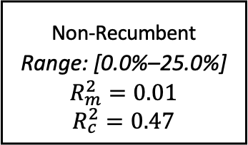
Body Temperature
Range: [38.5°–40.4°]
$$R_{m}^{2}=0.07$$
$$R_{c}^{2}=0.34$$
β = -0.117**
β = -0.060
Temperature- Humidity-Index
Range: [27.7–63.6]
Non-Recumbent
Range: [0.0%–25.0%]
$$R_{m}^{2}=0.01$$
$$R_{c}^{2}=0.47$$
β = -0.095*
r = 0.138**
β = 0.129***
Heartrate
Range: [32.0–86.0bpm]
$$R_{m}^{2}=0.64$$
$$R_{c}^{2}=0.71$$
β = 0.028
Notes:
Model with daynr and daynr^2

