Slide 1
Reinforcement Learning for self-adaptive control of urban traffic lights
Data Science Meetup // Kassel // 12/05/17
PD Dr.-Ing. habil. Sven Tomforde
Intelligent Embedded Systems Group, University of Kassel
stomforde@uni-kassel.de

Slide 2
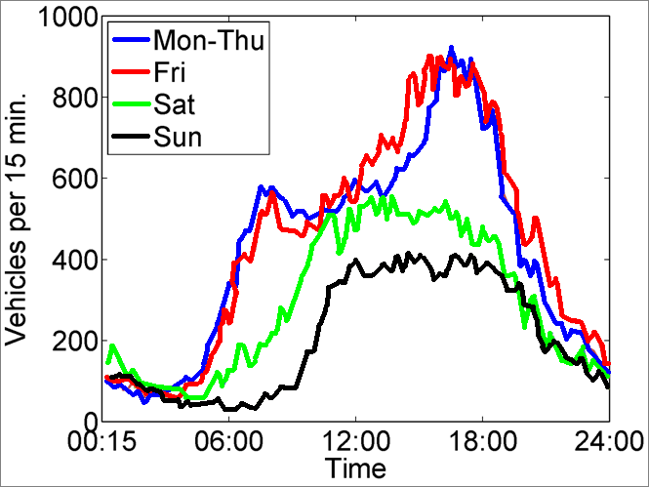
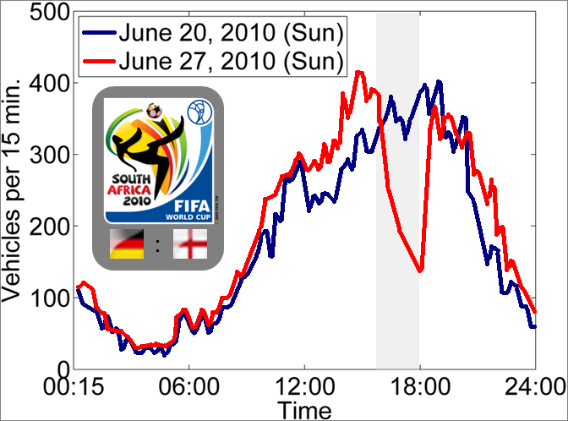
Motivation
Highly dynamic behaviour of traffic
Partly unanticipated at design-time
Distributed subsystems with clear local scope
Sven Tomforde (IES / Uni Kassel)

Slide 3

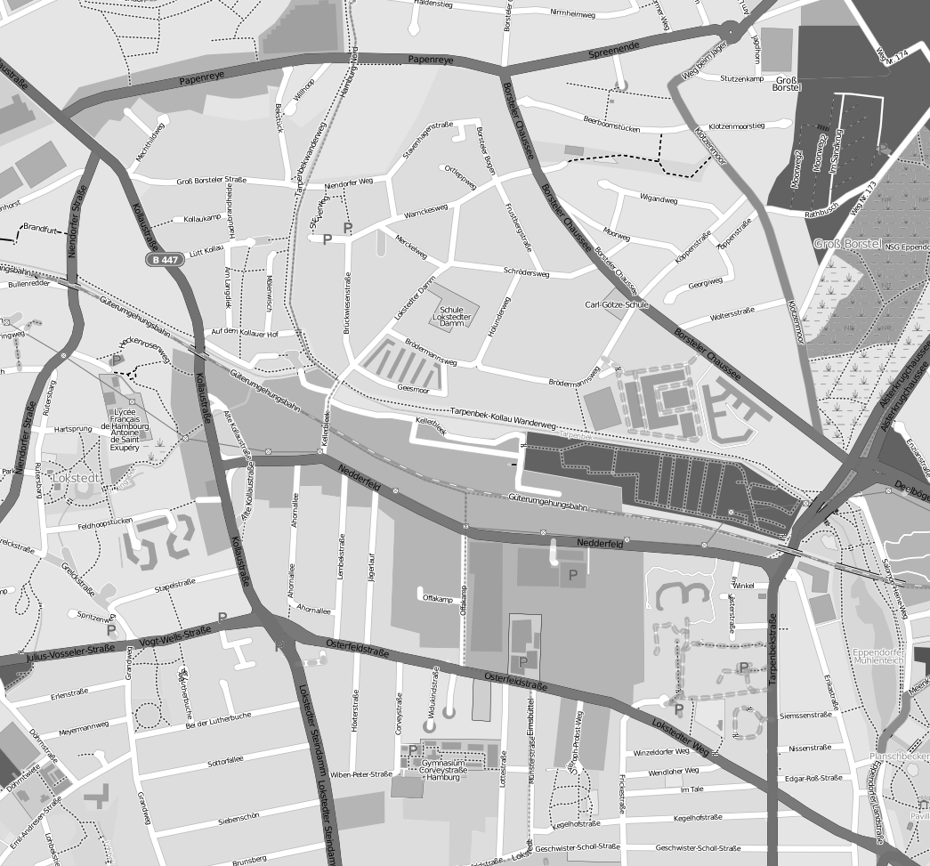
Motivation (2)
Goals of drivers:
Traverse network as fast as possible
Avoid stopping
Reduce fuel consumption
Visit sights
Goals of community (city):
Reduce emissions and noise
Avoid certain areas (e.g., residential areas)
Avoid road work (i.e., new roads, etc.)
Achieve load balancing
Give priority to certain participants (e.g. bus or tram)
Sven Tomforde (IES / Uni Kassel)

Slide 4
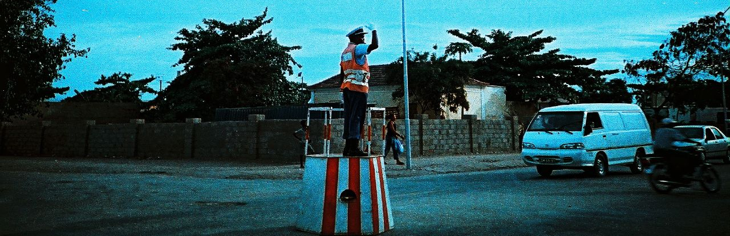
Self-adaptive traffic lights
Sven Tomforde (IES / Uni Kassel)

Slide 5
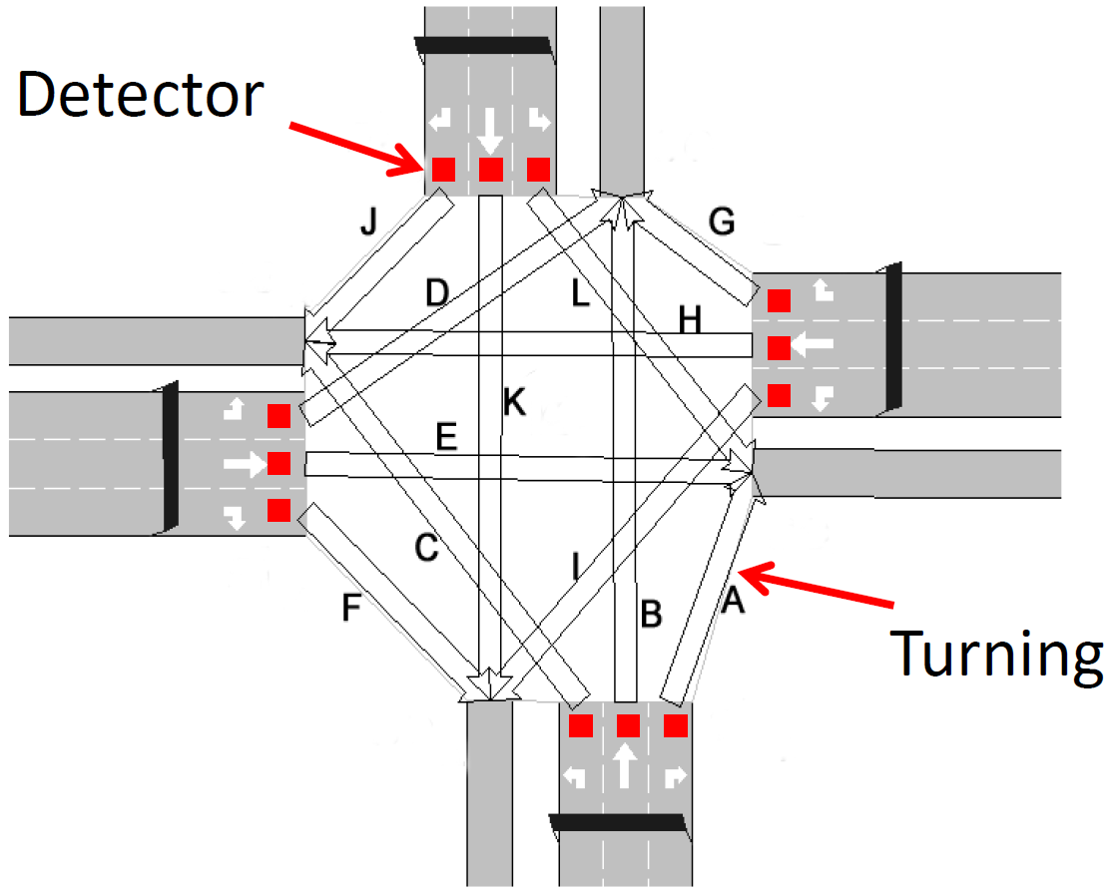
Some basics for traffic control
Intersection
Incoming sections
Outgoing sections
Turning movements connecting both
Detectors (e.g., induction loops in surface of streets)
Traffic lights (either per lane or for groups of lanes)
Sven Tomforde (IES / Uni Kassel)

Slide 6
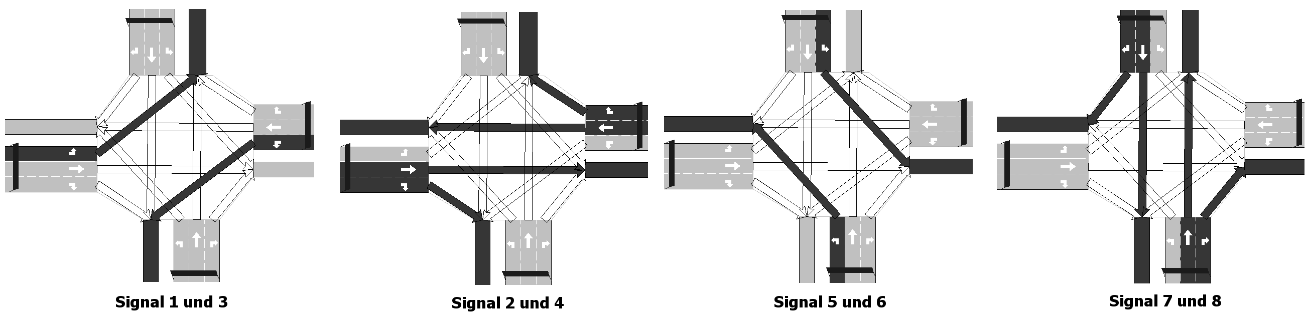
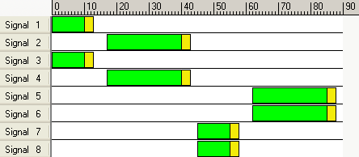
Some basics for traffic control (2)
Signal plan
Defines which groups are controlled together
Specifies durations for phases:
Green durations
Interphases (for clearing purposes)
Red durations
time (relative to cycle)
traffic signals
Sven Tomforde (IES / Uni Kassel)

Slide 7
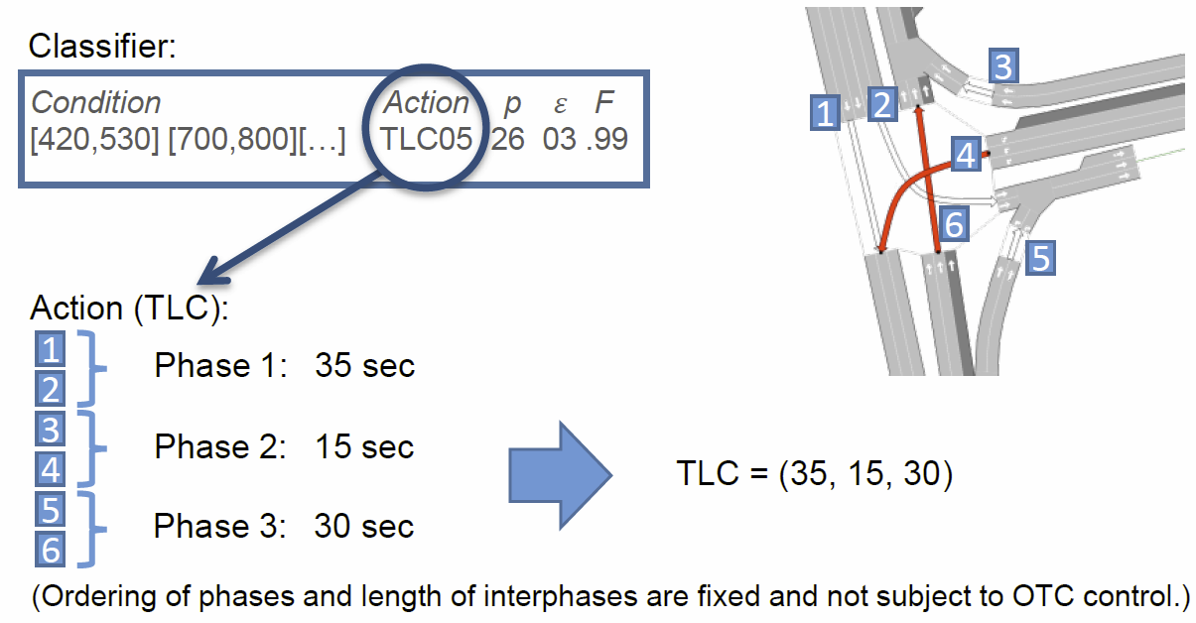
Actuator control
Sven Tomforde (IES / Uni Kassel)

Slide 8
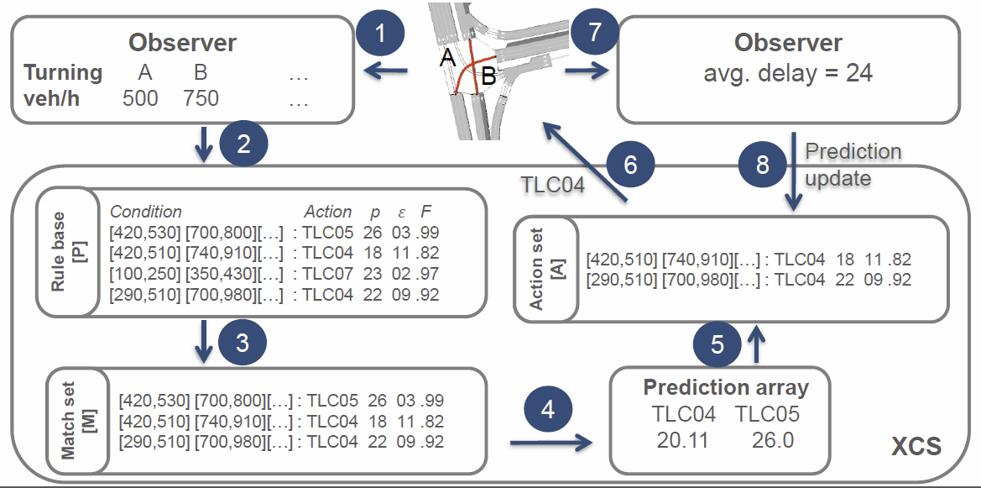
Learning from feedback
Sven Tomforde (IES / Uni Kassel)

Slide 9
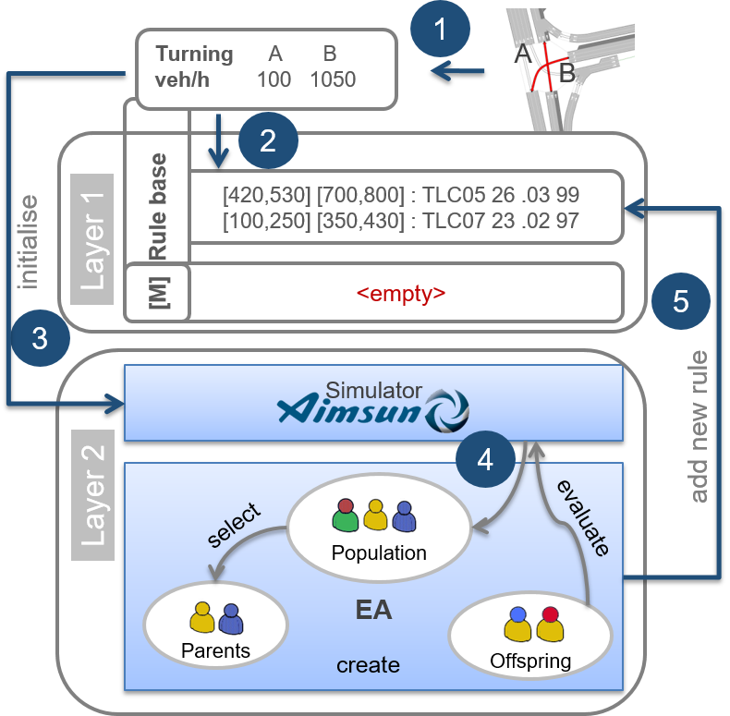
Safety-oriented rule generation
Sven Tomforde (IES / Uni Kassel)

Slide 10
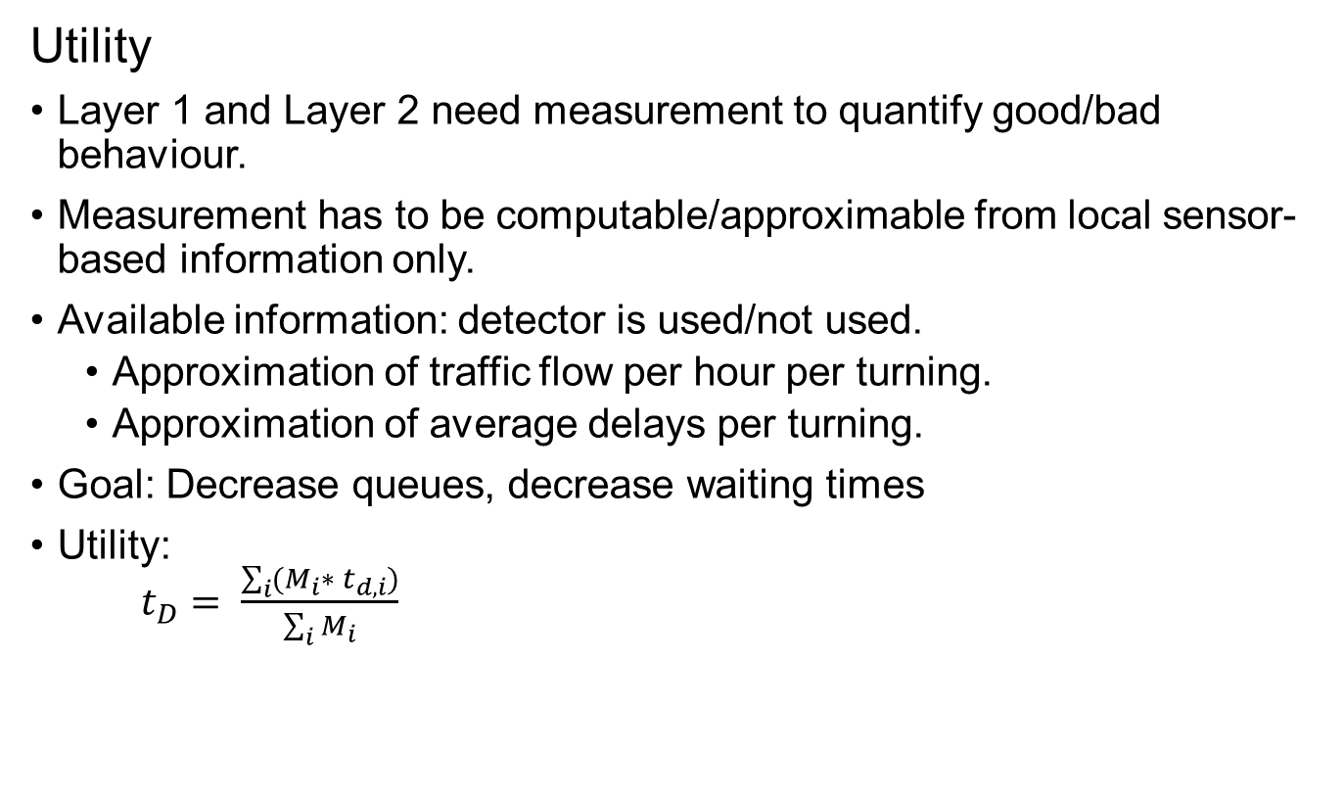
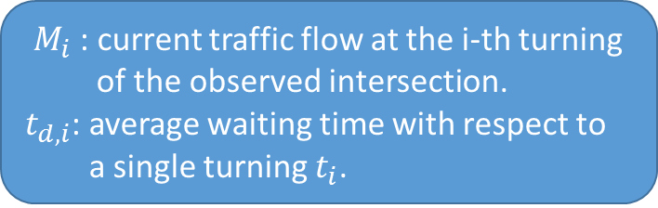
Utility
Utility
Layer 1 and Layer 2 need measurement to quantify good/bad behaviour.
Measurement has to be computable/approximable from local sensor-based information only.
Available information: detector is used/not used.
Approximation of traffic flow per hour per turning.
Approximation of average delays per turning.
Goal: Decrease queues, decrease waiting times
Utility: $t_{D}= \frac{\sum_{i}{(M_{i}∗ t_{d,i})}}{\sum_{i}{M_{i}}}$
$M_{i}$ : current traffic flow at the i-th turning of the observed intersection.
$t_{d,i}$: average waiting time with respect to a single turning $t_{i}$.
Sven Tomforde (IES / Uni Kassel)

Slide 11

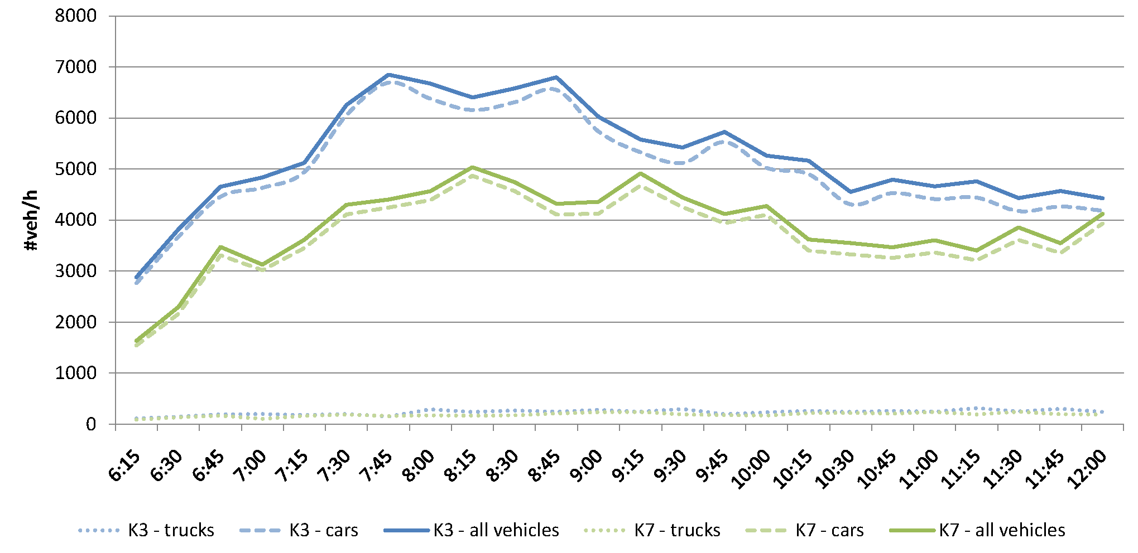
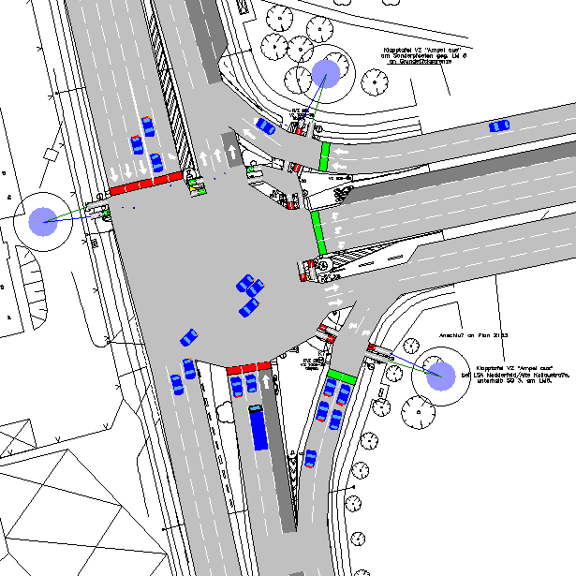
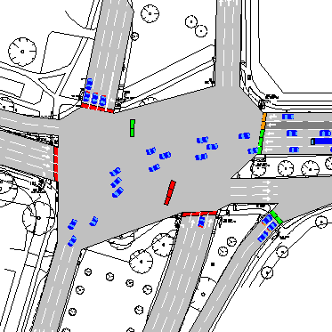
Evaluation
Network situated in Hamburg
Traffic demands from census
Reference: fixed-time control strategy (i.e., as a result of manual optimisation by engineers)
Normal working day / morning rush hour
K7
K3
Road network at Hamburg
K7
K3
Topology models of intersections K7 und K3
Traffic demands according to census for intersections K3 and K7
Sven Tomforde (IES / Uni Kassel)

Slide 12
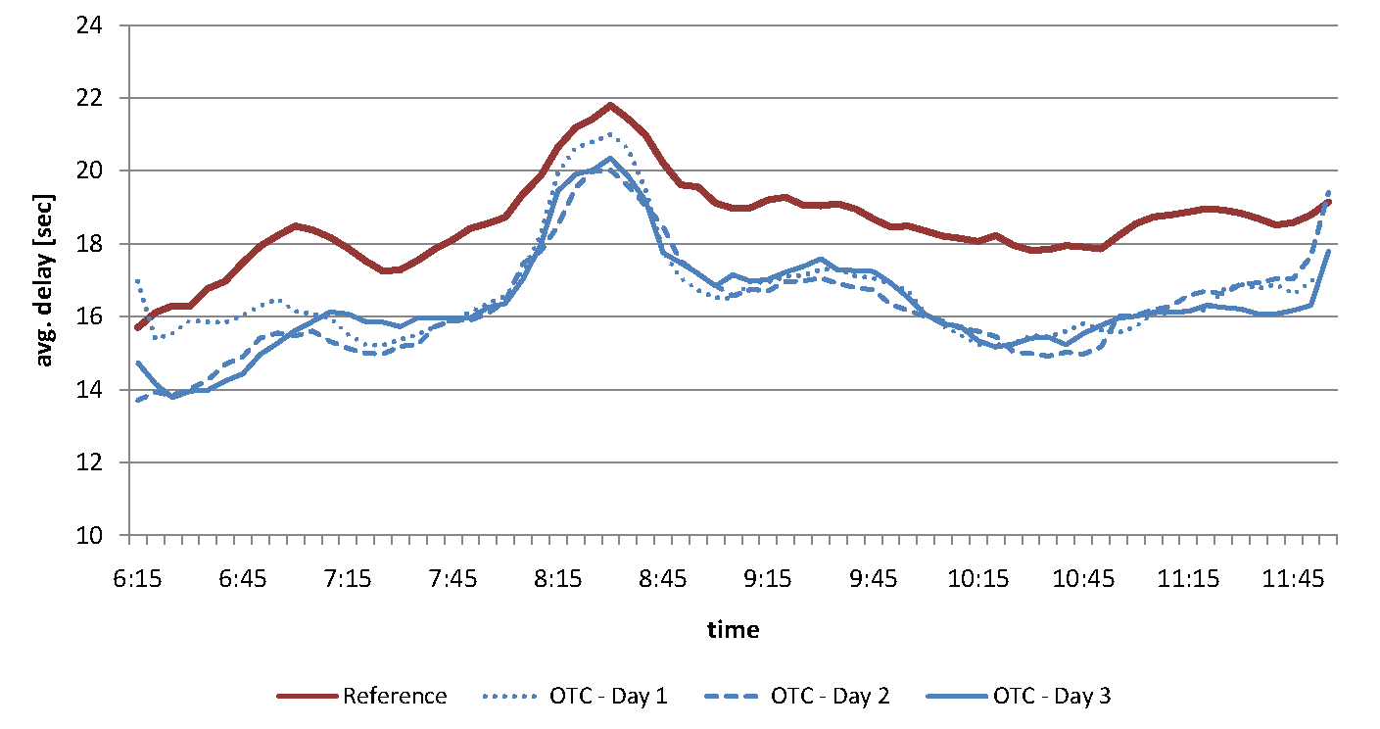
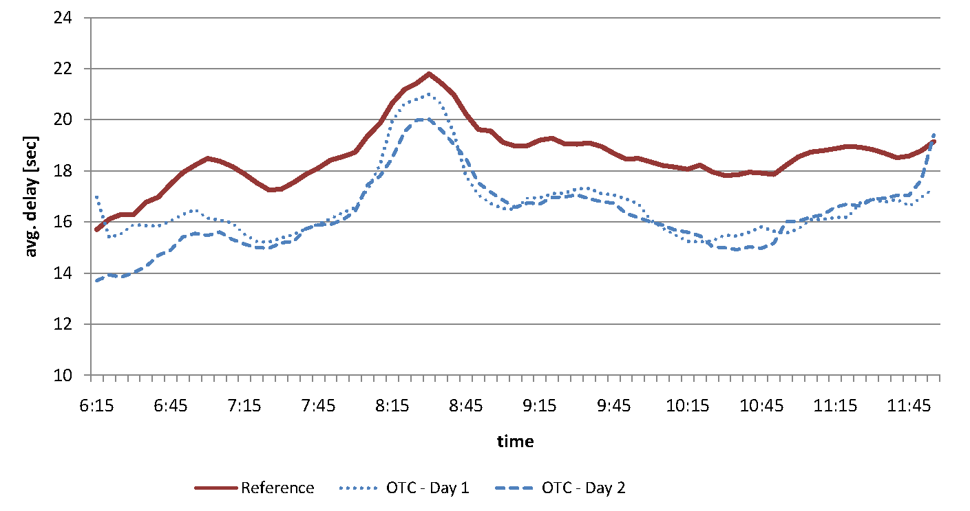
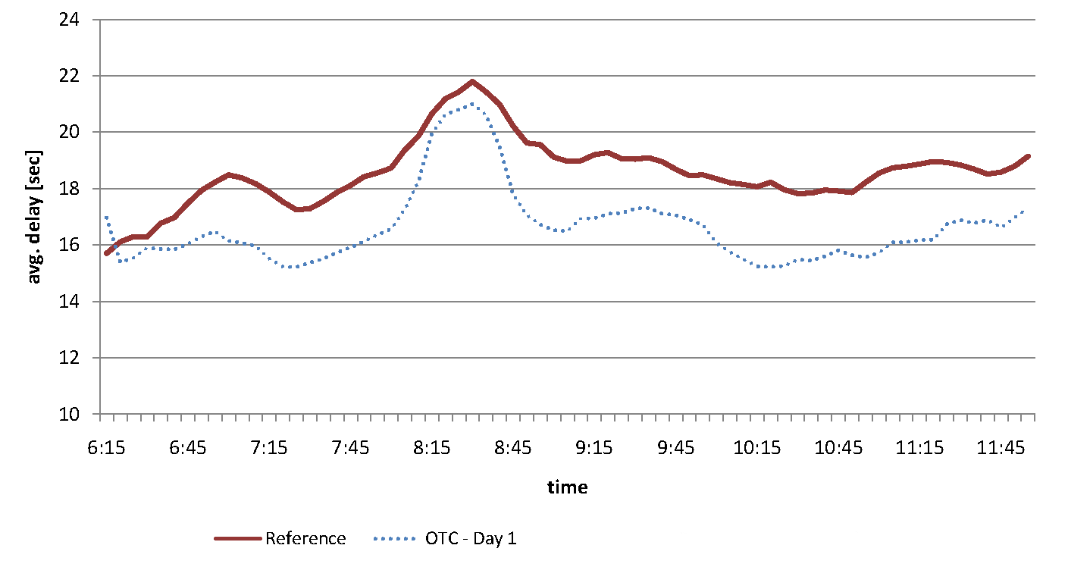
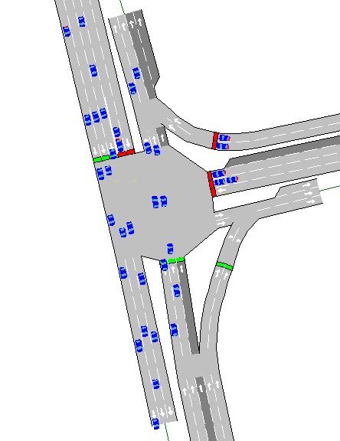
Evaluation (2)
K7 (Kollaustraße / Nedderfeld)
Day 1 Day 2 Day 3
Improvement by
organic control
10% 12% 12%
Sven Tomforde (IES / Uni Kassel)

Slide 13
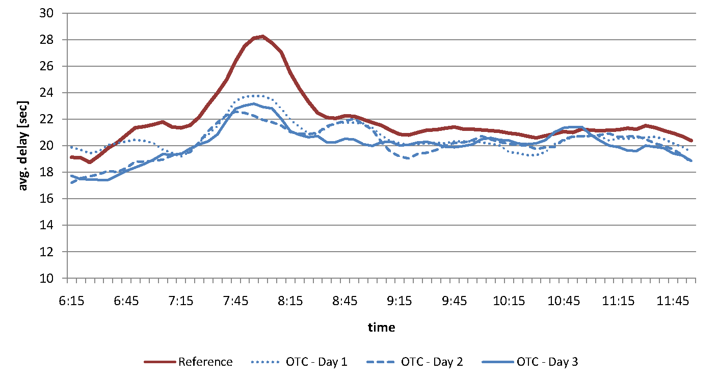
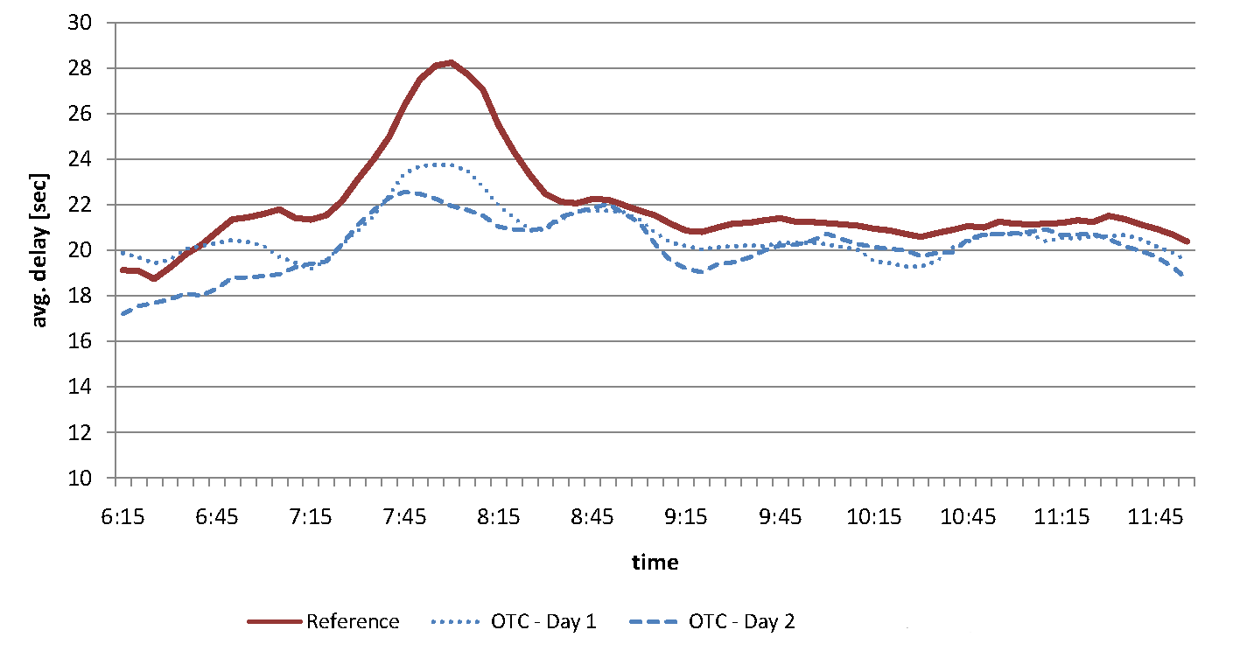
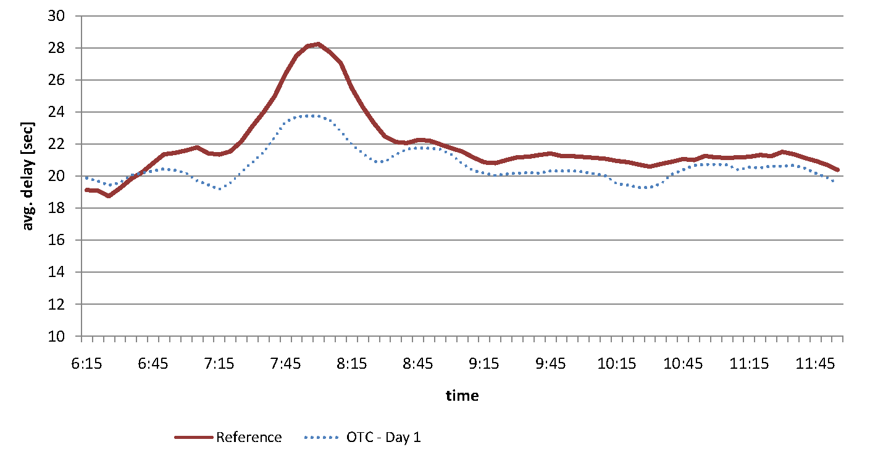
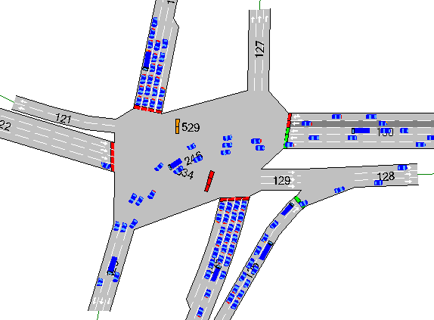
Evaluation (3)
K3 (Alsterkrugchaussee / Deelböge)
Day 1 Day 2 Day 3
Improvement by
organic control
6% 8% 8%
Sven Tomforde (IES / Uni Kassel)

Slide 14
Conclusion
Reinforcement Learning for self-adaptive traffic control
Rules / classifiers consisting of: condition, action, and evaluation parts
Evaluation includes parameters for:
Prediction of feedback
Prediction error
Strength of classifier
And: Numerosity, experience, …
Current research in LCS / XCS
Interpolation to close knowledge gaps
Assessment of existing knowledge / proactive generation of classifiers
Extensions for the control system
Progressive Signal Systems
Route guidance / stream-based route recommendations
Automated incident detection

