Slide 1


Chatbots for end-user and employees support
Diego Spinosa , Farzad Shami, Kimia Abedini, Martina Boscolo, Mirco Cazzaro, Riccardo Gobbo, Simone Merlo
10/03/2024 – Unox Hackathon

Slide 2
OUTLINE
01 Product Exploration
02 Procedures & Recipes
Product features
Get assistance
Help employees
Explore your own Procedures and Recipes
03 Explore Recipes
04 Future work
Adding Recipes through vocal chat
More
Discover new recipes

Slide 3
Product Exploration

Slide 4
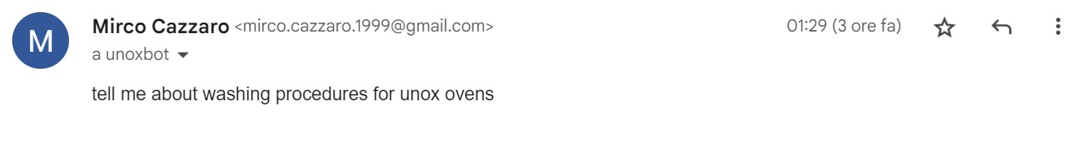
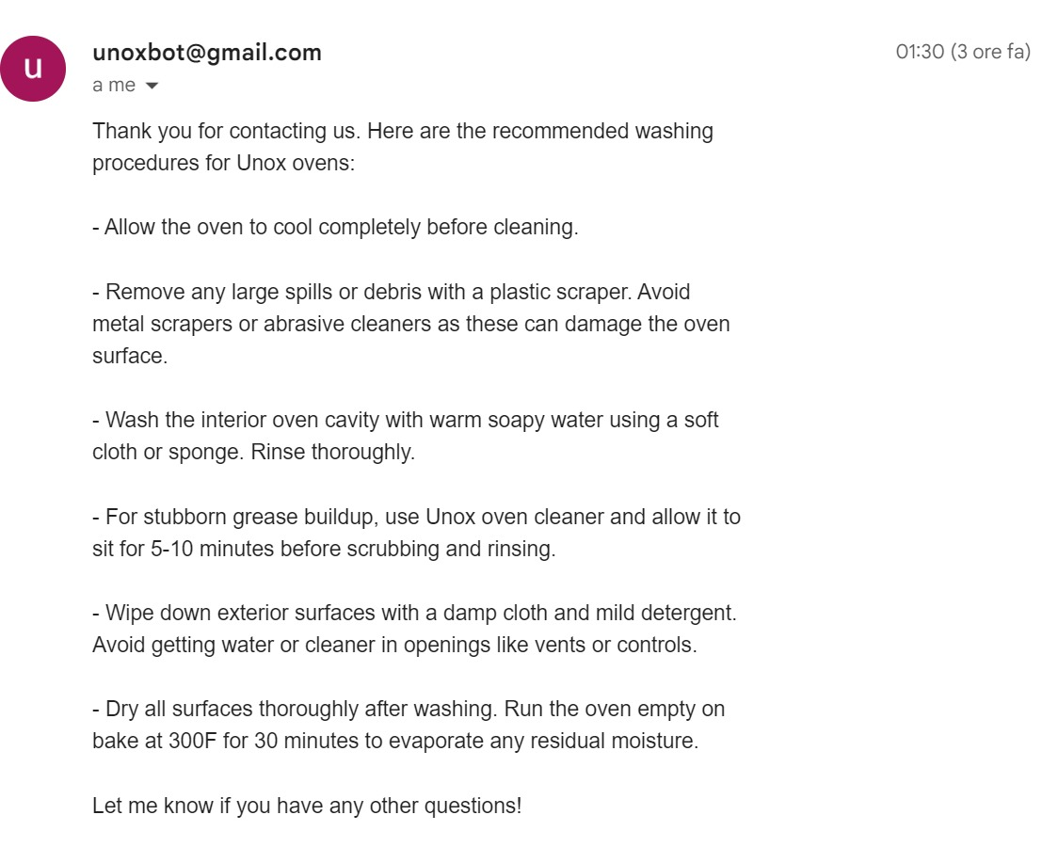
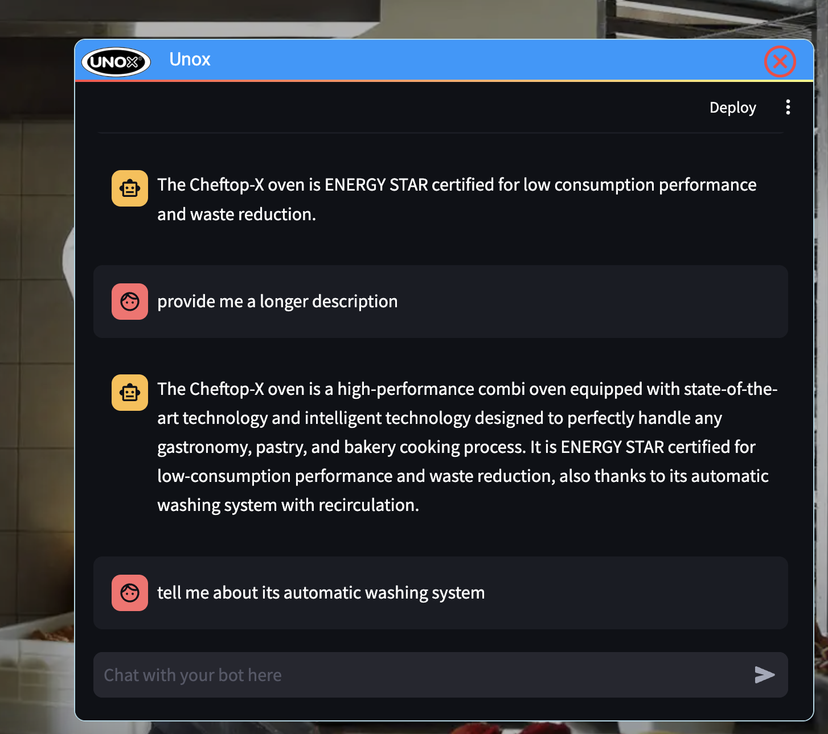
ChatBot and E-mail
We developed a ChatBot that will run on the Unox website and an e-mail assistant
Features:
Explore product features, characteristics and manuals
Get assistance
Use Cases:
User can get product infos and assistance directly through mail or ChatBot
Unox Employees can exploit the ChatBot and email assistant to be facilitated when providing assistance to the end-user
Note:
The e-mail based request are classified and stored to track the company-user interaction and to further improve the assistance

Slide 5
Procedures & Recipes

Slide 6
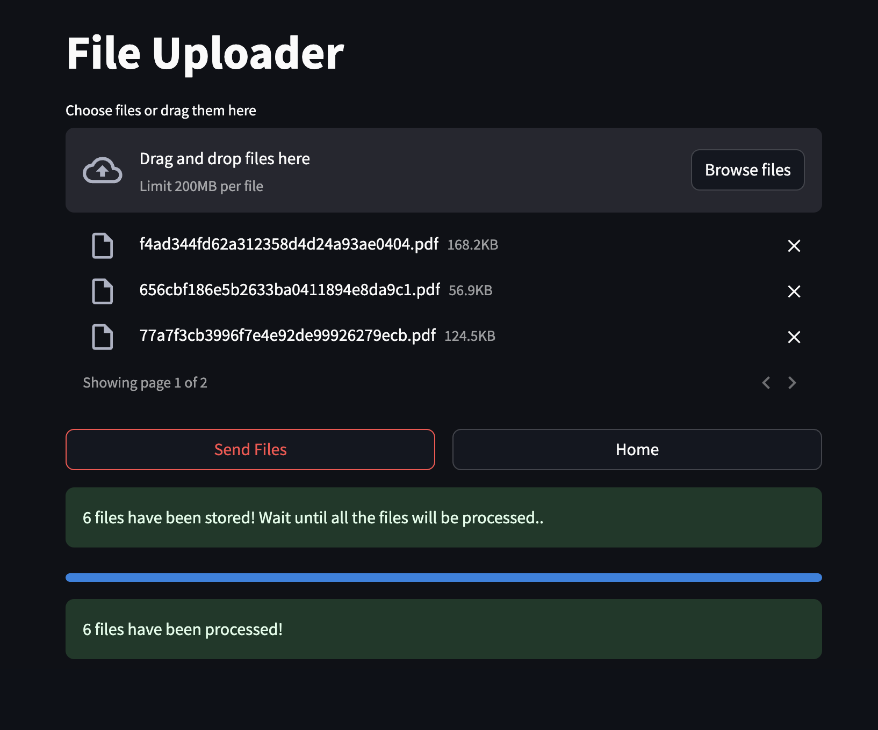
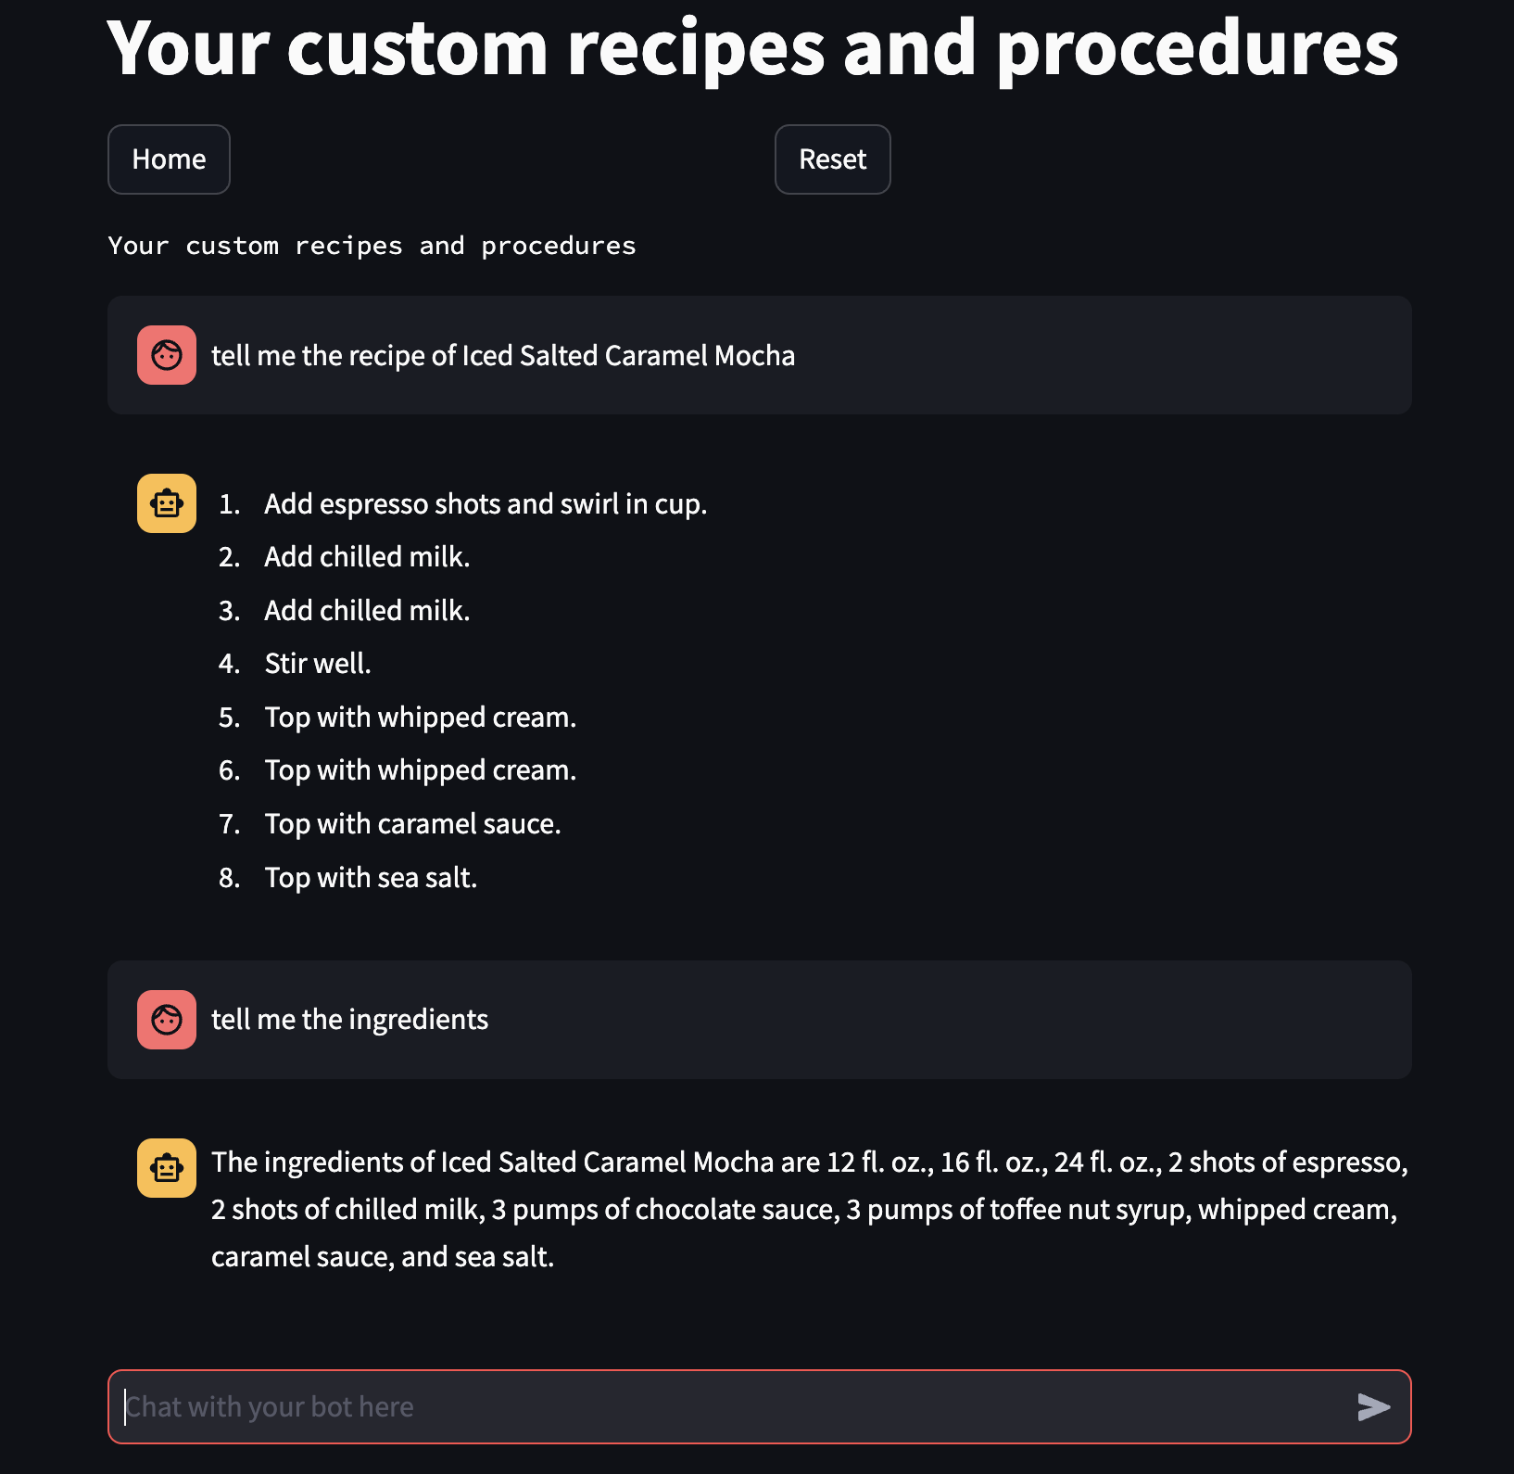
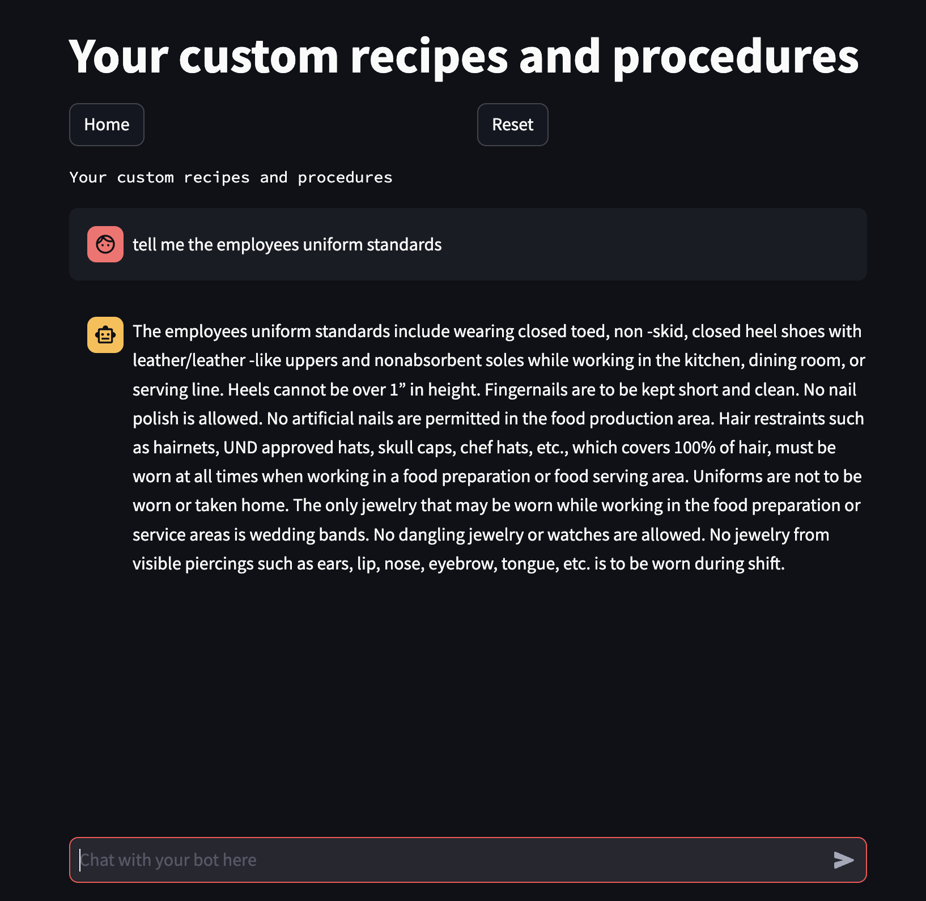
Procedures & Recipes
Motivation: large food-companies already have documents related to their procedures and recipes
Goal: exploit those informations by making them available to a ChatBot which can be used from the oven
How: upload the procedures documents through our interface
Result: The oven becomes also an assistant

Slide 7
Explore Recipes

Slide 8
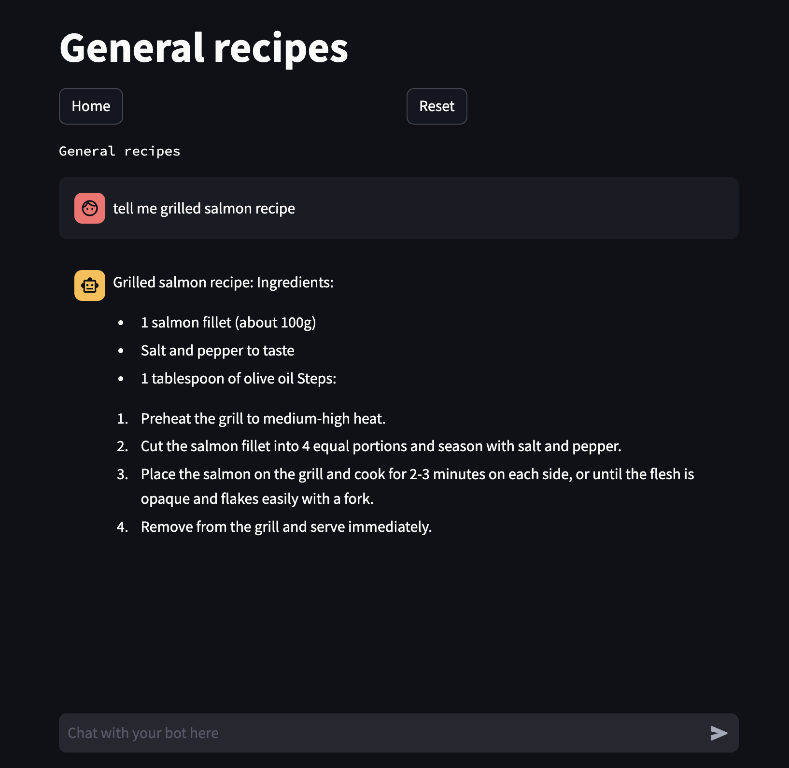
Explore Recipes
Motivation: Chefs may want to explore a new recipe (different from the ones on their library)
Goal: Let Chefs explore other recipes in order to get new ideas
How: we crawled all the recipes in the DataDrivenCooking platform and used this as side informations for an LLM

Slide 9
Underlying Structure & Advantages

Slide 10
General Structure
We use the same “user” interface for the different bots.
We adapt the model/parameters based on a session variable
The session variable is set to recognize the user type and/or the required functionality

Slide 11
Some points of strength
Website assistant chatbot | Custom recipes and practices chatbot | General recipe discovery bot
Multiple point-of-view | Automatized crawling of recipes from the DDC portal
Index update to quickly add new documents (thanks to FAISS VectorShare)

Slide 12
Cost analysis and evaluation
AI models cost
Fixed + pay-per-use
Engineering/development costs
Fixed cost

Slide 13
Future Work

Slide 14
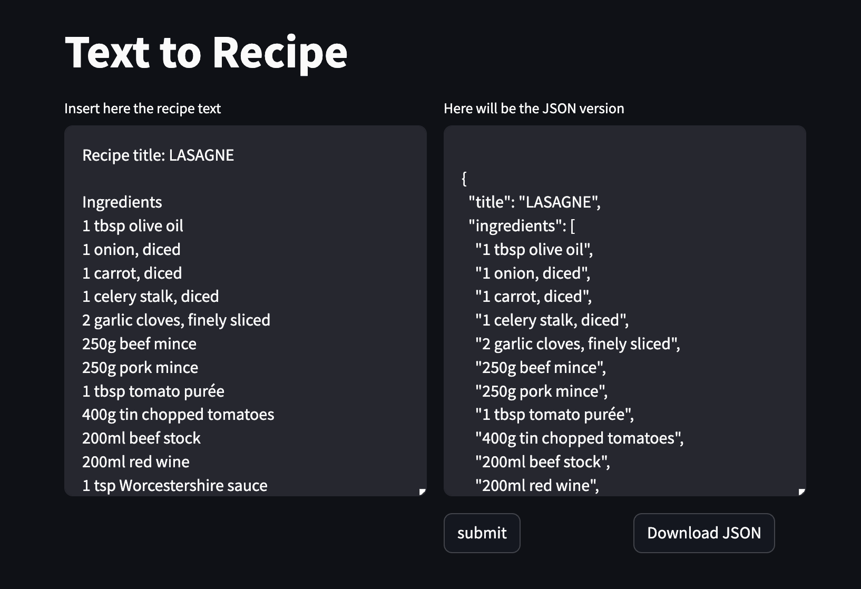
Add Recipes
We provide an interface to convert a text into a JSON file suitable to be used with the UNOX API
Text could be generated using the (already present) oven’s vocal control

Slide 15
Internal-use Chatbot
Future expansion of some functions into an internal-use chatbot
Targets employees
Offers aid in troubleshooting and KB access

Slide 16
THANK YOU!

