Slide 1


Chatbots for end-user and employees support
Diego Spinosa , Farzad Shami, Kimia Abedini, Martina Boscolo, Mirco Cazzaro, Riccardo Gobbo, Simone Merlo
10/03/2024 – Unox Hackathon

Slide 2
OUTLINE
01 Background & Introduction
02 System Model
03 Predis
Permissioned Blockchains
BFT
Goal
Bundle Chains
Predis Blocks
Voting
Node Types
04 MultiZone
05 Evaluation
Network Structure
Data Flow
Relayer Nodes
Predis Evaluation
MultiZone Evaluation

Slide 3
Background

Slide 4
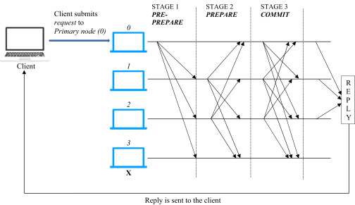
Background
Permissioned blockchains:
Permissioned blockchains = blockchains accessible only by users/nodes which have the permission (credentials)
BFT (leader-based Bizantine Fault Tolerance):
Nodes are split into:
Primary node (that can change over time)
Secondary nodes
Let f be the maximum number of faulty/malicious nodes allowed.
The leader-based BFT works as follows:
Client sends a request to the primary (leader) node.
Primary node broadcasts the request to the all the secondary nodes.
Nodes perform the service requested and send back a reply to the client.
The request is successfull when the client receives ‘f+1’ replies from different nodes with the same result.

Slide 5
Introduction

Slide 6
Introduction
GOAL: improve throughput of permissioned blockchains.
Predis blocks:
Blocks used to reach consensus.
Allows to improve throughput at the consensus layer.
Reach consensus considering grater number of transactions (than previous proposals) at a time and exploit the gained bandwidth to diffuse the transaction blocks.
Multi-Zone:
Alternative to the traditional topologies.
Allow to improve throughput at the network layer.
NOTE: Methods proposed for leader-based BFT blockchains!

Slide 7
System Model

Slide 8
System Model – Node Types
Client Node
Full Node
Consensus Node
Sign transaction
Submit to full nodes
Maintains ledger history
Serve clients
Full node
Pack transactions in blocks
Extends ledger
We define:
f = number of faulty/malicious nodes
n_{c} = 3f+1 = number of consensus nodes

Slide 9
Predis Blocks

Slide 10
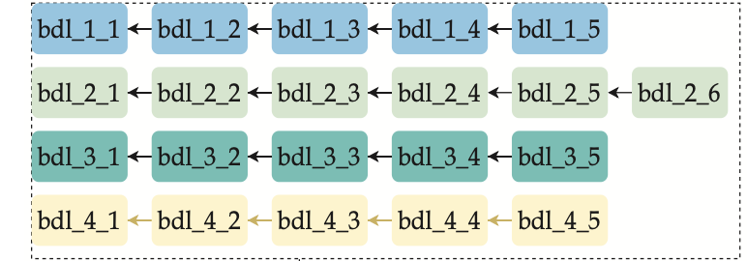
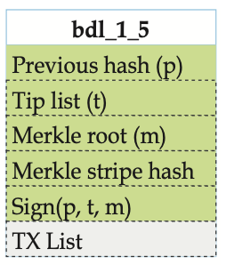
Predis – Bundle Chains
Bundle creation:
Transactions are packed into bundles by consensus nodes.
The producer of a bundle signs it and multicasts it to the other consensus nodes.
Bundle assumes:
One parent
One child
Each consensus node has n_{c} bundles chains, consituting the mempool.
t = tip list = height of the last bundle for each chain
[in this case n_{c} = 4, thus f=1]
Header
Body (transactions)

Slide 11
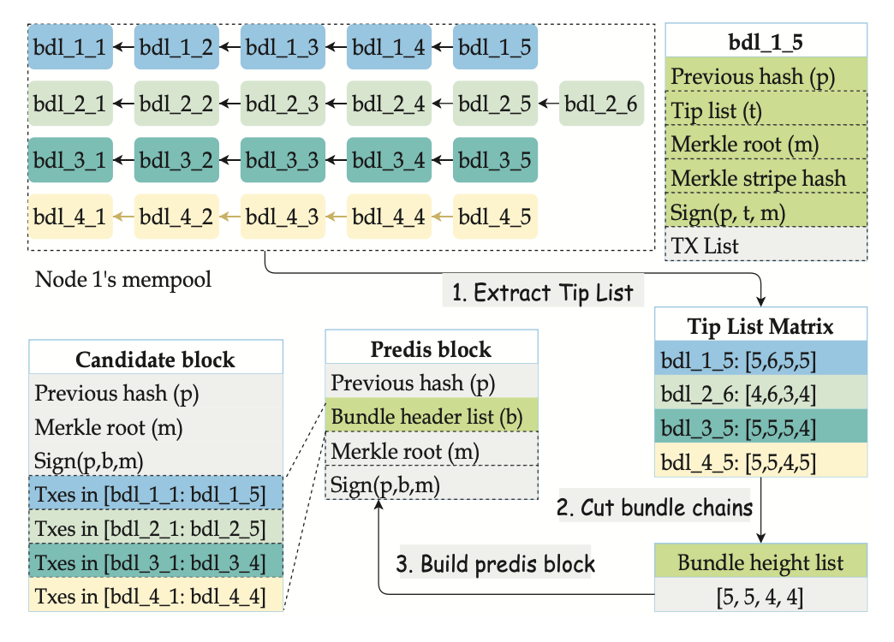
Predis – Predis Blocks
Let h’ be the minimum height of bundles received by the fastest n_{c}-f nodes.
To create a Predis block:
Consider the headers (tip lists) of the last bundles for each chain.
Cut at height h’.
Build the bundle header list.
Create the corresponding Candidate block

Slide 12
Predis – Ban List
Nodes that failed or are detected as outliers are put in a “ban list”.
They will not be considered for:
Voting
Building the Predis blocks

Slide 13
Predis – Voting
A node verifies a Predis block by checking:
If the parent node has been received, if not it is requested.
Predis does not contain bundles of banned nodes.
If all the bundles indicated by the header list are present, if not it requires them.
If the Merkle root and the signature are valid (done after retrieving all the considered transactions).
Voting thresholds are the same of standard BFT approaches

Slide 14
Predis – Advantages
n_{tx}=number of transaction in the candidate block
Competitors block size = O(n_{c}*n_{tx})
Predis block size = O(n_{c})
Does not depend on number of transactions verified
Saved bandwidth can be used to diffuse blocks
Predis is robust to:
Forking attacks.
Censorship attacks.

Slide 15
MultiZone

Slide 16
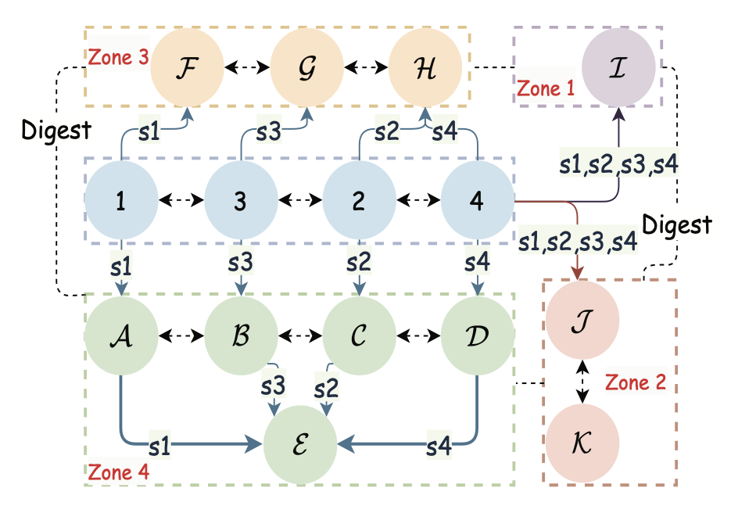
MultiZone
Unpermissioned Blockchains | Permissioned Blockchains
Unstable nodes | More stable
Star/random topologies | MultiZone (zone-based)

Slide 17
MultiZone - Nodes
Full Nodes
Maintains ledger history
Serve clients
Consensus Nodes:
Decodes a bundle (when received) into stripes.
Sends stripes to relayers.
Relayer Nodes:
Forward stripes.
Ordinary Full Nodes:
Reconstruct bundle based on the received stripes.
Data
Data
Note:
One stripe for each consensus node
Each Consensus node forwards its stripe

Slide 18
MultiZone & Predis – Data Flow
Client:
Produce transaction
Submit transaction to a full node
Consensus nodes:
Receives transactions
Produce bundles
Share bundles with relayers (using stripes)
Reach consensus using predis blocks (normally)
Share verified Predis blocks with relayers
Relayers:
Diffuse blocks to all nodes
Full nodes:
Receive bundles
Receive verified Predis blocks
Reconstruct blockchain blocks (candidate blocks) based on bundles and Predis blocks

Slide 19
MultiZone
Zones are based on:
Connectivity
Locality
Double ended line = full-mesh
1,2,3,4 = consensus nodes

Slide 20
MultiZone - Relayers
Relayers:
Receive data from at least q_{c}>f consensus nodes (ensure at least one non-malicious source).
Must send heartbeat messages.
Relayers can receive stripes from consensus nodes in parallel.
Relayers can exchange stripes.
IMPROVE THROUGHPUT

Slide 21
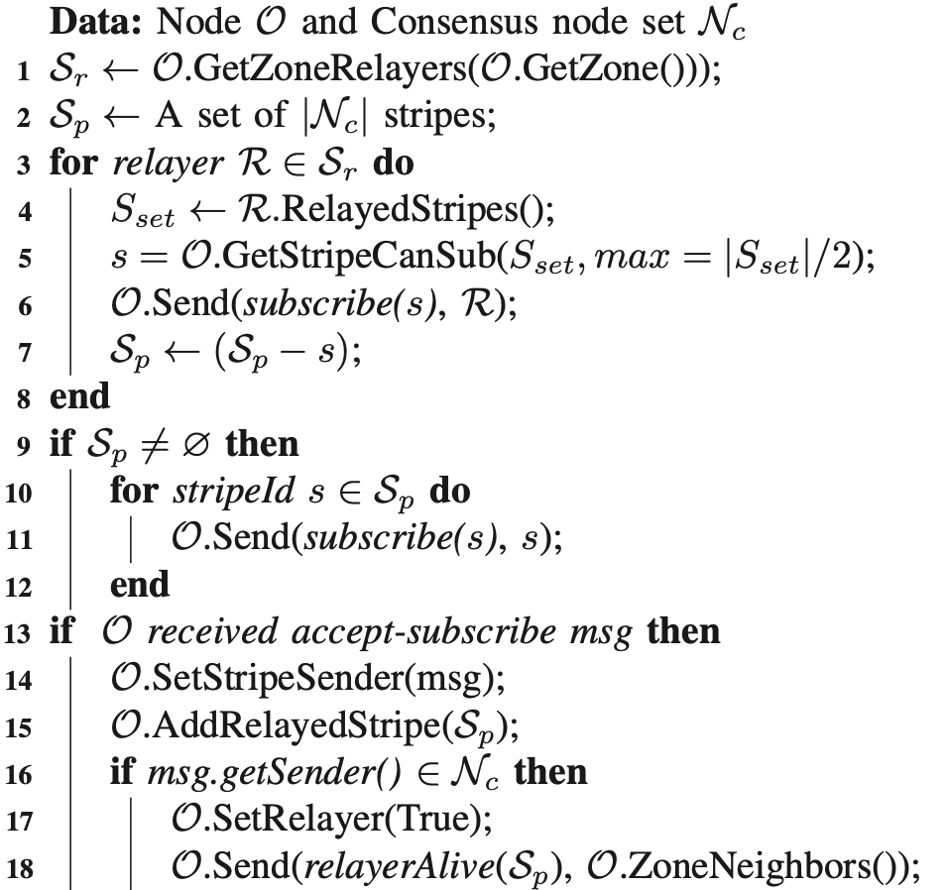
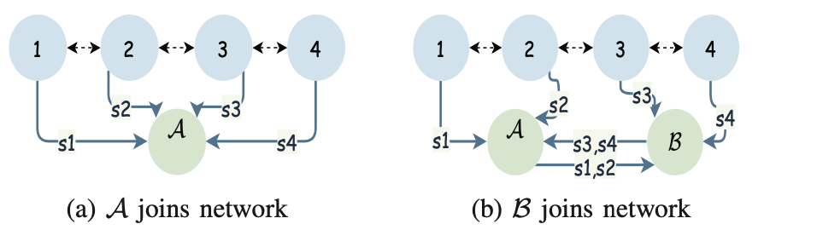
MultiZone – Network Construction
When a new node enters the network:
Gets relayers of its zone from neighbors.
Request to subscribe to at most half of the stripes for each relayer.
If it hasn’t been able to subscribe for some stripes, then become the relayer of those.
If answer to 2 is positive, record the relayer.
If answer comes from a consensus node become a relayer.
A relayer refuses the request when it reaches its upper limit of ordinary nodes.
It is preferrable to subscribe to relayers instead of consensus nodes.

Slide 22
Evaluation

Slide 23
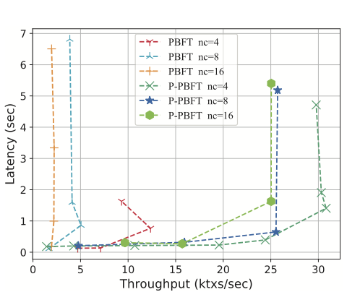
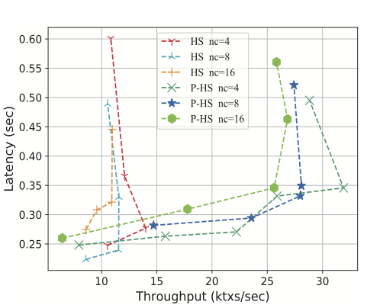
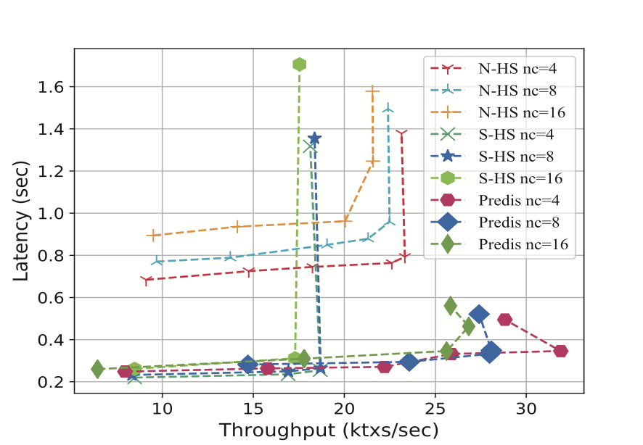
Evaluation - Predis
Comparison with PBFT, Hotstuff and state-of-the-art methods (Narwal and Stratus)
Narwal and Stratus put the identifier of microblock in the proposals (to verify more transaction the proposal must have larger size)
Notes:
B sottoscrive prima a A e poi a CONSENSUS e poi con l’hartbeat A si adatta

Slide 24
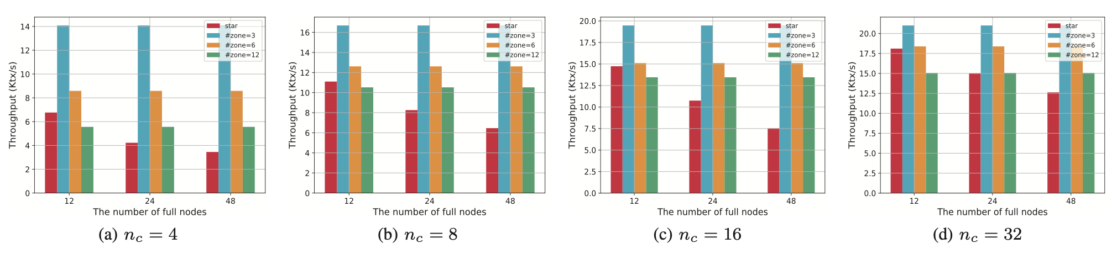
Evaluation - MultiZone
Comparison with star topologies.
Increasing consensus nodes ➔ Increase throughput
Increasing zones ➔ Decrease throughput
Notes:
B sottoscrive prima a A e poi a CONSENSUS e poi con l’hartbeat A si adatta

Slide 25
Rating

Slide 26
Paper Evaluation
Paper Originality:
Technical Meaning:
Clarity of Paper:
Relation with Distributed Systems:
AVERAGE:
Pro: Innovative methodologies
Con: Common topic
Pro: Incredible improvement
Pro: Good English level
Con: Confusion in using “block”
Terms not always defined
Pro: Hot topic in DS nowadays
Notes:
B sottoscrive prima a A e poi a CONSENSUS e poi con l’hartbeat A si adatta

Slide 27
THANK YOU!

