Slide 1
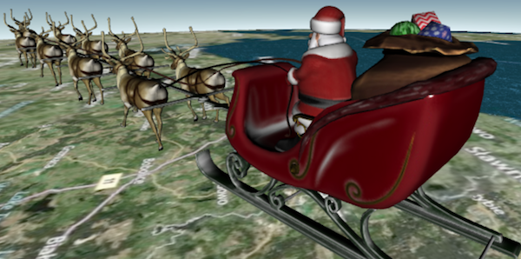
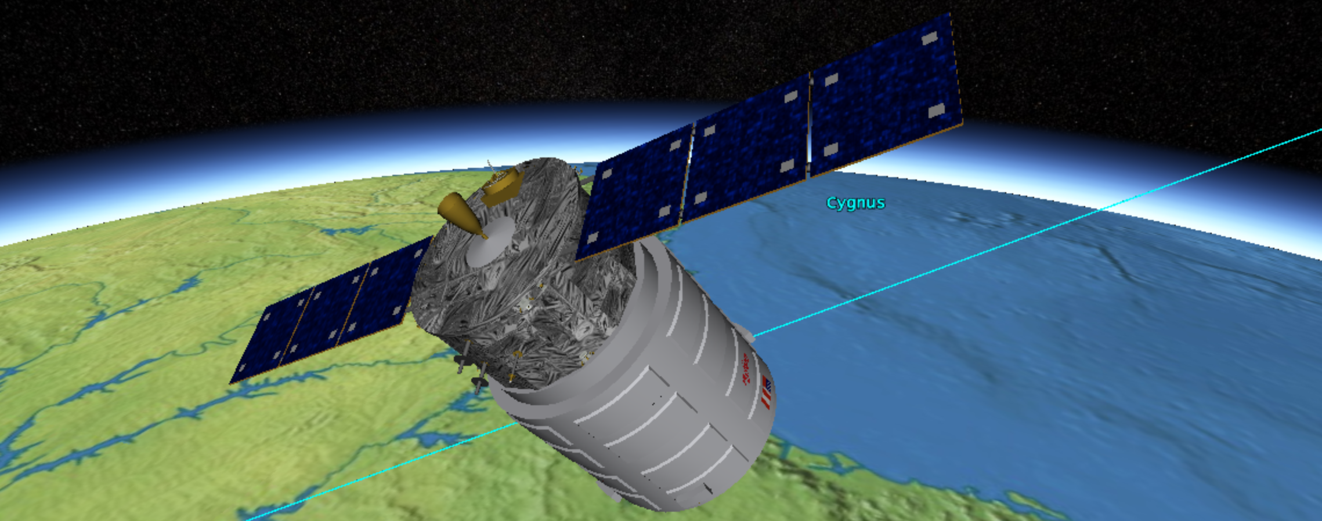
WebGL Content Pipeline with glTF
Patrick Cozzi, @pjcozzi
Analytical Graphics, Inc.
University of Pennsylvania
Notes:
Like OpenGL, WebGL is a rendering API that exposes the capabilities of the hardware. It knows about low-level concepts like buffers, textures, shader programs, and uniforms. Artists, on the other hand, use modeling tools like Maya or Modo, to create assets using much higher-level constructs such as geometries, node hierarchies, materials, and animations. As engine developers, it is up to us to create a content pipeline that brings assets from modeling tools to our WebGL-based engines. Furthermore, this pipeline needs to produce runtime assets that are easy and efficient to use on the web with WebGL.
Historically engine developers have created custom asset formats for their engine and custom exporters for modeling tools or converters from interchange formats like COLLADA. This talk introduces glTF, the runtime asset format for WebGL, OpenGL ES, and OpenGL, which significantly reduces the amount of work engine developers have to do by providing an efficient and extensible format based on JSON and binary blobs, and an open-source content pipeline for creating glTF assets from COLLADA.

Slide 2
Outline
Interchange and runtime formats
glTF goals and schema
COLLADA to glTF content pipeline
Notes:
We’ll briefly talk about the differences between interchange and runtime formats. Then, we’ll look at the design goals of glTF and some examples of the schema. Finally, we’ll look at the open-source tools and pipeline stages to convert a COLLADA asset to glTF.

Slide 3

Interchange Formats
Maya
Blender
Modo
.fbx
.obj
…
…
Notes:
Interchange formats are used by artists to move assets from one tool to another. These formats strive to preserve the full authoring contents of an assets but are not optimized for runtime engines, especially for use on the web with WebGL.

Slide 4
Interchange Formats
Target tools, not WebGL
Example: COLLADA
XML + image files
One index per attribute, not vertex
Unsigned int indices
Transform stack per node
Polygons and splines
Common profile materials
Doesn’t specify image file format
Lots of flexibility and indirection in animations and skins
Notes:
Interchange formats are generally verbose and slow to load for runtime use. They need to go through many conversion steps before being ready for WebGL. This doesn’t belong in the runtime engine; it belongs in the content pipeline.
Several examples from COLLADA are shown here. With this format, XML is verbose; indices are specified per attribute, not vertex vertex as WebGL requires; unsigned int indices are used, which requires a WebGL extension (a widely supported one though) or division into multiple meshes; each node can have a stack of transforms, whereas at runtime, we just want a 4x4 matrix; polygons and splines need to be tessellated; shaders need to be generated for materials (however, some engines will want to do this to match their g-buffer format for deferred shading, for example); any image format may be used, including ones not supported by browsers; and keyframe animations support several different splines, which is more flexibility than most runtime engines need.

Slide 5
Runtime Format
Optimized for use in an engine
Tool
format
Content Pipeline
Runtime
format
WebGL
Engine
Interchange format
Notes:
Instead of loading interchange formats, most engines use an offline content-pipeline to convert assets to a runtime format for their engine. Thinking in terms of images, this is similar to creating an image as a .bmp but then publishing it to the web as a .jpg.

Slide 6




glTF
“the runtime asset format for WebGL, OpenGL ES, and OpenGL”
jpg, mp3, mpeg, … what about 3D?
Open standard
Not ratified yet
Notes:
With WebGL, there are a handful of ah hoc runtime formats, usually based on JSON, for a few of the major engines like Three.js [1] and Babylon.js [2]
[1] https://github.com/mrdoob/three.js/wiki/JSON-Model-format-3.1
[2] https://github.com/BabylonJS/Babylon.js/wiki/Babylon.js-file-format
glTF is an open-standard runtime asset format that strives to be useful to most WebGL engines but providing a schema and content pipeline for the most common asset constructs like geometry and materials, and to be extensible so each engine can add their own custom data.

Slide 7
glTF Goals
Easy and efficient to render
.json
Node hierarchy, materials, lights, cameras
.bin
Geometry: vertices and indices
Animation: key-frames
Skins: inverse-bind matrices
.glsl
Shaders
.png, .jpg, …
Textures
Notes:
The number one goal of glTF is that assets are easy and efficient to render; we want engines to be “fast by default.”
A glTF asset is composed of JSON describing the asset; binary .bin files containing geometry, animations, and skins; .glsl text files containing shaders; and image files for textures. Binary, glsl, and image files can also be embedded in the JSON.
glTF uses JSON because it is cross-platform, compact, readable, allows validation, and minifies and compresses well.
Binary data is little endian. Binary blobs allow efficient creation of GL buffers and textures since they require no additional parsing, except perhaps decompression. An asset can have any number of binary files for flexibility for a wide array of applications.

Slide 8
glTF Goals
Balanced Feature Set
Extensible
<
<
Notes:
glTF has more features than WebGL, like a node hierarchy, animation, and skins, but less features than an interchange format, like physics and spline representations. It tries to strike a balance between providing enough features and being bloated.
glTF is extensible by allowing extra JSON properties (literally named “extra : {}”) on each property, which is forward-compatible.

Slide 9
glTF Goals
Code, Not Just Spec
Content Pipeline is key to adoption
Three.js is key to adoption
Implementations are needed for a sane spec
Community
Grassroots and transparency
WebGL, OpenGL ES, and OpenGL
Initial adoption - WebGL
https://github.com/KhronosGroup/glTF
Notes:
Like WebGL, glTF itself is really just a spec (and supporting schema). However, a spec alone is not useful to developers. There is an open-source content-pipeline that converts COLLADA to glTF [1], which allows engine developers to save on the amount of code they have to write; in simple cases, we won’t need any additional content pipeline code. In addition Three.js is widely used by the WebGL community so there is an open-source glTF loader for Three.js. We also believe that it’s impossible to write a reasonable spec without implementing it so everyone working on the spec, implemented a glTF loader, sometimes even rewriting it from scratch.
All of the spec work, and content pipeline and Three.js loader code, was done in the open using github. This was useful for bug fixes and more folks joining in on discussions.
glTF is designed for WebGL, OpenGL ES, and OpenGL, but initial adoption is primarily with WebGL since the engines are still emerging. Established engines like Unity and C4 already have a runtime format and have written supporting tools.
[1] https://github.com/KhronosGroup/glTF

Slide 10
glTF Schema
scene
*
glTF duck
example
node
*
1
1
*
camera
mesh
light
animation
*
*
*
accessor
material
skin
*
1
1
*
bufferView
technique
texture
1
1
1
1
buffer
program
image
sampler
2
shader
Notes:
Here is the layout of a glTF assets. From the bottom up:
Geometry
buffer – binary blob. Can be combination of geometry, animation, and skins
bufferView – subset of buffer with target info (ARRAY_BUFFER, ELEMENT_BUFFER, animation/skin)
accessor – subset of bufferView with type info, e.g., float-pointing. Similar to a call to glVertexAttribPointer
For example, a bufferView may be all vertices in the asset (think glBufferData), where as an accessor may be an individual attribute for a mesh (think glVertexAttribPointer)
mesh – (composed of primitives, not shown) – corresponds to glDrawElements
node – one or more meshes, plus transform, plus children
Material
image – Image file
sampler – texture filter and wrap modes, think glTexParameter
texture – think glTexImage2D
shader – GLSL shader source
program – think glCompileShader and glLinkProgram
technique – parameter inputs (attributes + uniforms) + pass, which is program + render state
material – an instance of a technique. Overrides parameter inputs. This is a standard material/technique/pass layout like we see in CgFX, ColladaFX, etc.
Animation
animation accesses keyframes from accessor
animation targets node (transforms), material/technique parameters, and camera/light
Skin
skin accesses inverse-bind matrices from accessor
node references skins. skins reference nodes

Slide 11
TODO
Selected schema examples
Converter command-line example
Demos
Implementation tips?
More artist tips?
Reference “An Artist's Guide to glTF”

Slide 12
Content Pipeline
Optimize and package assets for use with the engine
COLLADA2GLTF
WebGL
Engine
Custom
Pipeline
Stage(s)
COLLADA2GLTF
Custom
Pipeline
Stage(s)
WebGL
Engine
Any format
Notes:
The content pipeline is code outside the engine that creates that processes and creates the final runtime asset. In general, this is not usually all coded from scratch. Instead it is a combination of tools, often in different languages, from different third-parties, e.g., texture compression, mesh compression, vertex cache optimize, etc.
TODO: finish notes

Slide 13
Content Pipeline
Several areas
Geometry
Animation and skins
Texture
Shaders

Slide 14
Content Pipeline: Geometry
Triangulation
Polygons Triangles
Higher-order surfaces
Notes:
Also, triangle strips/fans to triangles.
For polygons, this only adds indices so the payload increase is not that bad.
Ear clipping. Accelerate with spatial data structure.
Randomized algorithm. Select random cut. Split polygon if it doesn’t intersect any edges.

Slide 15
Content Pipeline: Geometry
Deindex
One index per attribute one index per vertex
positions
position indices: [0, 1, 2, 0, 2, 3]
normals
normal indices: [0, 0, 0, 0, 0, 0]
positions
normals
indices: [0, 1, 2, 0, 2, 3]
Notes:
Deindexing reduces the about of index data but can increase the amount of vertex data. A single set of indices is required for glDrawElements and friends.
Example here is one side of a box. It is 2 triangles with one normal. Deindexing requires duplicating the normals.
This example:
Before:
Vertex data: 16 + 4 = 20
Index data: 12 +12 = 24
Total: 44
After:
Vertex data: 16 + 16 = 32
Index data: 12
Total: 46
If most attributes are unique (not shared by multiple vertices), deindexing can decrease the size.
* See “Indexing Multiple Vertex Arrays” in OpenGL Insights. Chapter 26.

Slide 16
Content Pipeline: Geometry
Flatten node hierarchy
Notes:
Node hierarchy or “scene graph.”
Increases the batch size and, therefore, reduces the number of draw calls.
Nodes need the same material (and vertex format, which is implied when they share material).
Transform combined meshes into the same coordinate system. Children have their transform applied when they are combined with their parent.
If a node is targeted by an animation, it’s sub-tree can be combined, but it can’t be combined with its parent.
Texture atlases help nodes have the same material since they share the same texture.
Also reduces the number of meshes and combines buffers as needed.

Slide 17
Content Pipeline: Geometry
Split meshes
So indices fit into unsigned short
vertices ... ...
indices: [0, 1, 2, ..., 64K - 3, 64K - 2, 64K - 1, 3, 4, 5, 64K, 64K + 1, 64K + 2, ...]
vertices ...
indices: [0, 1, 2, ..., 64K - 3, 64K - 2, 64K - 1, 3, 4, 5, ...]
vertices ...
indices: [0, 1, 2, ...]
Notes:
Needs to duplicate some vertices.
Without extensions, this is needed for WebGL 2 and OpenGL ES 2. The unsigned int extension is widely supported, and although it uses more memory and potentially contributes to cache pollution, I have not noticed a performance hit, and it allows for larger batches.

Slide 18
Content Pipeline: Geometry
Compression
Open3DGC (TFAN)
Pre-gzip for web deployment
Easy tricks
Minify JSON, e.g., whitespace
Exclude default values, e.g., identity matrix
Uniform scale instead of non-uniform scale
4x3 matrices instead of 4x4
Quaternions are normalized, only store 3 components
Notes:
Need to consider decompression time along with the payload savings.
Open3DGC – http://kmamou.blogspot.com/2013/07/open-3d-graphics-compression-open3dgc.html
TFAN – fans, quantize, parallelogram predict, O(n) wrt vertices to decompress.
These transform tricks also apply to animation data.
Also see “WebGL Models: End-to-End” in OpenGL Insights (Chapter 30).

Slide 19
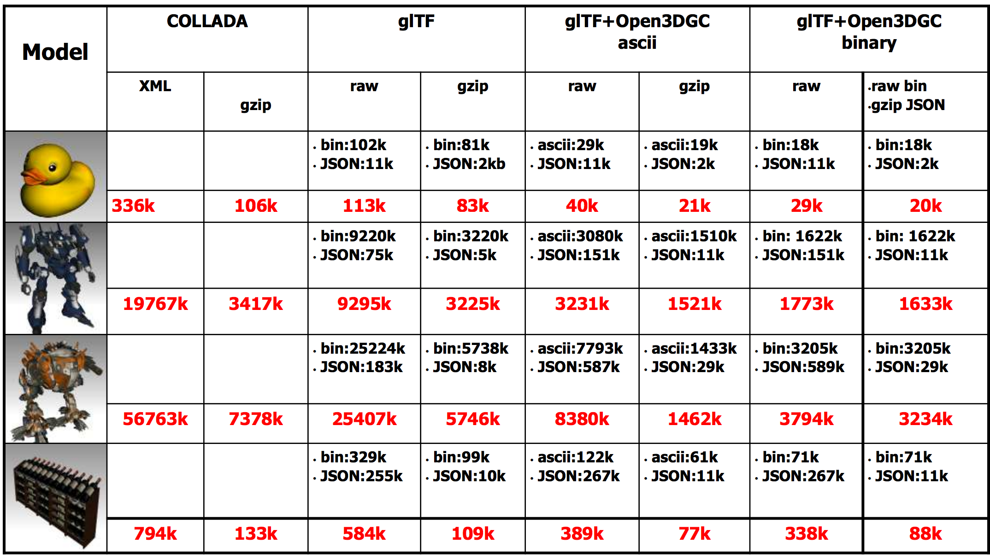
Notes:
Slide from https://www.khronos.org/assets/uploads/developers/library/2013-siggraph-collada-bof/COLLADA-BOF_SIGGRAPH-2013.pdf

Slide 20
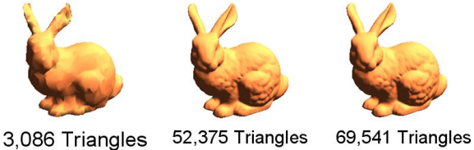
Content Pipeline: Geometry
Generate LODs
Notes:
Vertex clustering from my master’s thesis is shown here.
QEM is most popular.
Many games are not using geometric LOD on their characters.
Many generate different models for different platforms – mobile vs. console vs. desktop.

Slide 21
Content Pipeline: Geometry
Others
Consistent up axis
What’s up? y? z? What’s forward?
Re-order for the pre- and post-vertex-shader caches
Interleave vertex attributes?
Notes:
Vertex cache optimization
* http://home.comcast.net/~tom_forsyth/papers/fast_vert_cache_opt.html
* http://gfx.cs.princeton.edu/pubs/Sander_2007_%3ETR/
Interleaving – see Chapter 3 - http://www.sci.utah.edu/~csilva/papers/thesis/louis-bavoil-ms-thesis.pdf

Slide 22
Content Pipeline: Animation and Skins
Animations
Resample key-frames
Compress like geometry
Skins
Limit joints affecting a vertex
Split meshes
Notes:
Animation:
15 fps may be fine instead of 30 or 60
Control points don’t need to be uniformly sampled, e.g., samples can be removed for linear parts.
Don’t store a channel for scale, for example, if it never changes.
See Section 11.8 in Game Engine Architecture
Skins:
2 joints for an elbow. 3 weights for a hip. Games rarely use more than 4 weights.
Mesh splits are required to keep joint matrices in a uniform array.

Slide 23
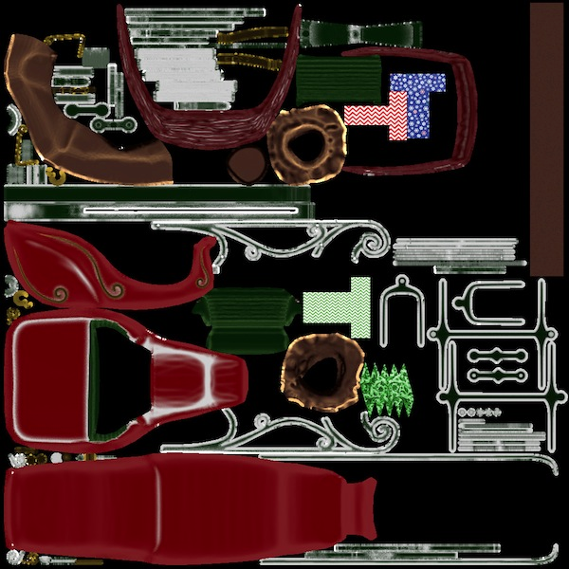
Content Pipeline: Texture
Create texture atlas
Increases batch size. Reduces individual files
Notes:
Care needs to be taken when mipmapping.
Packing a texture atlas is NP hard, see
http://clb.demon.fi/files/RectangleBinPack.pdf
http://clb.demon.fi/projects/even-more-rectangle-bin-packing
http://www.blackpawn.com/texts/lightmaps/
See https://developer.nvidia.com/sites/default/files/akamai/tools/files/Texture_Atlas_Whitepaper.pdf

Slide 24
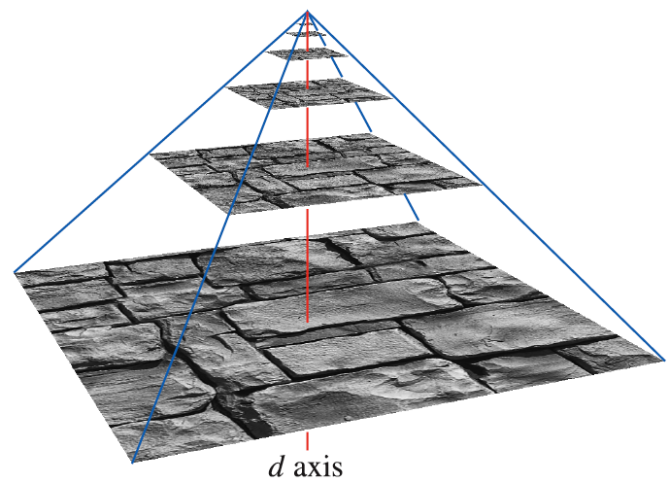
Content Pipeline: Texture
Generate mipmaps
Higher quality than doing it online
Increase size by 1/3
Notes:
glGenerateMipmap may use a low-quality filter and/or be slow.
In addition to visual quality, mipmaps also help the GPU cache since sampling from the mip level has better spatial coherence than sampling from the full texture.
Image from Real-Time Rendering - http://www.realtimerendering.com/

Slide 25
Content Pipeline: Texture
Convert image formats
For example, .bmp to .jpg
Compress images
DXT / S3TC
ETC2
Notes:
Format for modeling: lossless. Format for runtime: can be lossly. In our engine, we would compress satellite imagery except for the leaf nodes.
Often, we convert .tga to .png.
.jpg can have an alpha channel nowadays.
JPEG compression is better than DXT.
DXT – use PCA to fit a line through color space. Lossy. Slow to compress but fast to decompress on-the-fly in hardware. Also higher visual quality if compressing a larger texture, compared to a smaller uncompressed texture. Several versions of DXT, with and without alpha.
ETC2 required in ES 3.0 and GL 4.3. Higher quality than DXT at same bitrate. More flexibility in texture format, e.g., R and RG formats.
Also, ASTC (Adaptive Scalable Texture Compression), but is optional in GL.
“Recent research shows that special-purpose packing methods can compress ETC-files to sizes smaller than JPEG for equal quality, at around 2.2 bpp.”
* See https://www.khronos.org/assets/uploads/developers/library/2012-siggraph-opengl-es-bof/Ericsson-ETC2-SIGGRAPH_Aug12.pdf

Slide 26
Content Pipeline: Shaders
Generate shaders
Common profile -> GLSL
g-buffer formats
Optimize shaders
Notes:
g-buffer format is engine-specific.
Less important if shaders are hand-coded.
Combine uniforms. Replace uniforms with constants if they aren’t targeted for animation (don’t add more materials or techniques though).
Minify or just remove whitespace. Size is nothing compared to textures, geometry, and animations.
See
* https://github.com/KhronosGroup/glTF/issues/34
* https://github.com/KhronosGroup/glTF/issues/36

Slide 27
Artist Tips
Some exports create redundancies
Remove unused nodes, meshes, materials, techniques, etc.
Remove unused vertices. Remove duplicate vertices
Remove duplicate materials and techniques
Combine primitives with the same material and vertex format
Notes:
SketchUp story with one triangle per primitive.

Slide 28
Summary
Themes
Keep the runtime simple
Push work to the Content Pipeline
glTF spec and content pipeline:
https://github.com/KhronosGroup/glTF

Slide 29
References
Fabrice Robinet et al. glTF: Designing an Open-Standard Runtime Asset Format. GPU Pro 5, 2014
Patrick Cozzi. Building a WebGL Santa with Cesium and glTF. 2013
Notes:
Khronos logos from http://www.khronos.org/legal/trademarks/

