Slide 1
Towards developing a secure medical image sharing system based on zero trust principles and blockchain technology
学无止境，气有浩然
致力于开发基于零信任原则和区块链技术的安全医学图像共享系统
speaker：李超群
producer ：李超群
Notes:
/'prɪnsəpl/

Slide 2
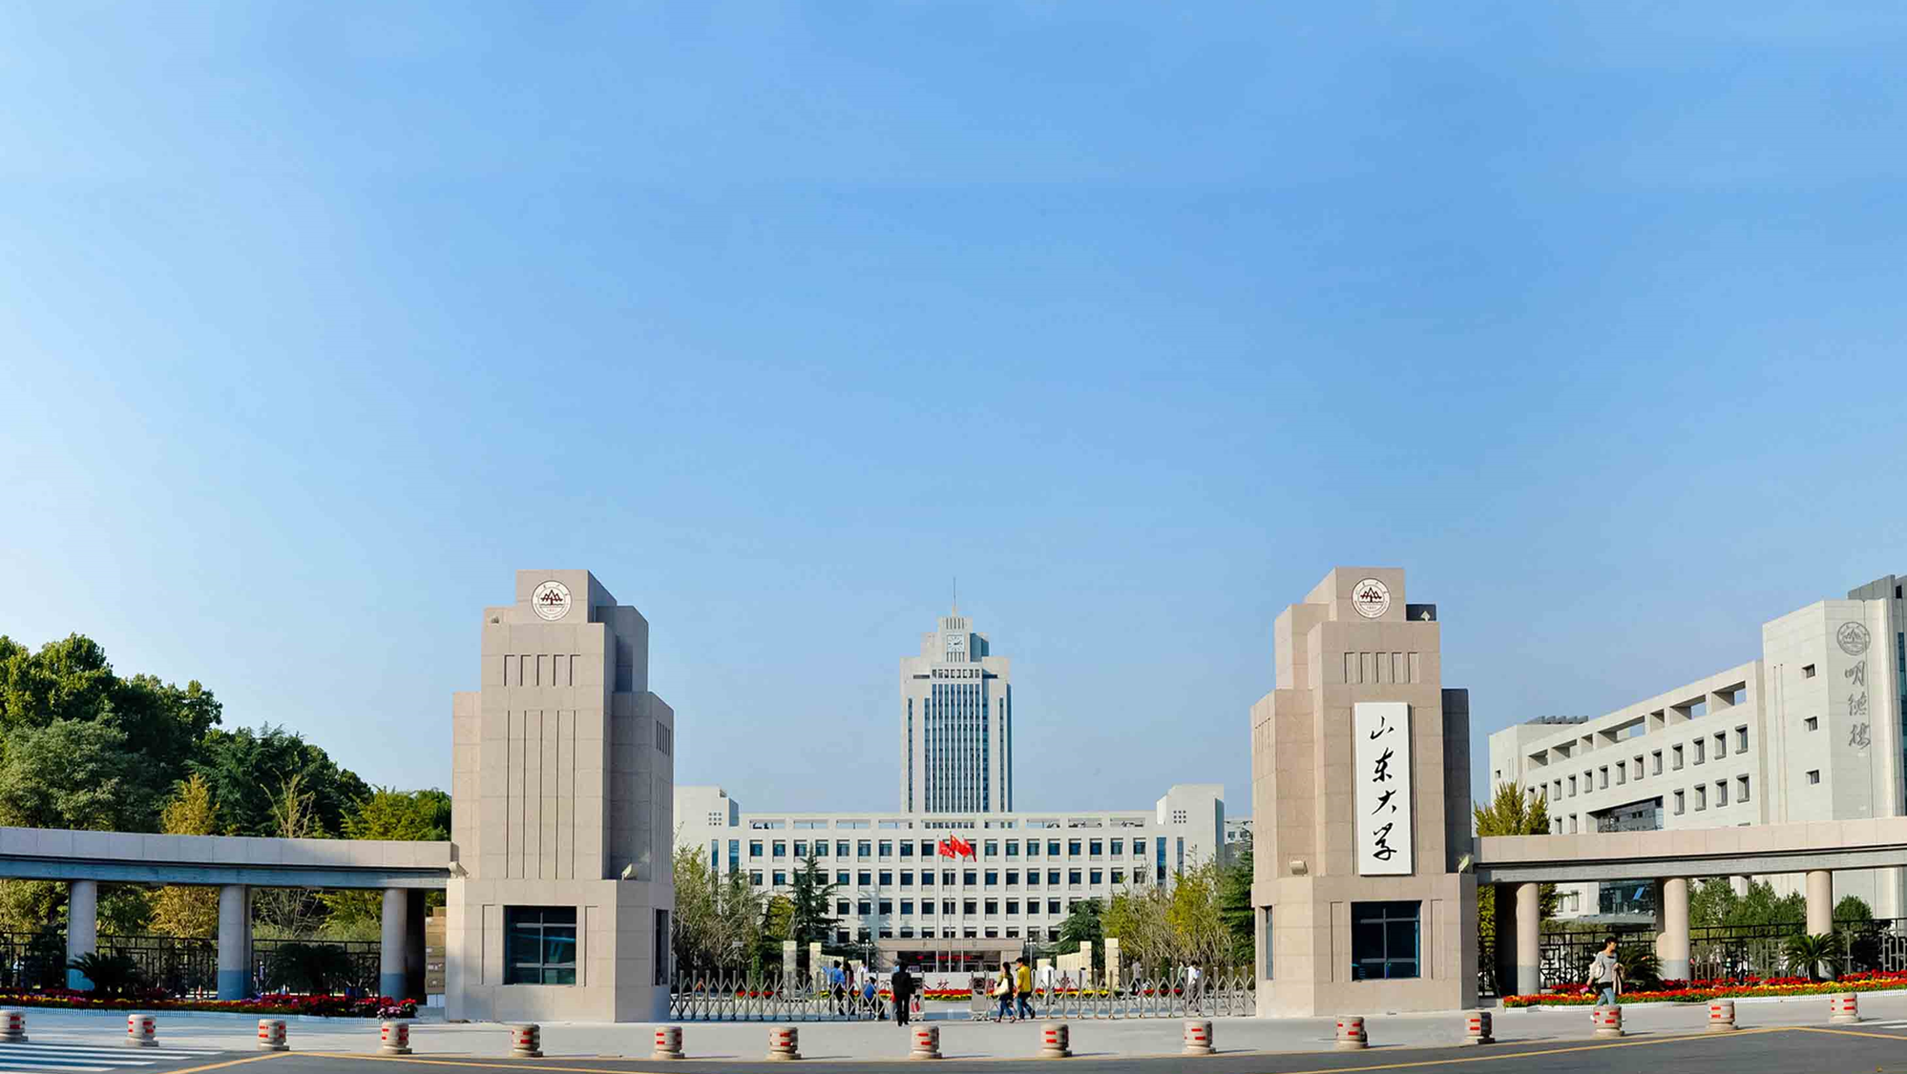

CON
TENT S
0 1
0 2
0 3
Background
Preliminary Knowledge
System Model
0 4
0 5
0 6
Specific Construction
Security analysis
Conclusions
Notes:
Divided into six parts

Slide 3
Background
0 1

Slide 4
Background
The first ever functioning prototype has been proposed by Azaria which integrates blockchain to handle EMRs (Electronic Medical Record). Patients are given full control over their data. Medical stakeholders act as miners who are incentivized in two ways. Permissions associated with medical records are handled by smart contracts deployed on Ethereum. Later, data exchange is handled off chain between pre-existing centralized trusted databases. At every node, patient medical records are stored locally.
In another study, Omar put forward a model which provides accountability, integrity, pseudonymity, security and privacy by storing encrypted medical data on blockchain and giving patients full control over their data. Here the data senders are the patients themselves and the data receivers are doctors, hospitals etc. Only registered users can communicate with the blockchain. It uses cryptography with blockchain to tackle data preserving vulnerabilities.
2
1
Notes:
Many mature storage solutions have been proposed, but there are still some inevitable problems to be solved.
There are two cases

Slide 5
Problem
Second
First
Proper security measures have not been taken around the internal instruments of the hospital, they are easy to be manipulated and tampered with, and the data sources are extremely vulnerable to persecution
The traditional hospital network framework is very fragile in the era when it needs to be partially opened up.
2
1
Third
3
Electronic medical records have become a trend of preserving medical results, so it is necessary to ensure the security of the data sources in medical records as well as the security in the process of transmission.
Notes:
Data security has been a critical topic of research and discussion since the onset of data sharing in e-health system. The traditional hospital network mostly adopts the construction mode of multiple sets of network connection isolation /ˌaɪsə'leʃən/, such as internal network, external /ɪk'stɝnl/ network, intelligent private network and so on.
So I summed up three more serious problems.
//The traditional hospital network architecture relies too much on physical isolation, with the popularity of //electronic medical system, which requires its network to be partially open to the outside world, and the //vulnerability of its network architecture is infinitely magnified, which can be easily broken by hackers.
So I summed up three more serious problems.

Slide 6
Preliminary Knowledge
0 2

Slide 7
Zero Trust
Access subject
Based on identity
Visiting object
Key Capability Model
Business security access
Don’t trust defaultly Dynamic trust
The key ability of zero-trust security can be summarized as identity-based, business security access, continuous trust assessment and dynamic access control, which are mapped to a set of core architectural components that interact with each other and have high adaptability to various business scenarios.
Continuous trust assessment
Dynamic access control
Notes:
The essence of zero trust is to build a dynamic trusted access control system based on identity between the access subject and the object. Through the key ability of identity as the cornerstone, business security access, continuous trust assessment and dynamic access control, based on the digital identity of all participating entities in the network, all access requests that are not trusted by default are encrypted, authenticated and forcibly authorized. Gather and associate various data sources for continuous trust evaluation, and dynamically adjust the permissions according to the degree of trust, and finally establish a dynamic trust relationship between the access subject and the access object.
零信任的实质是在访问主体和访问客体之间建立基于身份的动态可信访问控制系统。通过身份为基石、业务安全访问、持续信任评估、动态访问控制等关键能力，基于全网所有参与实体的数字身份，对所有默认不可信的访问请求进行加密、认证和强制授权。收集和关联各种数据源进行持续的信任评估，并根据信任度动态调整权限，最终建立访问主体和访问客体之间的动态信任关系。

Slide 8
System Model
0 3

Slide 9
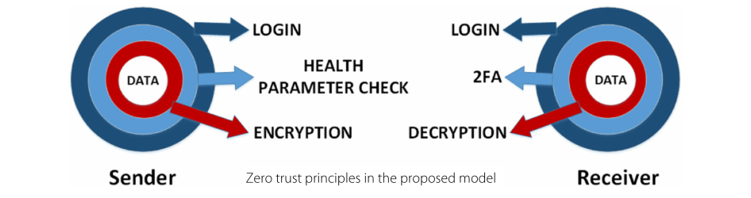
Zero trust principles
Notes:
First let’s realize about left
Login : This provides outermost layer of security which involves authentication of the sender using their login credentials like username and password via their end device, which in this case is the PC connected to the medical imaging device.
Health Parameter Check : This is the second layer of security which involves checking the health parameter of the sender’s device before sending the data. This helps to detect whether the device is up to date on the latest security patches and precautions. This in turn ensures that the device has not been hacked or compromised.
Encryption : This is the innermost layer of security which deals with data encryption. After the sender successfully passes the previous two layers, the data to be sent is encrypted with receiver’s public key thus making it accessible only to the intended receiver possessing the key.
B:
Login : like on the left
2FA(Two Factors Authentication) : This is the second layer of security which involves undergoing two factor authentication (2FA) in order to enter the system. An authentication app will generate a code, which they must also input in order to gain access. Thus attackers cannot easily access a person’s device or online account because knowing the victim’s password alone is not enough. Two-factor authentication adds this additional layer of security to the authentication process.[????如何让登录者知道生成的密码,==》获取者进行一步类似steam上的手机令牌的方式保证本人】
Decryption : This is the innermost layer of security which involves decryption of data. After completing the previous two steps, the receiver can view the encrypted data sent to them after decrypting it with their private key. Thus only the receiver can see their data

Slide 10
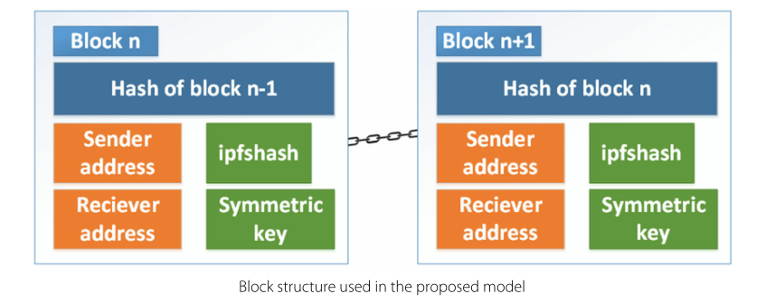
Blockchain
Keep a record of every transaction taking trace.
The smart contracts in blockchain help to enable role-based access control.
Notes:
Blockchain is used in the model primarily to keep a record of every transaction taking place. The smart contracts in blockchain help to enable role-based access control which allows person to perform activities they are given permission.
//
To increase scalability, only hash of the data is stored in blockchain while the actual data is stored off chain in IPFS (a distributed file system and storage platform). It is decentralized so there is no single point of failure, and all trust is not put on a single node .

Slide 11
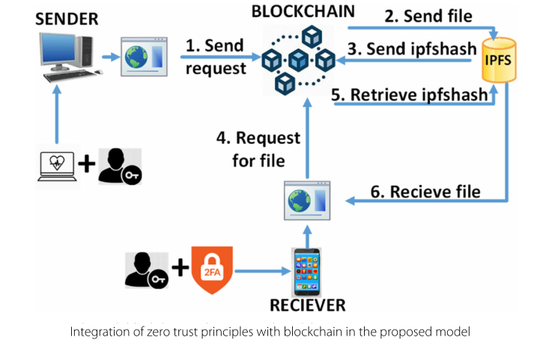
Combination of blockchain and zero trust principles
Notes:
Step1:Send request，After the sender goes through the first two outer layers of security, Login and Health Parameters Checkup the smart contract checks their authorization roles and privileges. If available, the request is processed and they will be able to send a file.
Step2:The file itself will be encrypted with a symmetric key and stored in IPFS. The corresponding hash of the file, referred to as ipfshash, is instantly generated. This hash denotes the location of the file in IPFS
Step 3 (Send ipfshash) : The generated ipfshash will be digitally signed with the sender’s private key and then encrypted using the receiver’s public key. A block will be created in the blockchain .
Next query function
Step 4 (Request for file) : After the receiver goes through the first two outer layers of security, Login and Two factor authentication, the smart contract compares their authorization roles and privileges. If available, they will be able to request for file retrieval.
Step 5 (Retrieve ipfshash) : If the request for file sent by the receiver contains the correct private key, the encrypted ipfshash retrieved from the blockchain will be decrypted and later verified with the sender’s public key.
Step 6 (Receive file) : The encrypted file will be retrieved from IPFS with the help of the ipfshash and later decrypted with the symmetric key. Only then will the user be able to view the file they had requested for, in their end device.

Slide 12
Specific Construction
0 4

Slide 13
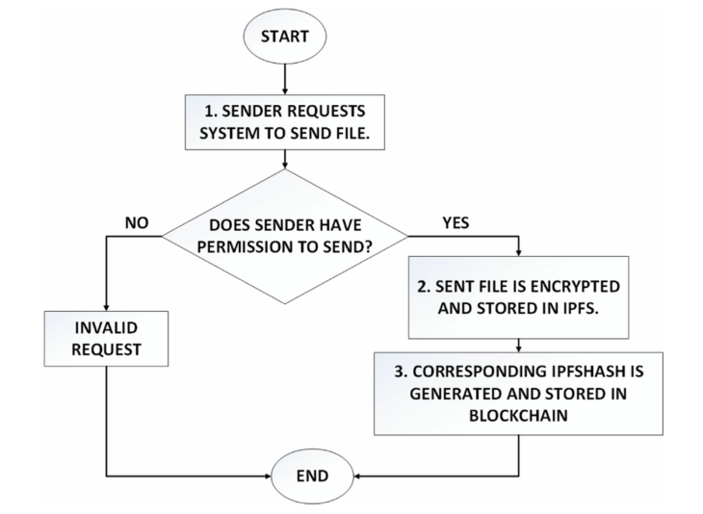
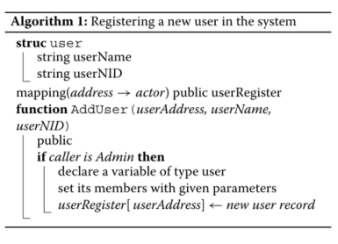
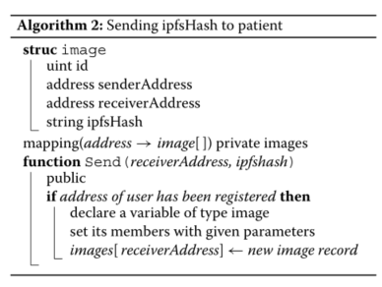
the steps that take place when sender wants to send a file
Notes:
The is the step that take place when sender wants to send a file.
The sender verifies the identity first, and the smart contract will determine whether the sender has the permission to upload the file according to the established rules.
And then encrypt it symmetrically and upload it to IPFS.
Finally, the ipfshash is signed with the sender's private key, then encrypted with the receiver's public key, and the ciphertext is uploaded to the block chain

Slide 14
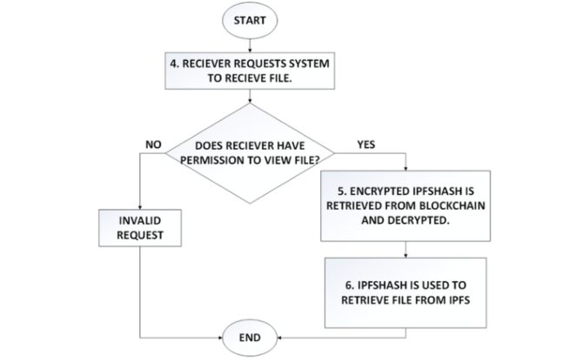
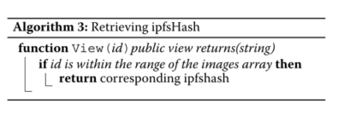
the steps that take place when receiver wants to retrieve the file
Notes:
This is the steps that take place when receiver wants to retrieve the file
Similarly, verify the permissions first.
And then get the address through id mapping，and get the block chain that holds the data through the address, and then the ipfshash is obtained by decrypting the private key.
Finally query files from ipfs by the ipfshash

Slide 15
Analysis
0 5

Slide 16
Security analysis
01.Permission Security
03.Data immutable
User account password and
OTP(once time password)
数据安
全
The system uses blockchain to keep an immutable audit trail of data access instances . Unless a 51 percent attack occurs
02.Equipment safety
various health parameters of the device are checked.
Notes:
The implemented model is analyzed below to see how it can effectively meet with the above design goals:

Slide 17
Analysis
01.Role-based access control
02.Decentralization
In the proposed model, smart contract assigns users with different roles associated with different functions and privileges.
The data is decentralized both on and off chain, through blockchain and IPFS, both of which involve peer-to-peer verification and eliminate central control. This removes single point of failure and
more importantly, eliminates trust from central authority.

Slide 18
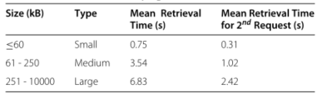
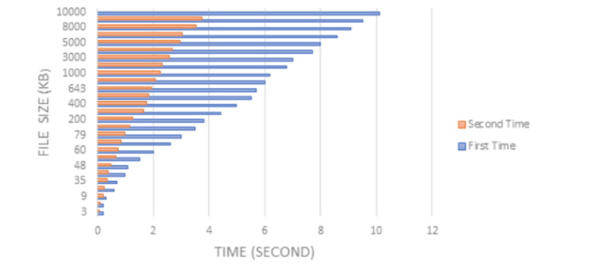
Performance analysis
Although larger files start to load at around 5 to 7 seconds, the full image can sometimes take as long as 1 minute to show up on screen. The gathered data has been illustrated in the form of a chart in the second picture. From the chart, it is evident that file size and latency are directly proportional, the bigger the file, the longer it takes to retrieve. However, it is also seen that, retrieval of the same files from IPFS the second time is significantly a lot faster because IPFS caches the data locally after the first delivery, thus, reducing the latency. Either way, improvements need to be made to retrieve larger files quicker.
Notes:
File size will affect efficiency

Slide 19
Conclusions
0 6

Slide 20
Conclusions
Shortcoming:
1. Inefficiency
2. Single function---for sharing only
3. Key management is a burden for users
Notes:
I think this model have three shortcoming:

Slide 21
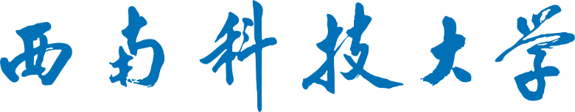
THANKS And You r Slogan Here
演讲人：李超群
制作人：李超群

