Slide 1
Data Science Tools
Foundations IV – Computational Methods

Slide 2
Overview
Getting organized (on your workstation):
Structured folders
Environments
Containers
Organizing and sharing your code:
Git
GitHub
High-performance computing:
Amarel & SLURM
Sharing code & data – open data initiatives and repositories:
OSF
OpenNeuro
Dandi

Slide 3
Getting Organized
File and Folder Structure

Slide 4
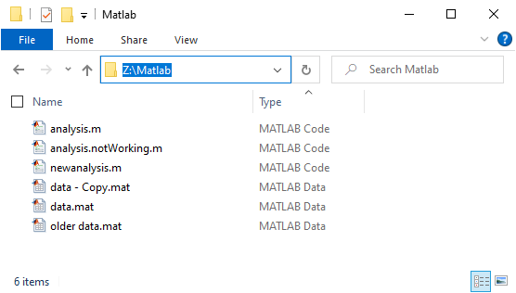
File Chaos
Data and code are mixed
File names are abstract
Different versions of the same code/data are kept

Slide 5
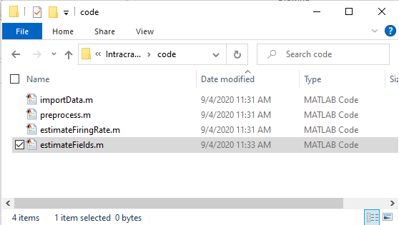
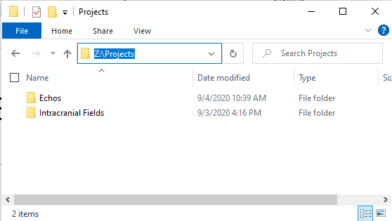
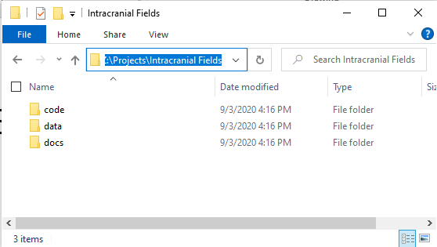
Structured Solutions
Chaos
Structure
Mixed data and code
Abstract file names
Multiple versions
One folder per project
data/code/docs
Use meaningful file names
estimateFiringRate.m
Separate logically/conceptually distinct units
read/preprocess/analyze/visualize
Use git for version control

Slide 6
Version Control
Git and GitHub.com

Slide 7
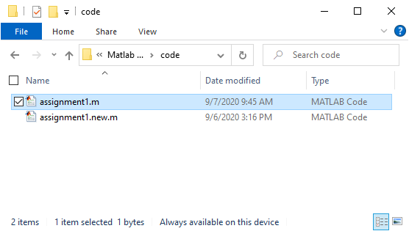
Version Control Software : git
Keeps track of different versions (including the latest one)
Avoids file clutter
Allows you to backtrack
Documents changes: who, when, and why
Simplifies collaboration and code sharing
Simplifies code review

Slide 8
Git Terminology
Repository – the collection of all versions of all files.
Local: the repository on your machine
Remote: the repository on a server somewhere else (github.com)
Sandbox – the versions that I am currently using on my machine.
Stage – Label the changes in a file for inclusion in the Repository
This allows you to keep some files or changes only in the Sandbox, while others are going to be added to the Repo.
Commit – Add all staged changes to the Local Repo
This is where you add a message explaining why these changes were made.
Push – Add changes in the Local Repo to the Remote Repo

Slide 9
Git Terminology
Clone – create a local copy of the central Repo.
Pull – Add changes from the Central Repo to the Local Repo.
Branch – A copy of the code where you develop new features without interfering with the code that has already been developed.
Main branch - tested/released code.
Develop branch - newly developed code.
Pull Request – Submit a branch for review.
Receive feedback from the maintainers.
Merge – include the changes from one branch into another.

Slide 10
Git is not meant for large data files. (< 100 MB)
Use Version Control for Data:
Git Large File Storage (LFS)
< 2 GB
Git Annex
Complicated to setup
Hard to maintain
Datalad
Uses git-annex internally.
Slightly easier to maintain.
OpenNeuro
Do you really need version control for data?

Slide 11
DataJoint – explicit data analysis pipelines

Slide 12
Options for large data files. (> 100 MB)
Data streaming service (Google Drive, OneDrive, Box,…)
Setup a structured folder for all your data:
\data\project1
\data\project2
Stream or Sync project to your workstation
Google Drive: Offline Access\Make Available Offline
One Drive: Always keep on this device
Advantages:
Share by providing a read-only link (put instructions for users in the project Readme.md)
Automatically backed up by Google/Microsoft/Box
Save space on your workstation by selective syncing (or streaming)
Write your code so that the data folder can easily be changed.

Slide 13
Version Conflicts
Scenario: You are working on two projects:
Project A: Requires Python 3.8 with numpy 1.19.5 and scikit-learn 0.24. Project B: Requires Python 3.10 with numpy 1.23.0 and tensorflow 2.9.
Problem Without Environments:
If you install all these packages globally, they could conflict. For example, tensorflow might require a newer version of numpy that breaks compatibility with scikit-learn in Project A. Attempting to install both versions system-wide could lead to version conflicts and unexpected behavior across projects.

Slide 14
Python (Anaconda)
Project A: conda create --name projectA python=3.8 conda activate projectA conda install numpy=1.19.5 scikit-learn=0.24
Project B: conda create --name projectB python=3.10 conda activate projectB conda install numpy=1.23.0 tensorflow=2.9
Dependencies are installed automatically, with appropriate versions.
Package management is easy for user, but complicated for the developer.
Most toolboxes/packages have conda instructions.

Slide 15
Matlab
Centralized biannual releases with associated add-ons.
Mixing and matching may work, but there are no guarantees.
Projects:
startup
Check for files, start parallel workers, connect to a vpn, write something to a log?
Set the search path
shutdown
upgrade
export
Alternative : startup.m

Slide 16
Containerized Computing
Docker, Singularity

Slide 17
Beyond environments
Container
A virtual computer with all the software needed for a data analysis project.
Mainly open-source software (i.e., Linux + Python + …)
Docker (Workstation running Linux, Windows, MacOS)
SingularityCE (HPC)
Examples (hub.docker.com):
NeuroDebian: a large collection of popular neuroscience research software: AFNI, FSL, PyMVPA, and many others.
bids (hcppipelines, heudiconv)

Slide 18
Docker Examples
docker pull hello-world # Get the image docker run hello-world # Start the container
docker run -it ubuntu bash # Get the image and start a container
docker run -it -v C:/:/tmp ubuntu bash # Mount c:/as /tmp

Slide 19
Docker for Matlab
docker pull matlab:r2024b docker run -it --rm -p 8888:8888 --shm-size=512M mathworks/matlab:r2024b -browser
Add toolboxes by modifying the Docker file and building your own image (see Mathworks help)

Slide 20
Container Lingo
# Use an official Python runtime as the base image
FROM python:3.10-slim
# Set the working directory inside the container
WORKDIR /app
# Install Python dependencies directly
RUN pip install --no-cache-dir numpy pandas
# Copy the application code to the container
COPY . .
# Specify the command to run the application
CMD ["python", "app.py"]
Dockerfile
Instructions to build an image (=set up the computer)
Written by maintainer/developer
Image
Template for a container.
Read-only
Complete installation.
Container
Docker “boots” the image to create a running instance on your workstation.
Interact with it via browser, terminal, and GUI.
Read-only, all data are lost once the container is shut down.
Volumes & Bind Mounts
External disks for data persistence
Registry
Image storage and sharing (Docker Hub)

Slide 21
Should I use a container for my project?
Environments
Containers
+ Only Python
+ Only Matlab
+ Easy to setup
Hidden dependencies
read/write
+ Multiple interacting software packages (e.g., Matlab + Python)
+ Multiple machines, users
- more work to setup
+ read-only
? Data Sharing

Slide 22
High-Performance Computing
Amarel & SLURM

Slide 23
Amarel
A shared community-owned advanced computing environment available to any Rutgers investigator or student with projects requiring research computing resources.
770 compute nodes - 37,472 Intel Xeon cores - 248 GPUs
Spans three Rutgers data centers (Piscataway, Newark, and Camden), producing a unified compute, data, and storage system.

Slide 24
SLURM
amarel
amareln
amarelc
Head nodes
partition
Compute nodes
Storage

Slide 25
SLURM
#!/bin/bash
#SBATCH --job-name=my_job # Job name
#SBATCH --output=output_%j.txt # Standard output log (%j expands to job ID)
#SBATCH --time=01:00:00 # Time limit (hh:mm:ss)
#SBATCH --partition=price,main # Partition to submit to
#SBATCH --ntasks=10 # Number of tasks
#SBATCH --cpus-per-task=4 # Number of CPU cores per task
#SBATCH --mem=8G # Memory per task
# Load required modules (if needed)
module load python/3.8
# Activate the environment
conda activate myenv
# Run your code
python my_script.py

Slide 26
Amarel
Pros
Cons
Pre-installed software
module load *
module spider *
Memory (256 GB)
GPUs
Dumb parallelism (100 subjects, 5000 neurons, 25 experiments)
Startup cost/effort
Preemption
Noninteractive
but FastX, OnDemand

Slide 27
Data Sharing

Slide 28
Policies
NIH has a longstanding commitment to making the results of NIH-funded research available. Responsible data management and sharing has many benefits, including accelerating the pace of biomedical research, enabling validation of research results, and providing accessibility to high-value datasets.
From: Data Management and Sharing Policy | Data Sharing
PLOS believes that sharing data fosters scientific progress. Data availability allows and facilitates:
Validation, replication, reanalysis, new analysis, reinterpretation or inclusion into meta-analyses;
Reproducibility of research;
Efforts to ensure data are archived, increasing the value of the investment made in funding scientific research;
Reduction of the burden on authors in preserving and finding old data, and managing data access requests;
Citation and linking of research data and their associated articles, enhancing visibility and ensuring recognition for authors, data producers and curators.
From: Data Availability | PLOS

Slide 29
Problems & Solutions
Data files are large
Sharing should be forever
Data folders should be machine-readable
Fixed data format, folder structure, meta data
Meta data should also be human readable
json (JavaScript Object Notation)
{
"name": "John Doe",
"age": 30,
"isEmployed": true,
"skills": ["JavaScript", "Python", "Java"],
"address": {
"street": "123 Main St",
"city": "Anytown",
"zipcode": "12345"
}
}

Slide 30

Brain Imaging Data Structure (BIDS)

Slide 31
BIDS: the (?) standard for human data sharing
Pro
Con
(f)MRI, EEG, MEG
Automated conversion to (and from) BIDS
Standardized preprocessing (fmriprep, hcp, nypipe)
Standardized quality control (mriqc)
HS protection
Standards beyond MRI “under development”

Slide 32
Emerging standards beyond BIDS MRI?
Many recording devices, each with their output format
Multiple devices per experiment
Quality control & provenance
Electrophysiology
Neurodata without Borders data format
DANDI Archive

Slide 33
Open Science Foundation
No standards enforced; share anything
Link to GitHub, Google Drive,…
Pre-registered studies

Slide 34
Do I need …
File & Folder Structure?
Yes
GitHub?
Yes
Environments?
Python – Yes, use conda
Matlab – Maybe Projects, but at least use a project-specific startup.m
Containers?
Neuroimaging – Yes
Develop a toolbox – Yes
Multiple interacting tools - Yes
Share your work with others - Maybe
Amarel/HPC?
High memory demand – Yes
Dumb parallelism – Yes.
Data Sharing
Neuroimaging – Yes, relatively easy on OpenNeuro
Others – Yes, somewhat painful with NWB and Dandi.

