Slide 1

Peptide identification
for Breast Cancer Data

Slide 2
What our data take about
we're looking at breast cancer data, Which looks at the possibility of infection in the long run, as the MZml and Fasta data compare the patient’s data in terms of all possible analyzes and the data of the disease itself in terms of the severity of the injury and its results in these analyzes

Slide 3
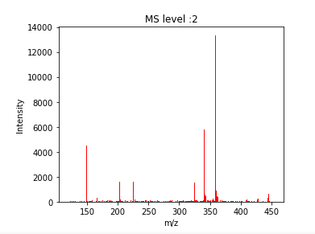
Experimental spectra
At first, we show the Experimental spectra for the first MZml data
MZml file:
20200306_Fusion_Project_395_Agami_Remco_ATF4GFP_Ctrl_02.mzML

Slide 4
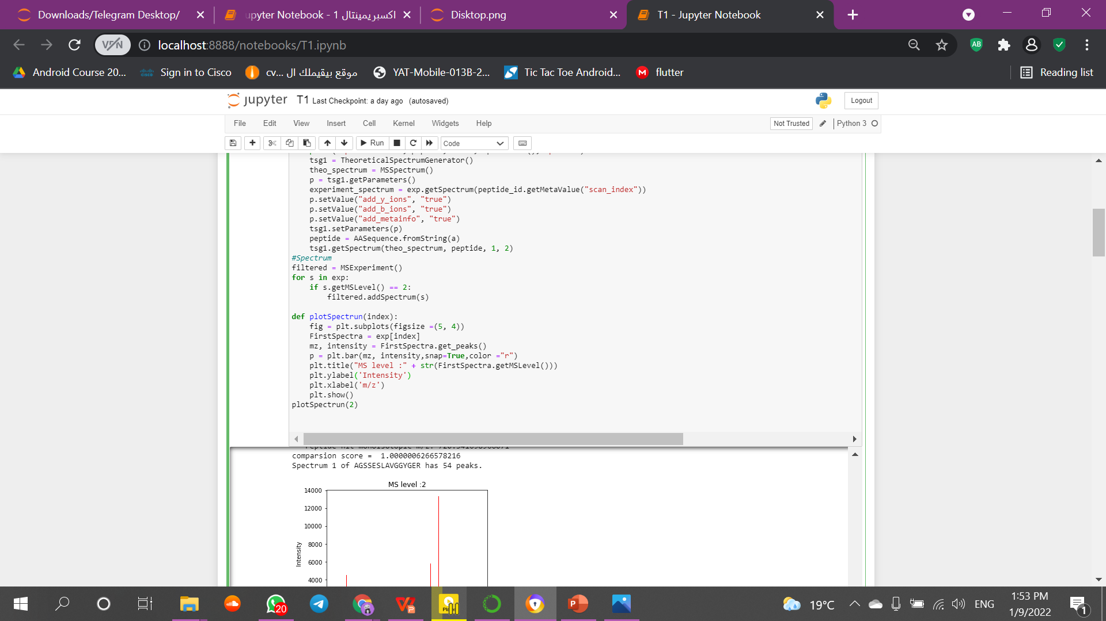
The code we are use for generate the Experimental spectra and filter the level to show ms2

Slide 5
And have downloaded a FASTA file that contains information about the tumor and its possibility of infection
Fasta file name:Pr395_GFP_IP_GFP_fs_mutant.fasta

Slide 6
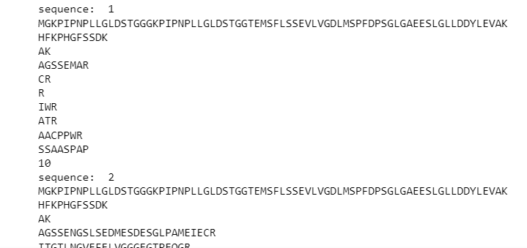
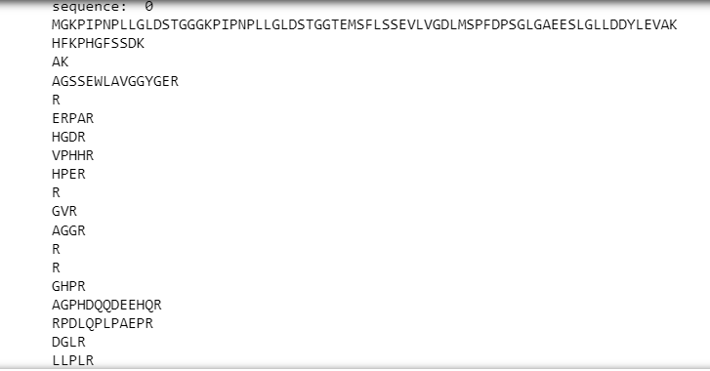
Theoretical Spectra
We divide the Fasta data into smaller peptides that allow comparison with MZml
with trypsin , b and y ions

Slide 7
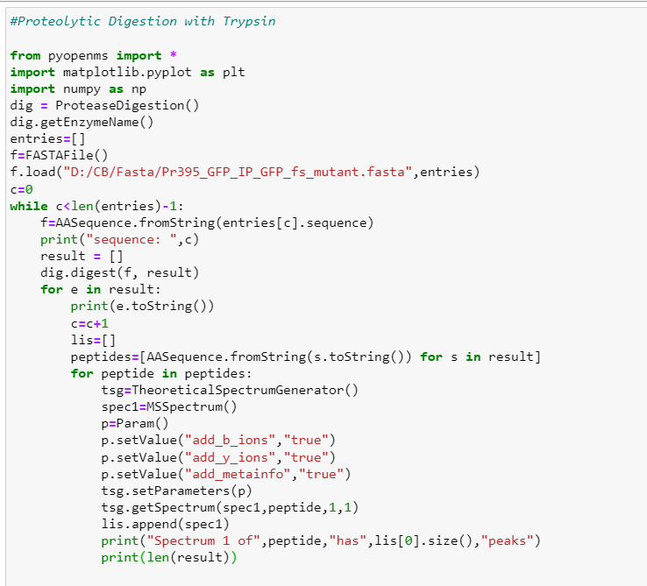
Digestion Code with trypsin , b and y ions

Slide 8
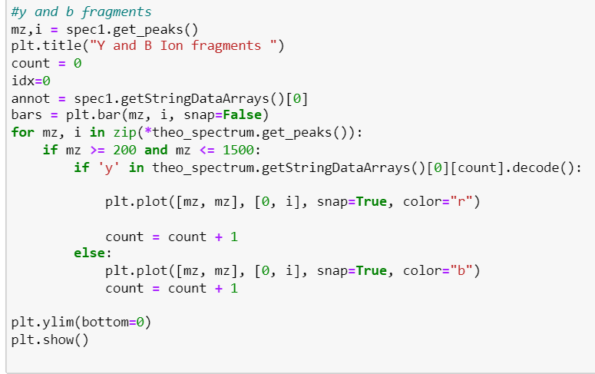
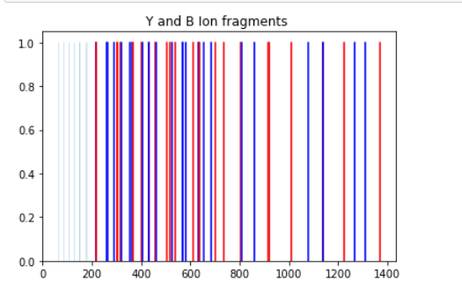
Y and B ions

Slide 9

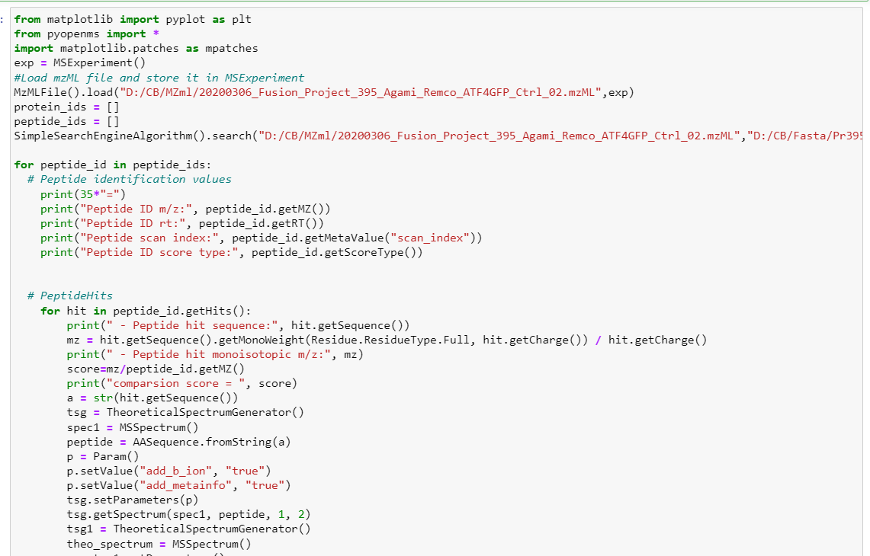
Then we make the comparison every peptide sequence spectra with MZml spectra

Slide 10
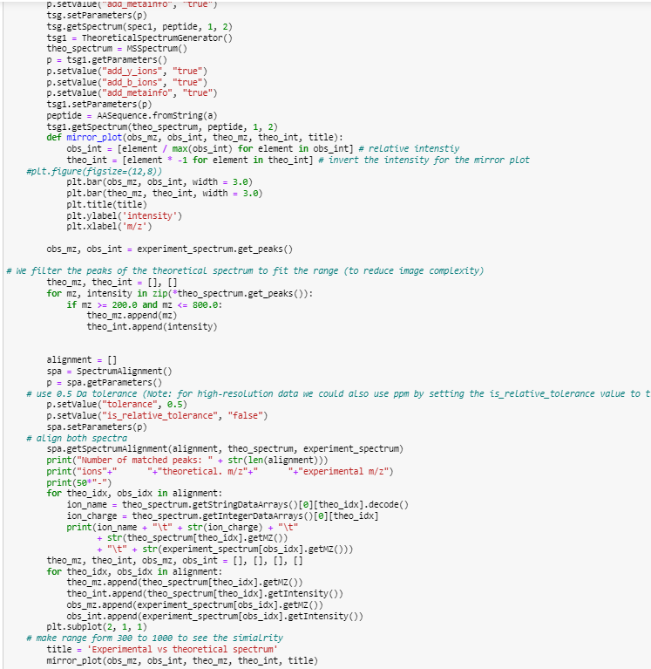

Slide 11
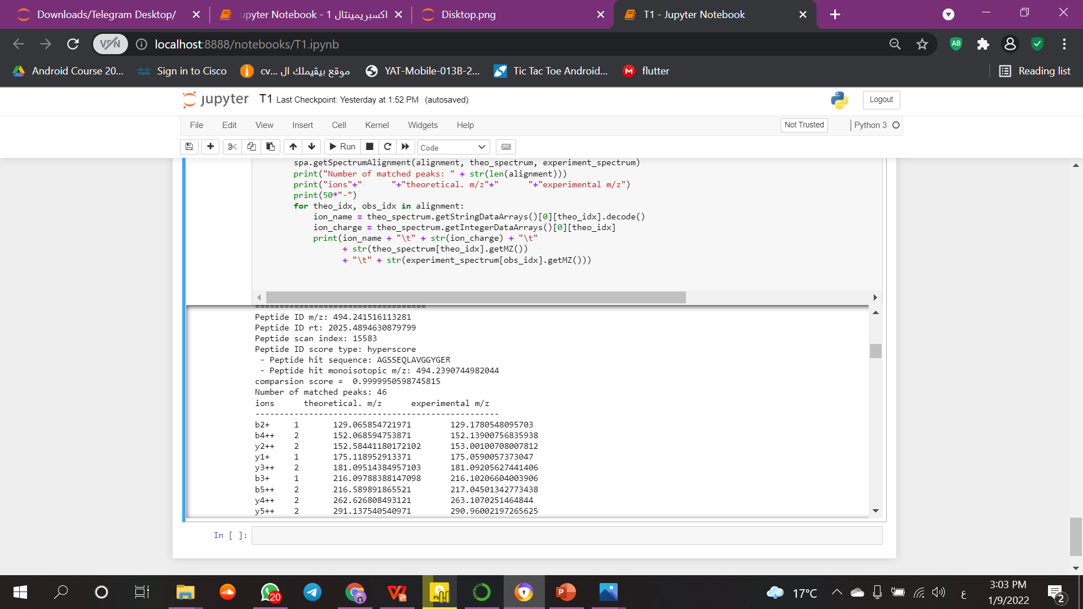
Comparison code output
That show the matches score in every peptide sequence

Slide 12
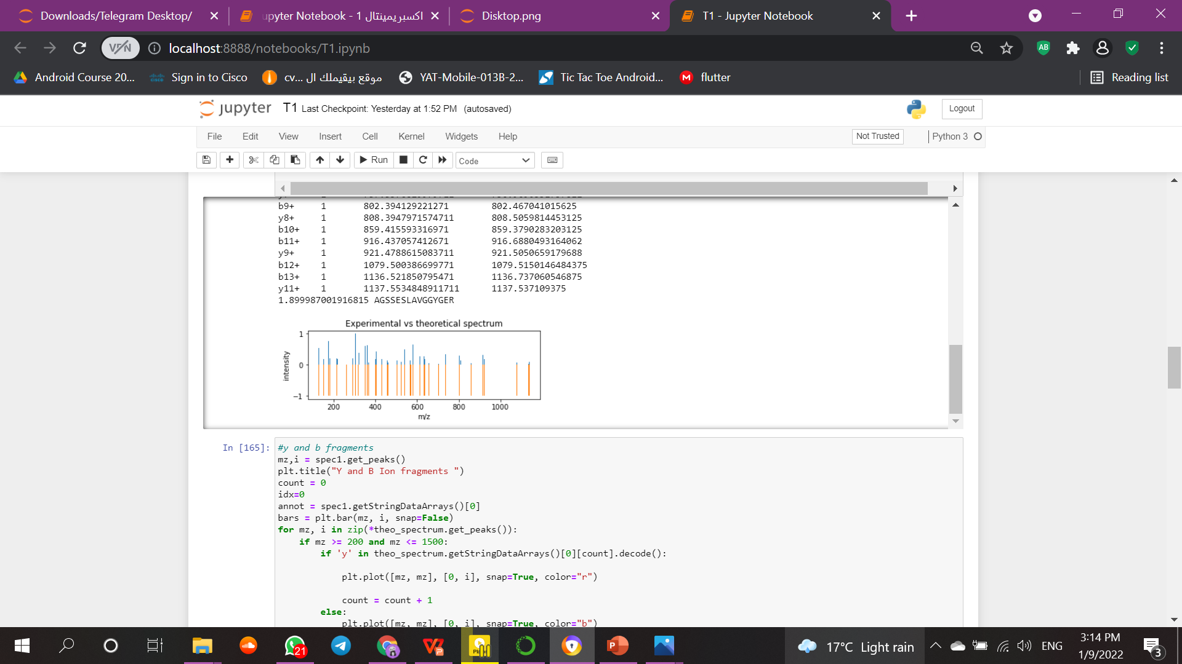
This code make spectra comparison result in graph that show in mirror

