Slide 1

SILAC
Stable isotope labeling using amino acids in cell culture

Slide 2
SILAC :- (Stable Isotope labeling by /with amino acids) is a technique based on direct addition of selected stable isotope amino acids into the cell culture medium, allowing superior quantitative analysis of the cellular proteome compared to other labeling methods. is a technique and a powerful method to study the relative proteomic change under differential treatments, based on mass spectrometry that detects differences in protein abundance among samples using non-radioactive isotopic labeling. Based on SILAC and mass spectrometry, we can analyze the relative proteomic change under differential treatments. In addition, compare with other technologies.

Slide 3
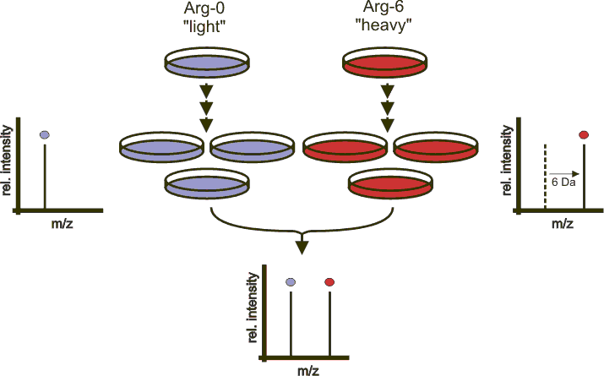

Slide 4
Applications
Pulsed SILAC:
Is one of SILAC methods where the labelled amino acids are added to the growth medium for only a short period of time.
This prefer detecting differences in de novo protein production rather than raw concentration added to the growth medium for only a short period of time.
It had also been used to study biofilm tolerance to antibiotics to differentiate tolerant and sensitive subpopulations

Slide 5
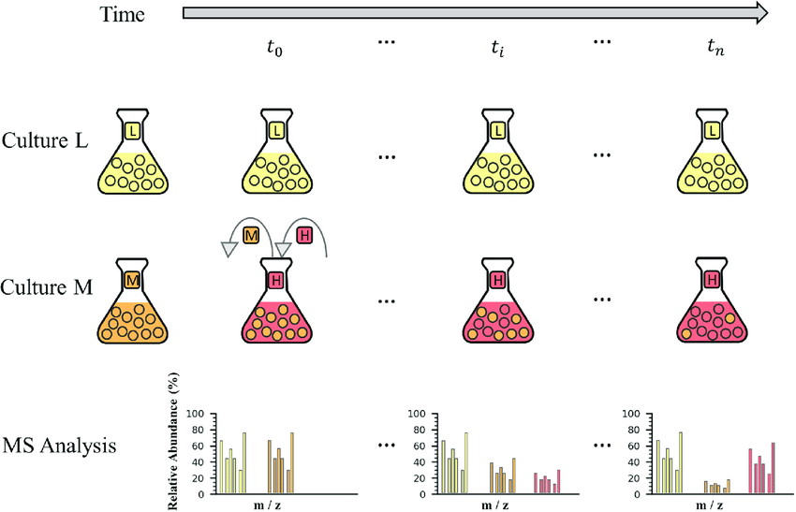
Pulsed-SILAC-method-illustration-E-coli-cells

Slide 6
NeuCode SILAC
Is the level of multiplexing in SILAC was limited due to the number of SILAC isotopes available. Recently, a new technique called NeuCode (neutron encoding) SILAC, has augmented the level of multiplexing achievable with metabolic labeling (up to 4).
The NeuCode amino acid method is similar to SILAC but differs in that the labeling only utilizes heavy amino acids. The use of only heavy amino acids eliminates the need for 100% incorporation of amino acids needed for SILAC.
The increased multiplexing capability of NeuCode amino acids is from the use of mass defects from extra neutrons in the stable isotopes. These small mass differences however need to be resolved on high resolution mass spectrometers.

Slide 7
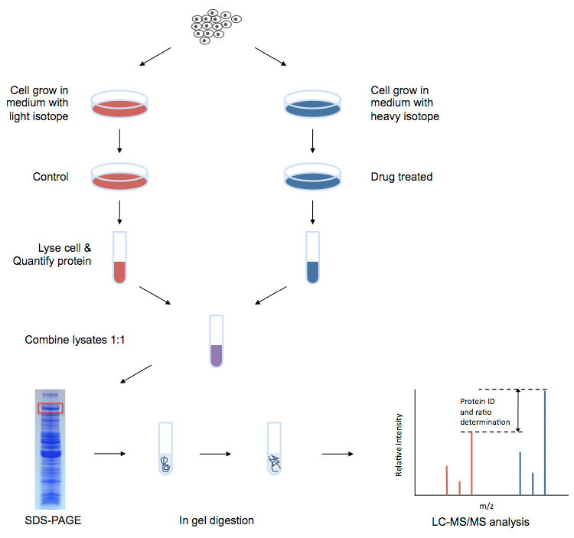

Slide 8
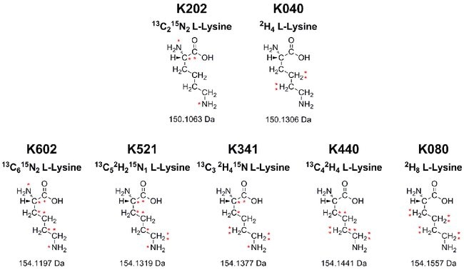
Structures and masses of NeuCode amino acids

Slide 9
Advantages of SILAC-based Proteomics Analysis Services
High labeling rate: The labeling efficiency is not affected by lysate and efficiency can be as high as 100%.
High sensitivity: The sample requirements are small, usually only tens of micrograms of protein per sample.
High throughput: Mass spectrometry can identify and quantify hundreds to thousands of proteins simultaneously.
High precision: Multiple samples are mixed, simultaneously digested, and identified. The subsequent experiments have the same effect on the sample, which reduces the impact of experimental operation and equipment, and has higher precision and reproducibility.
High activity: The label uses in vivo labeling technology and is closer to the true state of the sample.
Comprehensive services: Combined with other technologies, we can provide protein-protein interaction and post-translational modification analysis.

Slide 10
Reproducible—eliminates intra-experimental variability caused by differential sample preparation
Flexible—media deficient in both L-lysine and L-arginine, as well as Flex media formulations that allow the addition of glucose, glutamine and phenol red separately
Versatile—broadest portfolio of liquid and powdered SILAC media, as well as unique NeuCode amino acids, enabling higher multiplexing
Convenient—media and amino acids are available in kits or as stand-alone reagents
Compatible—label proteins expressed in a wide variety of mammalian cell lines, including HeLa, 293T, COS7, U2OS, A549, NIH 3T3, Jurkat and others

