Slide 1

C-Tree
Shereen Magdy
Merna Ashraf
Manar Magdy
Nehal Reda

Slide 2

Introduction
phylogenetic tree
A phylogenetic tree is a diagram that represents evolutionary relationships among organisms. Phylogenetic trees are hypotheses, not definitive facts.
The pattern of branching in a phylogenetic tree reflects how species or other groups evolved from a series of common ancestors.

Slide 3
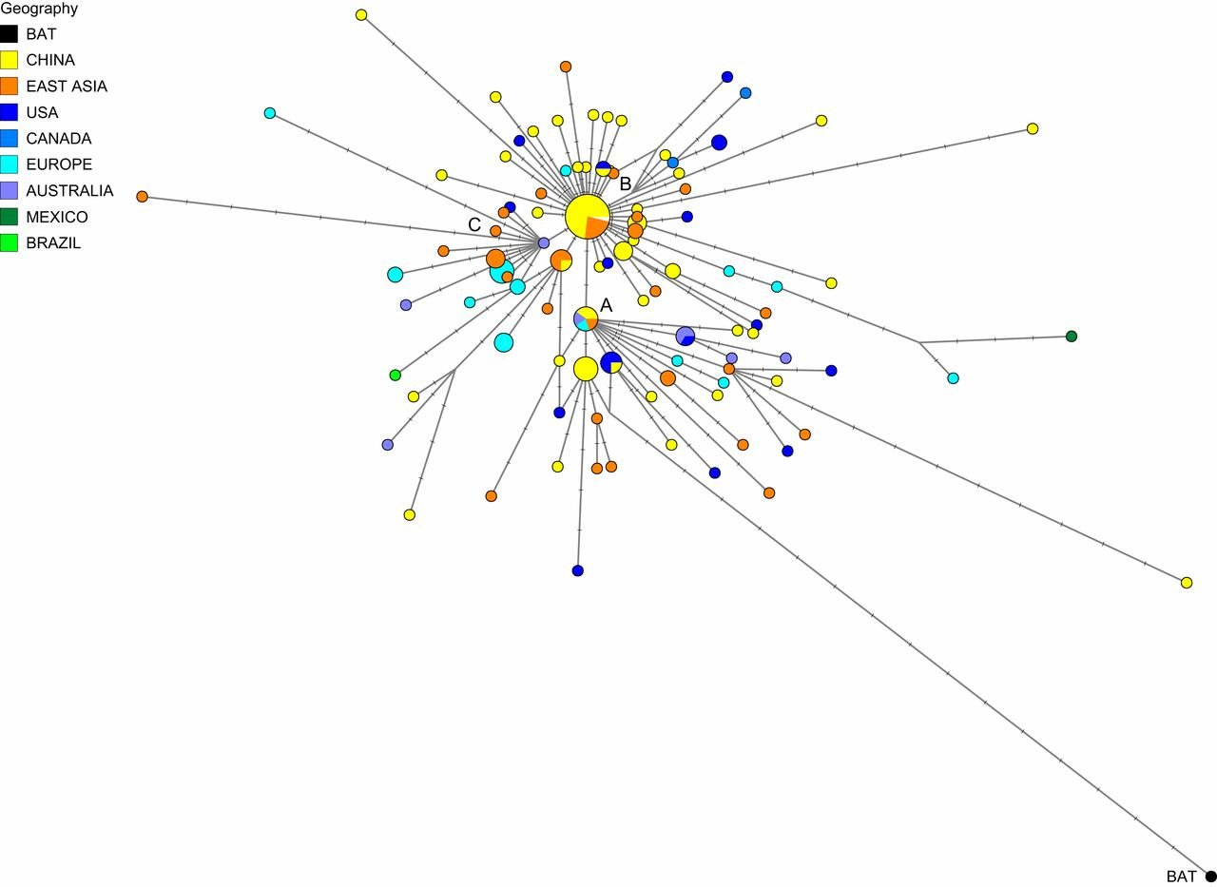
Abstract
This is a phylogenetic network of SARS-CoV-2 genomes sampled from across the world. These genomes are closely related and under evolutionary selection in their human hosts, sometimes with parallel evolution events, that is, the same virus mutation emerges in two different human hosts. This makes character-based phylogenetic networks the method of choice for reconstructing their evolutionary paths and their ancestral genome in the human host. The network method has been used in around 10,000 phylogenetic studies of diverse organisms, and is mostly known for reconstructing the prehistoric population movements of humans and for ecological studies, but is less commonly employed in the field of virology.

Slide 4
contents
01
02
03
A phylogenetic tree contains the family of SARS and each with its spread location and time
Search algorithm to know the percentage of each type in all countries
Symptoms of covid, prevention, spread timeline in present and any related information

Slide 5
Problem
The problem is that the usual sites that shows or talks about that topic are complicated for the people who have not studied these kind of materials related to genomics or computer science.
Solution
We will take the topic and show the diagram of the tree and families of covid in a simple way that everyone interested in the topic will understand it
problem

Slide 6

THANK YOU

