Slide 1
We’ll Cross That Bridge When We Get There:
Novel Approaches to Ancestral Trait Reconstruction (And an Appropriately Unhinged Recap of the Field)

Slide 2
Who Am I?

Slide 3
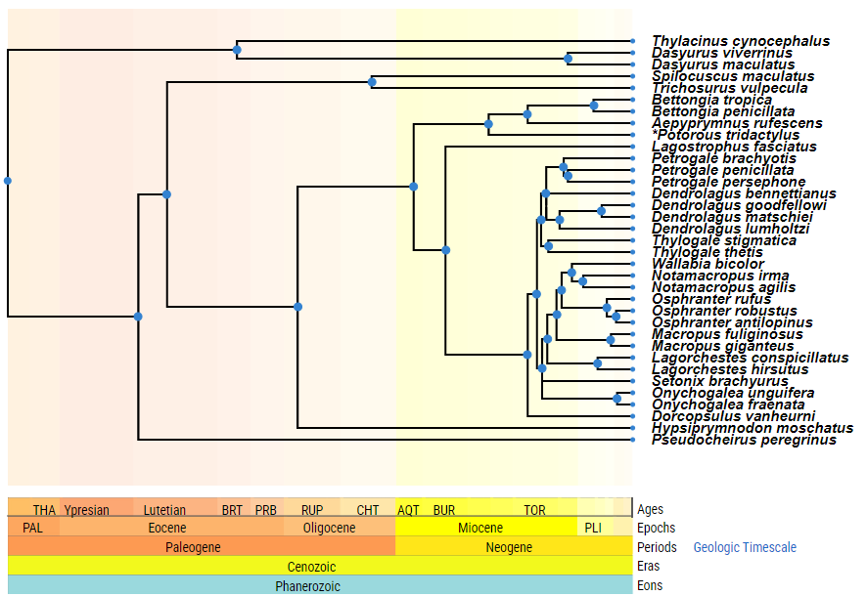
The Problem

Slide 4
What is a Species?
And who gets to decide?
A Brief History of Panthera tigris
1758 Carl Linnaeus describes the tiger giving it the scientific name Felis tigris
1929 Reginald Innes Pocock places the species in Panthera
We recognize up to 9 (Living and Extinct) tiger subspecies: Bengal, Malayan, Indochinese, South China, Siberian, Caspian, Javan, Bali, Sumatran
1999 Proposal to recognize only 2 subspecies as previous definitions rely solely on morphological characteristics
Panthera tigris tigris, Panthera tigris sondaica
2015 corroboration of two subspecies proposal due to morphological, ecological and mitochrondrial DNA traits
2018 whole genome sequencing on the 6 remaining subspecies from 1929-1999 definitions indicate all belong to different clades
Corroborated in 2021, 2023

Slide 5
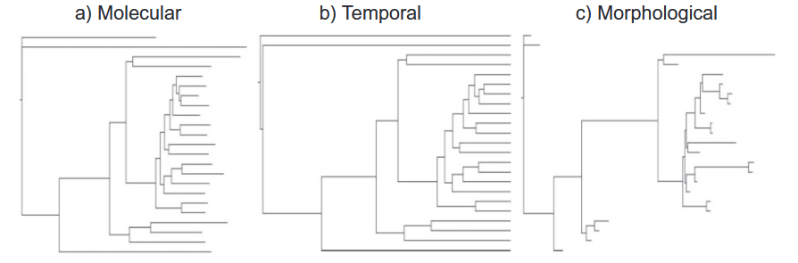
Trees
We’ll cross this bridge when we get to it

Slide 6
The Problem

Slide 7
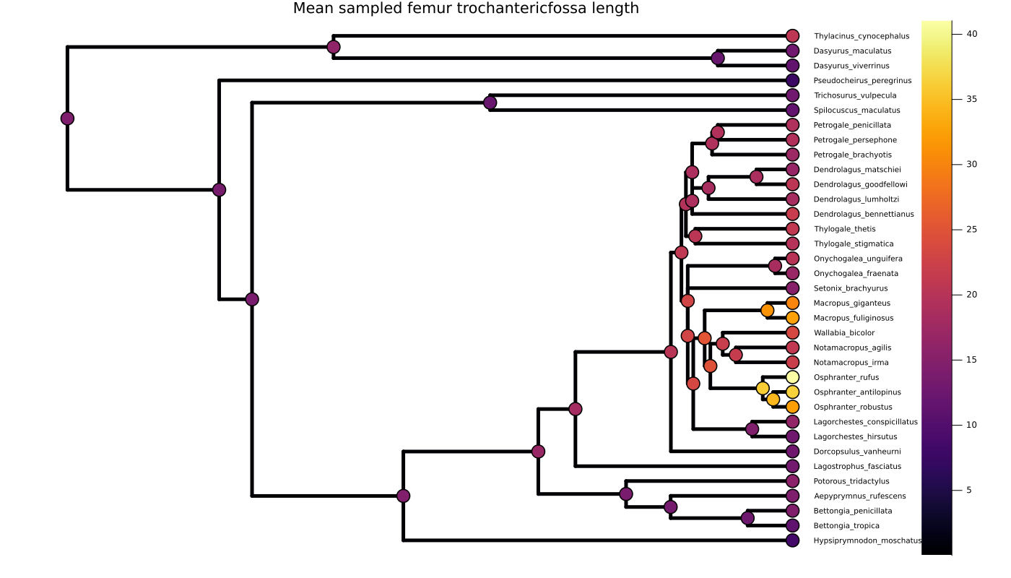
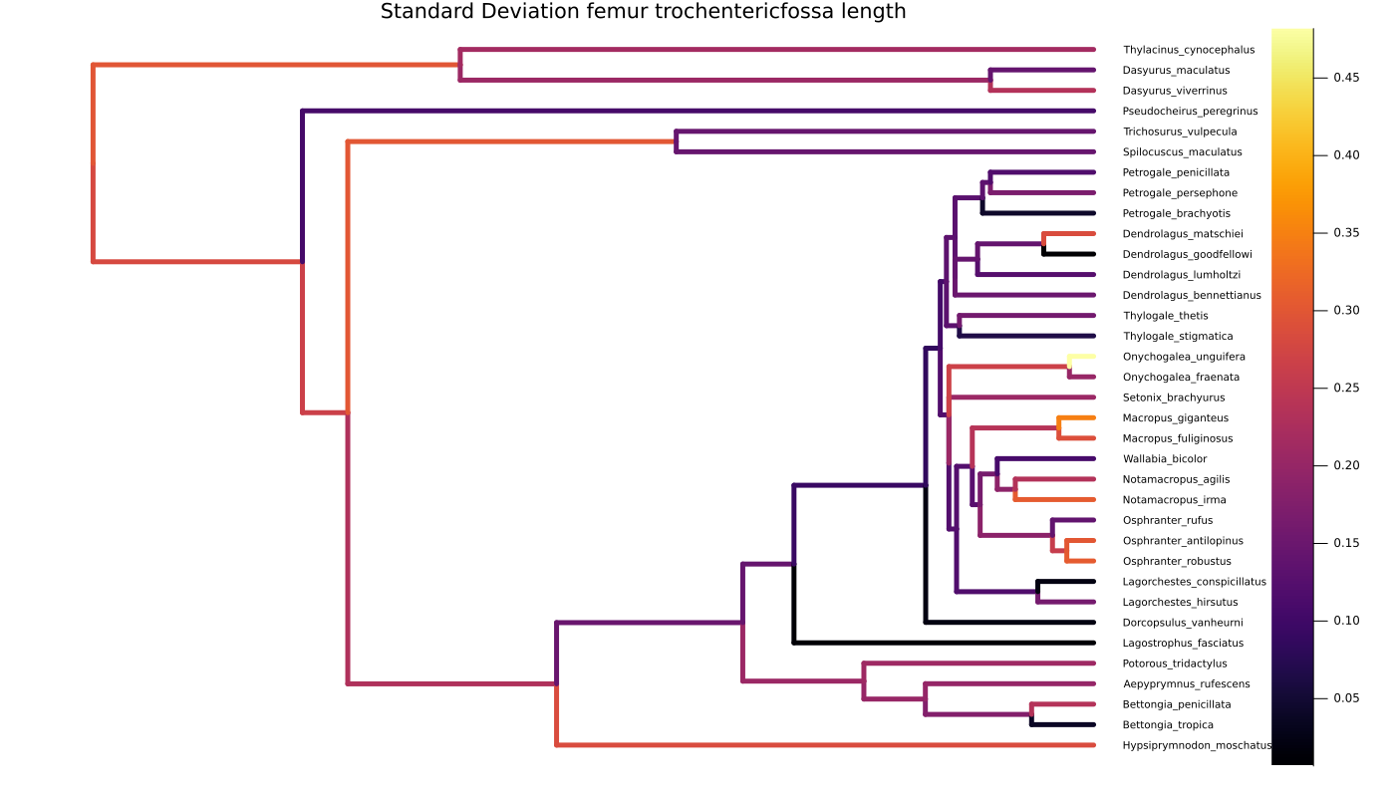
Ancestral Character Reconstruction
A
B
Figure 1: Ancestral trait reconstruction of 35 marsupial species for femur trochanteric fossa length value from 25 multiple imputations,
from 25 independent initial samples with trait reconstruction repeated 25 times. A) indicates the mean with heat map over the marker
indicated predicted mean values, B) shows standard deviation normalized to mean value of the length of the tree

Slide 8
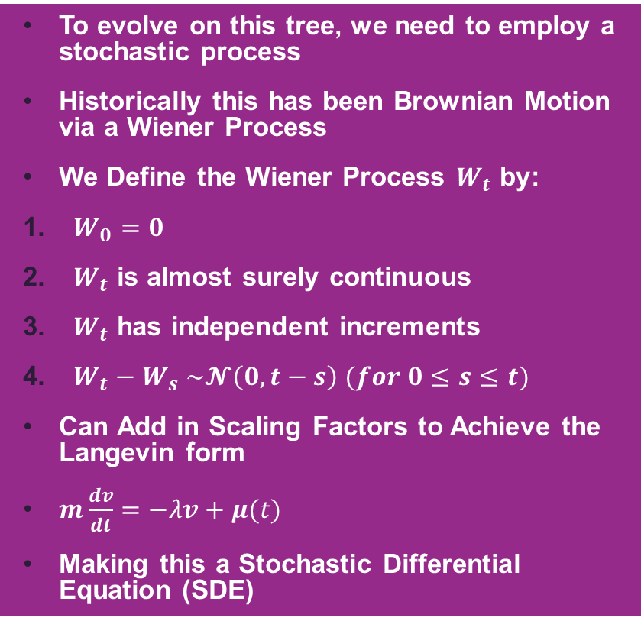
Brownian Motion
To evolve on this tree, we need to employ a stochastic process
Historically this has been Brownian Motion via a Wiener Process
We Define the Wiener Process $W_{t}$ by:
$W_{0}=0$
$W_{t}$ is almost surely continuous
$W_{t}$ has independent increments
$W_{t}−W_{s} \sim 𝓝\left(0, t−s\right) (for 0≤s≤t)$
Can Add in Scaling Factors to Achieve the Langevin form
$m\frac{dv}{dt}=−λv+μ(t)$
Making this a Stochastic Differential Equation (SDE)
Simplest Model
Figure 2: Brownian Motion sampling from N(0, t) over 10 seconds

Slide 9
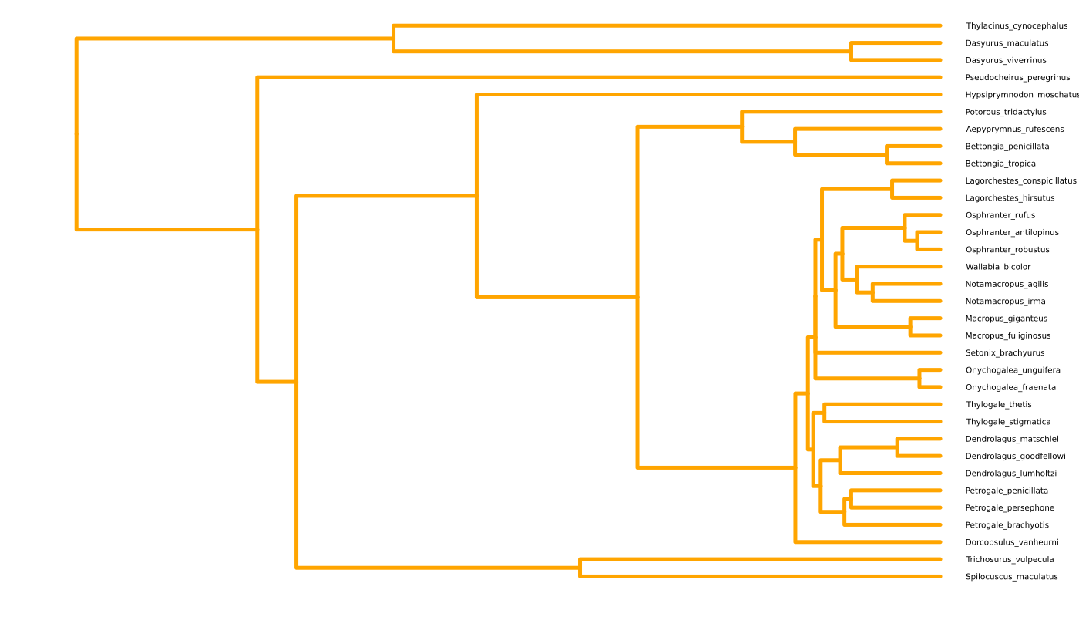
Maximum Likelihood Estimation
Figure 3: Phylogenetic Tree reconstruction of 35 macroform marsupial species

Slide 10
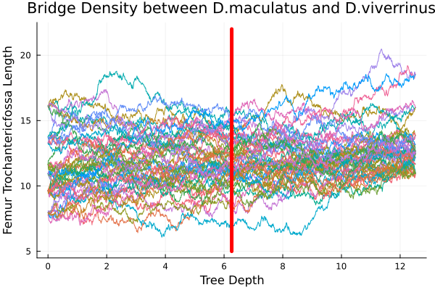
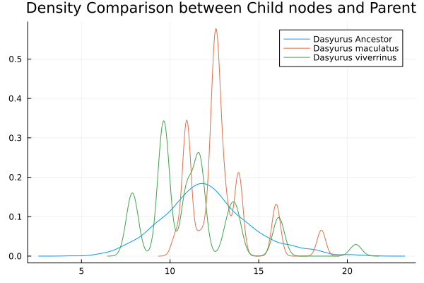
Bridging the Gap
A
Start with the knowns
Diffusion Bridges Allow us to extend our SDE
A Diffusion Bridge is an SDE where the value (v) at a time T is known
Given this there are a set number of solutions to the SDE and we can sample from the list of viable solutions
For our phylogeny: given two known tip values, we can Simulate BM over the branches between them (T) to our known value (v)
We can continue this process down the tree leading to our first 2 figures
B
Figure 4: Brownian Bridge trait reconstruction between Dasyurus maculatus and Dasyurus viverrinus. A) contributing Brownian Bridges
to the ancestral trait value of the ancestor, red line indicates the time point of the ancestor B) kernel density estimates of the contributing
leaves to the resulting ancestral nodes, blue line corresponds to the density seen in figure A

