Slide 1
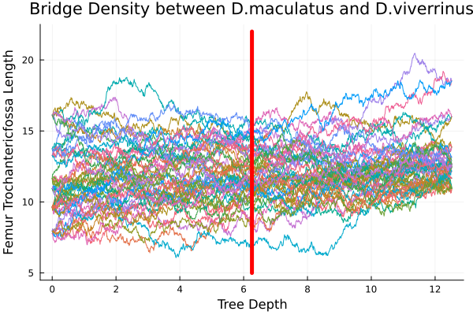
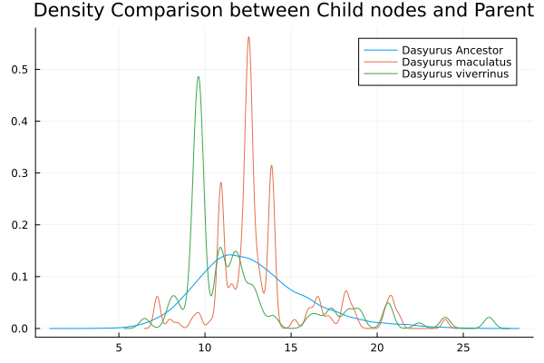
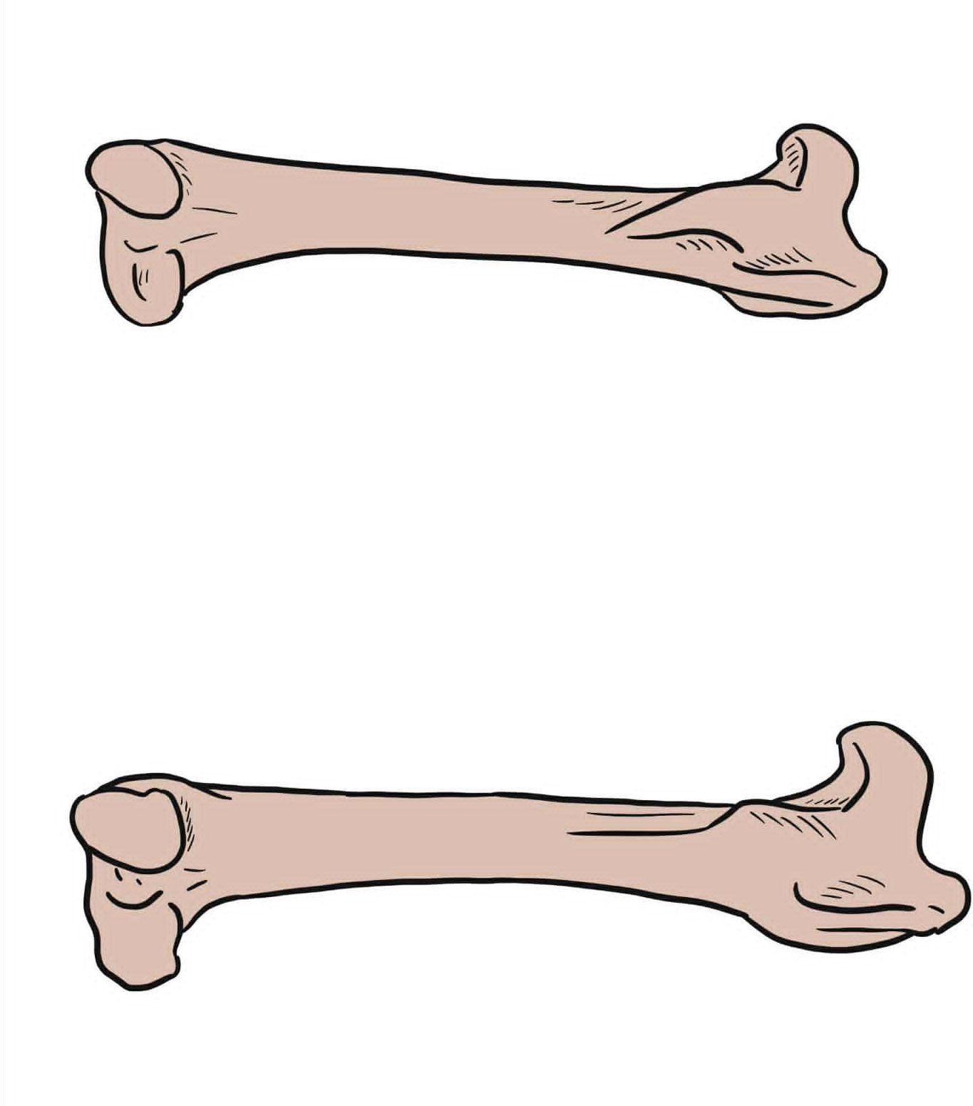
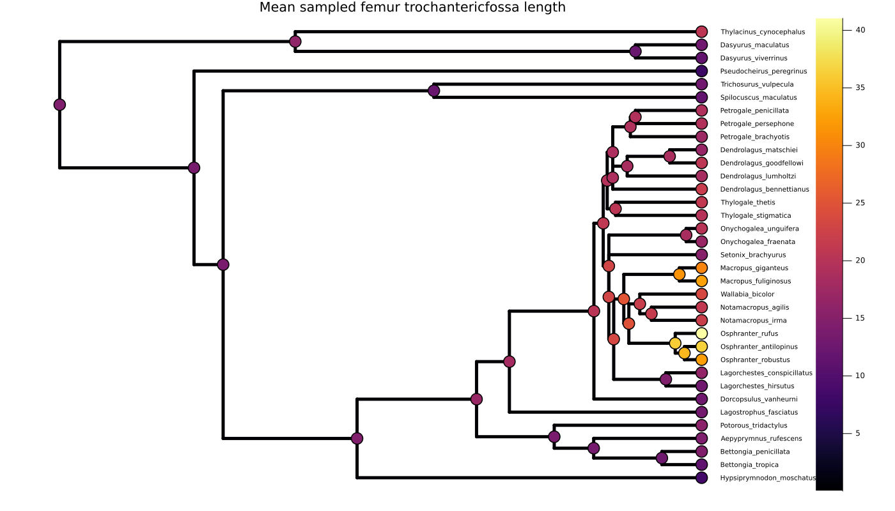
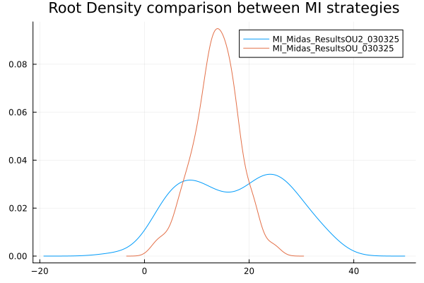



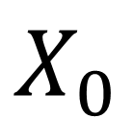
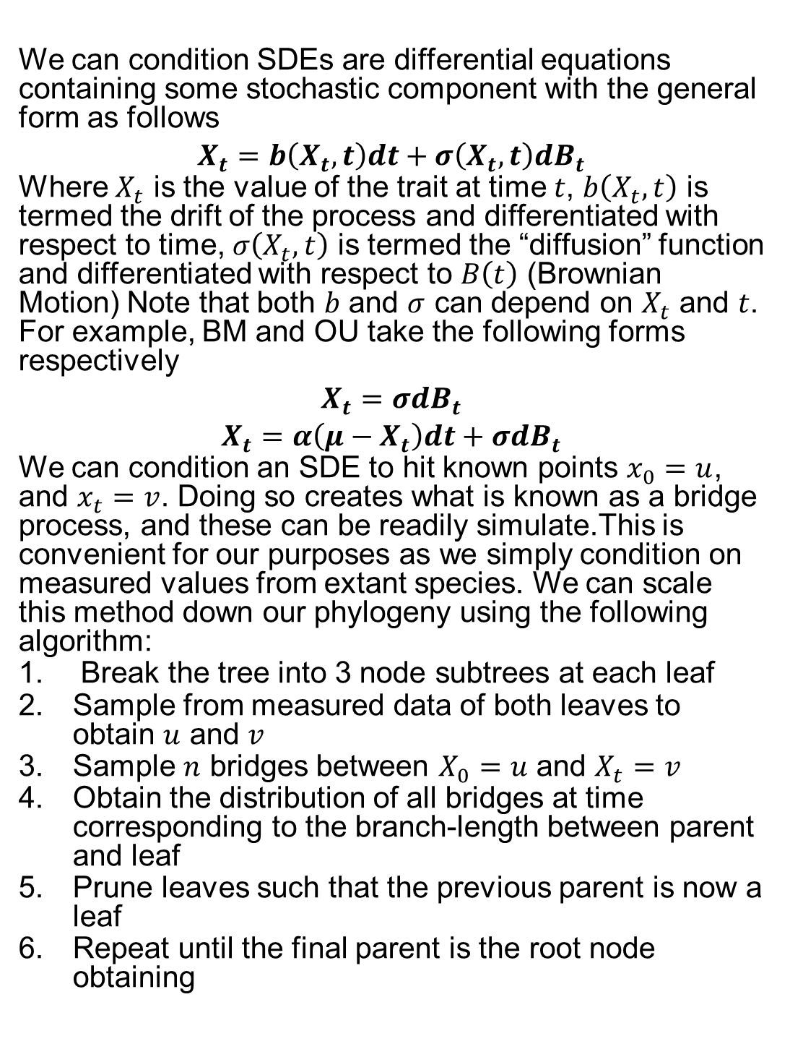
We’ll Cross That Bridge When We Get There: Ancestral Trait Reconstruction with Monte Carlo Diffusion Bridge Sampling
Rowan Elson-Green¹, Simone Blomberg¹
¹ School of the Environment, The University of Queensland, St Lucia, QLD, Australia
Ancestral Trait Reconstruction
Ancestral Trait Reconstruction (ATR) is the process of reconstructing historical trait values of unknown ancestor species, in relation to some phylogenetic tree, such as the one seen in Figure 2 this relies on a fundamental idea; Species that are closely related are likely to have more similar trait values than those that are further apart. However properly accounting for this shared history, and other ecological factors has been a major struggle for evolutionary biologists for almost 50 years, as there is a significant loss in statistical convenience when working with non-independent data.
Historically this problem is avoided, by using normally distributed Stochastic Differential Equations (SDEs) such as Brownian Motion (BM) or Ornstein-Uhlenbeck Processes (OU) as the underlying model of evolution. We wish to remedy this by extending these processes to take non-independence into account, in the process we must provide tools that allow us to do so.
Diffusion Bridges
We can condition SDEs are differential equations containing some stochastic component with the general form as follows
$$X_{t}=b\left(X_{t},t\right)dt+σ\left(X_{t},t\right)dB_{t}$$
Where $X_{t}$ is the value of the trait at time $t$, $b\left(X_{t},t\right)$ is termed the drift of the process and differentiated with respect to time, $σ\left(X_{t},t\right)$ is termed the “diffusion” function and differentiated with respect to $B\left(t\right)$ (Brownian Motion) Note that both $b$ and $σ$ can depend on $X_{t}$ and $t$. For example, BM and OU take the following forms respectively
$$X_{t}=σdB_{t}$$
$$X_{t}=α\left(μ−X_{t}\right)dt+σdB_{t}$$
We can condition an SDE to hit known points $x_{0}=u$, and $x_{t}=v$. Doing so creates what is known as a bridge process, and these can be readily simulate.This is convenient for our purposes as we simply condition on measured values from extant species. We can scale this method down our phylogeny using the following algorithm:
Break the tree into 3 node subtrees at each leaf
Sample from measured data of both leaves to obtain $u$ and $v$
Sample $n$ bridges between $X_{0}=u$ and $X_{t}=v$
Obtain the distribution of all bridges at time corresponding to the branch-length between parent and leaf
Prune leaves such that the previous parent is now a leaf
Repeat until the final parent is the root node obtaining
$$X_{0}$$
$$X_{t}$$
Figure 3: Ancestral trait reconstruction of 35 marsupial species for femur trochanteric fossa length value from 25 multiple imputations, from 25 independent initial samples with trait reconstruction repeated 25 times indicates the mean with heat map over the marker indicated predicted mean values
CRICOS 00025B • TEQSA PRV12080
Figure 2: Brownian Bridge trait reconstruction between Dasyurus maculatus and Dasyurus viverrinus. A) contributing Brownian Bridges to the ancestral trait value of the ancestor, red line indicates the time point of the ancestor B) kernel density estimates of the contributing leaves to the resulting ancestral nodes, blue line corresponds to the density seen in figure A.
r.elsongreen@uq.edu.au
uq.edu.au

