Slide 1
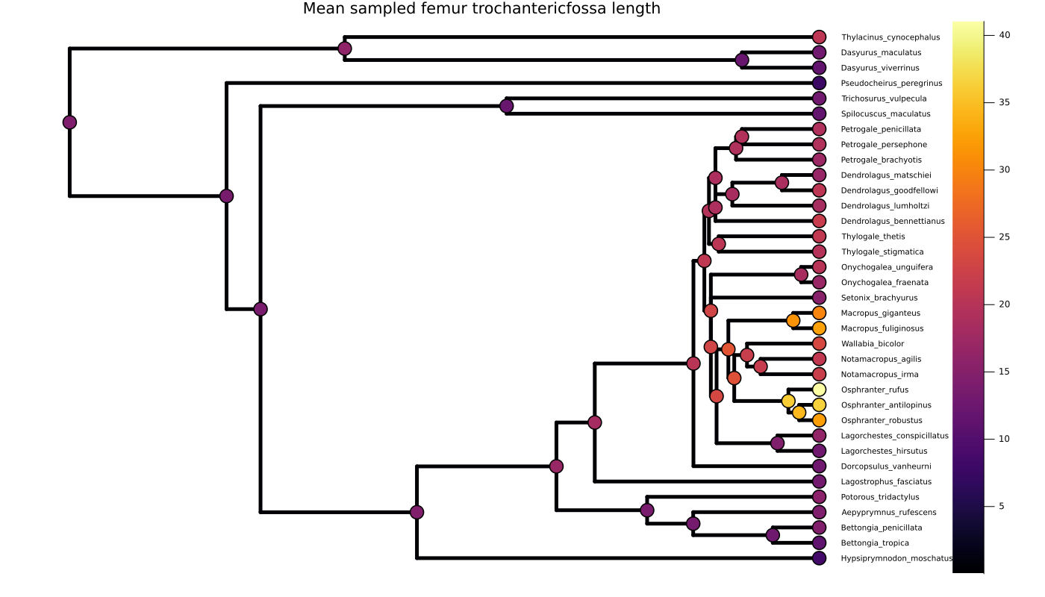
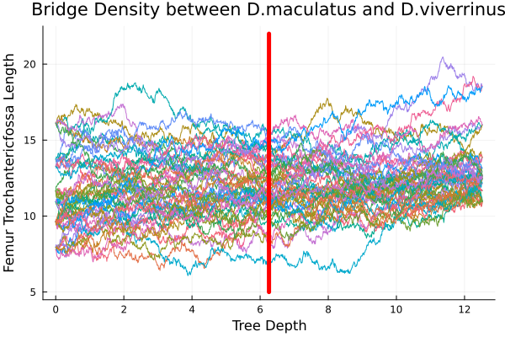
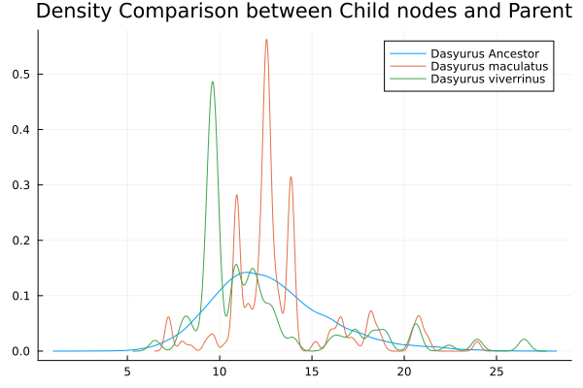
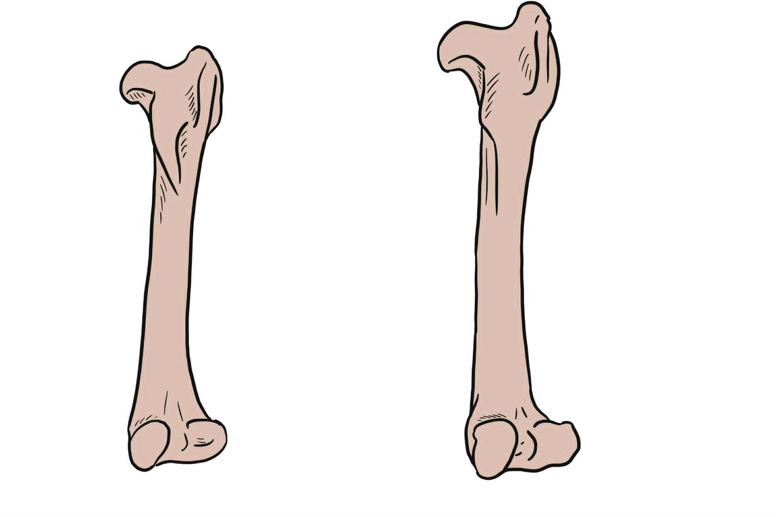


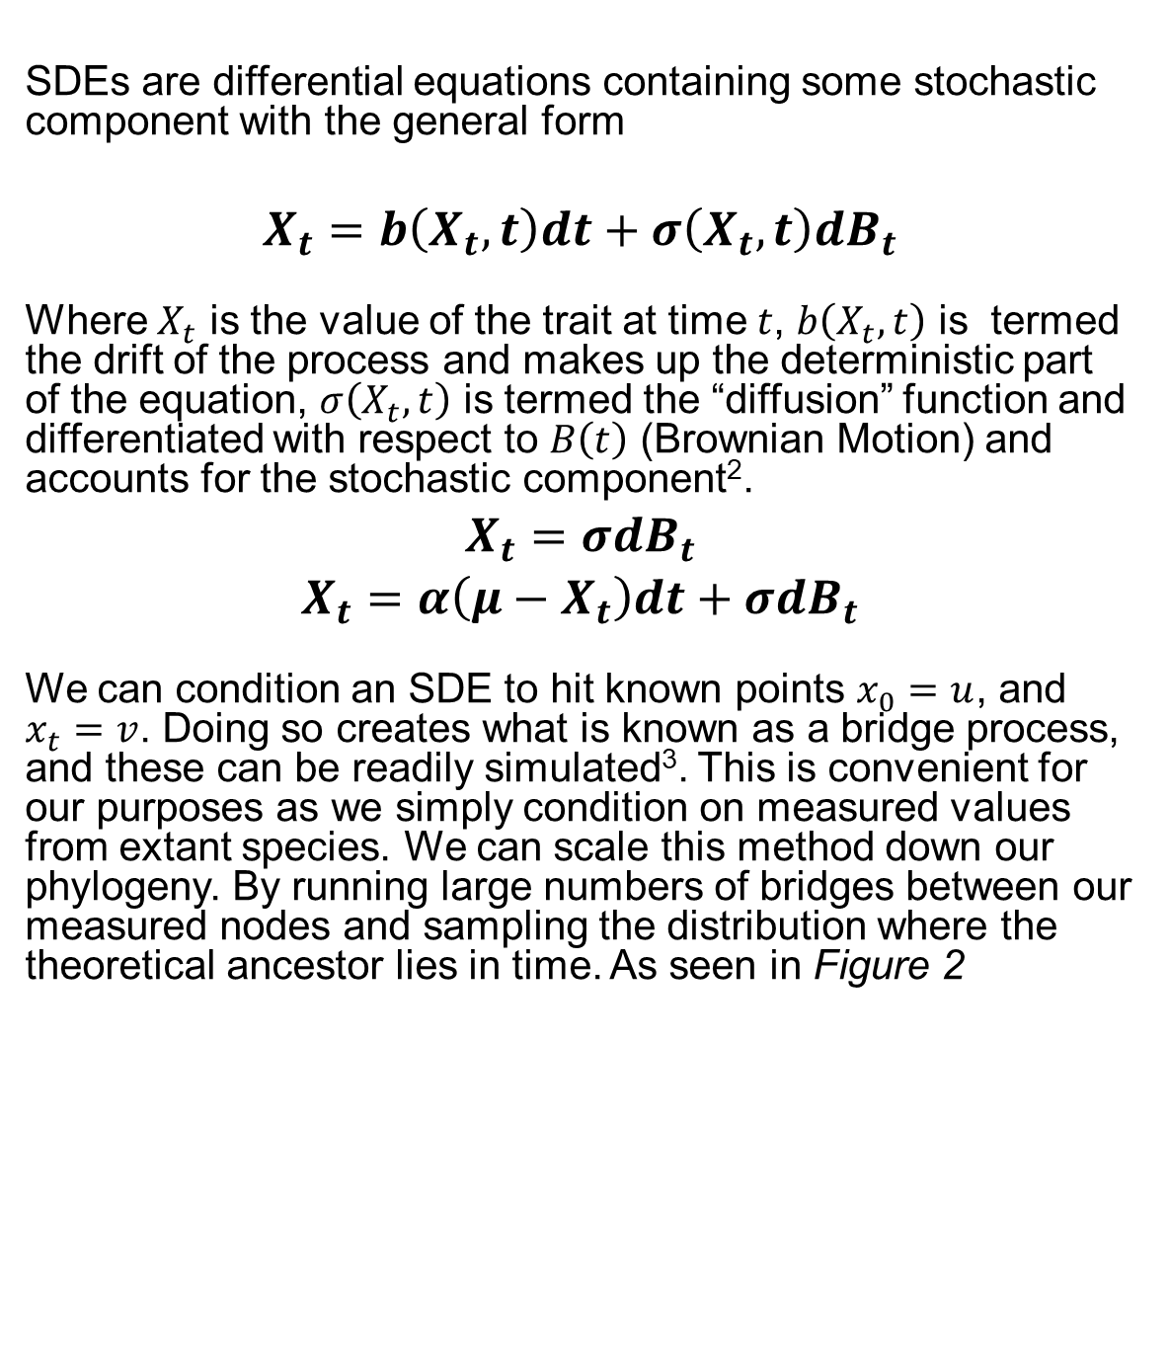


We’ll Cross That Bridge When We Get There: Ancestral Trait Reconstruction with Monte Carlo Diffusion Bridge Sampling
Thea Elson-Green¹, Simone Blomberg¹
¹ School of the Environment, The University of Queensland, St Lucia, QLD, Australia
Ancestral Trait Reconstruction
Ancestral Trait Reconstruction (ATR) is the process of reconstructing historical trait values of unknown ancestor species, in relation to some phylogenetic tree, such as the one seen in Figure 2 this relies on a fundamental idea; Species that are closely related are likely to have more similar trait values than those that are further apart¹. However properly accounting for this shared history, and other ecological factors has been a major struggle for evolutionary biologists for almost 50 years, as there is a significant loss in statistical convenience when working with non-independent data.
Historically this problem is avoided, by using normally distributed Stochastic Differential Equations (SDEs) such as Brownian Motion (BM) or Ornstein-Uhlenbeck Processes (OU) as the underlying model of evolution. We wish to remedy this by extending these processes to take non-independence into account. This will allow us to more accurately model evolutionary processes and include additional parameters that may be incredibly useful such as ecological or environmental factors that change between time and species. Additionally, we aim to allow for better multivariate methods to more accurately model within-species correlations
Trait Value
Time
Figure 1: Ancestral trait reconstruction of 33 marsupial species for femur trochanteric fossa length value from 25 multiple imputations, from 25 independent initial samples with trait reconstruction repeated 25 times indicates the mean with heat map over the marker indicating predicted trait values, branch lengths show relative time
Diffusion Bridges
A
SDEs are differential equations containing some stochastic component with the general form
$$X_{t}=b\left(X_{t},t\right)dt+σ\left(X_{t},t\right)dB_{t}$$
Where $X_{t}$ is the value of the trait at time $t$, $b\left(X_{t},t\right)$ is termed the drift of the process and makes up the deterministic part of the equation, $σ\left(X_{t},t\right)$ is termed the “diffusion” function and differentiated with respect to $B\left(t\right)$ (Brownian Motion) and accounts for the stochastic component².
$$X_{t}=σdB_{t}$$
$$X_{t}=α\left(μ−X_{t}\right)dt+σdB_{t}$$
We can condition an SDE to hit known points $x_{0}=u$, and $x_{t}=v$. Doing so creates what is known as a bridge process, and these can be readily simulated³. This is convenient for our purposes as we simply condition on measured values from extant species. We can scale this method down our phylogeny. By running large numbers of bridges between our measured nodes and sampling the distribution where the theoretical ancestor lies in time. As seen in Figure 2
Trait Value
Results and Extensions
B
$$X_{0}$$
We tested this protocol on a large marsupial dataset containing 33 species and 28 traits, we were able to perform high throughput simultaneous reconstructions with both traditional SDEs (BM and OU) with Figure 1 showing the reconstructed tree for simple BM on a single trait. Additionally Figure 2 demonstrates how the process looks within a single subtree between D.maculatus and D.viverrinus. The results obtained are almost indistinguishable from traditional MLE methods⁴.
This method is very easily extended by changing the drift and diffusion functions, while also being scalable to multivariate data.
The challenges from here are to both determine what those new drift and diffusion functions should be and develop parameter optimization functions that can account for such sparse data.
C
$$X_{t}$$
Figure 2: Brownian Bridge trait reconstruction between Dasyurus maculatus and Dasyurus viverrinus. A) contributing Brownian Bridges to the ancestral trait value of the ancestor, red line indicates the time point of the ancestor B) kernel density estimates of the contributing leaves to the resulting ancestral nodes, blue line corresponds to the density seen in figure A. C) measurements corresponding to initial densities of the bridges
References
CRICOS 00025B • TEQSA PRV12080
Blomberg, S.P., T. Garland Jr, and A.R. Ives, TESTING FOR PHYLOGENETIC SIGNAL IN COMPARATIVE DATA: BEHAVIORAL TRAITS ARE MORE LABILE. Evolution, 2003. 57(4): p. 717-745.
Blomberg, S.P., S.I. Rathnayake, and C.M. Moreau, Beyond Brownian Motion and the Ornstein-Uhlenbeck Process: Stochastic Diffusion Models for the Evolution of Quantitative Characters. The American naturalist, 2020. 195(2): p. 145-165.
Schauer, M., F. Van Der Meulen, and H. Van Zanten, Guided proposals for simulating multi-dimensional diffusion bridges. Bernoulli : official journal of the Bernoulli Society for Mathematical Statistics and Probability, 2017. 23(4A): p. 2917-2950.
4. Revell, L.J., phytools 2.0: an updated R ecosystem for phylogenetic comparative methods (and other things). PeerJ (San Francisco, CA), 2024. 12: p. e16505.
.
r.elsongreen@uq.edu.au
uq.edu.au

