Slide 1
CS1010S
Tutorial 1: Introduction to CS1010S & Python

Slide 2
Some things about me
Merrick Neo
Year 2 Computer Science
Took the mod in AY21/22 Sem 1
Contact Information:
Email: E0726513@u.nus.edu
Telegram: @merrickneo
Fun fact: I transferred courses 3 times before landing in CS🤡

Slide 3
Short Self-Introduction Session
Name
Course
Any background in programming?
What do you want to get out of CS1010S?
Notes:
Since we'll be seeing each other for the whole of this semester, let's do a little icebreaker to get to know one another, mostly for me to try and learn all of your names.

Slide 4
Admin Details
Tutorials will be conducted weekly at i3-0339 every Tue
Flow of each tutorial
Short Recap of the previous week's content
Discuss the tutorial questions in class
QnA session
* Do try to attempt your Tutorial Questions before coming!
Notes:
Qna to answer any questions yall might still have. Yall can definitely stop me at anytime and ask stuff relevant to what we are going through.
As for the last point, yes please do try to attempt as it counts towards tutorial participation as well.

Slide 5
Class Participation
Mainly comes in 2 ways
Participation in class
Discussions in the Forums
Feel free to ask any questions if you may have!
Notes:
No question is a dumb question

Slide 6
How to ask for help!
MANY Avenues to seek help!
Ranked in order of precedence:
yOuRseLF
Ask your friends
Coursemology Forums
Stack Overflow!! 🤩
Most important thing is that you don't give up💪🏻

Slide 7
Lecture Content Recap

Slide 8
Topics to cover
Primitives
Operators
Naming Conventions
Conditionals
Functions
'return' vs 'print'

Slide 9
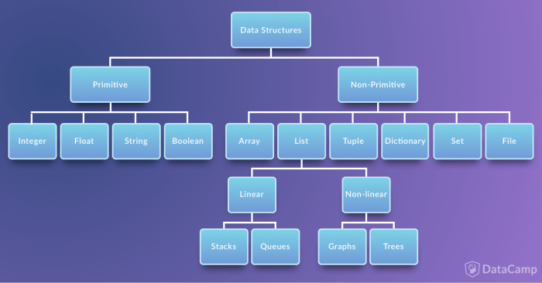
Primitives
Basic data structures
Four main primitive data types
Integers (Int)
Floats (Float)
Strings (String)
Boolean (Bool)

Slide 10
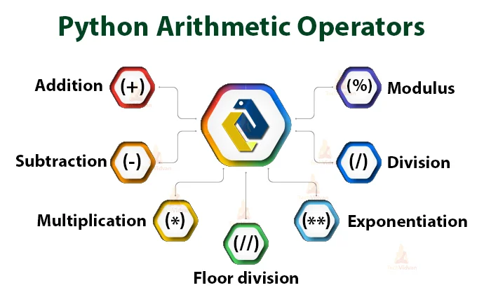
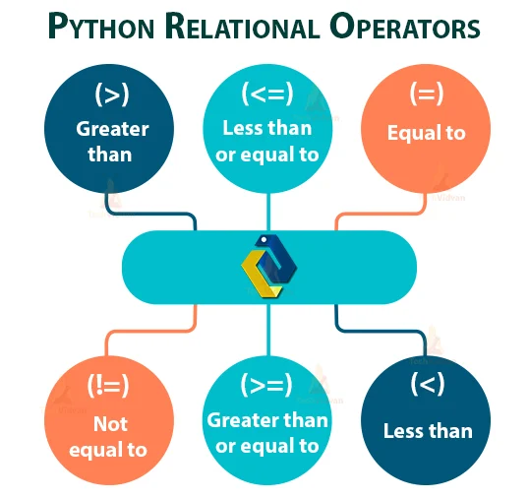
Impt Operators
Arithmetic Operators
Basically your math operators
Relational/Comparison Operators
Compares Values; Outputs a Bool
Assignment Operators
'=' assigns a value to your variable
Can be chained with arithmetic operators to do calculations then assign back to the variable
Read more here: https://techvidvan.com/tutorials/python-operators/
* Don't need bitwise operators for CS1010S

Slide 11
Naming Conventions
Normally for variables we use snake casing (small caps + underscores)
my_var = 10, my_str = "Hello World"
For Classes (later on), we capitalise each Noun
class CoffeeShop: ……….

Slide 12
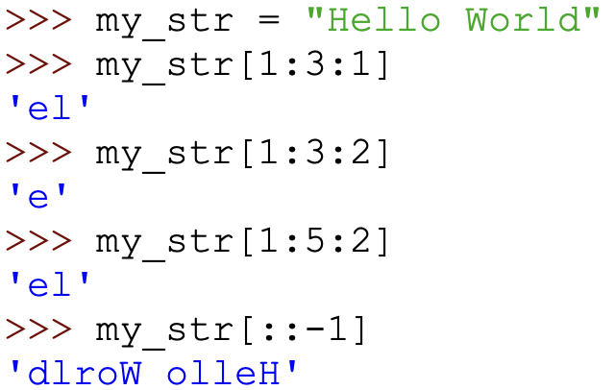
String Slicing
Slicing is the process of obtaining a portion (substring) of a string by using its indices
str[start:stop:step]

Slide 13
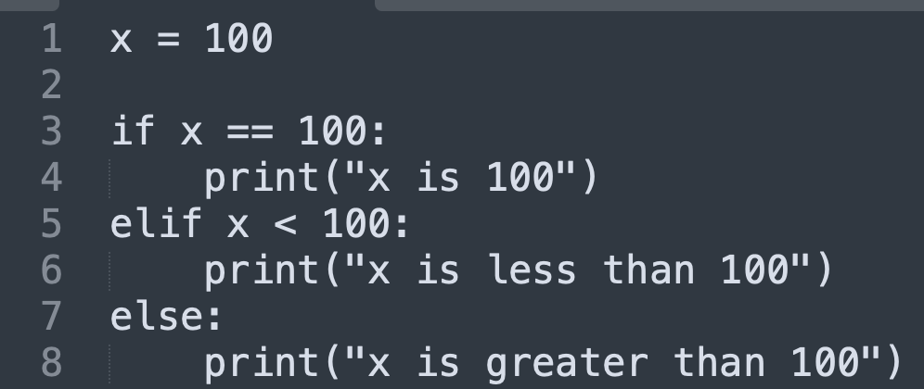
Conditionals
Using if, else, elif to control logic flow
else is used for the last case
Make sure all cases are covered before using else
Notes:
If something is fulfilled, then run this, if not run that

Slide 14
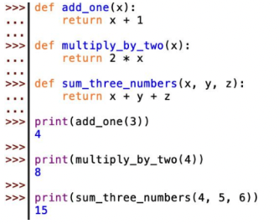
Functions
Functions are similar to mathematical functions
def function_name(params):
// Logic of function
return function_output

Slide 15
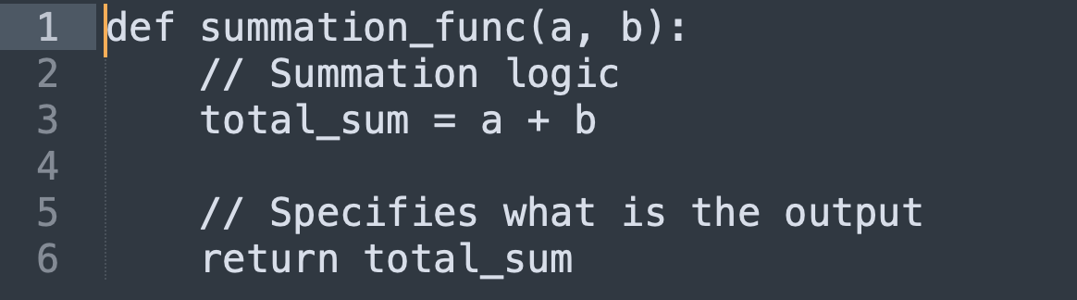
return vs print
print() just prints stuff to the screen
print("Hello World") | Output: Hello World
print("print this") | Output: print this
return is used in a function to specify the output
Not all functions must have an output!!!
Default output is None

Slide 16
Tutorial Questions

Slide 17
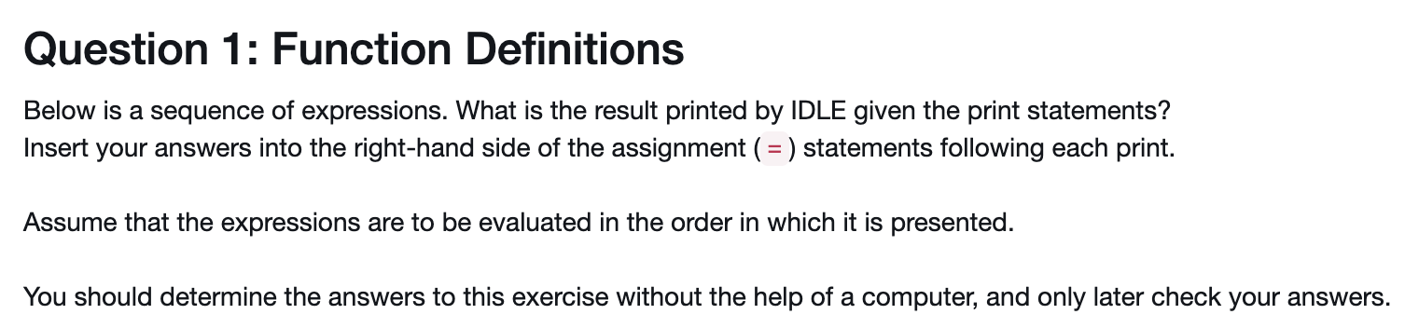

Slide 18
def square(x):
return x ** 2
def f(x):
return x * x
def try_x(f):
return f(3)
def square(x):
return x ** 2
print(square(2)) print(square(4))
print(square(square(square(2))))
#4
#16
#256
def f(x):
return x * x
print(try_f(f))
#9

Slide 19
def square(x):
return x ** 2
def f(x):
return x * x
def try_x(f):
return f(3)
def try_x(f):
return f(3)
print(try_f(f) == try_f(square)) # True
print(f(3) == square(3)) # True
print(f == square) # False

Slide 21
What is an odd integer?
A number that cannot be divided equally into 2 numbers
def odd(x):
if x % 2 == 1:
return True
else:
return False

Slide 22
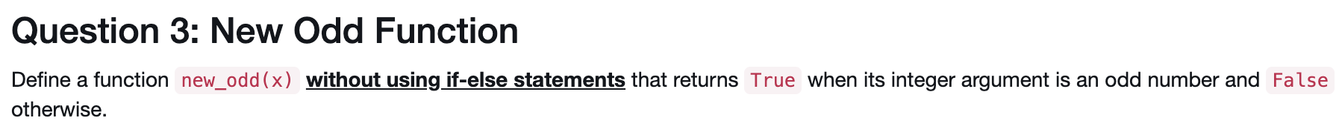
def new_odd(x):
return x % 2 == 1

Slide 24
def number_of_digits(i):
return len(str(i))
Only care about the absolute value of the number
Our Base Case!
Recursive Method:
def number_of_digits(i):
if abs(i) < 10:
return 1
else:
return 1 + number_of_digits(i // 10)
Recursive expression
Eg: my_number = 1020
1 + number_of_digits(102)
+ 1 + number_of_digits(10)
+ 1 + number_of_digits(1)
+ 1 (no additional + …)

Slide 25
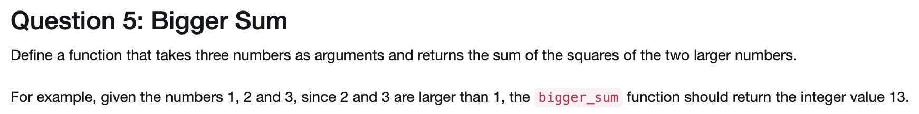
Helper Functions
def square(x):
return x ** 2
def sum_of_squares(x, y):
return square(x) + square(y)

Slide 26
Helper Functions
def square(x):
return x ** 2
def sum_of_squares(x, y):
return square(x) + square(y)
def bigger_sum(a, b ,c):
if a <= b and a <= c:
Return sum_of_squares(b, c)
elif b <= a and b <= c:
return sum_of_squares(a, c)
else:
Return sum_of_squares(a, b)

Slide 27
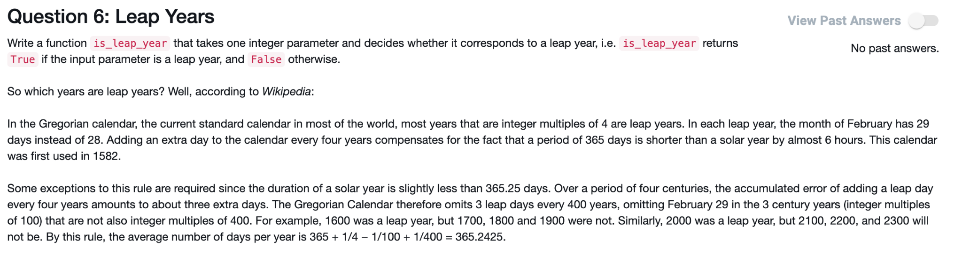
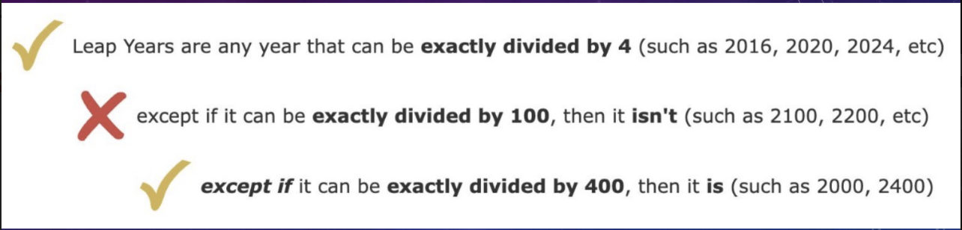

Slide 28
def is_leap_year(year):
return (year % 4 == 0 and not year % 100 == 0) or (year % 400 == 0)

