Slide 1
CS1010S
Tutorial 2: Functional Abstraction & Iteration

Slide 2
Scope
Variable Scoping
Functional Abstraction
Control Flow

Slide 3
Variable Scoping
A variable is only available in the scope it is created in
Example:
my_var = 100
def multiply(my_var):
my_var *= 10
print(my_var)
multiply(my_var)
print(my_var) # 100 or 1000?
Answer: 100!
Different Scope

Slide 4
Variable Scoping
What if I want to change the value of the variable?
my_var = multiply(my_var)
Output will be reassigned to the variable my_var

Slide 5
Variable Scoping
son = "Abraham"
def darth_vader():
print(f"I am your father, {son}") # f string formatting
son = "Lucas"
darth_vader()
UnboundLocalError: local variable 'son' referenced before assignment

Slide 6
Variable Scoping
son = "Abraham"
def darth_vader():
print(f"I am your father, {son}")
darth_vader()
# Output: Abraham

Slide 7
Functional Abstraction
Used to encapsulate certain logic
Can be used to simplify your code
Reduce duplications
Make your code more readable
User only needs to know what has to be passed into the function and get an output

Slide 8
Functional Abstraction
How to define a function?
def func_name(params):
<body>
return <something>
* You will learn about *args and **kwargs later on (Maybe)
Function can take an arbitrary number of parameters

Slide 9
Functional Abstraction
Using pass
# Declaring a empty function
def func_name(params):
pass
Since we didnt specify the return value, the output of the function is None

Slide 10
Functional Abstraction
Your function stops after the return statement is executed
def func_name(params):
// Code here
Return "Hello World"
// More code
Not Executed

Slide 11
Anonymous Functions
Functions that have no name
Single used functions
We can specify the input and output of the function in a single line
foo = lambda x: x + 1 => # foo(x) = x + 1
add = lambda x, y: x + y => # add(x, y) = x + y
# how about functions that takes no inputs
bar = lambda : 5

Slide 12
Control Flow

Slide 13
Recursion
Basic Structure
def fname(<args>):
if n == <base case>:
return <value_at_base_case> # termination!
else:
return <value_at_args> + fname(<args_with_reduced_value>)

Slide 14
Control Flow
Recursion
def fact(n):
if n <= 1:
return 1
else:
return n * fact(n - 1)
factorial(4) -> 4 * factorial(2)
4 * 3 * fact(2)
4 * 3 * 2 * fact(1)
4 * 3 * 2 * 1

Slide 15
Iteration: for loop
Basic Structure
def fname(<args>):
total = <intial_value>
For <counter> in range(<args>):
total += <value_at_counter>
return total

Slide 16
Iteration: while loop
Basic Structure
def fname(<args>):
total = <intial_value>
counter = <initial_counter_value>
while counter <= argos:
total += <value_at_counter>
counter += 1
return total

Slide 17
Break and Continue
Used to control the flow of your loops
break is used to break the current loop (Most immediate loop)
Continue stops the current iteration of the loop
Skips to the next iteration

Slide 18
Tutorial Questions

Slide 19
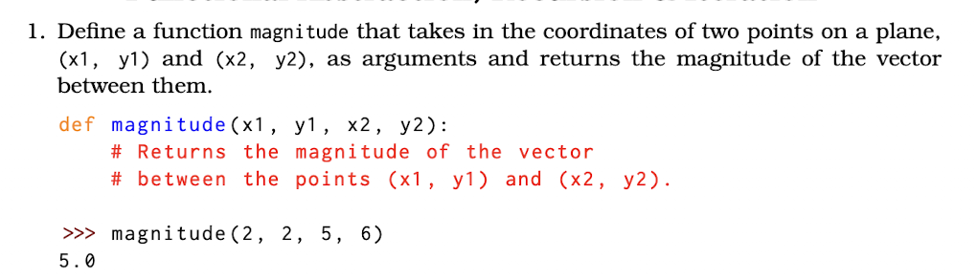
Question 1: Magnitude

Slide 20
from math import *
def magnitude(x1, y1, x2, y2):
return sqrt((y2 - y1) ** 2 + (x2 - x1) ** 2)
# Another way
def magnitude(x1, y1, x2, y2):
Return ((y2 - y1) ** 2 + (x2 - x1) ** 2) ** 2

Slide 21
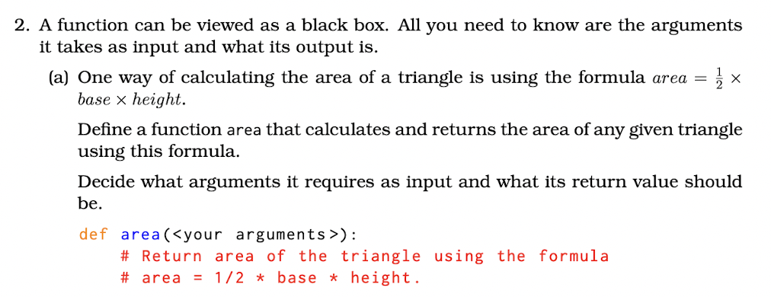
Problem 2: Area of Triangle

Slide 22
Problem 2a: Area of Triangle
def area(base, height):
return 0.5 * base * height

Slide 23
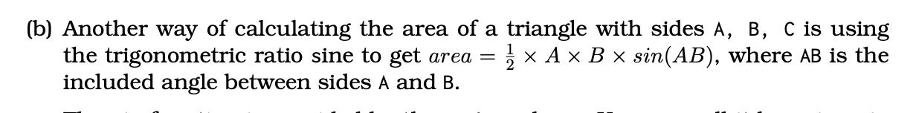
Problem 2b: Area of Triangle

Slide 24
def area2(A, B, included_angle):
return 0.5 * A * B * sin(included_angle)
# Both functions area2 and area calculate the same result.
# Can they be directly substituted for each other? Why?
=> No. Both functions take in different arguments

Slide 25
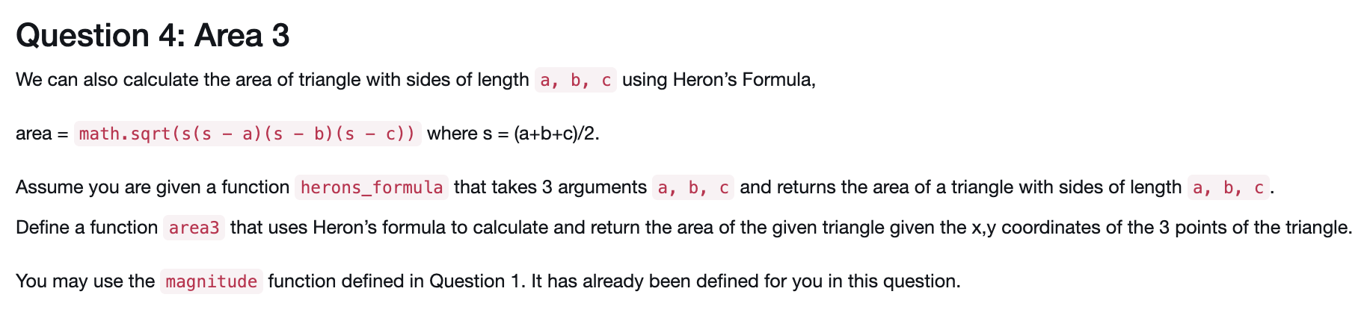
Question 3: Area 3

Slide 26
def area3(x1, y1, x2, y2, x3, y3):
a = magnitude(x1, y1, x2, y2)
b = magnitude(x2, y2, x3, y3)
c = magnitude(x1, y1, x2, x3)
return herons_formula(a, b, c)
def herons_formula(a,b,c):
s=(a+b+c)/2
return sqrt(s * (s-a) * (s-b) * (s-c))

Slide 27
Question 5: Expression Evaluation
def foo1():
i = 0
result = 0
while i < 10:
result += i
i += 1
return result
What does the code do?
// Initialise i and result
// Loops while i < 10
// Adds i to result
// Increments i by 1
Output: 45

Slide 28
Question 5: Expression Evaluation
def foo2():
i = 0
result = 0
while i < 10:
if i == 3:
break
result += i
i += 1
return result
What does the code do?
// Initialise i and result
// Loops while i < 10
// Breaks if i == 3
// Adds i to result
// Increments i by 1
Output: 3

Slide 29
Question 5: Expression Evaluation
def bar1():
result = 0
For i in range(10):
result += i
return result
What does the code do?
// Initialise result
// Loops 10 times (0-9)
// Adds i to result
Output: 45

Slide 30
Question 5: Expression Evaluation
def bar2():
result = 0
For i in range(10):
if i % 3 == 1:
continue
result += i
return result
What does the code do?
// Initialise result
// Loops 10 times (0-9)
// if there is a remainder of 1 continue
// Adds i to result
Output: 33

Slide 31
Question 6: Sum of even factorials

Slide 32
def sum_even_factorials(n):
result = 0
for i in range(0, n+1):
f = 1
if i % 2 != 0:
continue
else:
for j in range(1, i+1):
f *= j
result += f
return result
def sum_even_factorials(n):
result = 1 #Assuming n >= 0
factorial = 1
for i in range(1, n + 1):
factorial *= i
if i % 2 == 0:
result += factorial
return result

Slide 33
def sum_even_factorials(n):
result = 1 #Assuming n >= 0
factorial = 1
for i in range(1, n + 1):
factorial *= i
if i % 2 == 0:
result += factorial
return result
Another method

Slide 34
Question 7
def f(g):
return g(2)
def square(x):
Return x ** 2
f(square)
f(lambda z: z * (z + 1))
#4
#6
f(f)
f(2) => 2(2) 😵‍💫
What will happen if we evaluate f(f)?
=> TypeError: 'int' object is not callable

