Slide 1
CS1010S
Tutorial 3: Recursion, Iteration and Orders of Growth

Slide 2
Topics
Recursion
Order of Growth
Higher Order Functions

Slide 3
Components of Recursion
Base Case
This tells us what is the terminating condition
If the terminating condition is not reached, a RecursionError will occur
Will run forever!!
Recursive Call
We will call the function again and adjust some parameters when we call the function.

Slide 4
Example
There is a robot on an m x n grid. The robot is initially located at the
top-left corner. The robot tries to move to the bottom-right corner. The
robot can only move either down or right at any point in time.
Given the two integers m and n, return the number of possible unique
paths that the robot can take to reach the bottom-right corner.
Source: LeetCode

Slide 5
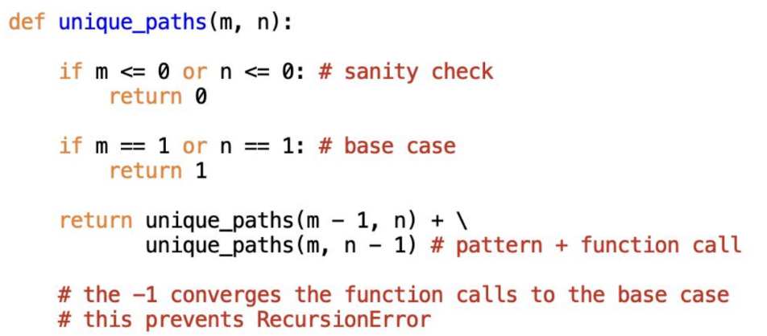
Solution

Slide 6
Order of Growth
The order of growth of an algorithm is an approximation of the time required to run a computer program as the input size increases.
We base efficiency on two areas:
Time Complexity (How fast?)
Space Complexity (How large?)

Slide 7
Big-O Notation
Referred to as the algorithm's upper bound
Evaluate the efficiency of the algorithm with increasingly larger inputs of n
Worst Case scenario of an algorithm
-> Tightest bound
To simplify things:
Remove Coefficients
Consider the term with the fastest growth
O(3n) -> O(n)
O(n^2 + n + 1) -> O(n^2)

Slide 8
Time Complexity
Evaluated by counting the total number of operations performed
Some things to think about:
How does the number of operations change over your input n

Slide 9
Space Complexity
Determine the minimum additional space required for an algorithm to perform its tasks
Things to consider:
Function Call Stack (Depth)
Splitting of recursion tree
Any additional variables initialised

Slide 10
Examples
def iterative_sum(n):
sum = 0
for i in range(n):
sum += i
return sum
time: O(n)
space: O(1)

Slide 11
Examples
def fib_recursive(n):
if n == 1 or n == 2:
return 1
return fib_recursive(n - 1) + fib_recursive(n - 2)
Time: O(2^n)
Space: O(n)

Slide 12
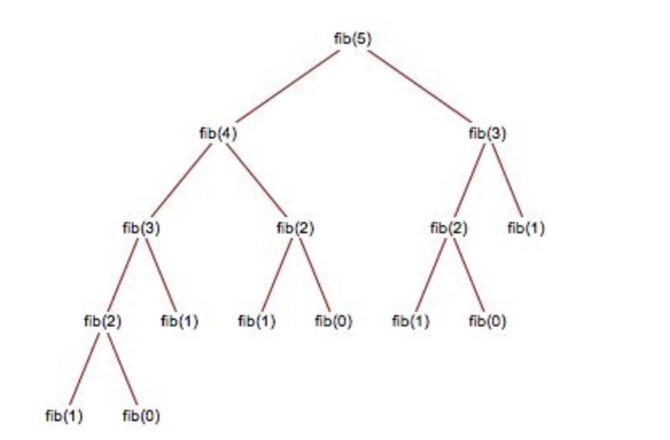

Slide 13
More Examples
def isprime(n):
if n <= 1:
return False
for i in range(2, int(n **0.5) + 1):
return True
# time: O(n^0.5)
# space: O(1)

Slide 14
Higher Order Functions
A function is called a Higher Order Function if it does at least one of the following:
Contains other functions as a parameter
Returns a function as an output
* This is possible as functions are considered as First-Class Citizens
Functions are treated just like any other variable (Can be passed into functions)

Slide 15
Functions returning Functions
def my_func():
def very_special_function():
return "Happy Birthday"
return very_special_function
wish_func = my_func()
print(wish_func()) # Happy Birthday

Slide 16
Examples
def twice(f):
def do(x):
return f(f(x))
return do
multiply_twice = twice(lambda x: x * 2)
multiply_twice(4)
# 16

Slide 17
Why make use of HOFs?
Benefits of HOFs
Allows us to shorten program and focus on the intended meaning of the program,
Makes code easier to read and understand

Slide 18
Tower of Hanoi
Input:
n — number of disks (iterating)
src — source pole
des — destination pole
mid — remaining/auxiilary pole
Output: print the steps (n, src, mid, des)

Slide 19
Tower of Hanoi
n = 1 (base case)
src -> des #(1, src, mid, des)
n =2
src -> mid #(1, src, des, mid)
src -> des #(1, src, mid, des)
mid -> des #(1, mid, src, des)

Slide 20
Tower of Hanoi
n = 3
src -> des
src -> mid
des -> mid
src -> dest
mid -> src
mid -> des
src -> des
#(2, src, des, mid)
#(1, src, mid, des)
#(2, mid, src, des)
Any Patterns?

Slide 21
Tower of Hanoi
def hanoi(n, src, mid, des):
if n == 1:
print(f"{src} -> {des}")
else:
hanoi(n - 1, src, des, mid)
print(f"{src} -> {des}")
hanoi(n - 1, mid, src, des)

Slide 22
Tutorial Questions

Slide 23
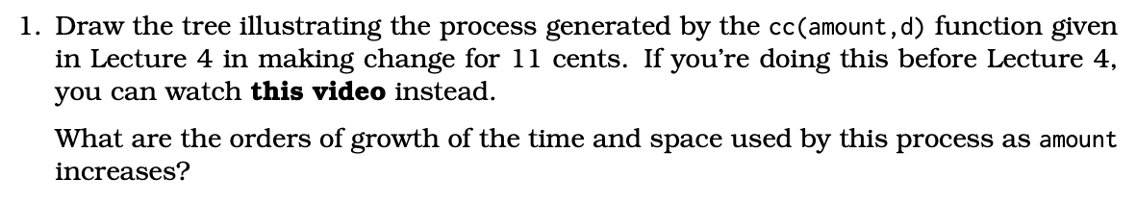
Question 1

Slide 24
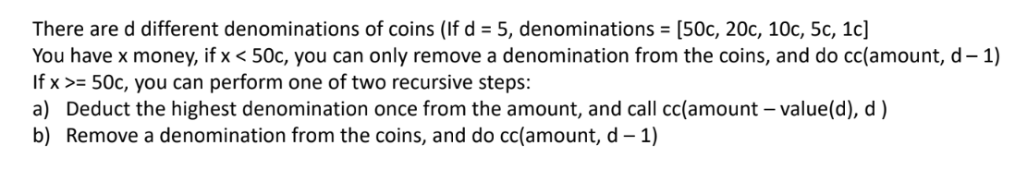
Try with the biggest coin amount
Remove one denomination from the coins

Slide 25
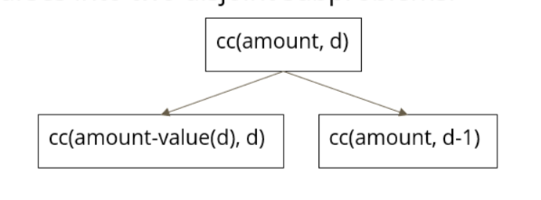

Slide 26
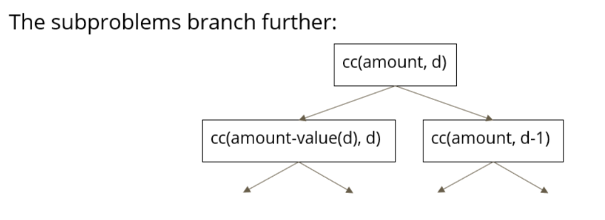

Slide 27
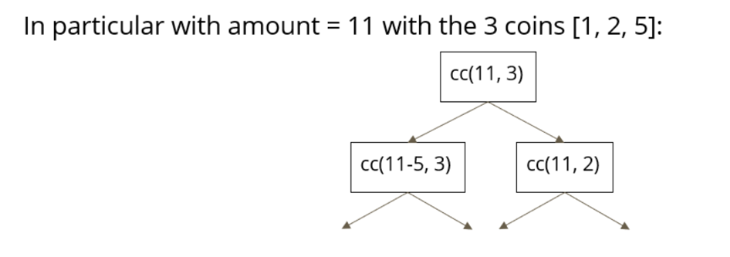

Slide 28
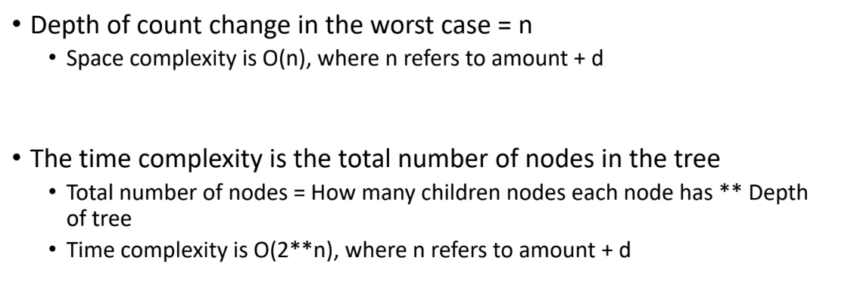

Slide 29
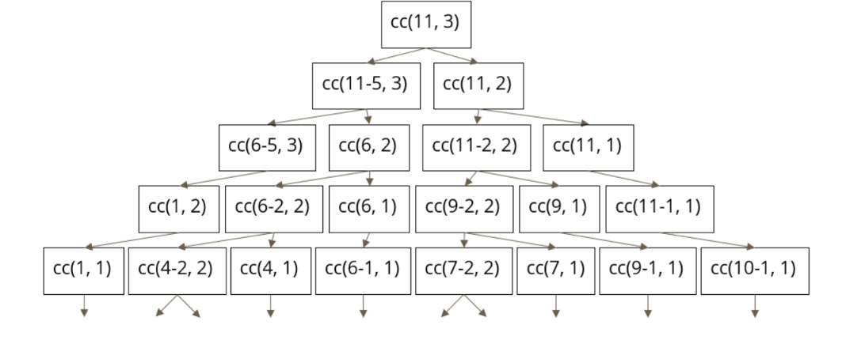

Slide 30
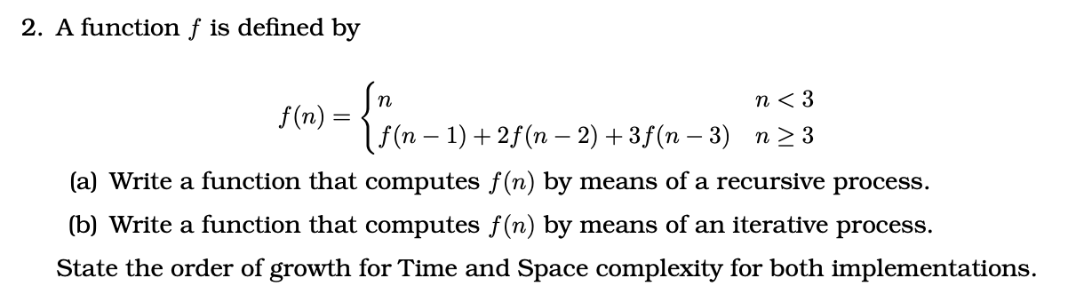
Question 2

Slide 31
(a)
def f(n):
if n < 3:
return n
else:
return f(n-1) + 2*f(n-2) + 3*f(n-3)

Slide 32
(a)
def f(n):
if n < 3:
return n
else:
return f(n-1) + 2*f(n-2) + 3*f(n-3)
Time Complexity: O(n**3)
Space Complexity: O(n)

Slide 33
(b)
def f(n):
if n < 3:
return n
else:
a, b, c = 0, 1, 2
for i in range(n-2):
a, b, c = b, c, (c + (2 * b) + (3 * a))
return c

Slide 34
(b)
def f(n):
if n < 3:
return n
else:
a, b, c = 0, 1, 2
for i in range(n-2):
a, b, c = b, c, (c + (2 * b) + (3 * a))
return c
Time Complexity: O(n)
Space Complexity: O(1)

Slide 35
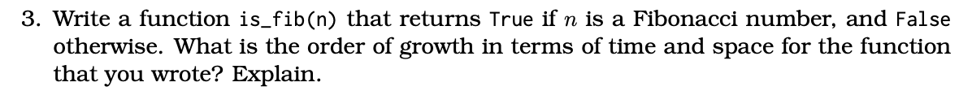
Question 4: Test for Fibonacci Number

Slide 36
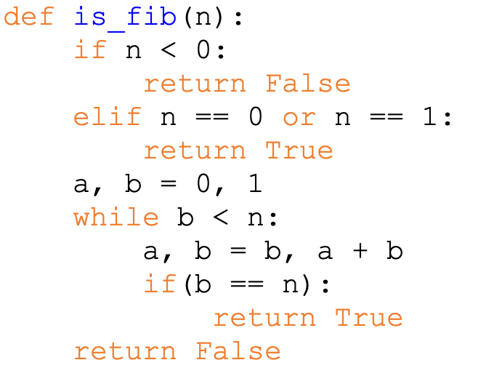
Order of Growth
Time: O(logn)
Space: O(1)

Slide 37
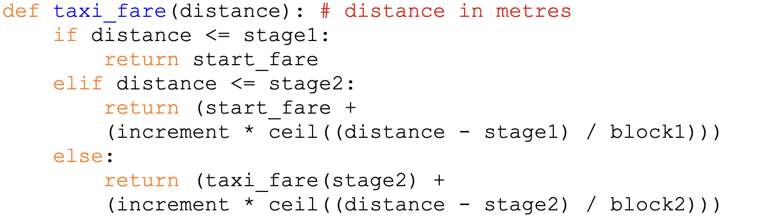
Question 5: Taxi Fare
stage 1 = 1000
Stage2 = 10000
start_fare = 3.0
increment = 0.22
block1 = 400
block2 = 350

Slide 38
Question 5: Taxi Fare
What are the requirements/constraints?
Our make_fare function should return a function that can do the calculations for us
distance <= stage1
Charged the start_fare
Distance <= stage2
Charged by start_fare + increment * (stage2 - stage1 dist) / block1
Last Case
Charged the max for stage2
Plus increment * (distance-stage2) / block2

Slide 39
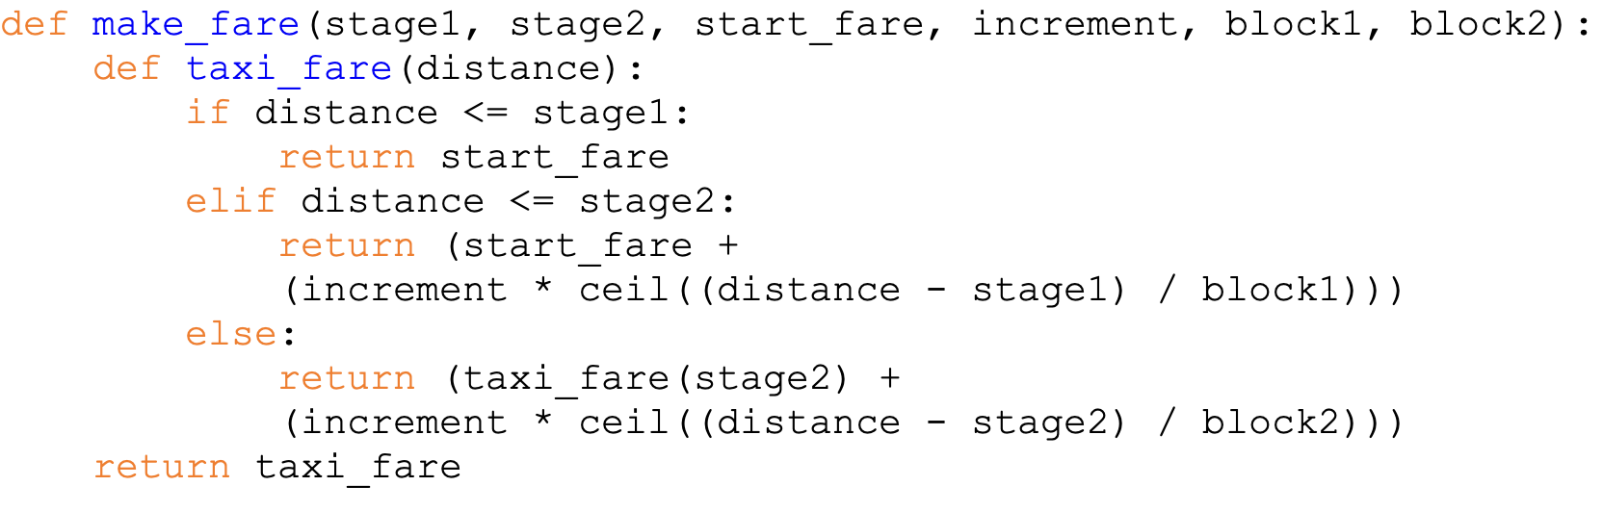
Question 5: Taxi Fare

